Slide 1
PPD Department Heads Meeting
ESH
10 April 2024

Slide 2
Summary
Training/ITNA Status
Injuries in March
ORPS/NTS in March
FESHM and Risk Program Updates
Off Hours High Hazard High Risk Work Guidance

Slide 3
ES&H Training and ITNA Status for employees – as of 04/08/2024
 | Training Courses |  |  |  | Individual Training Needs Assessments
Div/Sec | Completed | Required | Percent | Employees | < 1 Year Old | Percent | Missing | Missing for New Hires
 | 86 | 122 | 70.49% | 10 | 9 | 90.00% | 0 | 0
AD/ACTD | 5,997 | 6,360 | 94.29% | 231 | 231 | 100.00% | 0 | 0
AD/ARD | 354 | 377 | 93.90% | 17 | 17 | 100.00% | 0 | 0
AD/BD | 4,457 | 4,683 | 95.17% | 161 | 149 | 92.55% | 0 | 0
APS-TD/CS | 1,327 | 1,577 | 84.15% | 41 | 41 | 100.00% | 0 | 0
APS-TD/DFS | 1,036 | 1,078 | 96.10% | 55 | 53 | 96.36% | 0 | 0
APS-TD/MAG | 2,418 | 2,621 | 92.25% | 105 | 103 | 98.10% | 0 | 0
APS-TD/SRF | 1,510 | 1,600 | 94.38% | 70 | 65 | 92.86% | 0 | 0
COM | 561 | 601 | 93.34% | 55 | 54 | 98.18% | 1 | 0
COO/COAS/QU | 147 | 149 | 98.66% | 8 | 8 | 100.00% | 0 | 0
CSAID/DSSL | 555 | 579 | 95.85% | 46 | 46 | 100.00% | 0 | 0
CSAID/RTPS | 421 | 452 | 93.14% | 34 | 32 | 94.12% | 0 | 0
CSAID/SCSS | 648 | 664 | 97.59% | 60 | 55 | 91.67% | 0 | 0
DCO | 15 | 18 | 83.33% | 2 | 2 | 100.00% | 0 | 0
DI | 2,120 | 2,298 | 92.25% | 253 | 220 | 86.96% | 0 | 0
DI/IA | 44 | 44 | 100.00% | 4 | 4 | 100.00% | 0 | 0
ES | 3,137 | 3,466 | 90.51% | 108 | 104 | 96.30% | 0 | 0
ETD/IARCD | 218 | 241 | 90.46% | 10 | 10 | 100.00% | 0 | 0
ETD/MD | 291 | 330 | 88.18% | 24 | 23 | 95.83% | 0 | 0
ETD/QID | 208 | 243 | 85.60% | 15 | 14 | 93.33% | 0 | 0
FI | 1,133 | 1,197 | 94.65% | 111 | 94 | 84.68% | 0 | 0
FRA | 12 | 12 | 100.00% | 1 | 1 | 100.00% | 0 | 0
HR | 619 | 641 | 96.57% | 57 | 52 | 91.23% | 0 | 0
ISD | 6,108 | 6,430 | 94.99% | 225 | 221 | 98.22% | 0 | 0
ITD | 1,134 | 1,145 | 99.04% | 127 | 127 | 100.00% | 0 | 0
LBNFDUNE | 761 | 821 | 92.69% | 50 | 41 | 82.00% | 0 | 0
NQC/NQCDIV | 736 | 798 | 92.23% | 48 | 39 | 81.25% | 0 | 0
PIPII/PIPII | 274 | 299 | 91.64% | 20 | 15 | 75.00% | 0 | 0
SEC | 2,445 | 2,590 | 94.40% | 102 | 97 | 95.10% | 0 | 1
ND | 1,725 | 1,833 | 94.11% | 95 | 86 | 90.53% | 1 | 0
PPD | 4,664 | 5,097 | 91.50% | 252 | 247 | 98.02% | 0 | 0
THD | 393 | 457 | 86.00% | 53 | 38 | 71.70% | 0 | 0
Fermilab Total | 45,554 | 48,823 | 93.30% | 2,450 | 2,298 | 93.80% | 2 | 1
This month:
Last month:
ND | 1,806 | 1,937 | 93.24% | 97 | 88 | 90.72% | 1 | 0
PPD | 4,811 | 5,331 | 90.25% | 251 | 247 | 98.41% | 0 | 0
THD | 435 | 511 | 85.13% | 52 | 37 | 71.15% | 0 | 0

Slide 4
Injuries/Illnesses in March
03/01/2024 - First Aid Only, APS-TD
An employee was finishing up cavity electropolishing (EP) of a single cell cavity beam tube . After it was removed from the EP tool, the cavity was still wet with water. To avoid slipping, they held the cavity by the flange opening. A slight rotation resulted in the slicing of the 14 mm butyl glove by the sharp edge of the flange inner opening, further it cut into the right-hand index finger. It resulted in the need of a first aid bandage.
03/04/2024 - Medical Treatment Beyond First Aid, ISD
An employee was cleaning gym floor with walk-behind floor scrubber when trainee asked how to clean the showers. The employee picked up the restroom cleaner (SPARCLING Disinfectant), but it slipped out of the employee's hands. The nozzle on the bottle was open and as the employee tried to catch it, it landed upright. A droplet of the chemical shot up and landed in the employee's right eye. The employee rinsed the eye at the gym and then again in the subcontractor’s office eyewash station. The employee was taken to urgent care where they were given a prescription eye drop.

Slide 5
Injuries/Illnesses in March
03/11/2024 - No Treatment/ Reporting Only, ND
Employee works in various area where noise is an issue and over time noticed a decline in their hearing. Standard threshold shift on audiometric.
03/11/2024 – Medical Treatment Beyond First Aid, ES
An employee was performing radiological surveys on material for release from the Railhead as scrap. During an attempt to lift and relocate a crushed file cabinet to another pallet, a corner of the metal penetrated the weave of their glove at the point where the pinky finger and ring finger meet. When the puncture occurred, the employee pulled their hand away from the metal and affected the puncture becoming a laceration.
03/12/2024 – Medical Treatment Beyond First Aid, PPD
FOMO received WC first report from Chubb insurance that was reported to them by another party that the employee had a work-related injury on 3/12/24. FOMO had not been notified by the employee of any work-related injury. An investigation is in progress.

Slide 6
Injuries/Illnesses in March
03/13/2024 – First Aid Only, ISD
An employee was securing a pushcart in the vehicle they were using. When employee leaned over to lock the front right wheel they bumped their forehead on a metal hook. Noticing the injury, the employee reported to FOMO for first aid.
03/14/2024 - Lost Work, SEC
ORPS Event
On Thursday, March 14th, a firefighter was participating in shift training. In the process of trying to pull down a coworker (another firefighter), the firefighter experienced pain in their left elbow. The firefighter was sent for evaluation by an orthopedic physician. It was later learned that the firefighter had experienced a bicep tear and will need to undergo surgery.

Slide 7
Injuries/Illnesses in March
03/19/2024 - No Treatment/Reporting Only, AD
Wearing cotton gloves, an employee wiped down a surface they believed to be uncontaminated using a second pair of cotton gloves. The employee set down the second pair, exited the enclosure, and frisked their hands, and found that they read 250cpm. They removed the gloves and frisked again, finding nothing. The employee called the RSO. Two RCTs were sent who refrisked the employee and found that along the outside of their right index finger read 140cpm. They removed the contamination with duct tape after which the employee read background only.
03/21/2024 – First Aid Only, SEC
An employee reported skin irritation around the area of their neck where their uniform collar lies. This irritation had been present for two weeks with the employee attempting at-home treatments with no resolution. Reported to FOMO for first aid.

Slide 8
Injuries/Illnesses in March
03/21/2024 – First Aid Only, APS-TD
An employee was working in grit blast containment zone in full PPE and loose fitting PAPR respirator. The employee was working for approximately 2 hours on 3/20/24 and several hours on 3/21/24. On the second day they started to feel a little dizzy, shortness of breath, and chest pain. The employee exited the booth and felt better after removing PPE. Later that night they still had tightness in their chest. Reported to FOMO on 3/22/24. Employee went to ER for a personal health issue.
03/25/2024 – First Aid Only, AD
The employee was unsure of the exact date when this occurred, but on 3/25/24 they felt an itchy sensation on the back of the right thigh and noticed 3 red spots. The employee recalls visiting an outdoor area during the week of March 18 around Fo and the trail between Wilson Hall and the Lederman Center. Reported to FOMO on 3/28/24. First aid given.
03/28/2024 – First Aid Only, Directorate
While drinking tea, a visitor spilled some on their stomach resulting in a burn.

Slide 9
ORPS/NTS in March
Uncontrolled release of nitrogen gas, 03/04/2024 (ORPS Event, Level 2)
An unexpected event occurred 3/4/204 at 9:15am in ICBA. There were no injuries. The intent was to test a hypothesis that moisture was trapped within a capillary tube assembly filled with instrumentation wires. The plan was to freeze the capillary tube assembly with cold nitrogen gas and perform a hipot test. All previous hipot tests at room temperature had failed. The unexpected event was the sudden release of nitrogen gas from the test setup.
The test setup consisted of a flex line from the liquid nitrogen tank to an end can. The end can was filled with the wires from the capillary tube assembly warm head. The warm head and end can are the same diameter and were secured together with fiberglass tape, and duct tape. Additionally, a thin rubber strip and a stainless-steel sheet metal strip were placed around the tape and tightened with a hose clamp. A Quick clamp was used in the longitudinal direction, extending from one end of the pipes to the other. Once the setup was completed, we reviewed the setup and the plan.
The event occurred when the nitrogen tank valve was opened very slowly. Moments later a loud pop occurred.

Slide 10
ORPS/NTS in March
MINOS elevator stall and cable break, 03/19/2024 (ORPS Event, Level 2)
On the afternoon of 03/19, two personnel were descending into the MINOS underground using the main large elevator. While descending, the elevator stopped and there was a loud noise heard after the elevator stopped. The Fermilab Fire Department was dispatched to the scene and the elevator was lowered safely to the underground level. No personnel were injured. The occupants called the lab's emergency number, and the Fermilab Fire Department was dispatched to respond. Upon arrival, the Fermilab Fire Department personnel determined that a mechanical failure had occurred with the main elevator and requested a partial activation of the Emergency Operations Center (EOC).
The Fire Department evacuated all personnel that were underground at MINOS to the surface via the second, small elevator. Initial investigation has found that a cable broke and landed on top of the elevator car, which is likely the source for the loud noise that was heard.
Once all personnel were brought to the surface, access to the underground was restricted, and the Main Control Room was ordered to stop issuing keys for the MINOS underground space. The elevator was locked and tagged out of service, and there are local controls to keep the area restricted. The rescue elevator in the MINOS elevator shaft was inspected after the event by the elevator maintenance subcontractor, and a similar rack and pinion elevator in the MI-65/Nu-MI building was also inspected to ensure they were in safe condition prior to allowing use of either elevator.
The event is still under investigation to confirm the direct and contributing causes for the counterweight cable break. At this time, access to the underground and the experiments within is still restricted.

Slide 11
FESHM and Risk Program Updates
The following chapters have been updated in the last month. A brief summary is provided below.
03/18/2024 - FESHM 2010 Planning and Review of Accelerator Facilities and their Operations
Changes:
Updated to reflect updated DOE O 420.2D and updated programs
Updated/expanded existing sections:
Definitions (Section 2.0)
USI Process (Section 3.1)
Determination of Applicability (Section 3.2)
Hazard Analysis (Section 3.3)
Safety Assessment Document (SAD) (Section 0)
SAD Guidelines (Section 5.1)
Incorporate new sections:
Accelerator Safety Envelope (ASE) (Section 3.5)
Accelerator Readiness Review (ARR) (Section 3.6)
Operations (Section 3.7)
Accelerator Safety Order (ASO) Compliance Assurance (Section 3.8)
ASE Guidelines (Section 5.2)
Editorial updates to reflect organizational changes
Updated References

Slide 12
FESHM and Risk Program Updates
The following chapters have been updated in the last month. A brief summary is provided below.
03/19/2024 - Risk Program - Procedure Enterprise and Operational Risk Registers
Changes:
This procedure is a new release.
03/19/2024 - Risk Program - Procedure on Identification of New / Emerging Risks
Changes:
This procedure is a new release.
03/25/2024 - FESHM 1051 Control of Environment, Safety, and Health Documents
Changes:
Revised to reflect current organization structure.
Reviewed against the T&N matrix to ensure alignment.
Removed references to quality assurance, emergency management and physical security.
Notes:
These references are based on information sent out via email for FESHM, QAM, or FRCM chapters that are “Posted for comments”.
Double check last month’s slides to ensure everything released since last month’s meeting is included and nothing is doubled up.
NOTE: Covers chapter releases between last month’s meeting and current month’s meeting.

Slide 13
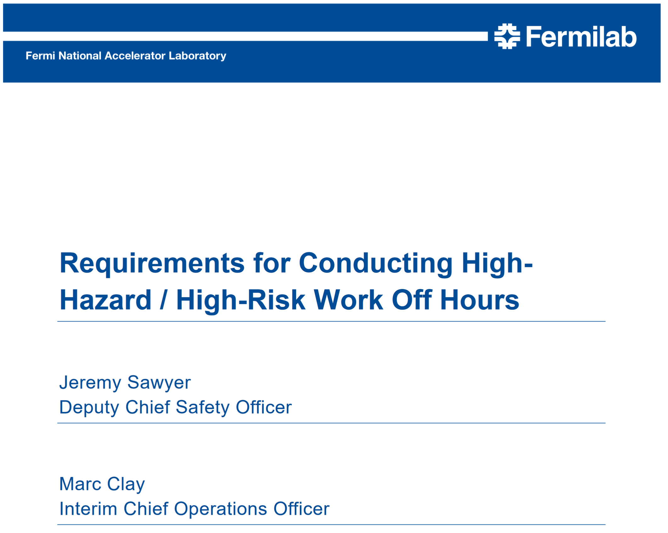
Off Hours High Hazard High Risk Work Guidance
Reference:
Off hours high hazard high risk work_rv1
High-risk work: Consider the risk factors below to determine high-risk activities. Please note, routine work may be deemed high hazard or high risk.
• Resource limitations.
• Personnel experience.
• First-time or very infrequent work.
• Work environment.
• Significant impact to lab or mission (e.g. lifting one of a kind equipment).
• Multiple work group coordination.
• Personnel executing the task consider the work high risk.

