Slide 1
9 AM Meeting
Judah O’Neil
MCR Crew Chief
Wednesday, April 3, 2024

Slide 2
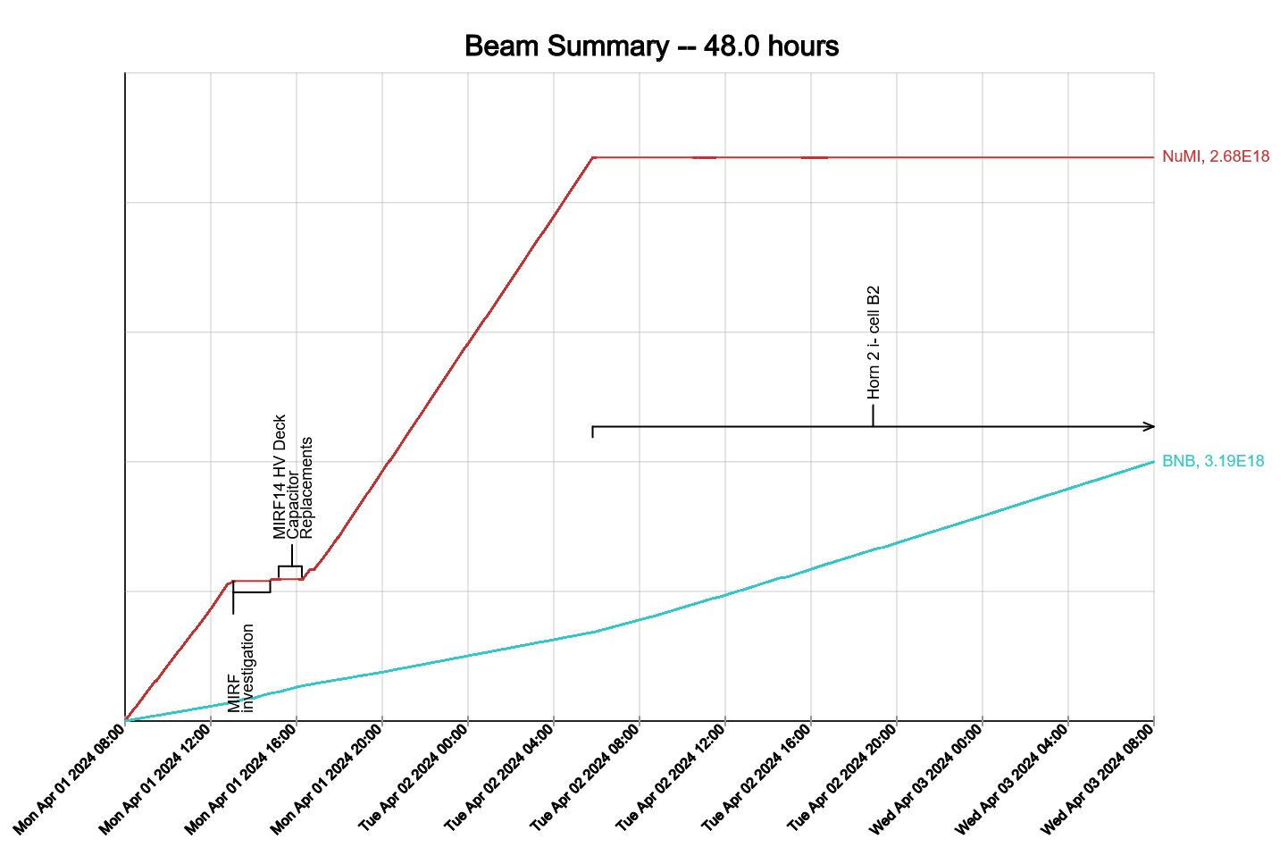
Since Monday…
Monday
Scheduled MI downtime for MIRF troubleshooting and HV101 work
Tuesday
NM3/NM4 put into controlled access for interlock testing
NuMI downtime due to Horn PS issue
MIRF14 station back up and running
Wednesday
Preparing MI 20-62 for access to look at sumps
NM3/NM4 put back into supervised access
NuMI Horn troubleshooting continues

