Slide 1
Switchyard & Meson Report
Michael K. Olander
AD 9:00 Meeting
5 April 2024

Slide 2
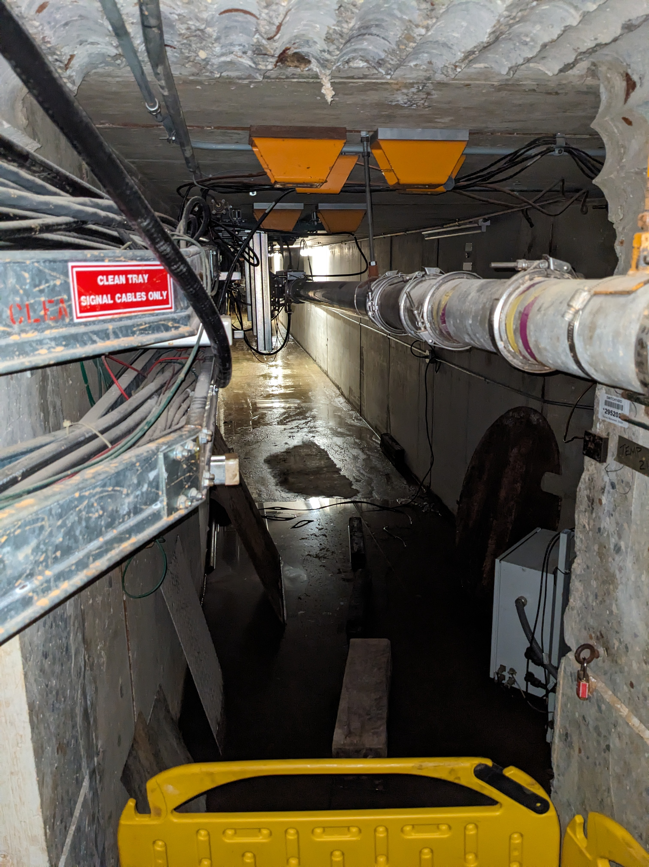
Enclosure B Sump & Vacuum Station 95 Repairs
ISD is waiting on check valves.
There is evidence that the sump pit has overflowed recently, meaning the Grindex pump is having trouble keeping up when it’s raining.
We cannot repair the 95 Vacuum Station until the sumps are returned to service.
We cannot operate Switchyard until the vacuum station is repaired.
The critical path for beam to the Switchyard Dump is the sump check valves.

Slide 3
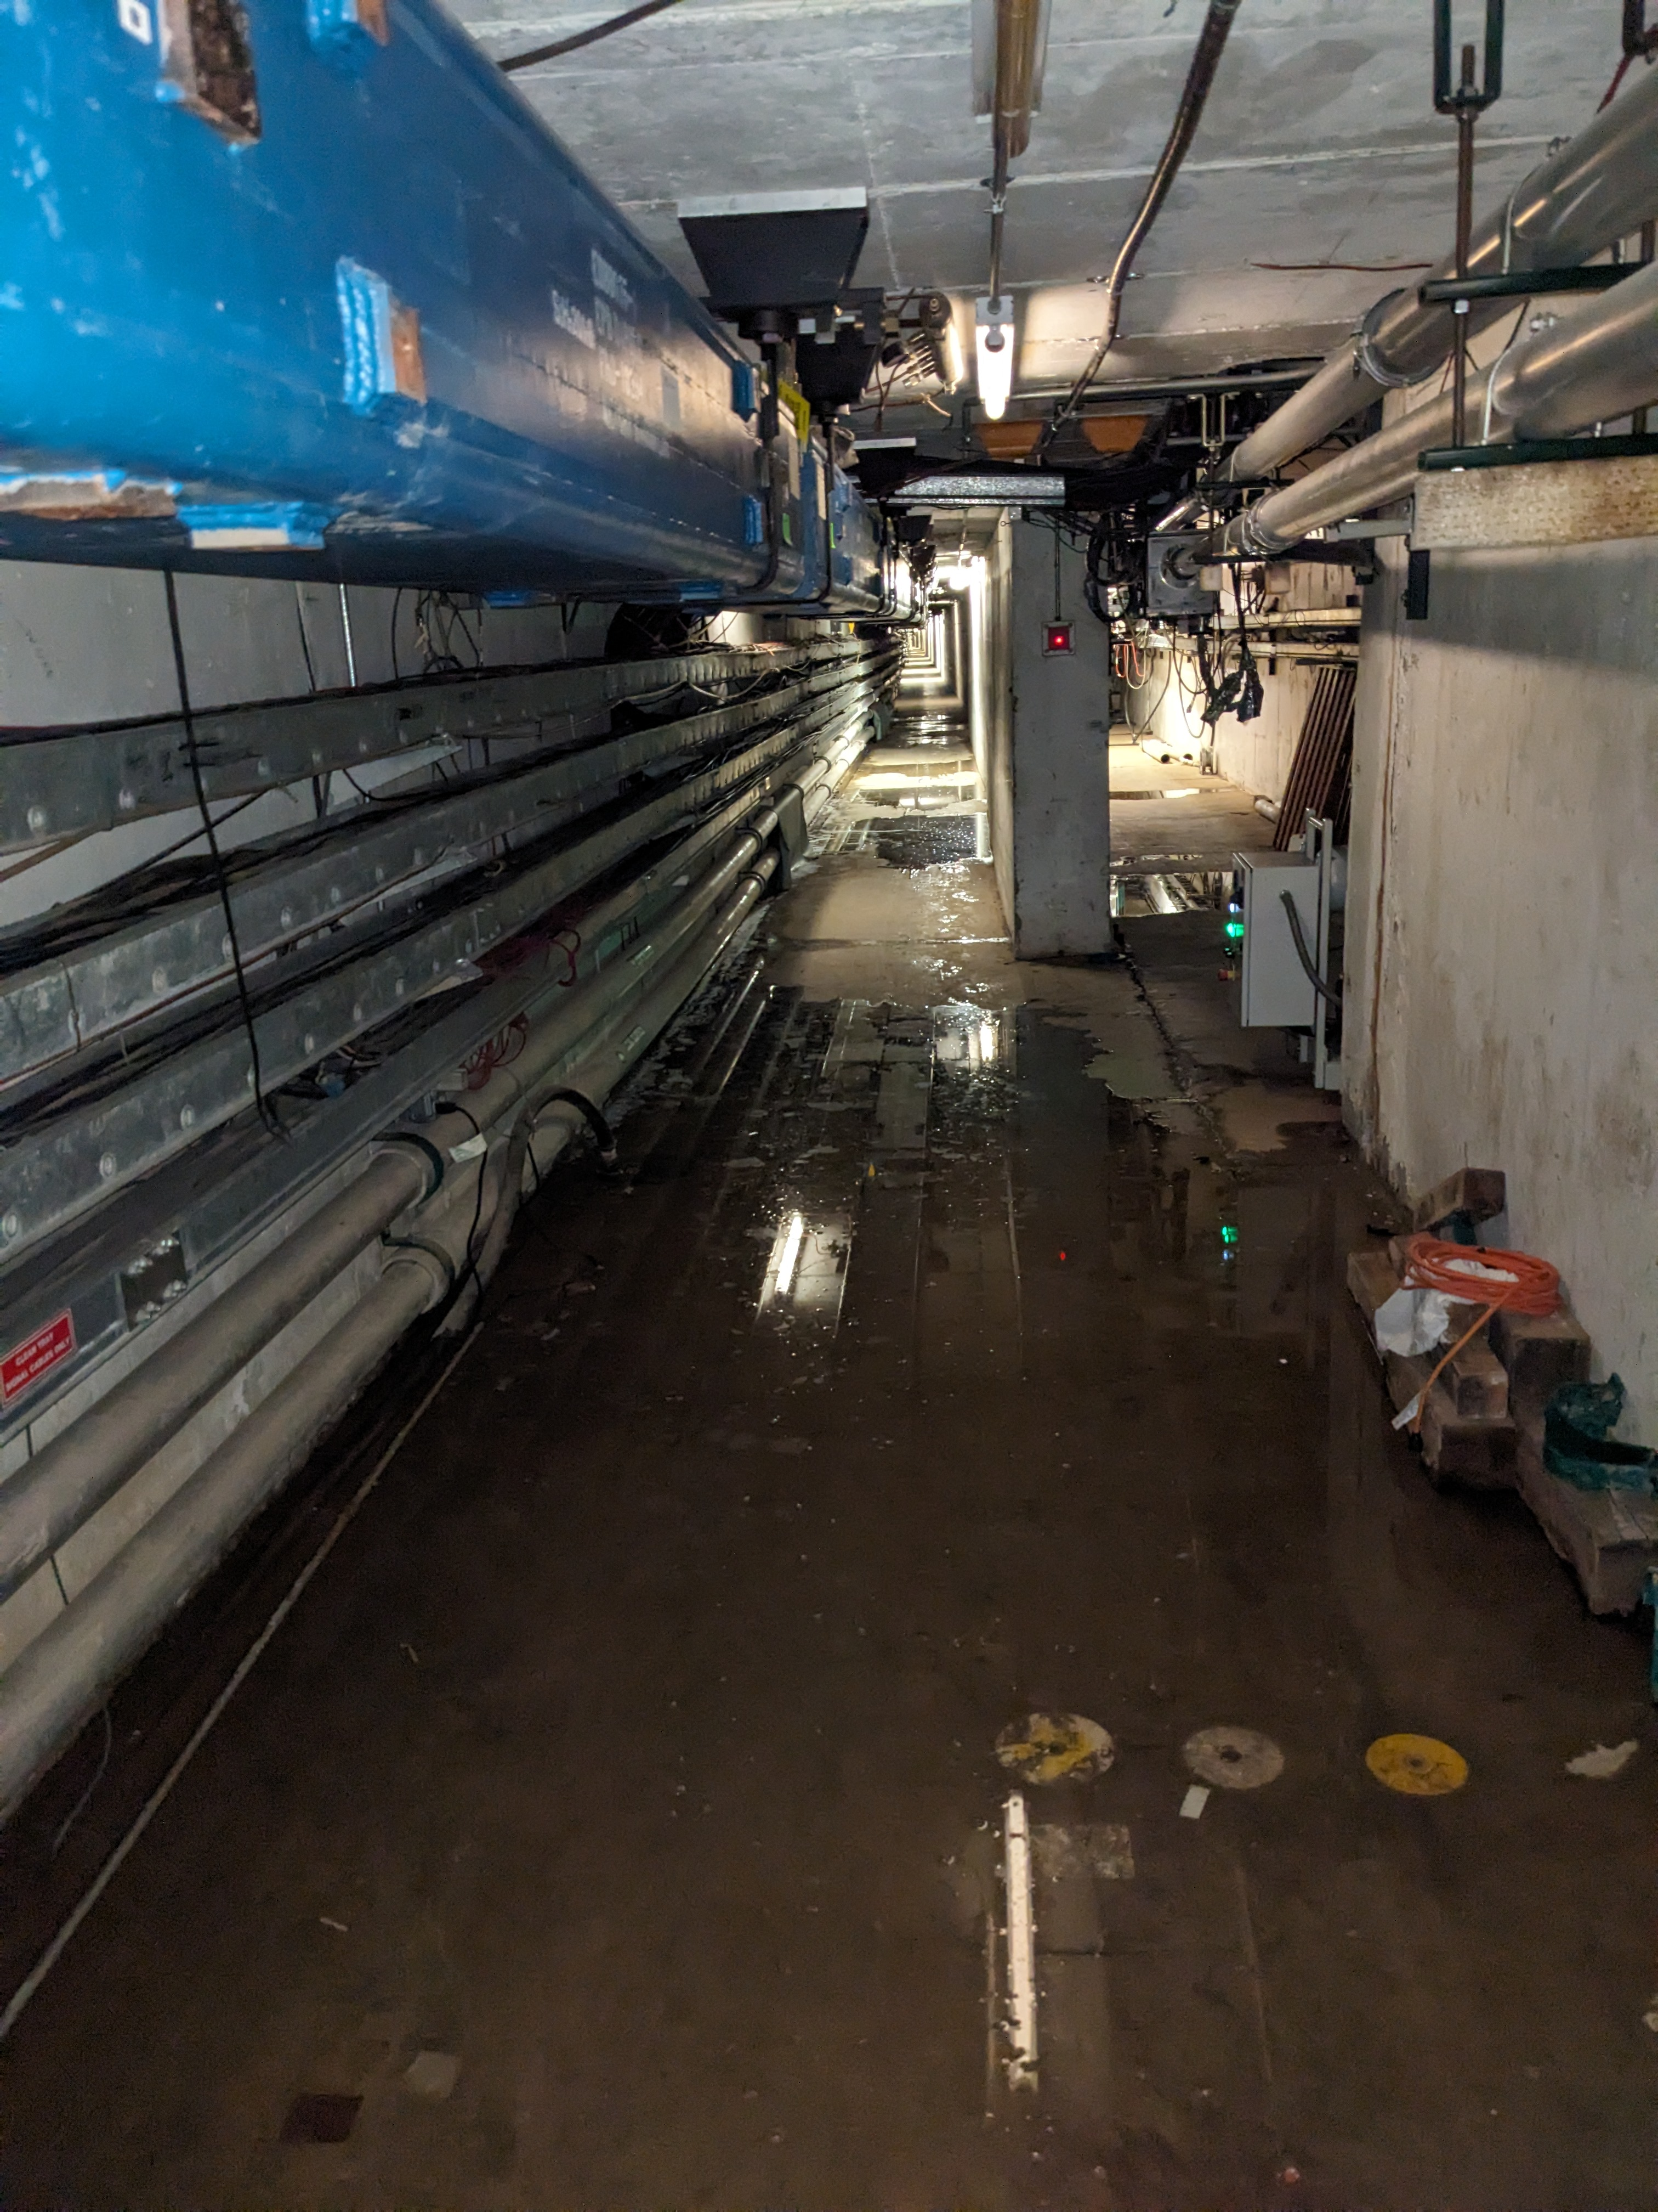
105 Floor Sump in Enclosure C
The floor French Drain sump, a simple 120V sump pump, stopped working.
ISD & EBD to access at 9:45a

Slide 4
Other News
Safety System Testing in Meson
Interlocks applying modifications to the Rep Rate Monitor as per the MCI/SAD/ASE.
MS2 LCW System restarted.
  Resistivity still polishing.
  M02 Header Leak Patch reapplied.

Slide 5
Goal
The goal is beam to users in 3 weeks.

