Slide 1
Mu2e report
Tom Diehl (FNAL), Greg Rakness (FNAL)
Friday 9am AD meeting
05-Apr-2024
https://indico.fnal.gov/event/64204/

Slide 2
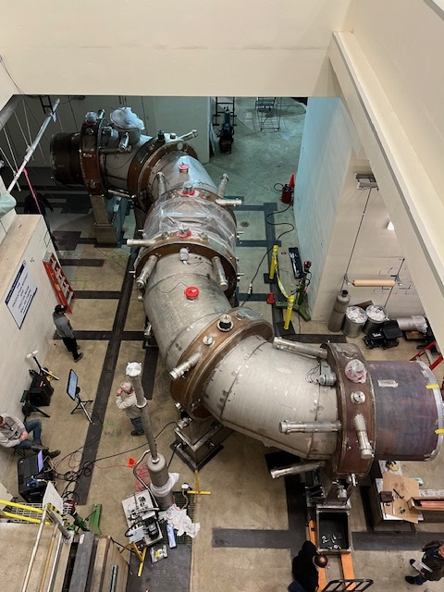
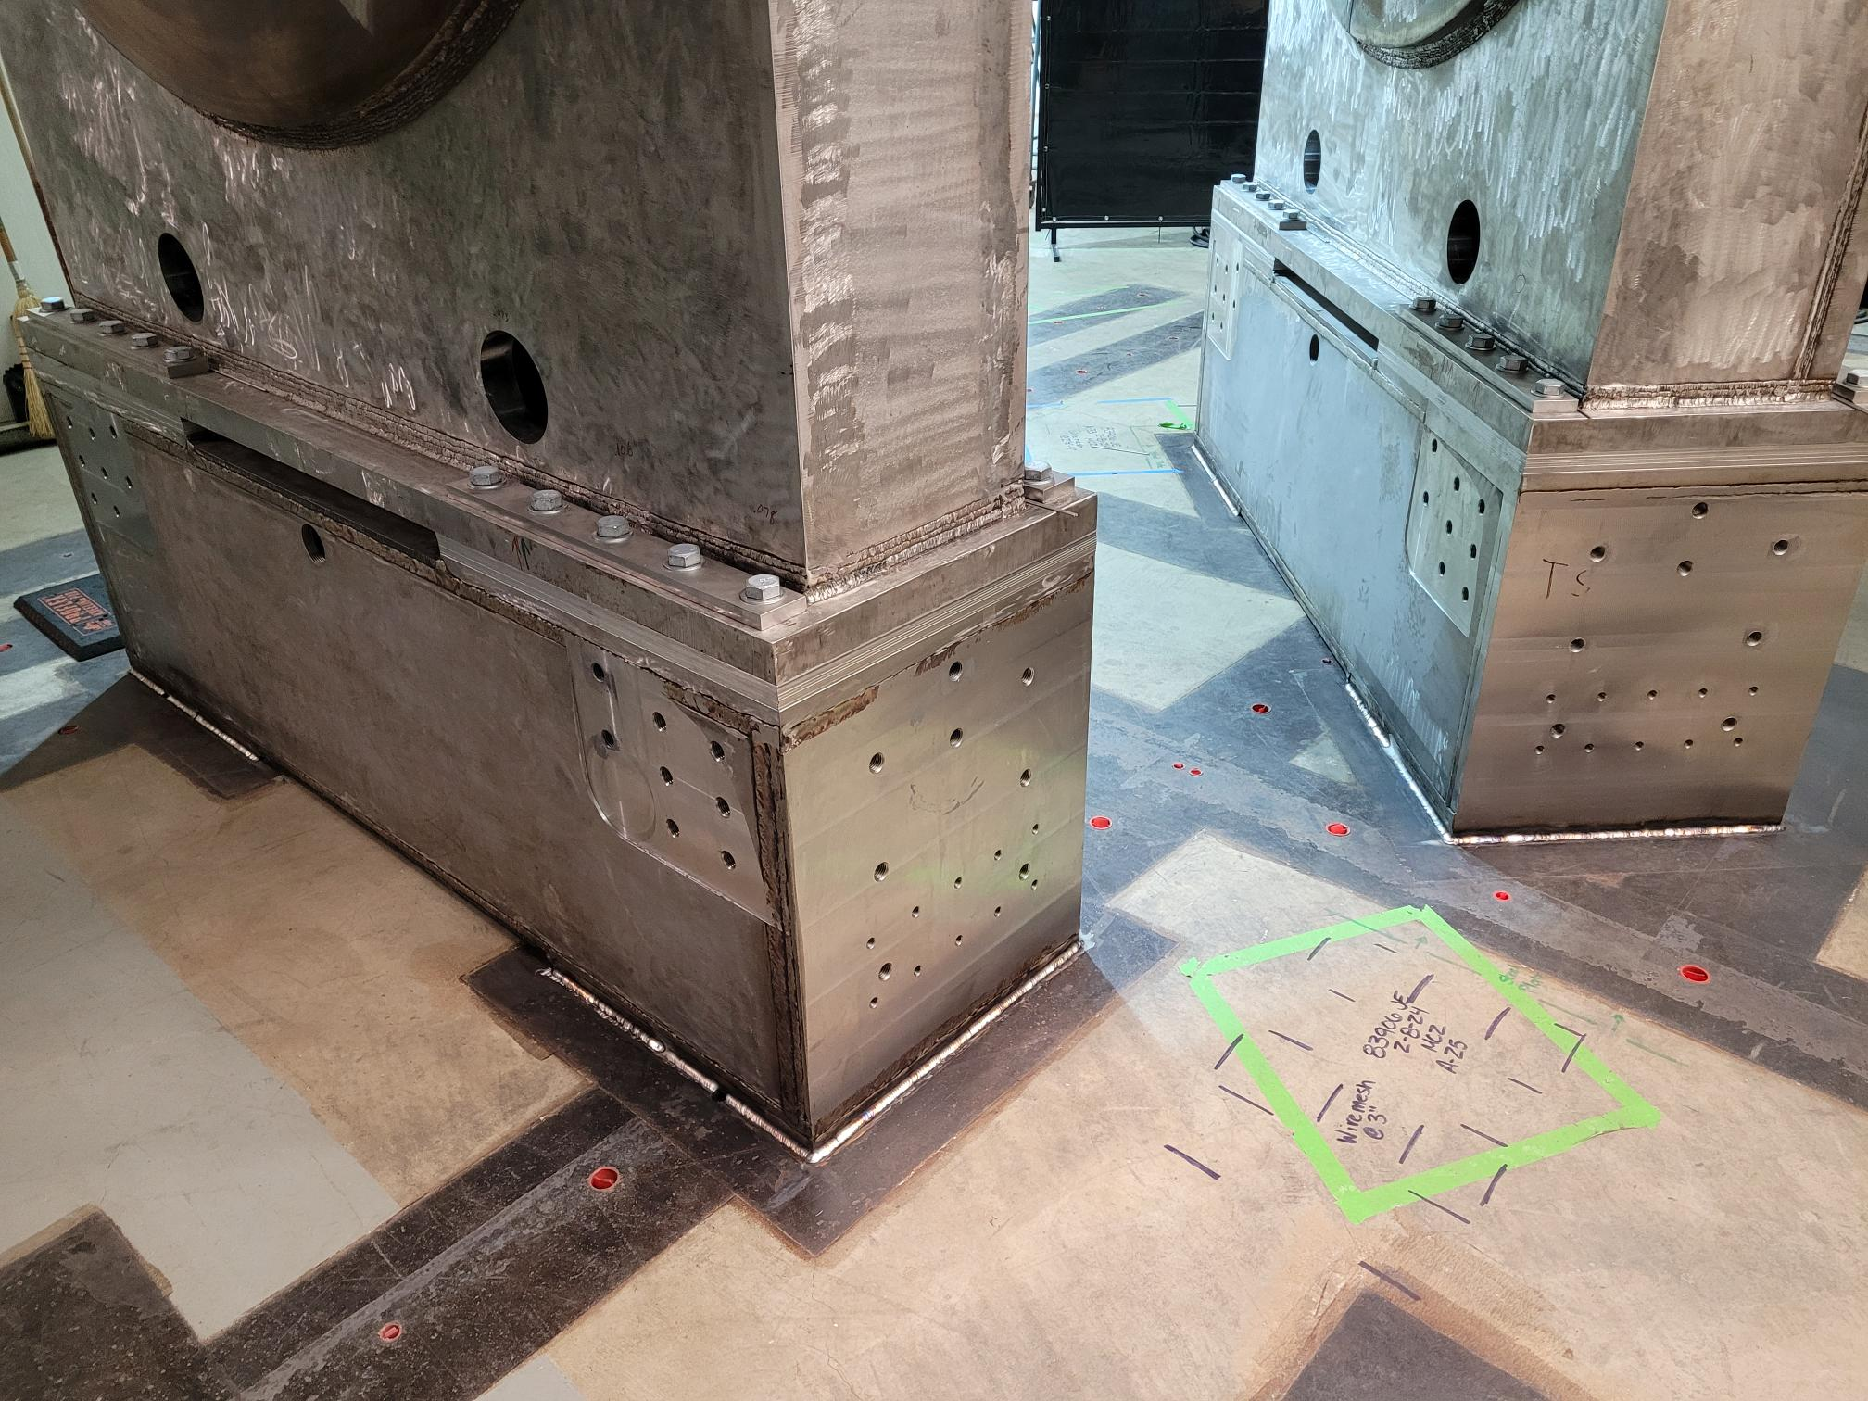
Transport Solenoids
Upstream Transport Solenoid (TSu)
All stands welded to floor plates. Elevation needs to be adjusted, then metrology
Welding on access platform to cryo services to resume
Downstream Transport Solenoid (TSd)
All stands welded to floor plates. Elevation needs to be adjusted, then metrology
Leak checking fixture removed from solenoid end, getting ready to wire the connectors tree

Slide 3
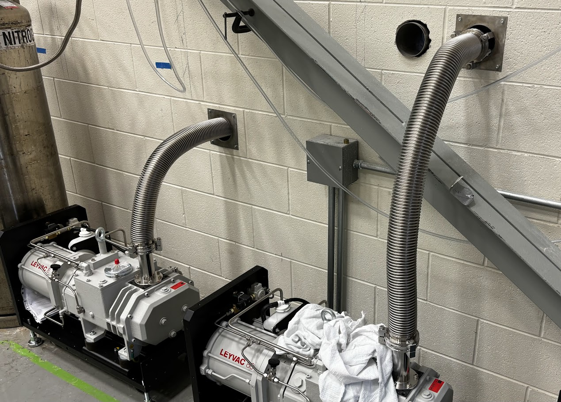
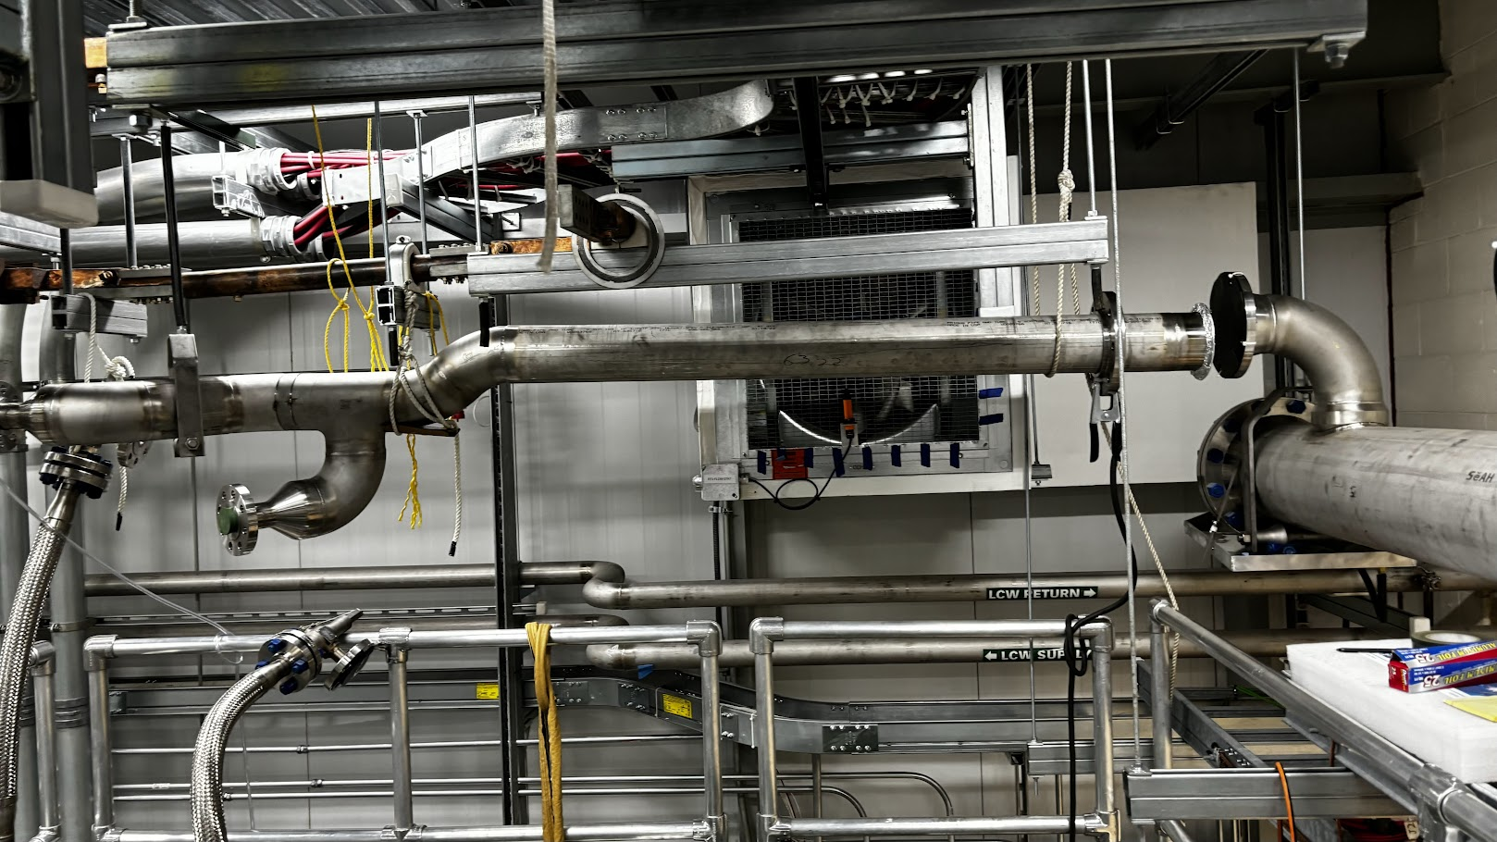
Solenoids infrastructure
Insulating vacuum
Control cables pulled to the pipe chase alcove
3 turbo pumps installed, 4th turbo being refurbished
Solenoids power supplies
Work continues in the power supply room intermittently
Controls and monitoring
Feedbox + Transfer line – connector tree wiring resumed
Helium vent lines
Feedbox to vent header installation ongoing

Slide 4
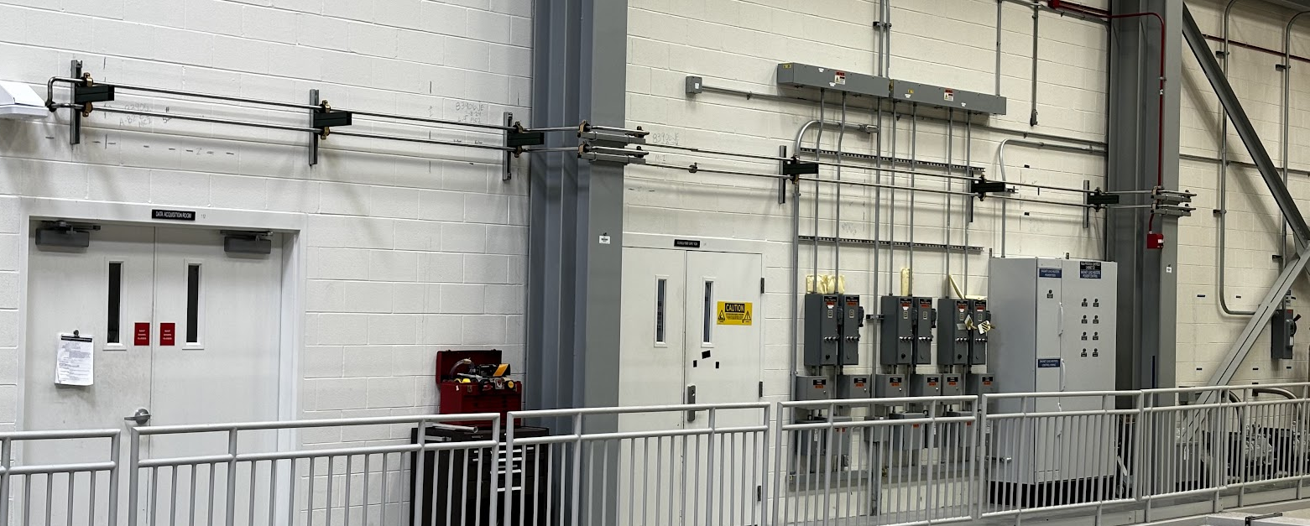
Equipment infrastructure
Equipment Cooling Water
Cut into CUB complete
Installation of piping ongoing in mechanical room and sidewalk
Compressed air lines
Installation in West wall relief and Production Solenoid area ongoing
Will use AD scanner in pipe chase alcove and RHR to install more anchors. HA approved to work overhead.

Slide 5
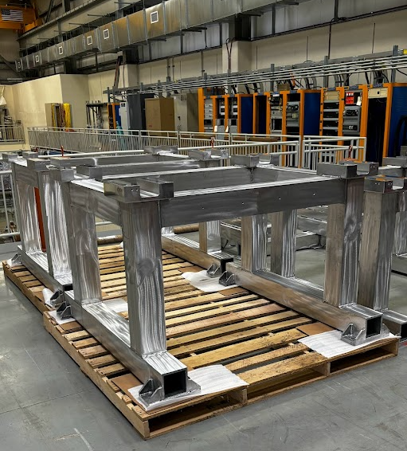
Detector subsystem infrastructure
Detector external stands
Inspection of top surfaces of top portions complete
Tracker chiller
Installation of piping ongoing
Tracker and Calo cables and fibers
Installation continues
Data Acquisition
Construction Readiness Review held: repurposing nodes from Muon g-2
Calorimeter DT generator
ORC held 04-Apr → following up on action items

