Slide 1
MI/RR machine report
Meiqin Xiao
Friday 9 O’clock meeting
05 April 2024

Slide 2
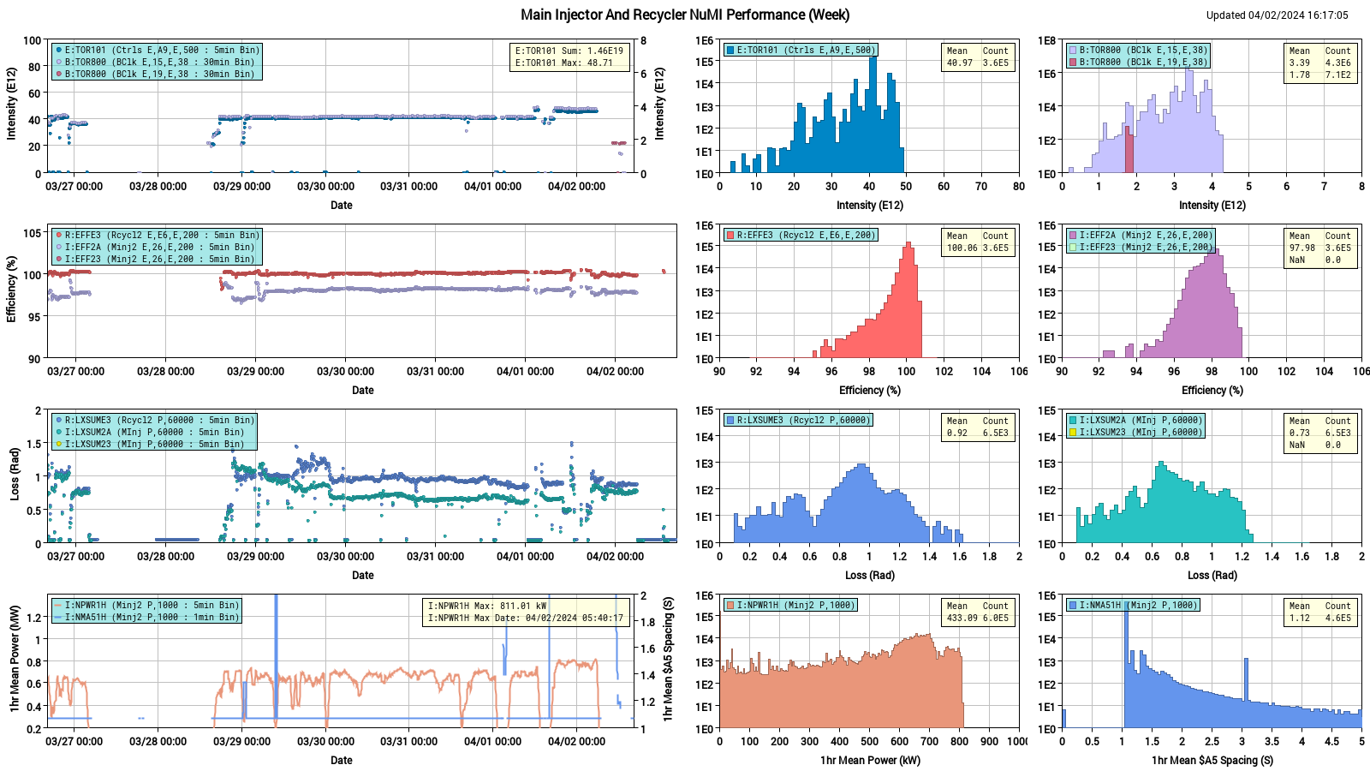
NuMI performance

Slide 3
Weekly summary
MI:
RF14 HV deck interlock fault, scheduled downtime for MIRF14 and MIRF16 series tube replacement on Monday , extended downtime for MIRF14 modulator caps replacement
RF5 off due to multiple gap envelop trips. MIRF5 cavity and PA got repaired on Wednesday
MIRF13 tripped this owl shift, Ops could not recover
Several MI corrector low input voltage faults, PESD will take a look.
The MI40 abort sump pump Issue:
Got noticed 04/03 early morning when the 24hr sump runtime rate reached zero
Ops coordinated with MI group, RSO/RCT, Cons & RunCo to investigate the MI Abort room. On 04/03 Wednesday Ops prepared MI20-62 for controlled access. Water was found in the MI abort room and Ops worked with ISD to pump the water to an adjacent sump pit. MI and Ops, ISD personnel and Rad safety have been working on it ever since.
MI-40 Vacuum work completed
MI8 line:
MI8 collimators have been moved in, which helped reducing RR loss by half.
IBPM8D issue has not yet solved, Instrumentation will try to change out the crate for IBPM8D today

Slide 4
Weekly summary
RR:
R:QT603 power supply ground fault Monday owl shift. The regulator was replaced
RR TBT data taken for lattice measurement
New ramp corrections into RR Horizontal and Vertical trims
Our plan:
Continue MI-20-62 controlled access. (morning)Replace MI-40 sump pump.
Investigate MI RF cavity LCW leak.
resume beam to NUMI for the weekend

