Slide 1
Muon Campus Operation Report
Jim Morgan
Friday 09:00 Operations Meeting
April 5, 2024

Slide 2
Muon Campus status
ESS1 & ESS2 Electrostatic Septa
ESS1 was transported to NWA on Tuesday, now in test cave
Vacuum pump-down underway
High voltage conditioning begins next week
ESS2 assembly has been paused, will resume at A0 Clean Room next week
New main A0 Air Conditioning unit expected to be tested next week
Working towards permission for beam operation, beginning sign-offs
AP-0 A/C work continued
LCW leak on header fitting behind Q206
Some progress on finishing D30 mechanical work
Reconnected most of cabling in D30 that was removed for planned work
Performing tunnel inspections of water valves and cabling
Study – M1-M3 Optics
Study – Alternative M5 optics
KPS5A PFL Repair
MC-1 Controlled Access
G-2 Trolley Run
Intentional Accelerator
Standby Period
<------------Week Days -------------------→

Slide 3
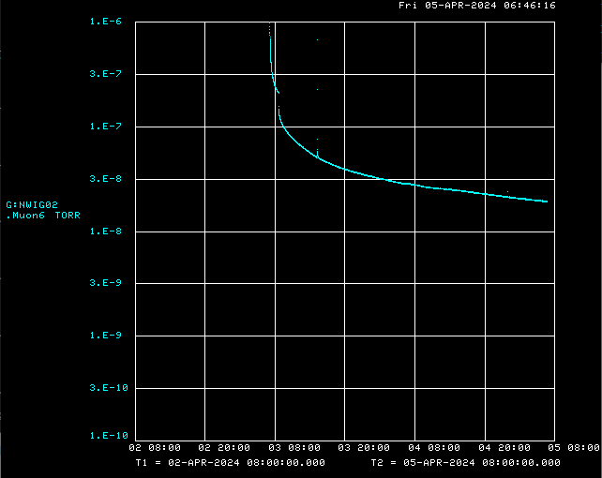
ESS1 vacuum pump-down at NWA

Slide 4
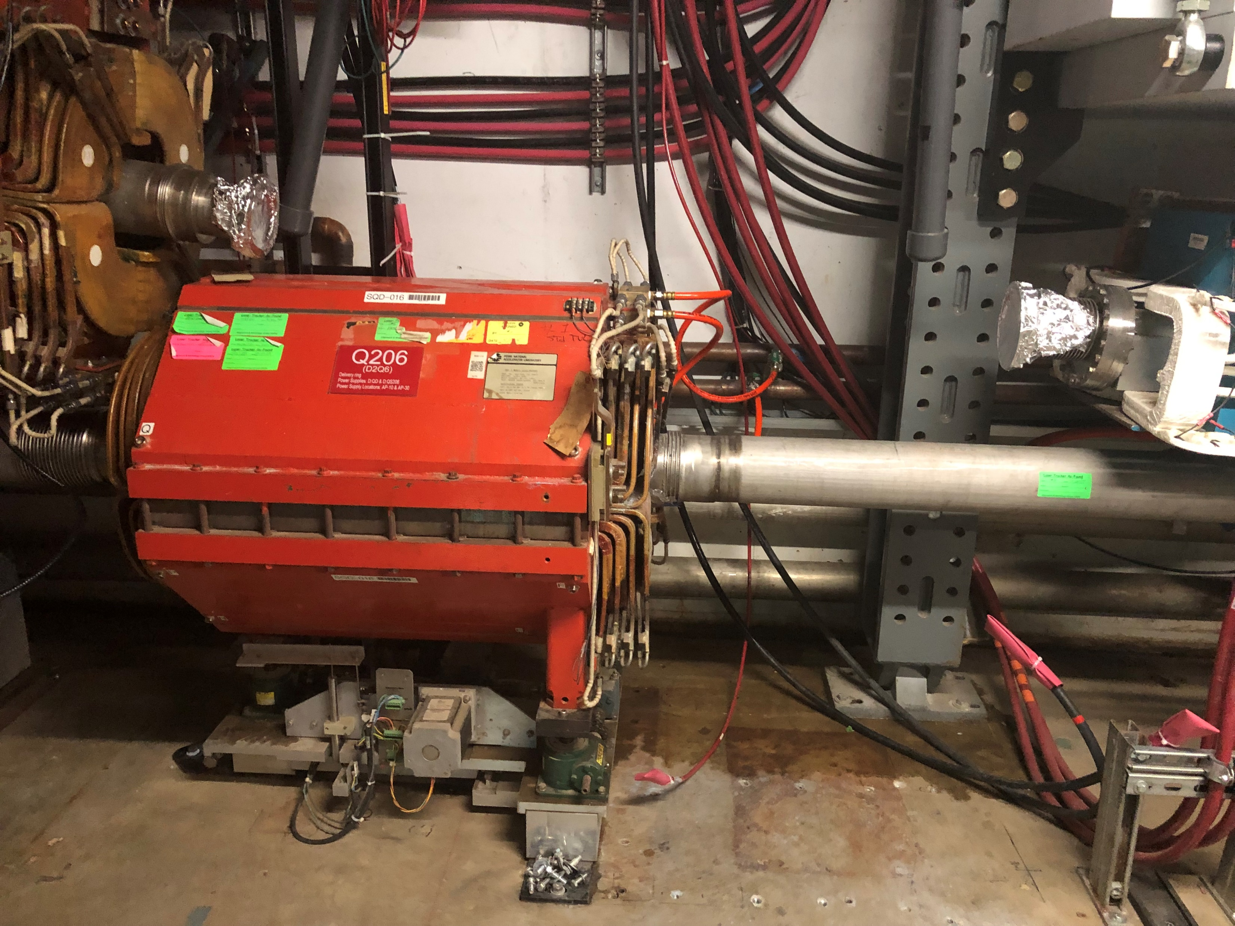
Leak behind Q206

Slide 5
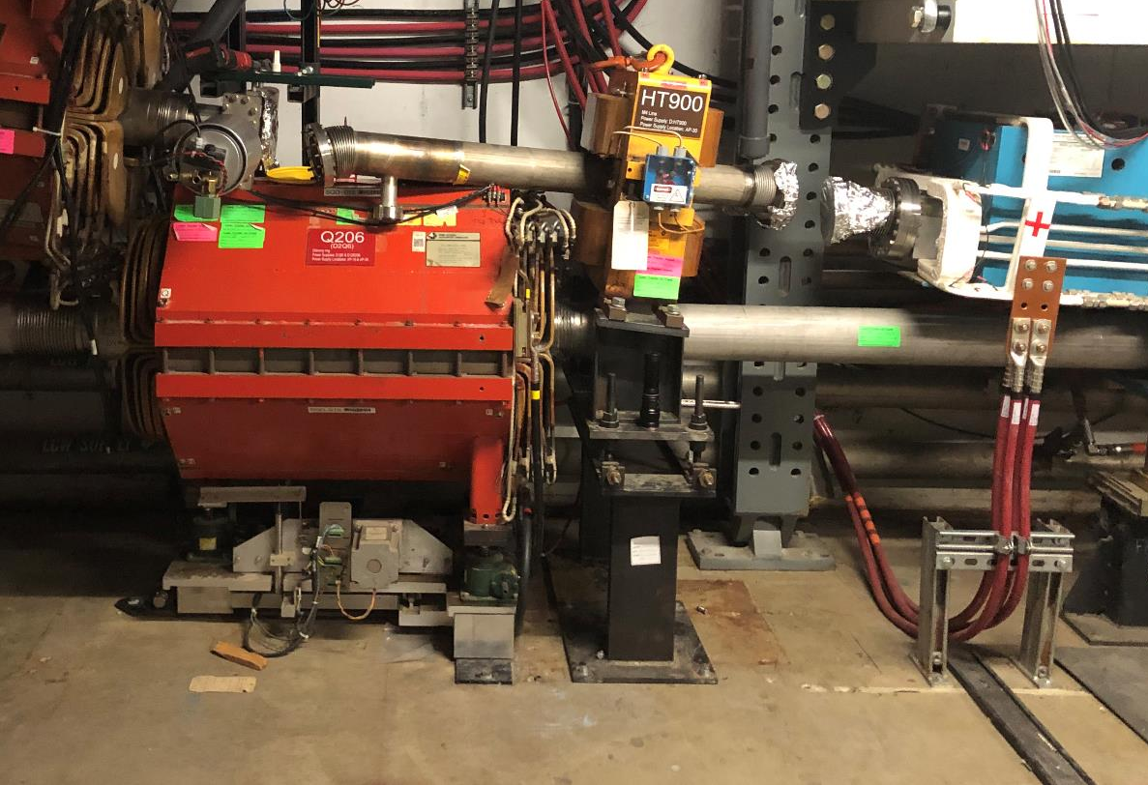
M4 Line components being reinstalled
PWC900 goes here

Slide 6
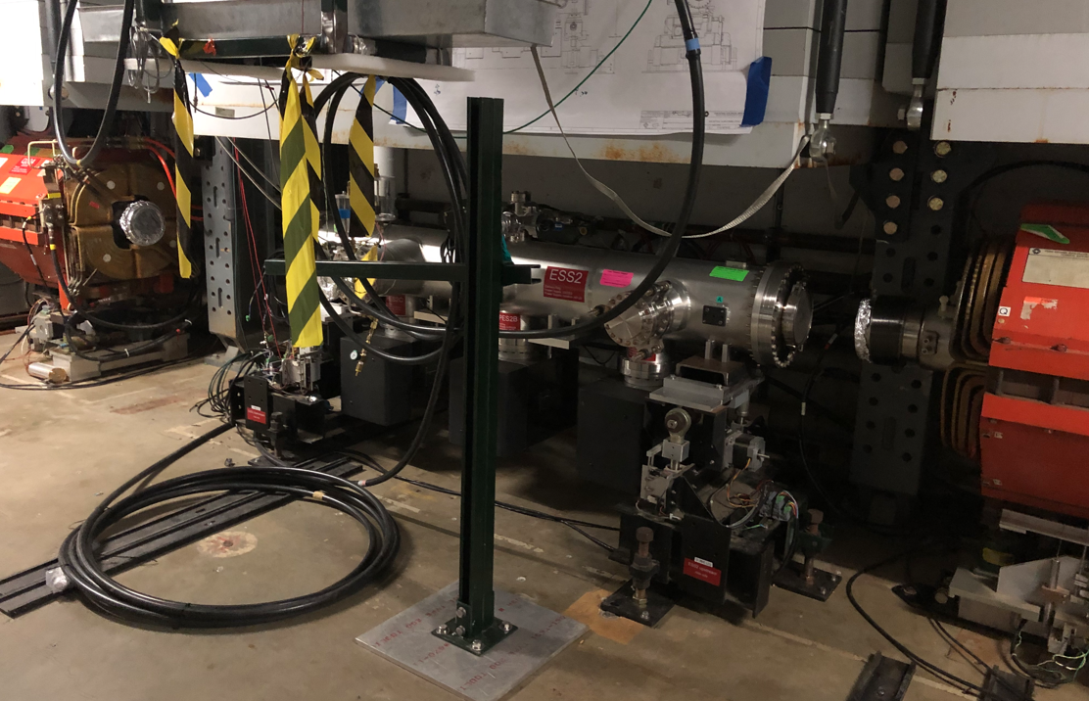
ESS2 awaiting vacuum spools

Slide 7
Upcoming work
ESS1 and ESS2
ESS1 high voltage conditioning expected to start Wednesday at NWA
ESS2 assembly will resume at A0 Clean Room
Portable A/C unit for Clean Room working well, main A/C unit nearly ready
Installation of new A0 Clean Room A/C units probably months away
Need to close up D30 vacuum and pump down
Vacuum spools for prototype ESS2 need to be installed
Vacuum spool already installed at ESS1 location
M4 line above Q206 being reinstalled
Vacuum leak check and pump-down will follow
AP-0 A/C work continues
Access to AP-0 Water Cage and rad fence area simplified while not running beam
Hope to resume beam operation later this month
Beginning start-up sign-offs
Need to re-core Delivery Ring, Extraction & M4 Enclosures from Shutdown keys
Still need to safety test these three enclosures

