Slide 1
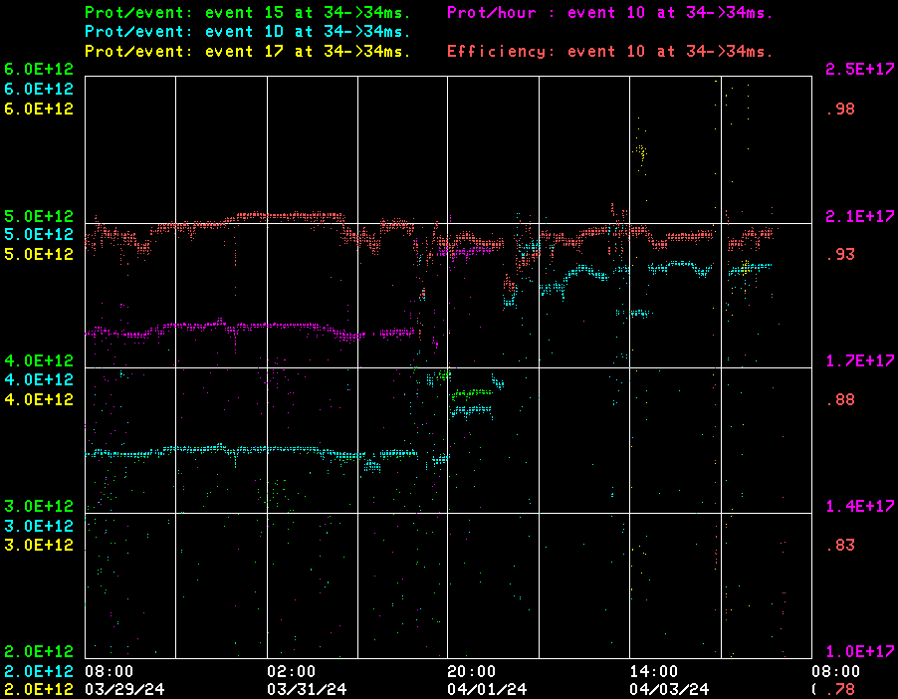
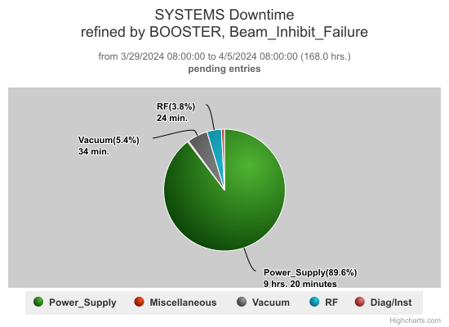
Booster Operations 3/29/24 – 4/5/24
F
DT ~10.5hrs
RF experts tuning stations with increased beam loading.
Booster Gradient Magnet PD testing continues.
PESD PS checkout at E4R planning continues.
Controls resolved data recovery issues with Booster IPM, Thanks to Instrumentation and Controls.
Controls fixed file access bug /Feature in Orbit smoothing program B80 and B40 BPM program.
Instrumentation Split signals for BPM locations L22 and S22 all planes for new BPM hardware development.
Thanks to Ops for their efforts in maintaining Booster operations.
This week:
Delivered beam on $15’s to MI/RR from 3-4E12 p/pulse. Rates over 800kW achieved in RR/MI.
Beam to BNB at 5Hz, 3-5E12 p/ pulse 4-9E16 p/hr. over week
RF experts recovered all RF stations, all are available going into weekend.
Analog Mode 2 damper Phase waveform card was bad and was replaced, Digital Mode 2 causing issues so was left off for experts to investigate.
Linac/Booster Debuncher Phase was reverted back to previous operating point to improve efficiency, will reassess the optimal operating point.
Tuned at higher beam intensities on $17 with 6E12 pulses at low duty cycle.
Late Thursday beam loss issues went into owls with GMPS4 PS having issues. Experts trouble shooting.

