Slide 1
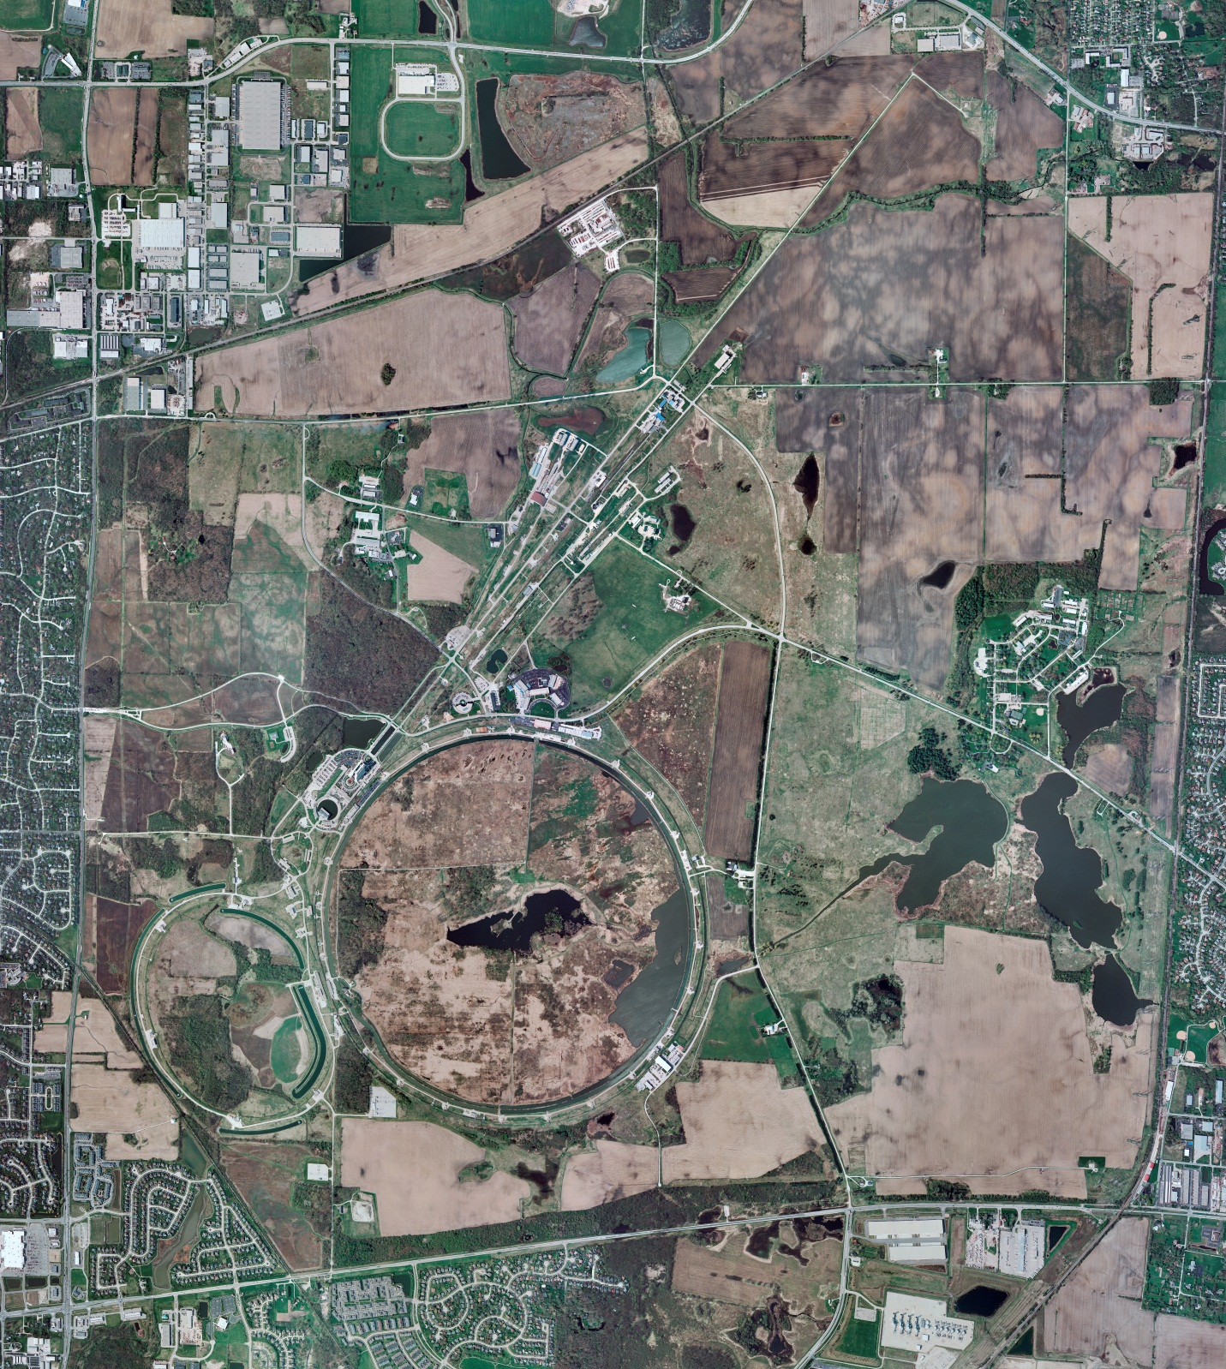
Helium Cryogenics
Status 4/5/2024 J.Makara
CMTF: SCP is cold running fine though 40 K internal heater power supply died; SCP will shut off next week for repairs
CMTS: HECM29 connections in progress
PIP2IT: South CM stand being modified for SSR2 pCM
North CM stand has HB650 installed and connections in progress
MCTF: cryo system is shut dpwm at RT
MDB/HTS: at RT
MDB/STC: at RT
MDB Magnet: at RT
NML/FAST: Cryo system is shut down and isolated for extended shutdown period;
CC1: at RT
CC2: at RT
CM: at RT
IB1: cryo system cold at 5 K and 2 K operations
Muon Campus: at RT with comprs off and system depressurized; LN2 off with LN2 Tank 50 being warmed up
Misc:…

