Slide 1
FSPA Updates
Michael Balcewicz on behalf of the FSPA Officers UEC Monthly Meeting
April 16, 2024

Slide 2
Early Career Seminars Ongoing
Seminar on 1st Thursday of the month—Come by if you are a student or postdoc!
April seminar given by URA (thank you Claudette and Stephany)!
8 in person and >4 on Zoom, consistent with prior months
We have a speaker for May lined up
01/16/24
FSPA Updates

Slide 3
Upcoming Events Plans
The FSPA Spring Boardgame Night is in approvals
Tentative date of May 31st at 6 pm at the User’s Center
01/16/24
FSPA Updates

Slide 4
New Perspectives
FSPA hopes to assist with New Perspectives.
I believe last year FSPA ran a BBQ, took care of indico and presumably collected abstract submissions and distributed prizes (possibly other areas as well).
We want to make sure that this is still the case this year
We need to know abstract submission deadlines, but we have not yet received a response to these queries from the conference office
01/16/24
FSPA Updates

Slide 5
GAPR Reimbursement
FSPA has had difficulties getting reimbursements for our events
Reimbursements seem to now be moving forward
It sounds as though there may be a significantly more limited budget than prior years
May cause issues later in year
01/16/24
FSPA Updates

Slide 6
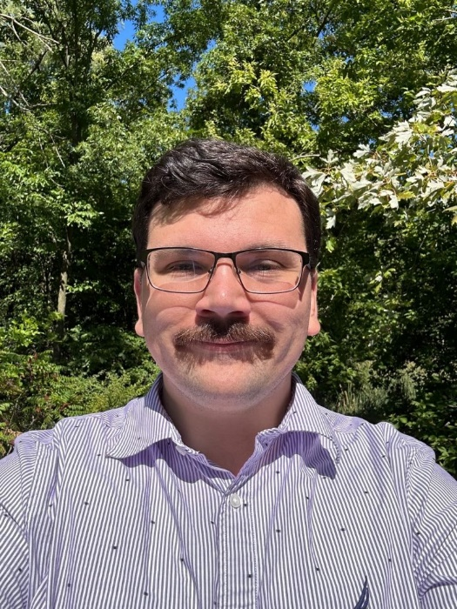
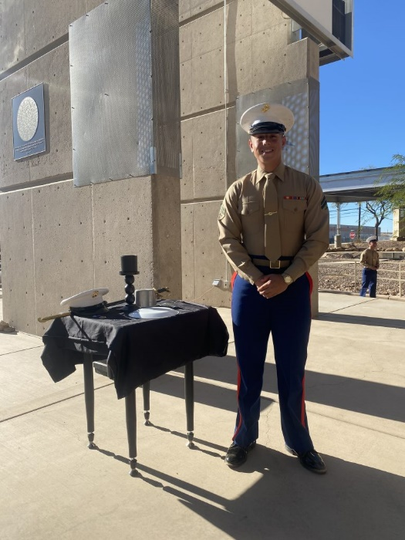
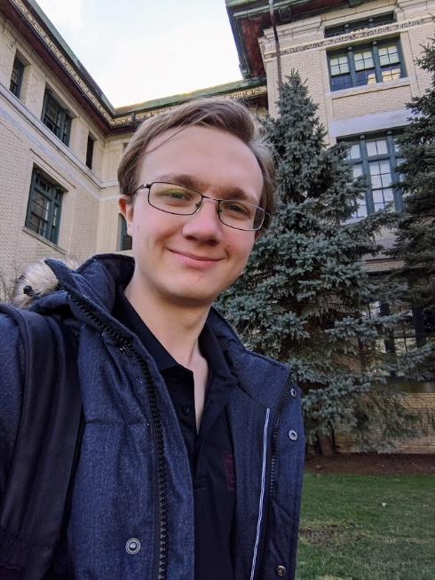
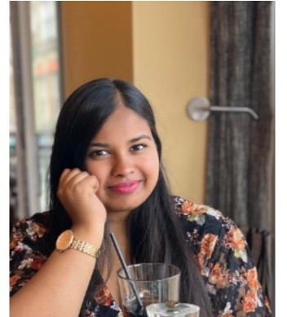
Thank you!
Michael Balcewicz
Miguel Gutierrez
Adam Quinn
Ishanee Pophale
01/16/24
FSPA Updates

