Slide 1
Status of DAPHNE V3 and planned testing in ICEBERG
David Christian
April 9, 2024

Slide 2
DAPHNE_V3 – FELIX will be replaced by 10/100 GbE switches & 100 GbE NICs
Differences between DAPHNE_V3 & DAPHNE_V2
  Xilinx Artix 7 & ST microprocessor replaced by Xilinx Zynq Ultrascale SOM (Kria K26)
    K26 provides similar FPGA resources and supports much higher speed I/O.
    Zynq architecture includes FPGA and a tightly-coupled multicore (Linux) processor
  10 GbE output; 4 links (can stream 8-10 channels per link or operate in self-triggered mode)
  Analog section is essentially unchanged from V2 (different transformer used in differential to single-ended conversion allows more flexibility to tune digitized pulse shape)
  Control/spy buffer readout over 1 GbE (same as V2, but no convoluted details)
  Redesigned power distribution; LDOs used for all analog rails
  2U enclosure to allow space for heat sink on Kria SOM (system-on-module) and larger fans.

Slide 3
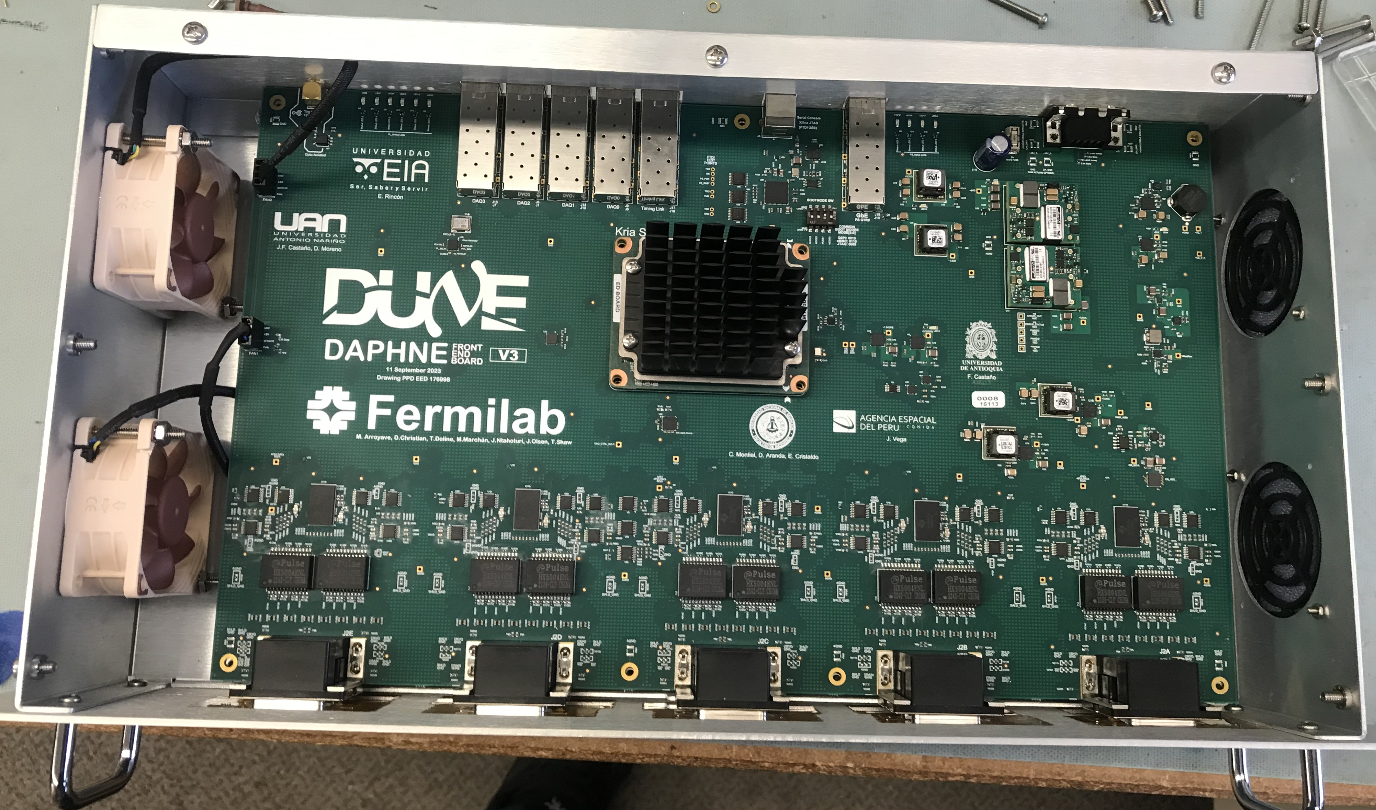
SFP+ & SFP cages for 10GbE, 1GbE, & DUNE timing system
Power management (DC/DC converters, LDOs, SiPM bias generator)
KRIA K-26
(Zync UltraScale) w/custom heat sink
2 4-chan transformers
AFE 5808A (8 chan)
OFFSET (ped) &
SiPM Trim V
2U enclosure provides room for KRIA heat sink and larger fans & filters)

Slide 4
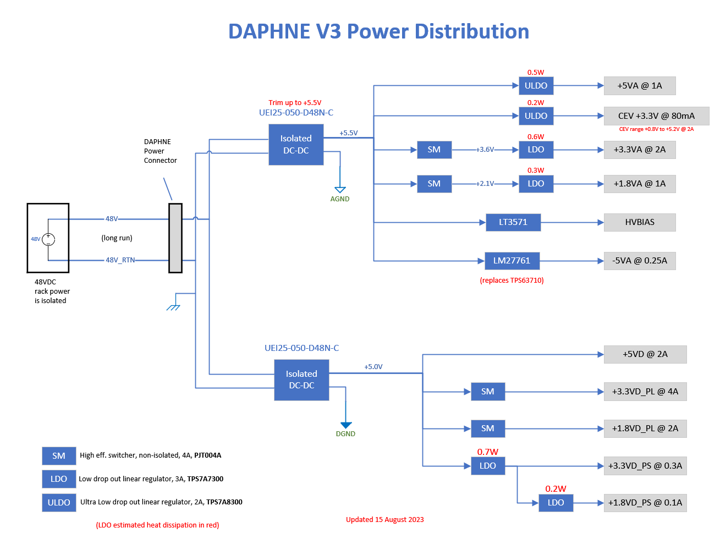
Power consumption is only very slightly more than DAPHNE_V2; no need for more bulk power supplies in FD1.

Slide 5
DAPHNE_V3 Firmware Structure
To be provided by DAQ Consortium (RAL) – prototype exists.
KRIA PS
(software)

Slide 6
Testing in ICEBERG
The ICEBERG cryostat holds a small liquid argon TPC designed for system testing of TPC readout electronics.
  Central APA (1/2 width; 1/6 height; wrapped wires; 10 FEMBs)
  2 30-cm drift volumes (one on each side of the APA)
  A VD-style XARAPUCA (with PoF & SoF) will be located under the TPC
DUNEDAQ is used for data taking
  Includes a DUNE timing system
  10/100 GbE switch
DAPHNE_V3 will be used to readout the XARAPUCA
  Timing endpoint firmware has been tested with the ICEBERG timing endpoint.

Slide 7
DAPHNE_V3 Firmware Development
Some of the Xilinx-provided firmware blocks used in DAPHNE_V2 are not available for the Zync
  The serial-to-parallel interface with the AFE chips has been rewritten (works in simulation)
It has taken much longer than anticipated to understand how best to use the “AXI bus” connection between the Zynq PS & PL (FPGA)
  We require VHDL firmware and gate-level simulation of all firmware
    But most of the modules provided by Xilinx for use with AXI can only be simulated using System Verilog… and the Vivado simulator does not support System Verilog (or UVM)
    Our design uses only a large shared memory space for all PS-PL communication (essentially the same as in the WIB)
    This design means that the PS-side Linux kernel (Petalinix) will only rarely need to be rebuilt.
    This week Jamieson has finally succeeded in implemented a shared memory in an implementation that can be simulated in Vivado
    We believe that our struggles with AXI bus are almost behind us.

Slide 8
DAPHNE_V3 Anticipated Remaining Timeline
Balance of April/early May (with working AXI shared memory):
  Reverify all PS-side control & monitoring functions
  Verify acquisition of data from AFEs – R/O through GbE
  Verify operation of spy buffers – R/O through GbE
  Test & verify (8-channel) streaming output with 10 GbE sender
May/June
  Integrations tests at ICEBERG (w/1&10 GbE R/O)
  Implement simple self-trigger version with 10 GbE sender
  Integration tests at CERN as possible without interfering in ongoing activities (NP04 will use DAPHNE_V2 at least until V3 is well tested)
Summer 2024
  Implement more capable self-triggering algorithms (to be tested soon with _V2)

