Slide 1
9 AM Meeting
Keymonty Bullock
MCR Crew Chief
Monday, April 8, 2024

Slide 2
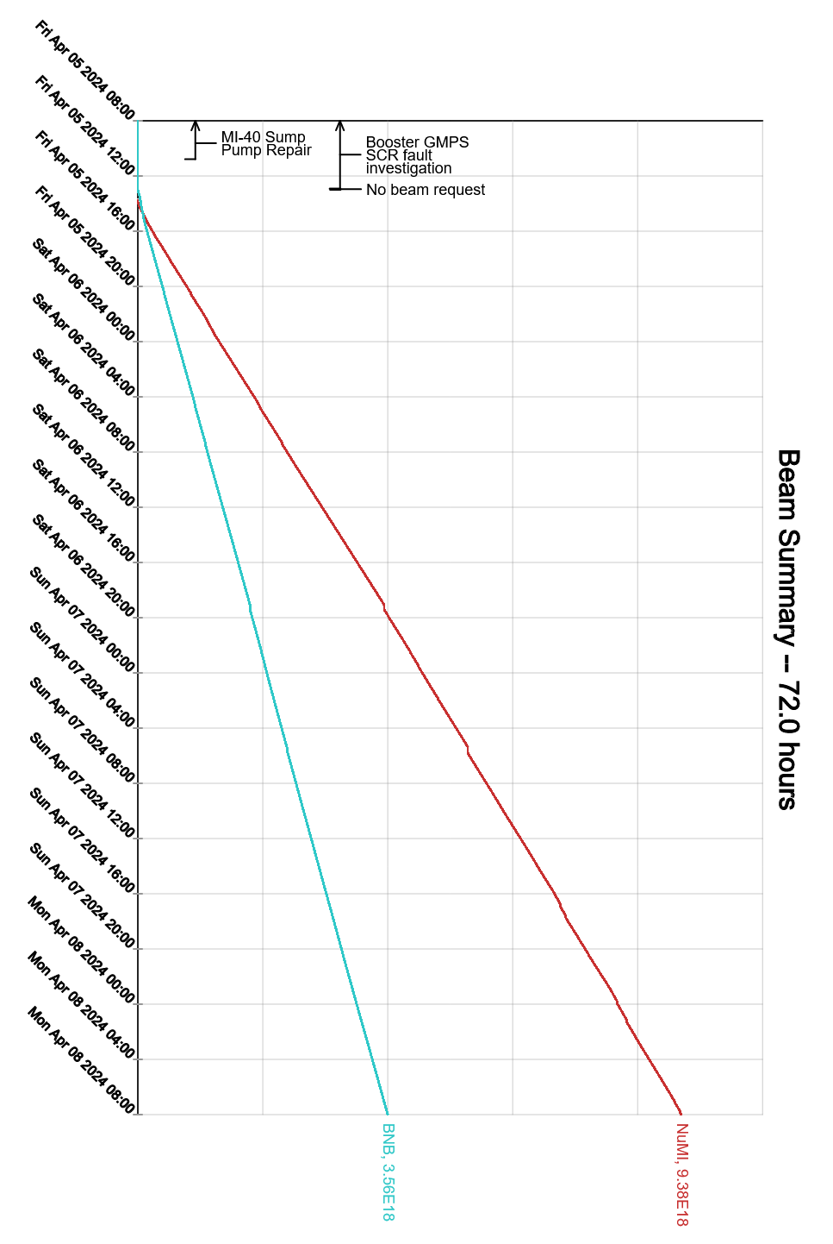
Since Friday…
MI-40 Sump work completed.
GMPS #4 output voltage issues
PESD and Booster Group were able to recover by ~1400hrs on Friday
MIRF issues over the weekend (MIRF06, 08, 14, 20)
Experts are working on recovering the stations
Beam to NuMI, BNB

