Slide 1
Low radioactivity argon from underground sources
Henning O. Back – Princeton University
LIDINE 2013

Slide 2
Atmospheric argon limits
Argon-39
  Beta emitter (q = 565 keV, t_{1/2} = 269 years)
  Produced in the atmosphere through cosmic ray interactions (eg, ⁴⁰Ar(n, 2n)→³⁹Ar)
  Atmospheric abundance
    ³⁹Ar/⁴⁰Ar is 8×10⁻¹⁶ (0.8 ppq)
    Specific activity = 1 Bq/kg
  Is the limiting factor in size and sensitivity for argon detectors
    Limits detector size due to ³⁹Ar event pile-up
    One ton detector
      Electron drift time across 1 ton detector (1m)= order 500μs (minimum time between events, equivalent to 2kHz)
      Atmospheric ³⁹Ar decay rate = 1kHz/ton

Slide 3
Terrestrial argon sources
As I understand them
⁴⁰Ar comes from ⁴⁰K decay
Atmosphere
  ³⁹Ar produced by cosmic ray neutrons
Crust
  No cosmic ray
  Neutrons from U and Th
Mantle
  Very low U and Th
  Lowest ³⁹Ar levels
Atmosphere (8×10⁻¹⁶ ³⁹Ar/⁴⁰Ar)
Crust – 1ppm U and Th (low ³⁹Ar)
Mantle
Low U and Th
(lowest ³⁹Ar)

Slide 4
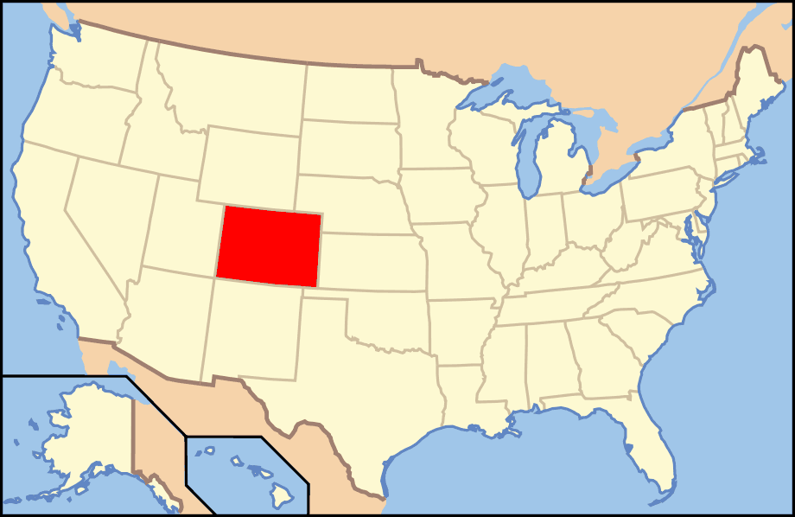
CO₂ well is SW Colorado
There are geological formations that trap gases underground
We found CO₂ well in SW Colorado (near Cortez)
Contains 600 ppm Argon
³⁹Ar activity < 0.65% of atmospheric argon (arXiv:1204.6011)

Slide 5
Getting to the argon
Extraction
  In Colorado we extract a crude argon gas mixture (Ar, N₂, and He)
Purification
  The gas from Cortez is then sent to Fermilab for further purification

Slide 6
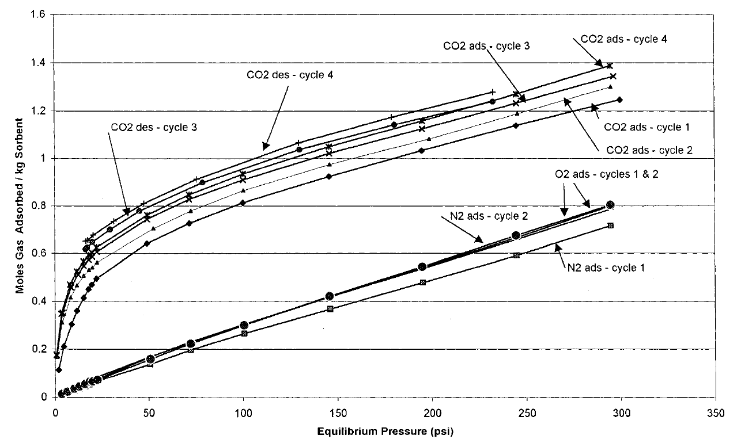
Absorption of CO2 on 4A zeolite
VPSA range
0-1.7 bar
Siriwardane et al., Energy & Fuels, Vol. 17, No. 3, 2003

Slide 7
Vacuum Pressure Swing Absorption (VPSA)
He, Ar, N₂ mixture
Capitalize on pressure dependence of absorption
Absorb CO₂ under pressure
Regenerate column under vacuum
Use 2 columns for (near) continuous operation
Gas flows through one column under pressure. CO₂, O₂, H₂O and CH₄ are absorbed on zeolite
Simultaneously the other column is pumped on to remove the trapped gases
Zeolite column
Zeolite column
Absorbed gas returned to company
Gas from well

Slide 8
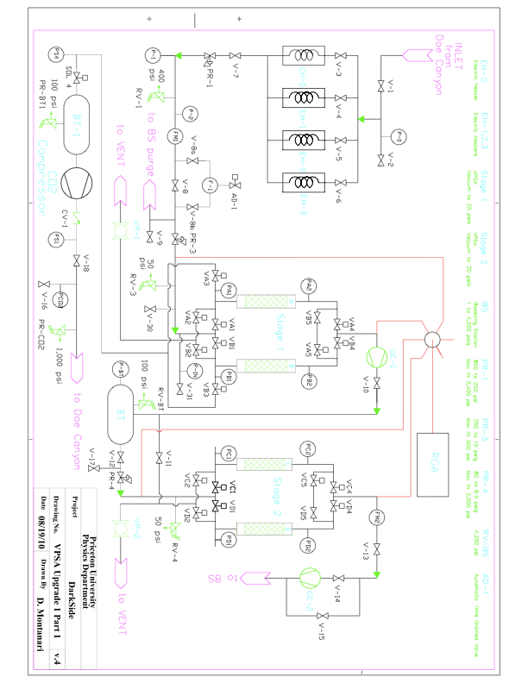
Our plant
Gas heaters
Warms gas to avoid liquefaction by to Joule-Thomson cooling
(total ΔP > 750 psi)
First stage
Second stage
Absorbs CO₂ and other unwanted gases
Allows Ar, He, and N₂ to pass
Reduces N₂ content

Slide 9
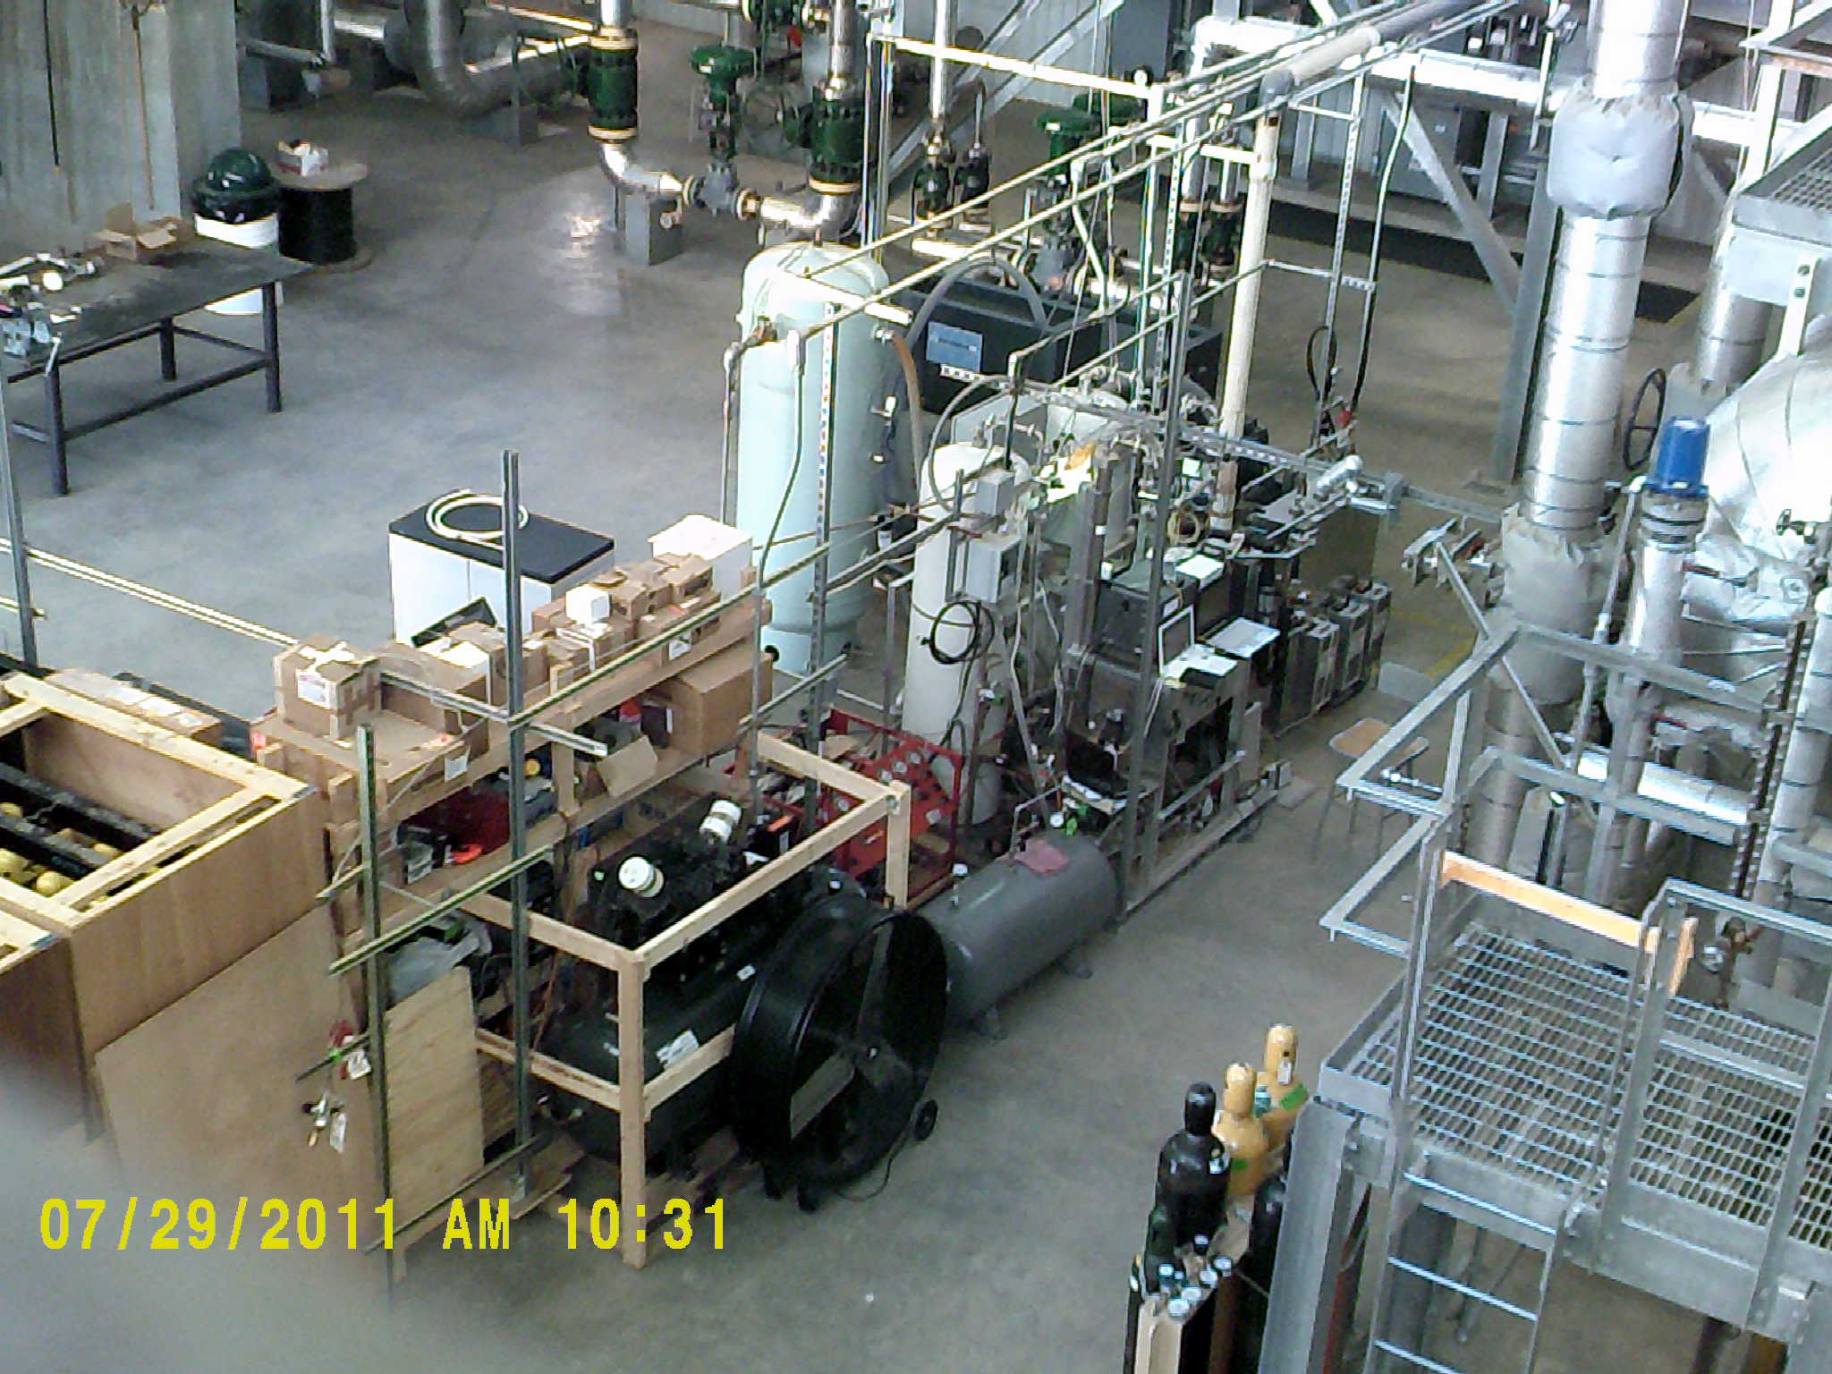
VPSA plant
Operated locally by technician Chris Condon – Managed by H. Back

Slide 10
²⁸N
⁴⁰Ar
²⁸N
⁴⁰Ar
RGA limit
³⁶Ar

Slide 11
Production
2010
  Output
    2.5% argon
    70% nitrogen
    27.5% helium
  Production
    23kg argon
2011
  Output
    ~5% argon
  Production
    53kg argon
    Continuous operation:
    May-June & July - October
2012
  Output
    5-7% argon
  Production
    67kg argon
    Duty factor – 57%
2013
  Output
    5-7% argon
  Production (to date)
    ~30kg argon
    Duty factor – 65%
Total underground argon collected to date ~ 173kg

Slide 12
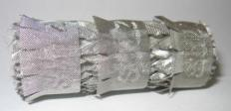
Purification at Fermilab
The Cryogenic Distillation Column
Waste gas (He and N₂)
5.5 cm
Lower boiling point gas preferentially moves up column
Column packing material
Column is filled with high surface area material
Boiling and condensation happens on the surface of column packing material
Controlling temperature and gas/liquid flows allows for continuous purification
Inject liquefied Ar/N₂into column
Packed column
Temperature gradient
Higher boiling point liquid preferentially moves down column
Product (pure Argon)

Slide 13
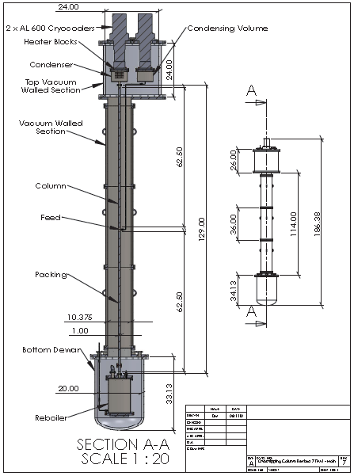
Distillation Column
2 – 600W cryocoolers
  Balanced with 700W heaters for temperature control
Reboiler cooled by liquid from column
  Temperature controlled with 700W heater
Active PID temperature control
Active mass flow control
Pressure and temperature monitoring throughout
Multiple input RGA measures gas at three points
  Input
  Waste
  Product

Slide 14
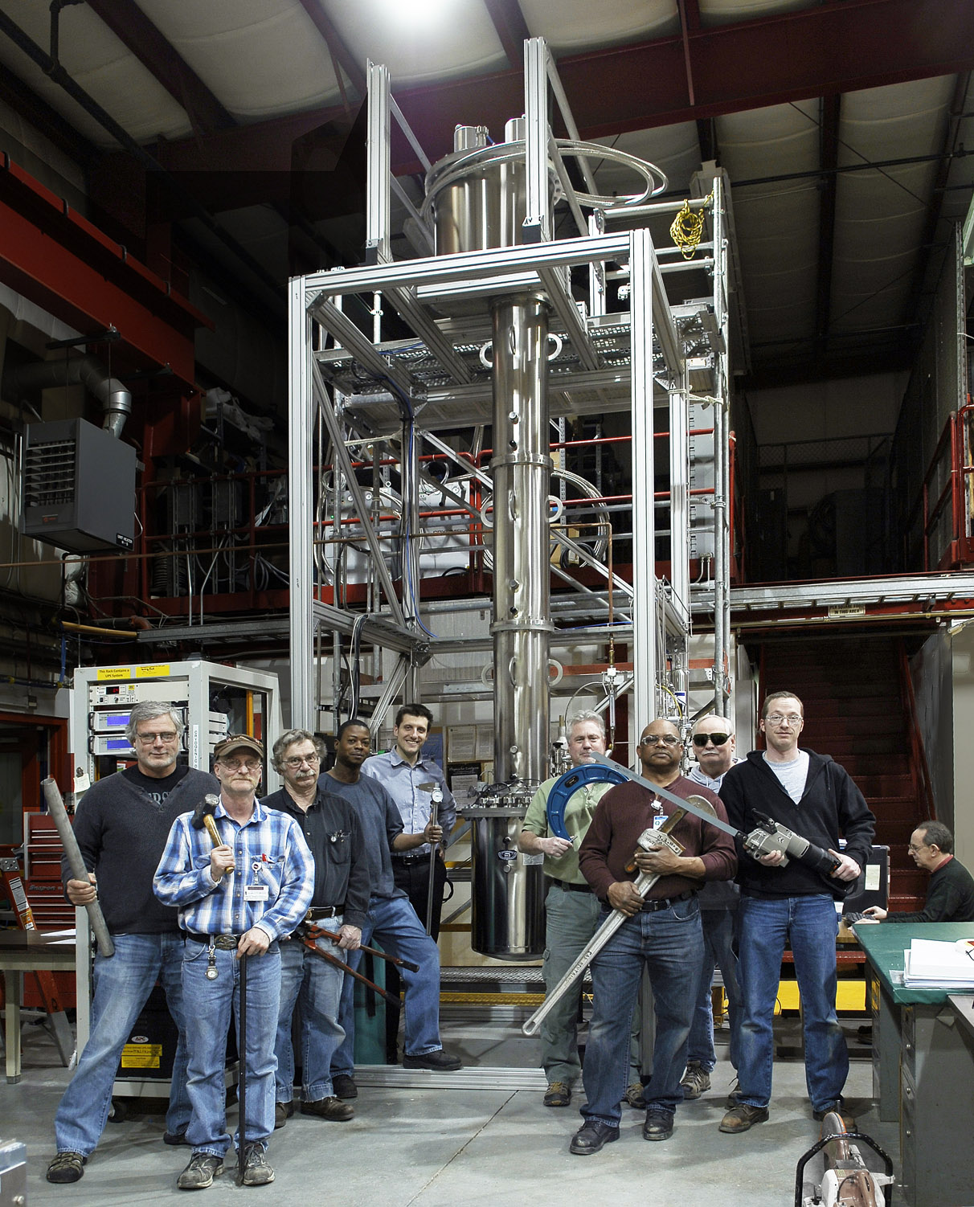

Slide 15
Nitrogen/Argon = 4.3×10⁻⁴
NOTE: Uncorrected pressures

Slide 16
Input gas:
5% Ar
40% N₂
55% He
Argon peaks
Nitrogen
Nitrogen
H₂O background
Other backgrounds
Other backgrounds

Slide 17
Argon purity = 99.9%
6 days from start
Consumed test gas
8.5 days from start

Slide 19
Tested gas samples
Sample #1
Sample #2
Our RGA measurement:
  N₂ = 1000 ppm
Atlantic Analytical:
  N₂ = 700 ppm
  O₂ = 40 ppm
Pacific Northwest National Lab
  N₂ = 920 ppm
  O₂ < 10 ppm
Our RGA measurement:
  N₂ < 500 ppm
Atlantic Analytical:
  N₂ = 4100 ppm
  O₂ = 810 ppm
Pacific Northwest National Lab (2 runs)
  N₂ = 4250 and 4000 ppm
  O₂ = 430 and 600 ppm
We believe there was air contamination

Slide 20
Argon recovery efficiency
Consumed 24 high pressure cylinders with 262 scf of gas each (7419 liters)
  662g of Argon / cylinder
  14.9 kg of Argon total in 24 cylinders
Accumulated mass (rough estimate)
  Mass lost through product line – 50scc/m for ~10days = 1.2kg
  Mass from liquid level
    16 cm of liquid = 10.8 kg
    Total = 10.8 + 1.2 = 12 kg
  Mass from measuring flow out of reboiler during warm up
    Integral volume out of product – 5521liters = 9.3 kg
    Total = 9.3 + 1.2 = 10.5kg
Collection efficiency
  During continuous distillation = 80%
  Residual loss during cool down, tuning, etc.
  Overall 70-80%

Slide 21
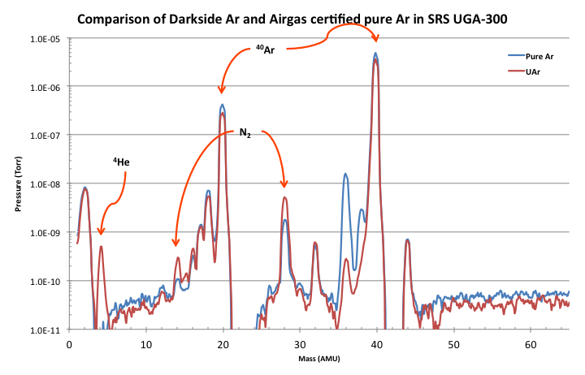
First Underground Argon purification
Processed 0.5M standard liters of gas
Reached 99.7% pure argon
Issues
  Gas flow abruptly stopped - CLOGGING
  Distillation stalled with different gas mixture – HIGH He CONTENT

Slide 22
Solidifying impurities
Residual impurities solidified in the Column
Impurities are below the sensitivity of the VPSA RGA
Need to remove impurities before reaching the column
Contaminant | Concentration (v/v) | After 500,000 standard liter of gas
 |  | contaminants | gas vol. | Liq./solid vol.
H₂O | 25 ppm | 61.2 ppm | 30.6 L | >30 mL
CO₂ | 30 ppm
CH₄ | 1.4 ppm
Isopentane (C₅H₁₂) | 3.0 ppm
N-pentane (C₅H₁₂) | 1.8 ppm

Slide 23
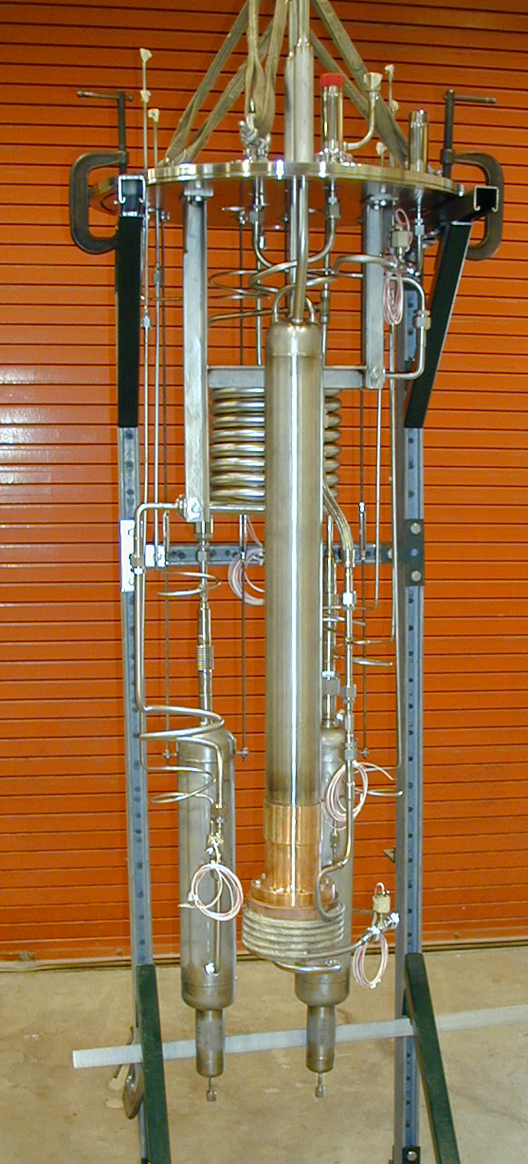
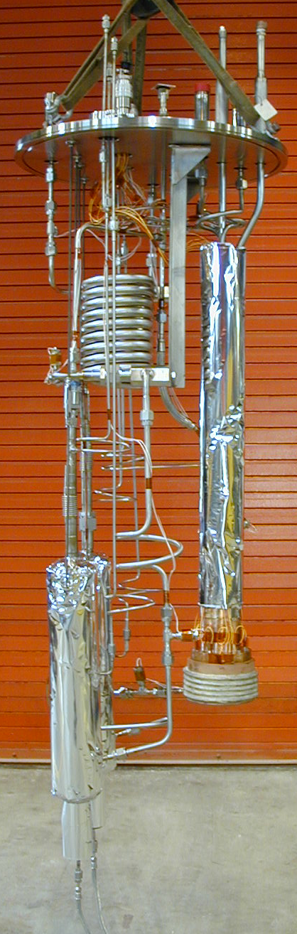
CDF cold traps
Originally used to remove alcohol from argon/ethane mix
Repurposed to remove our residual contaminants

Slide 24
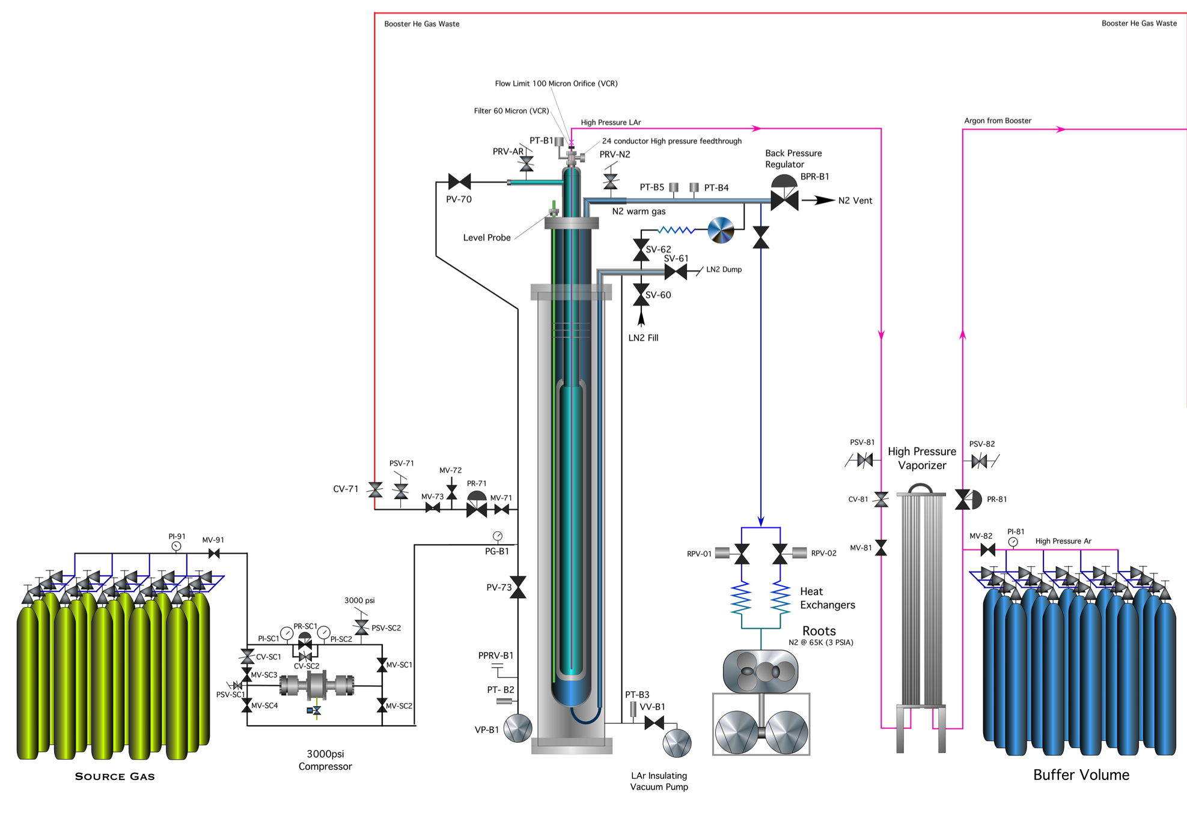
Condenser Booster Helium Separator
Pressurize Booster with Ar-He-N₂ mixture
Cool with LN₂
Ar and N2 condense
Remaining pressure is He, which is then vented
Pumping on LN₂ drives down temperature below 77K

Slide 25
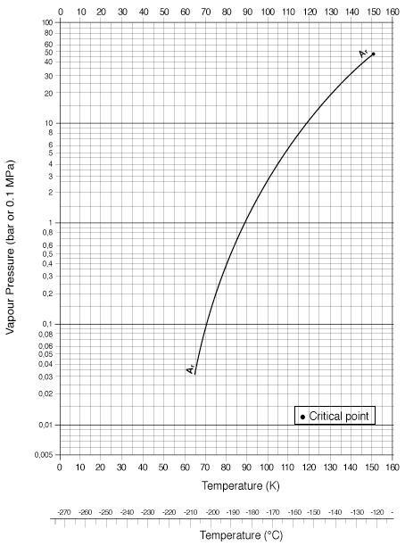
Argon collection efficiency
Condenser booster pressurized to 2600 psi (175 bar) = ~3500 L @ stp
Operation at 77K
  Ar vapor press. at 77K = 0.3 bar
  Ar concentration in 175 bar He at 77K = 0.17%
  Input gas = 5% argon
  Argon lost = 3.4%
Operation at 65K (subatmospheric LN2 jacket)
  Ar vapor press. @ 65K = .035bar
  Ar concentration in 175 bar He at 65K = 0.02%
  Input gas = 5% Ar
  Ar lost = 0.4%

Slide 26
Recovering Ar in waste streams
Argon is lost in the waste streams of the Condenser Booster and the Distillation Column
Argon traps readily on charcoal at LAr temps
Pass exhaust from Condenser Booster and Distillation Column to recover argon

Slide 27
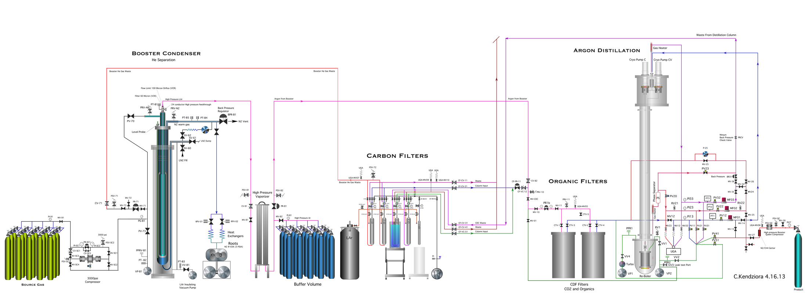
Complete argon purification plants at Fermilab

Slide 28
Argon purification process
FINAL Product
Ar – 100%
N₂ < 10 ppm
CH₄ – 0%
Booster
Vent outside
Product
Heated Getter
CB Waste
He >99%
Ar – trace
N₂ - trace
Waste
CB-CT
He – 0%
Ar – 100%
N₂ – 0%
CB
Charcoal Trap
(CBCT)
Input
Product
pumped out
CDF Product
He – 0%
Ar – 30-40%
N₂ – 60-70%
CH₄ <1%
Product
CDC-CT
Ar – 100%
N₂ < 0.25%
CH₄ – 0%
Transportation cylinder racks
Waste
Buffer Volume
Waste
Product
Condenser Booster Helium Separator
(CB)
CDF Organics Cold Traps
Cryogenic Distillation Column (CDC)
CDC
Charcoal Trap
Input
Product
Input
Product
Input
Product
Input
Waste
pumped out
CDC Product
Ar – 100%
N₂ < 0.25%
CH₄ ~ 2%
FROM COLORADO
He 80-90%
Ar 5-7%
N₂ 5-15%
+ contaminants
(CO₂, CH₄, C₄H₁₀, C₅H₁₂, etc.)
CB Product
He – 0%
Ar – 30-40%
N₂ – 60-70%
+ contaminants
(CO₂, CH₄, C₄H₁₀,
C₅H₁₂, etc.)
Waste
CDC
Charcoal Trap
Product
Input
CDC-CT
Ar – 100%
N₂ – 0%
CDC-Waste
N₂ - 99%
Ar – 1%
Waste
Same Charcoal Trap performing both operations
Vent outside

Slide 29
Conclusions and recap
Argon purification plants are complete and commissioning on going
Underground argon purification begins shortly (2 weeks)
VPSA plant has collected better than 170 kg of argon in Ar/He/N₂ mix
Distillation column performed very well with ideal gas mixture
Residual contaminants and high helium concentration required addition of new plants for their removal
Unfortunately I am not available for the discussion section
  I am here for most of the workshop
  Contact info: hback@fnal.gov or +630-840-2218

