Slide 1
R11410-21 3-Inch Photomultiplier Tube
for XENON1T Dark Matter Experiment
A. Lyashenko (UCLA)
LIDINE2013, May 29, Fermi Lab

Slide 2
Why do we need a new PMT?
  Reducing $$$/area
  Reducing Radioactivity
  Higher QE

Slide 3
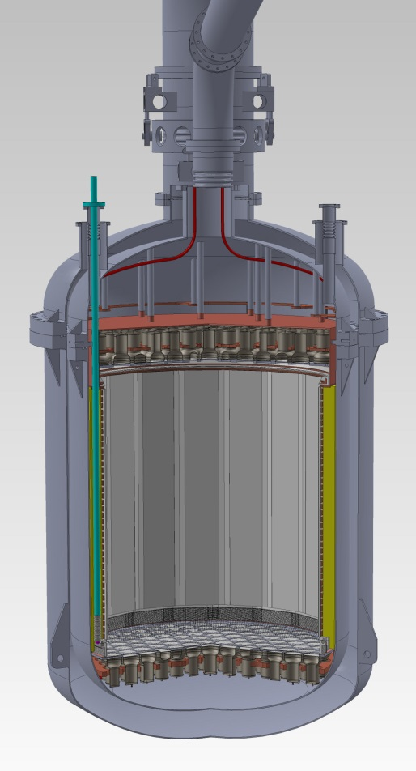
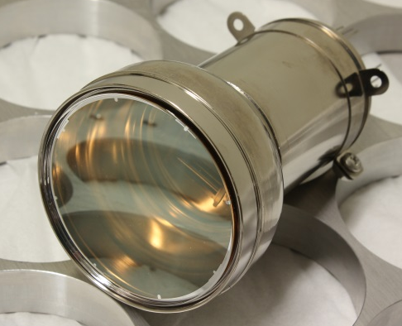
Quick reminder about XENON1T
1m
1T LXe fiducial
~250 3” PMTs R11410-21
Fully funded project

Slide 4
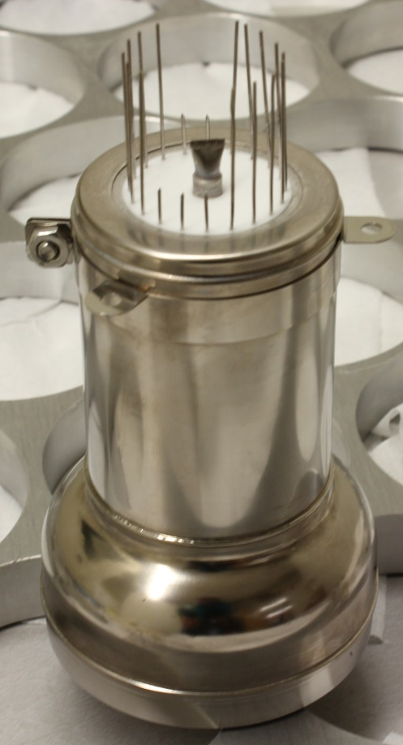
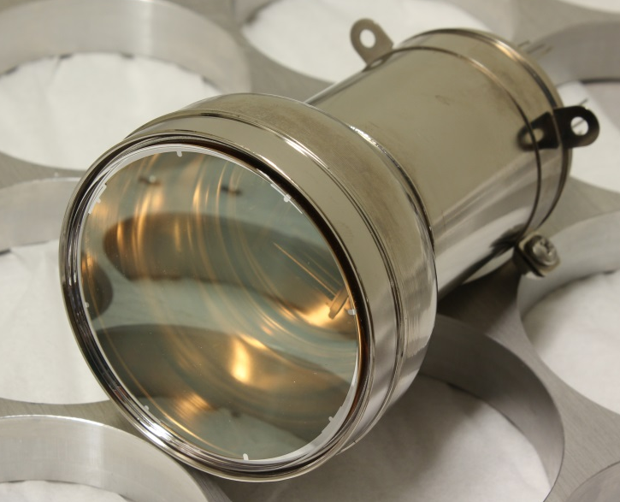
R11410 PMTs
Developed by Hamamatsu & XENON collaboration
123mm
Ø76mm
Head-on type
Linear-Focused
12 Dynodes
SS/Kovar Enclosure

Slide 5
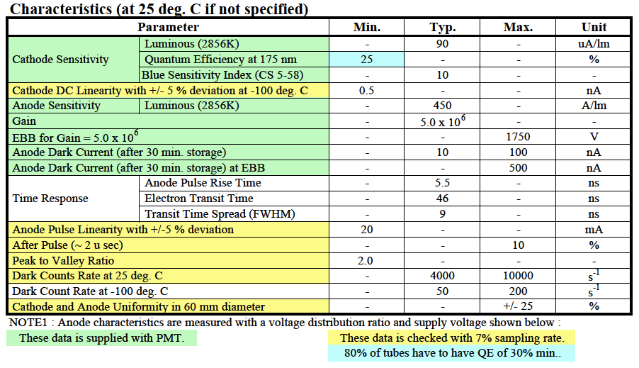
R11410-21 Specs by Hamamatsu
Out of spec PMTs will be replaced at no cost

Slide 6
R11410-21 Ordering and Pricing
Hamamatsu recommends the default specs of QE Min. of 25%.
  Selection of 30% min. costs 10% more.
  For 25% Min., Hamamatsu guarantees >80% PMT with QE > 30%.
  Hamamatsu has agreed to measure QE for all the PMTs
Purchase orders has been placed from 3 places:
  Columbia (NSF) 150
  MPIK 90 (partially in 2013)
  Zurich 75
New R11410-21 will have lower radioactivity
  Purer/softer Aluminum
  Cobalt-free Kovar metal
  Cleaner fused silica for the dynodes’ support
25% QE min. --> 519,000 Yen / 80 = $6,488
30% QE min. --> 573,000 Yen / 80 = $7,163

Slide 7

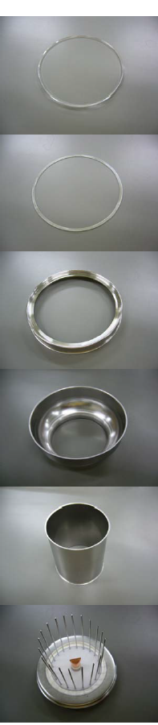
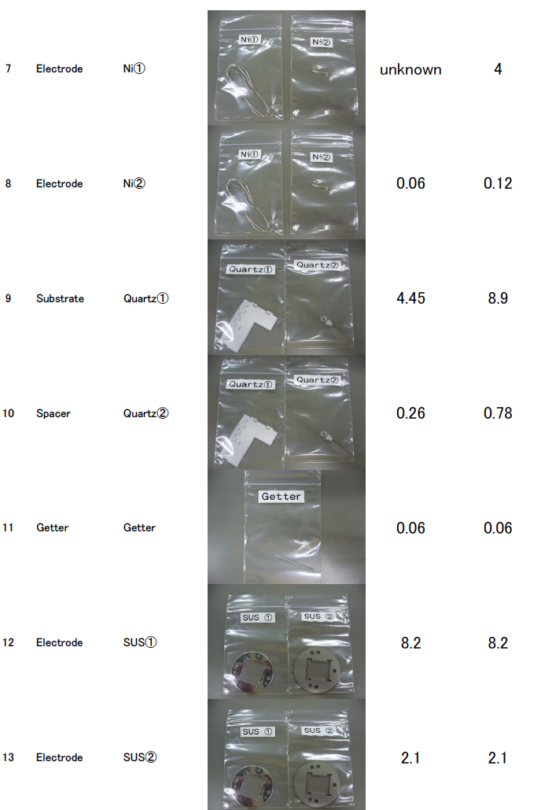
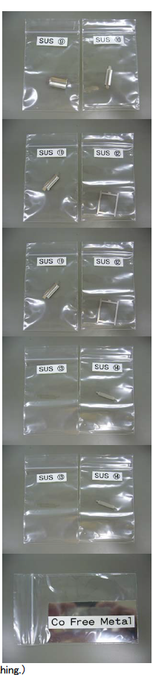
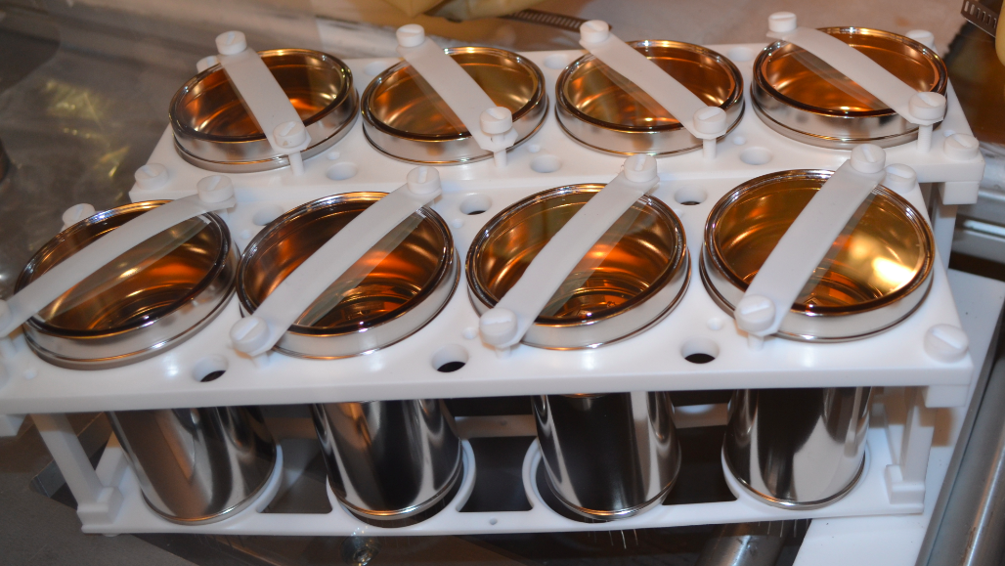
R11410-21 Screening
Raw Materials
GDMS, Ge
Ge

Slide 8
R11410-21 Screening: GDMS
Sample No. | Material | Weight in PMT | Th |  |  | U |  |  | K
 |  | g |  | ppb | mBq /PMT |  | ppb | mBq /PMT |  | ppb | mBq /PMT
1 | Quartz Face Plate | 30 | < | 5.00 | 0.627 | < | 5.00 | 1.825 | < | 100 | 0.093
2 | Al | 0.6 | < | 0.10 | 0.0003 |  | 0.20 | 0.0015 | < | 10 | 0.0002
3 | FeNi Alloy | 78 | < | 0.10 | 0.033 | < | 0.10 | 0.095 |  | 40 | 0.097
4 | Stainless Steel (Disk) | 8.2 |  | 0.20 | 0.007 |  | 0.50 | 0.050 |  | 70 | 0.018
5 | Stainless Steel (Dynode) | 7.2 | < | 0.50 | 0.015 |  | 2.00 | 0.175 |  | 6 | 0.001
6 | Stainless Steel (Shield) | 4 |  | 1.00 | 0.017 |  | 0.70 | 0.034 |  | 7 | 0.001
7 | Quartz (Dynode Support) | 14.4 | < | 5.00 | 0.301 | < | 5.00 | 0.876 | < | 100 | 0.045
8 | Kovar (flange) | 18 |  | 0.13 | 0.0098 |  | 0.20 | 0.0438 |  | 6 | 0.0033
9 | Ceramic (stem) NEW | 16 |  | 3.00 | 0.201 |  | 5.00 | 0.974 |  | 1300 | 0.644
9' | Sapphire | 16 | < | 1.00 | 0.067 | < | 1.00 | 0.195 |  | 500 | 0.248
10 | Kovar (stem) | 14 |  | 0.13 | 0.008 |  | 0.20 | 0.034 |  | 6 | 0.003
PRELIMINARY
Total:
Th-232: <1.21mBq/PMT; U-238: <4.1mBq/PMT; K-40: <0.9mBq/PMT
Total (Sapphire Stem):
Th-232: <1.1mBq/PMT; U-238: <3.3mBq/PMT; K-40: <0.51mBq/PMT

Slide 9
R11410-21 Screening:
Low BG Ge (GATOR,GeMPI)
Sample No. | Material | Weight in PMT | U-238 | Ra-226 | Th-232 | Th-228 | U-235 | K-40 | Co-60
 |  | g | mBq /PMT | mBq /PMT | mBq /PMT | mBq /PMT | mBq /PMT | mBq /PMT | mBq /PMT
1 | Quartz Face Plate | 30 | <1.7 | <0.048 | <0.072 | 0.039 ±0.02 | <0.063 | <0.3 | <0.0066
2 | Al | 0.6 | <0.028 | <0.00072 | <0.00066 | 0.0066 ±0.0003 | <0.00055 | <0.0057 | <0.00012
3 | FeNi Alloy | 78 | <9.2 | <0.26 | <0.36 | <0.34 | <0.17 | <0.99 | 0.07 ±0.02
4 | Stainless Steel (Disk) | 8.2 | <0.9 | <0.025 | <0.043 | <0.033 | <0.019 | <0.064 | 0.072 ±0.006
5 | Stainless Steel (Dynode) | 7.2 | <0.53 | 0.027 ±0.006 | <0.0094 | <0.0094 | <0.011 | 0.06 ±0.03 | 0.006 ±0.003
6 | Stainless Steel (Shield) | 4 | <0.37 | 0.013 ±0.002 | 0.008 ±0.004 | 0.008 ±0.004 | <0.052 | <0.032 | 0.0024 ±0.0012
7 | Quartz (Dynode Support) | 14.4 | <1.2 | <0.025 | <0.023 | <0.013 | <0.022 | <0.13 | <0.004
8 | Kovar (flange) | 18 | <3.1 | 0.16 ±0.04 | <0.07 | <0.067 | <0.1 | 0.3 ±0.1 | 0.85 ±0.07
9 | Ceramic (stem) NEW | 16 | 2.4±0.4 | 0.26 ±0.02 | 0.23 ±0.03 | 0.11 ±0.02 | 0.11 ±0.02 | 1.1 ±0.2 | <0.02
9' | Sapphire | 16
10 | Kovar (stem) | 14 | <0.65 | <0.0082 | <0.031 | <0.0075 | <0.017 | 0.07 ±0.04 | 0.22 ±0.02
PRELIMINARY
Total:
Th-232: <0.85mBq/PMT; U-238: <20mBq/PMT; K-40: <3.05mBq/PMT

Slide 10
R11410-21 Screening: Summary
Screening of 10 R11410-20 PMTs:
Th-232:0.9±0.2mBq/PMT; U-238:<18mBq/PMT; K-40:<12mBq/PMT
GDMS
Th-232:<1.21mBq/PMT; U-238:<4.1mBq/PMT; K-40: <0.9mBq/PMT
Low BG Ge:
Th-232:<0.85mBq/PMT; U-238:<20mBq/PMT; K-40:<3.05mBq/PMT
The latter results in:
0.15 neutrons/year/1T, 0.03 gammas/year/1T

Slide 11
R11410-21 Characterization
QE (room temperature, LXe temperature)
Gain
SPE peak
Linearity
PC Uniformity
Dark Count Rate @ -110C
Afterpulsing Rate
LXe tests

Slide 12
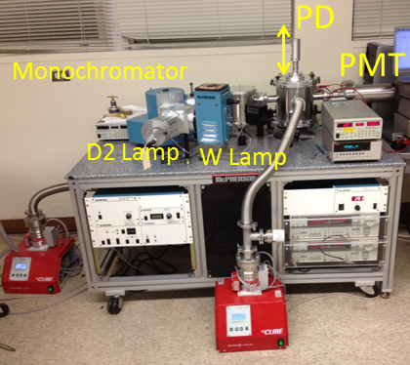
R11410-21 QE measurements
Using VUV monochromator (120nm-800nm)
Room or Cryogenic Temperature

Slide 13
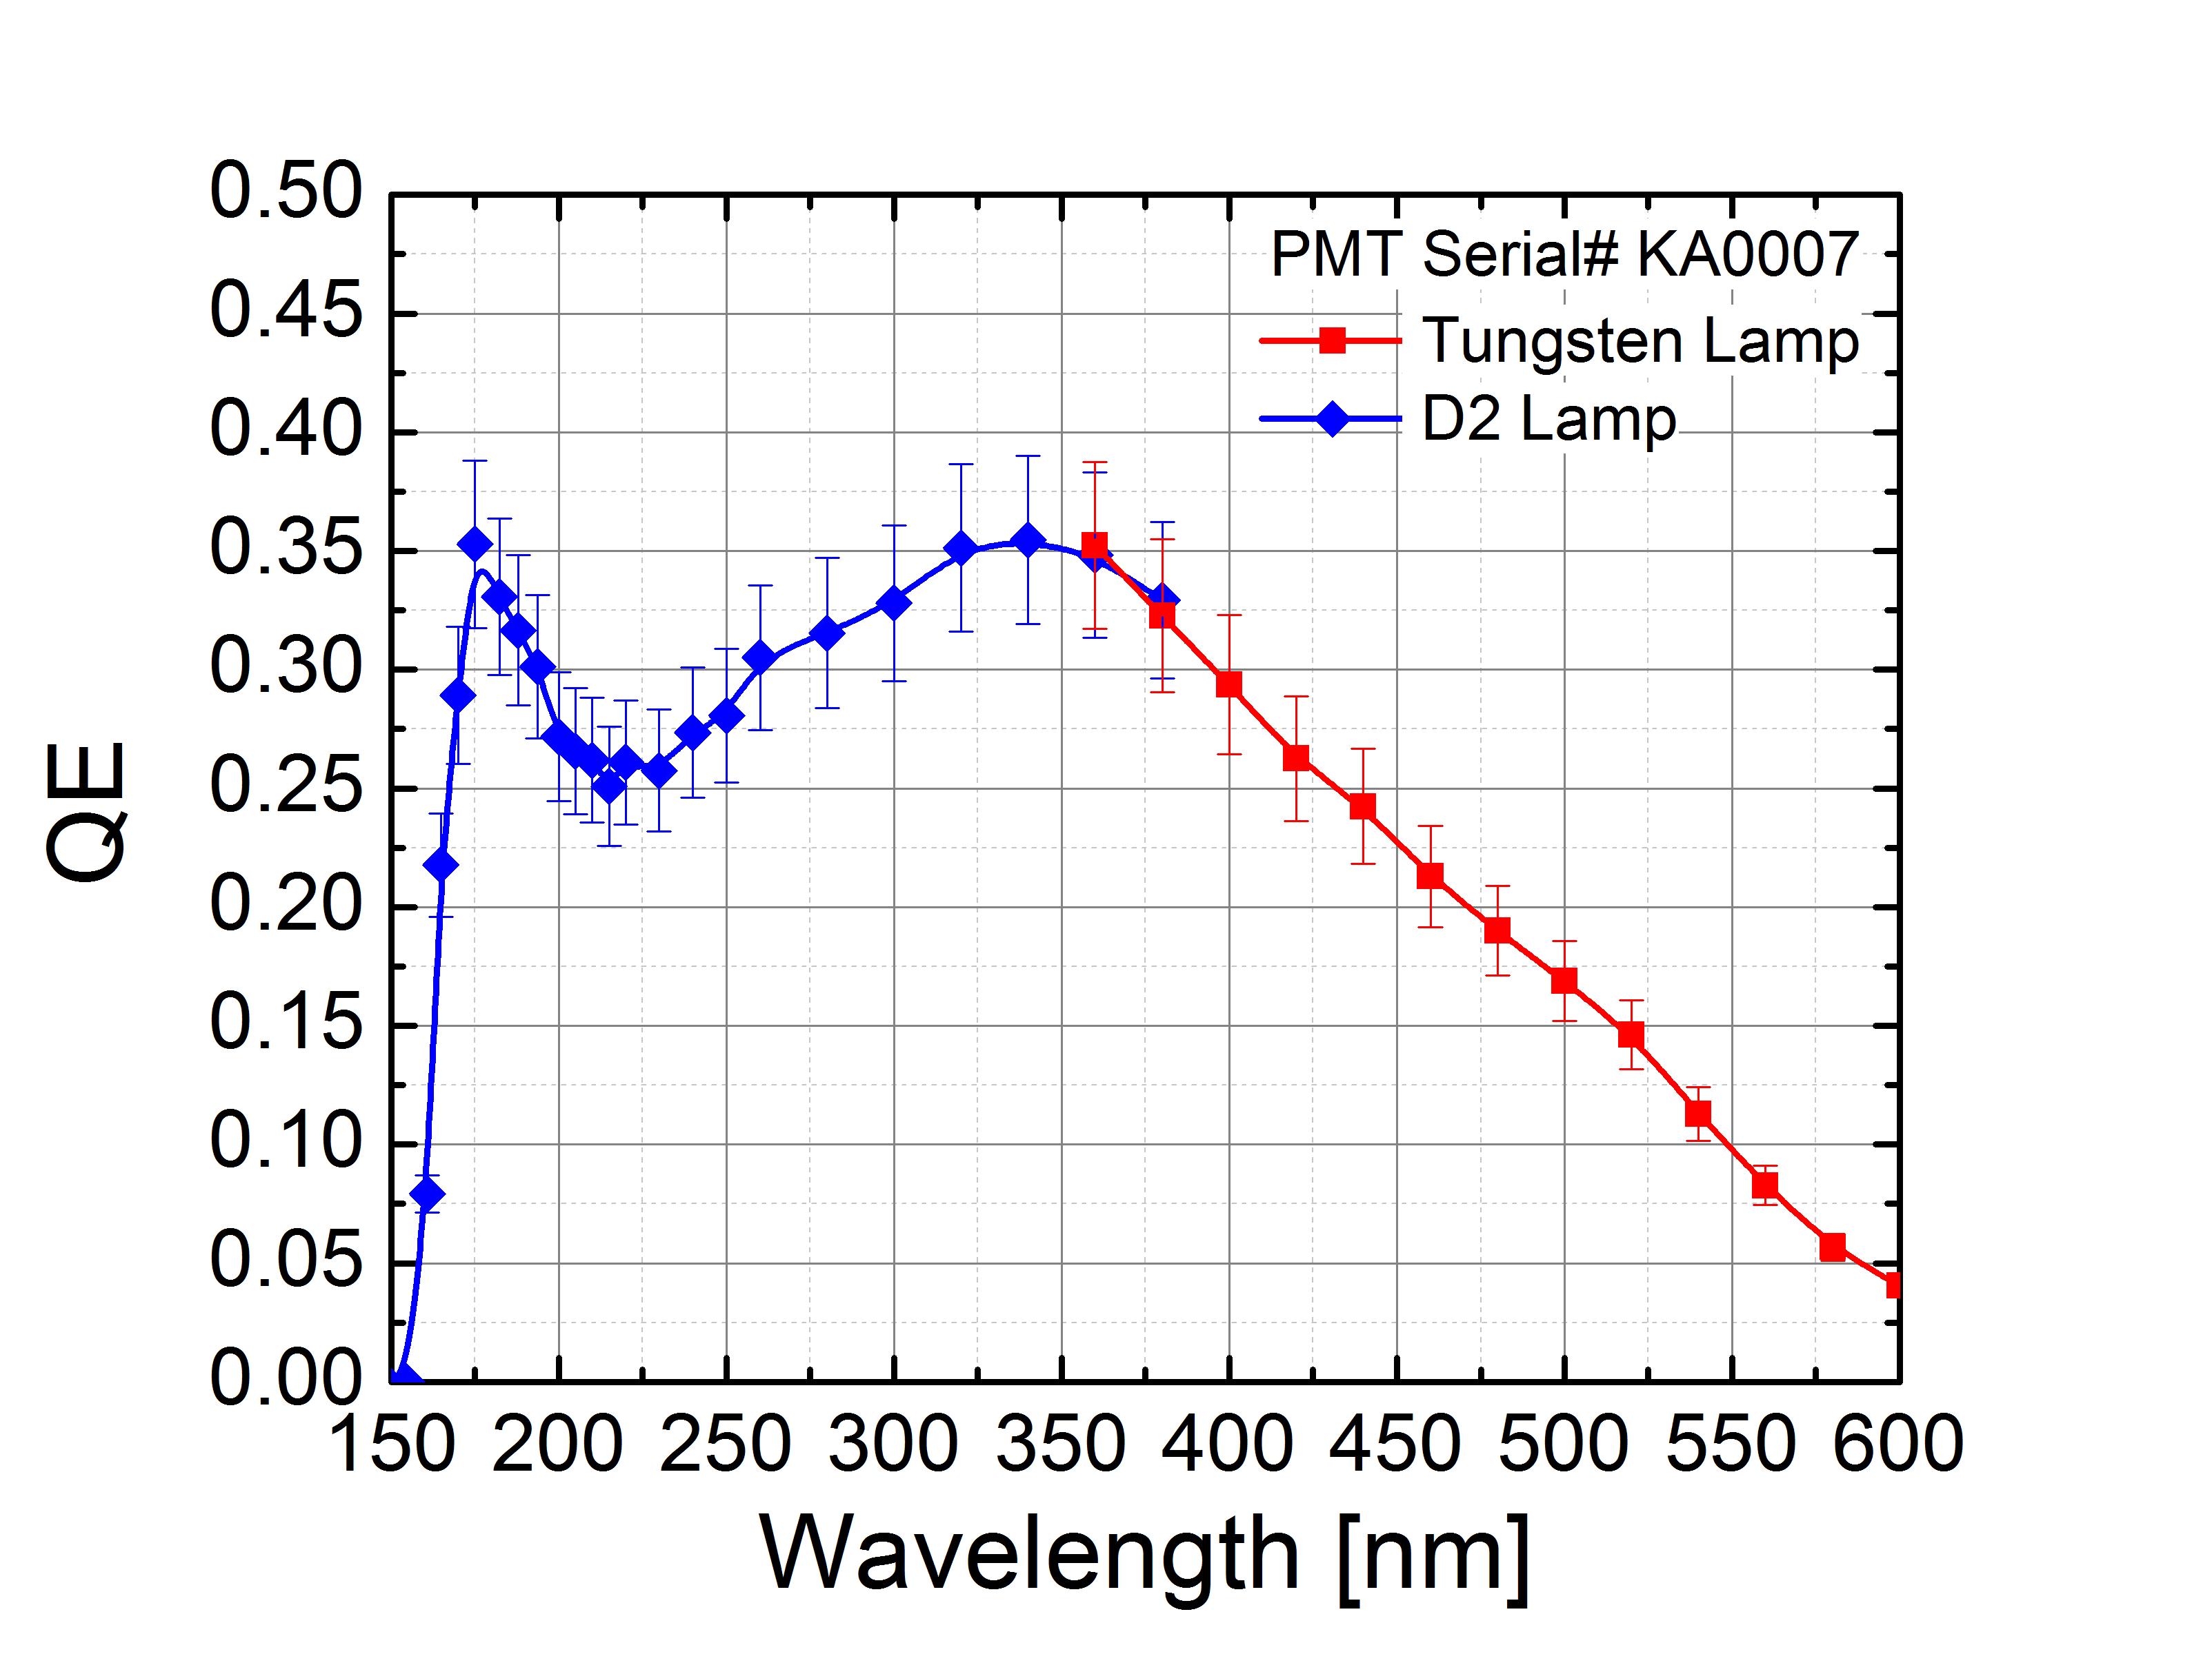
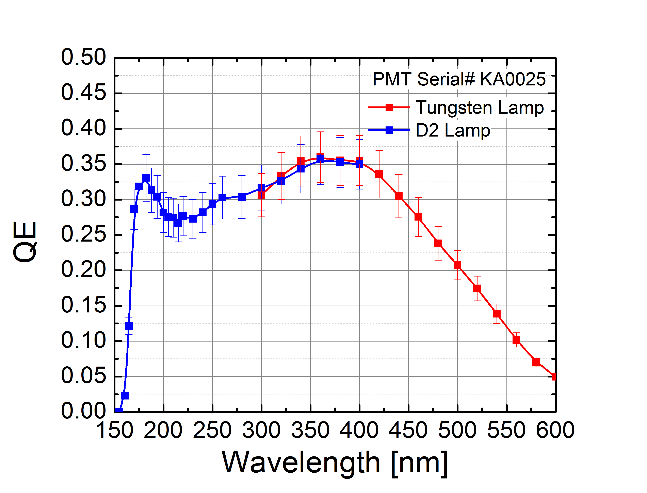
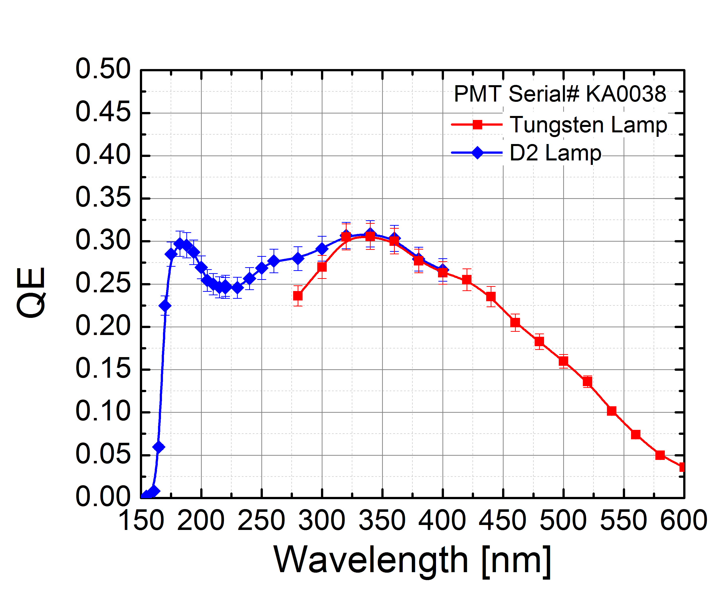
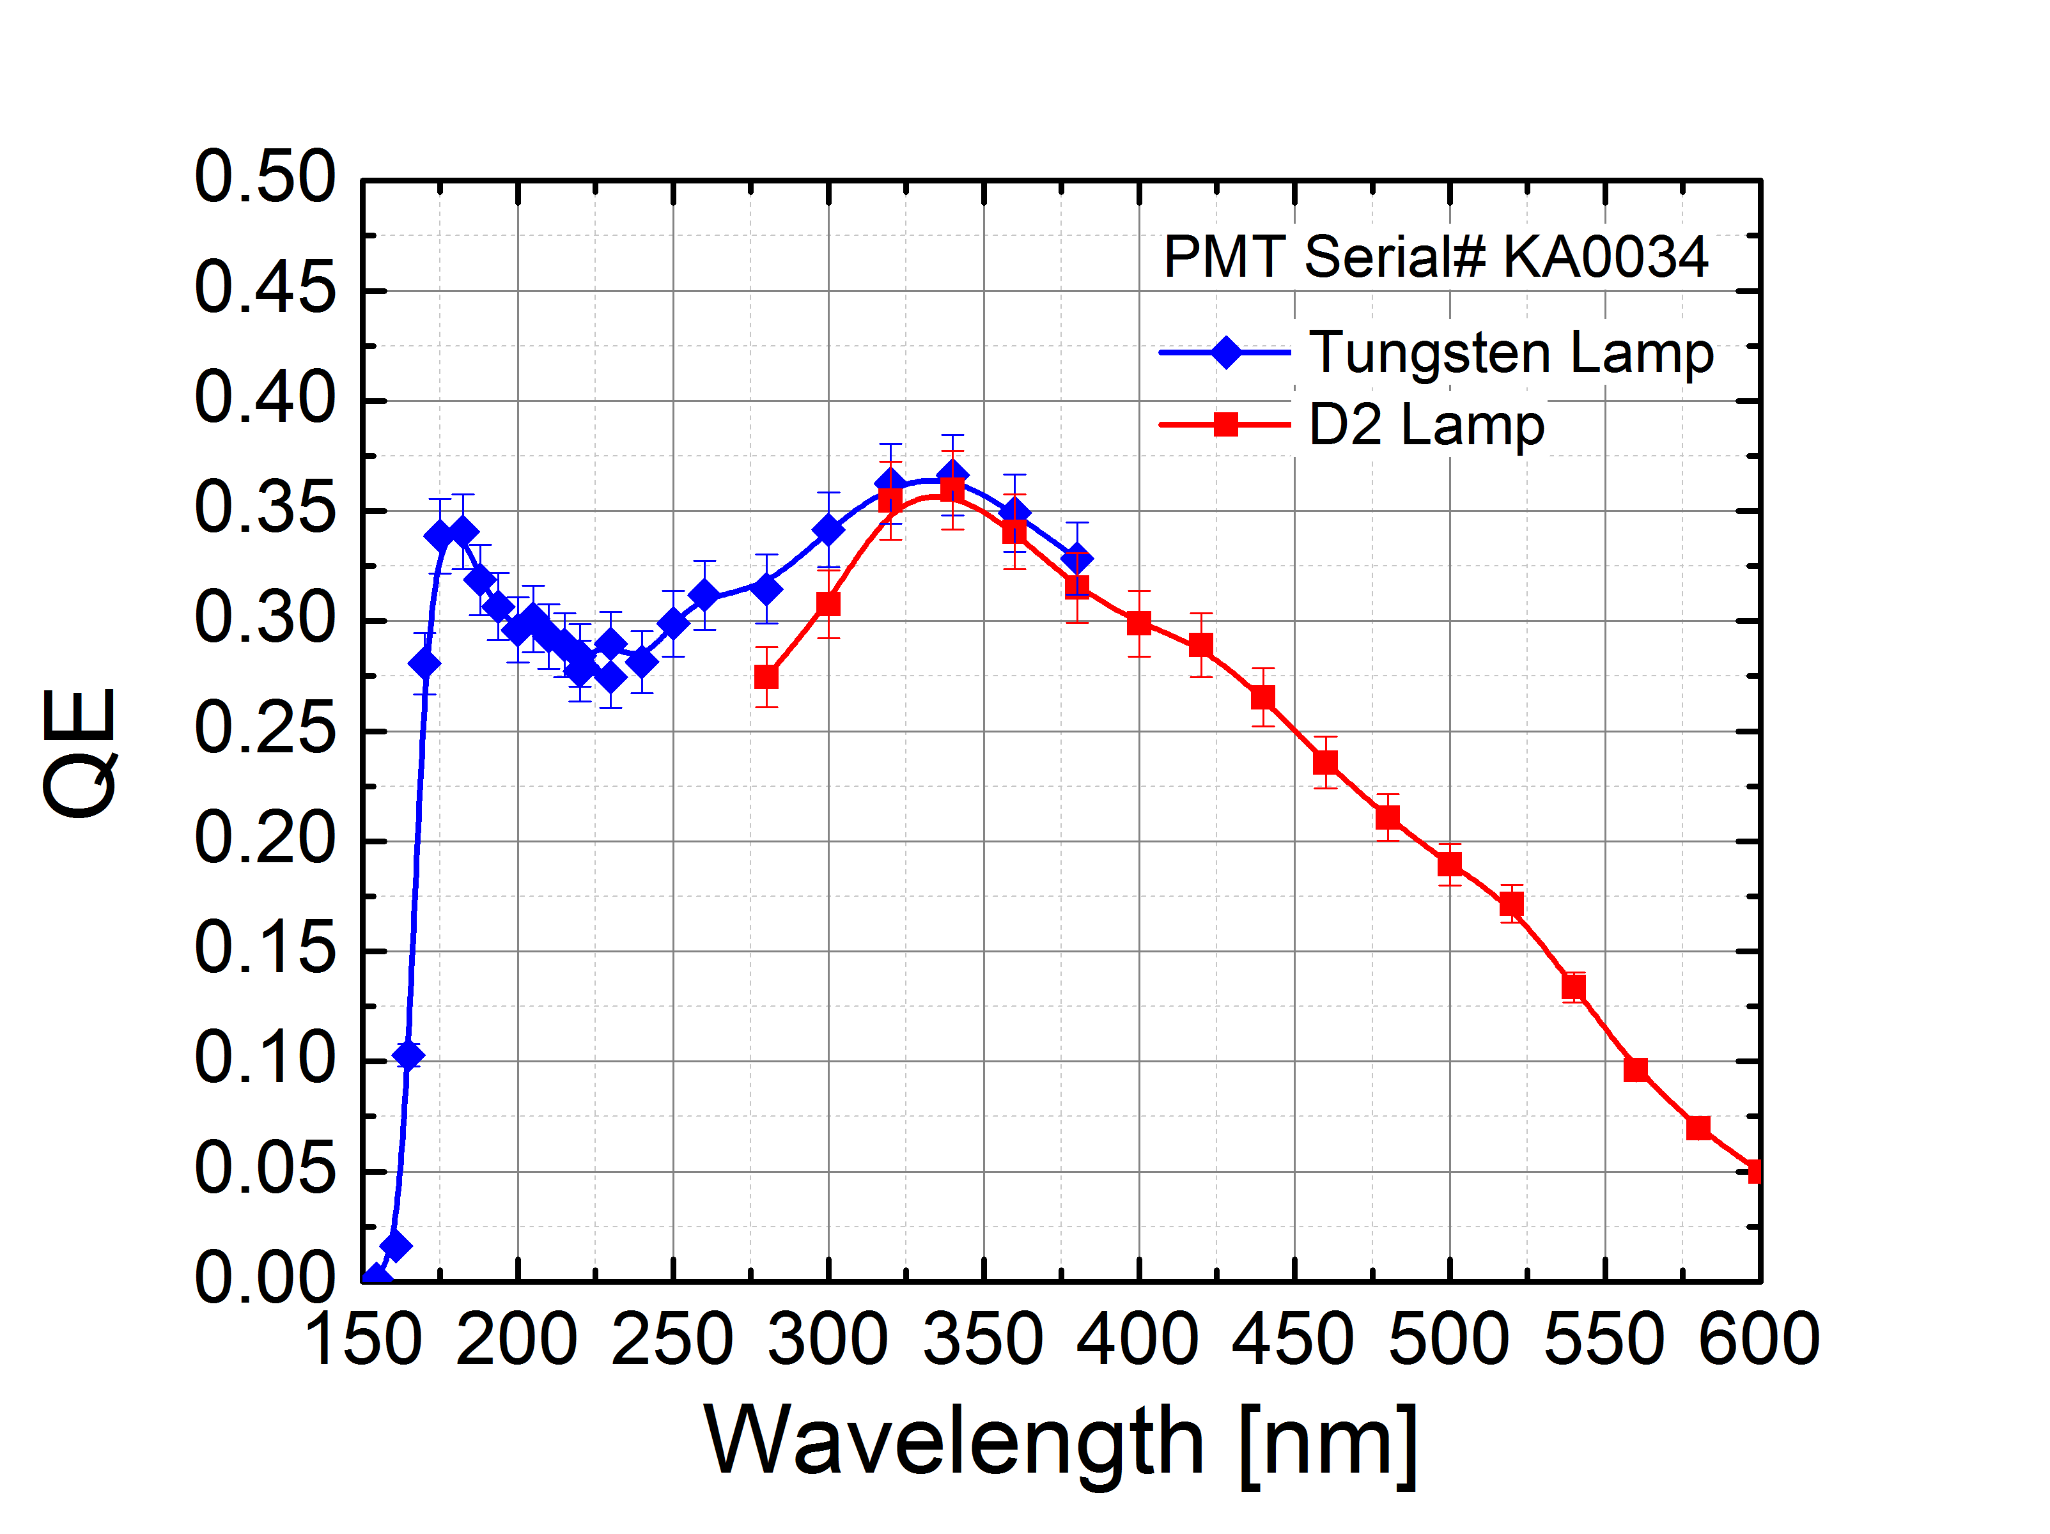
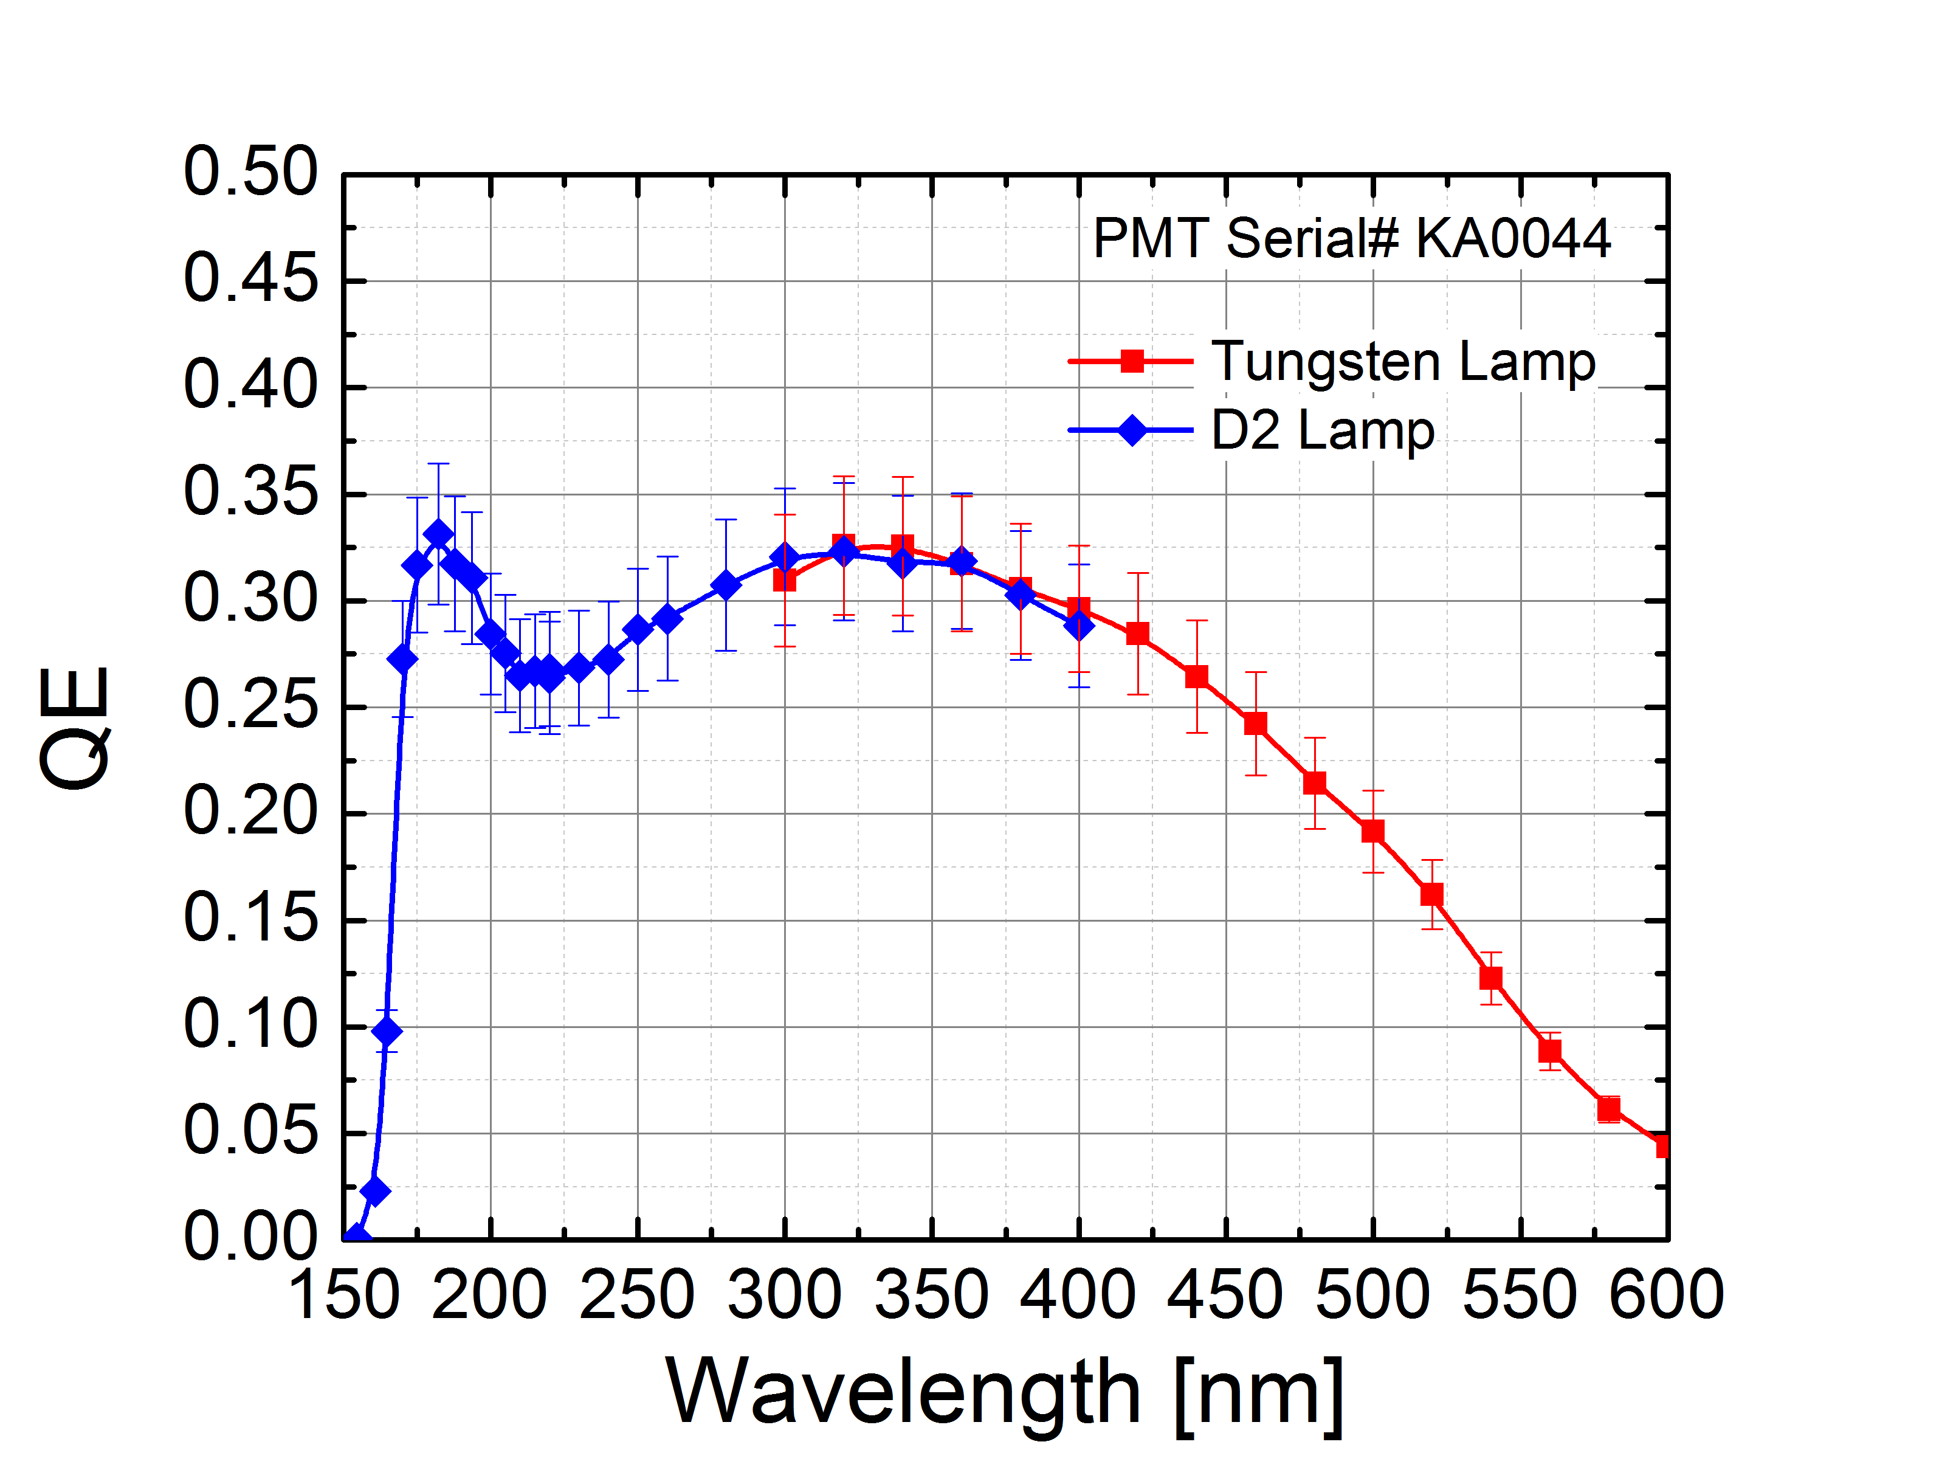
R11410-21 QE measurements: RT
35%@175nm
33%@175nm
30%@175nm
34%@175nm
33%@175nm
QE>30%, matches Hamamatsu measurements

Slide 14
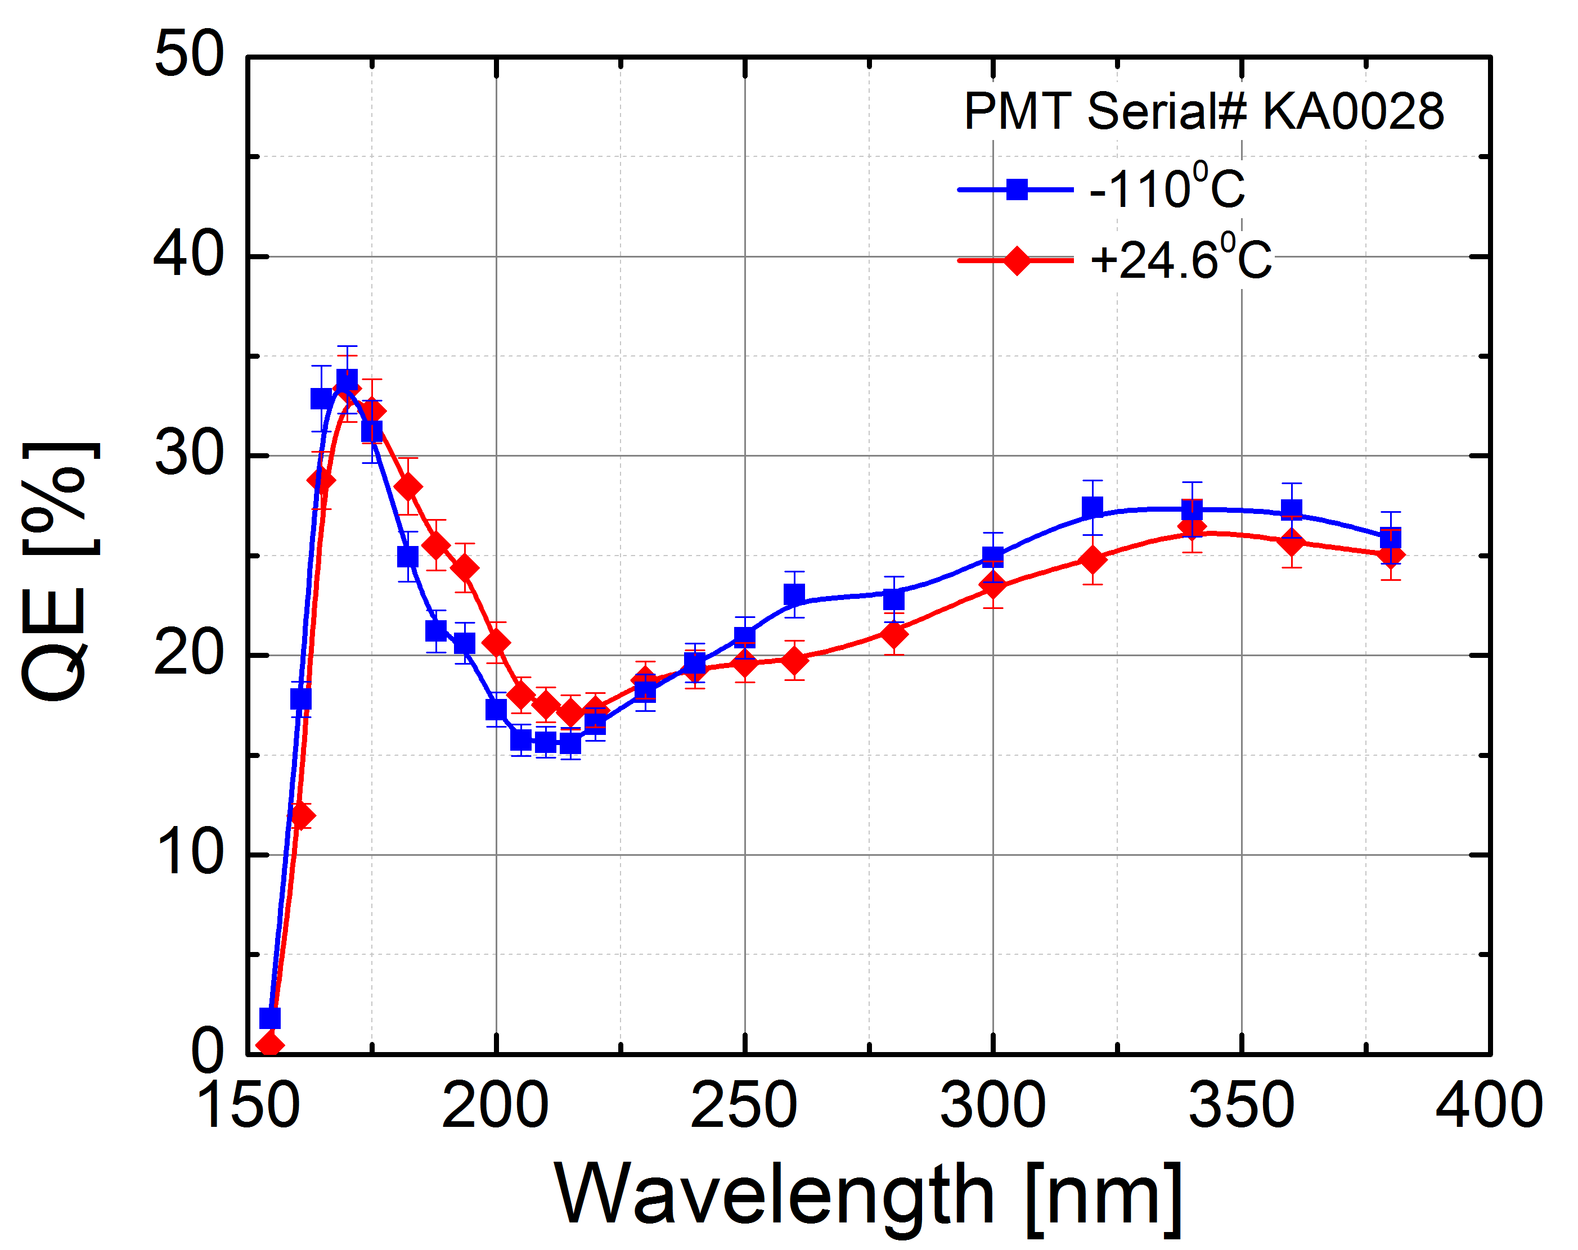
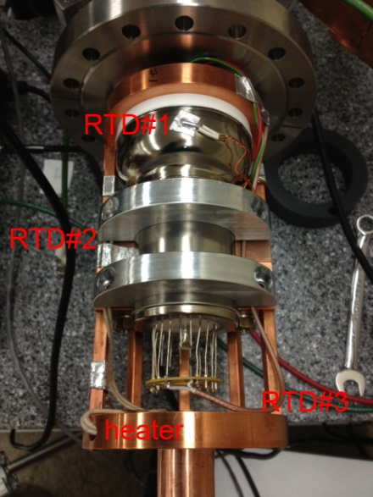
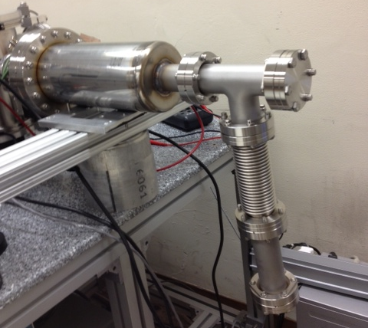
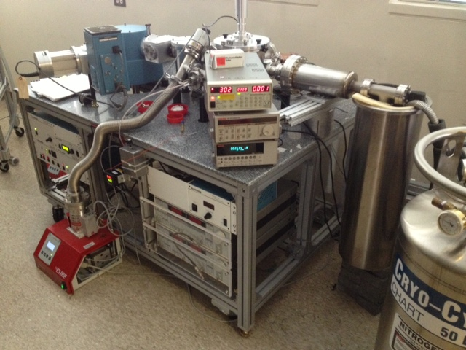
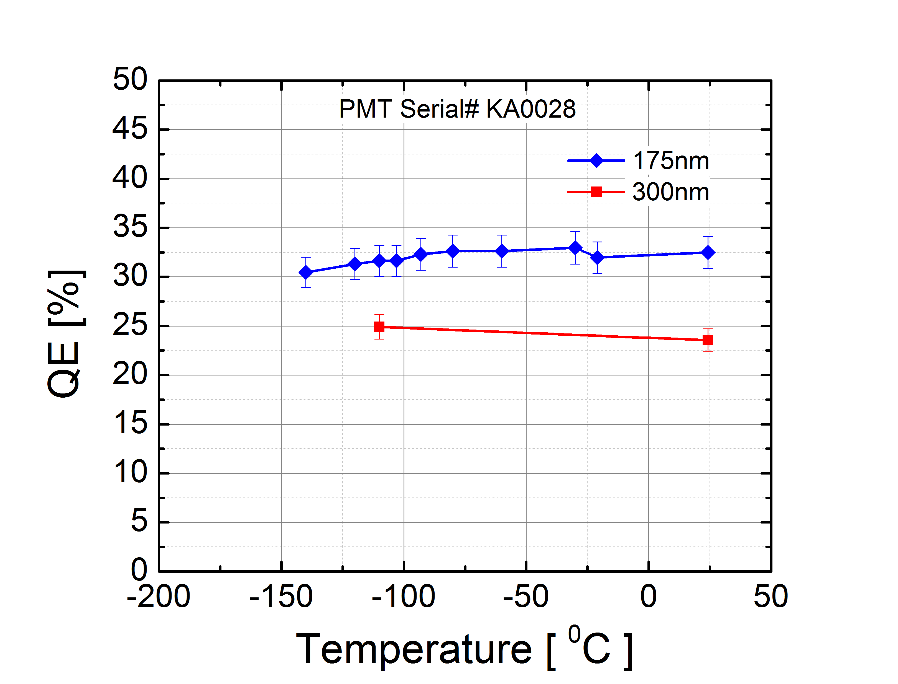
R11410-21 QE measurements: LXe T
PRELIMINARY
At 175nm QE(T)~const

Slide 15
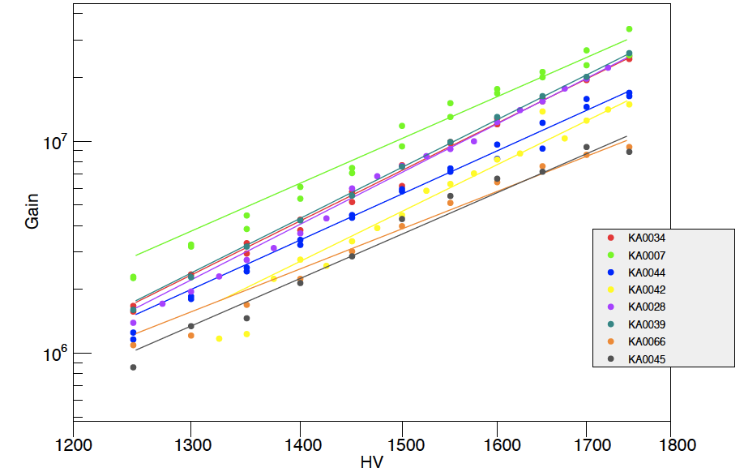
R11410-21 Gain
Gain ~ 10⁷ @ 1700V

Slide 16
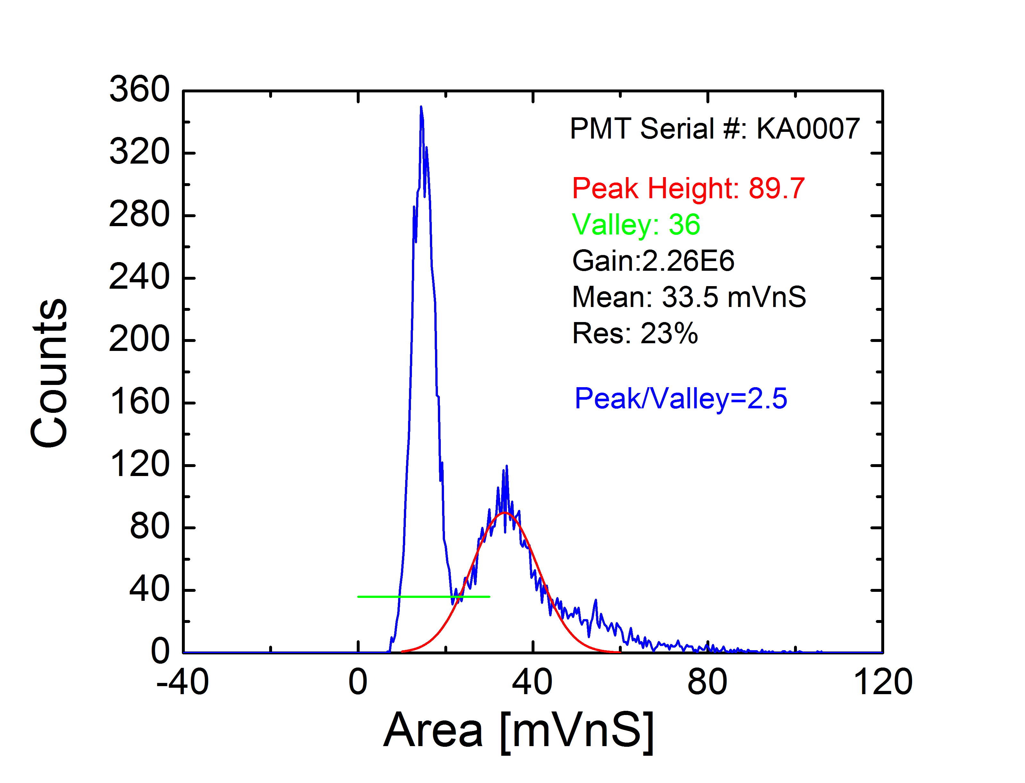
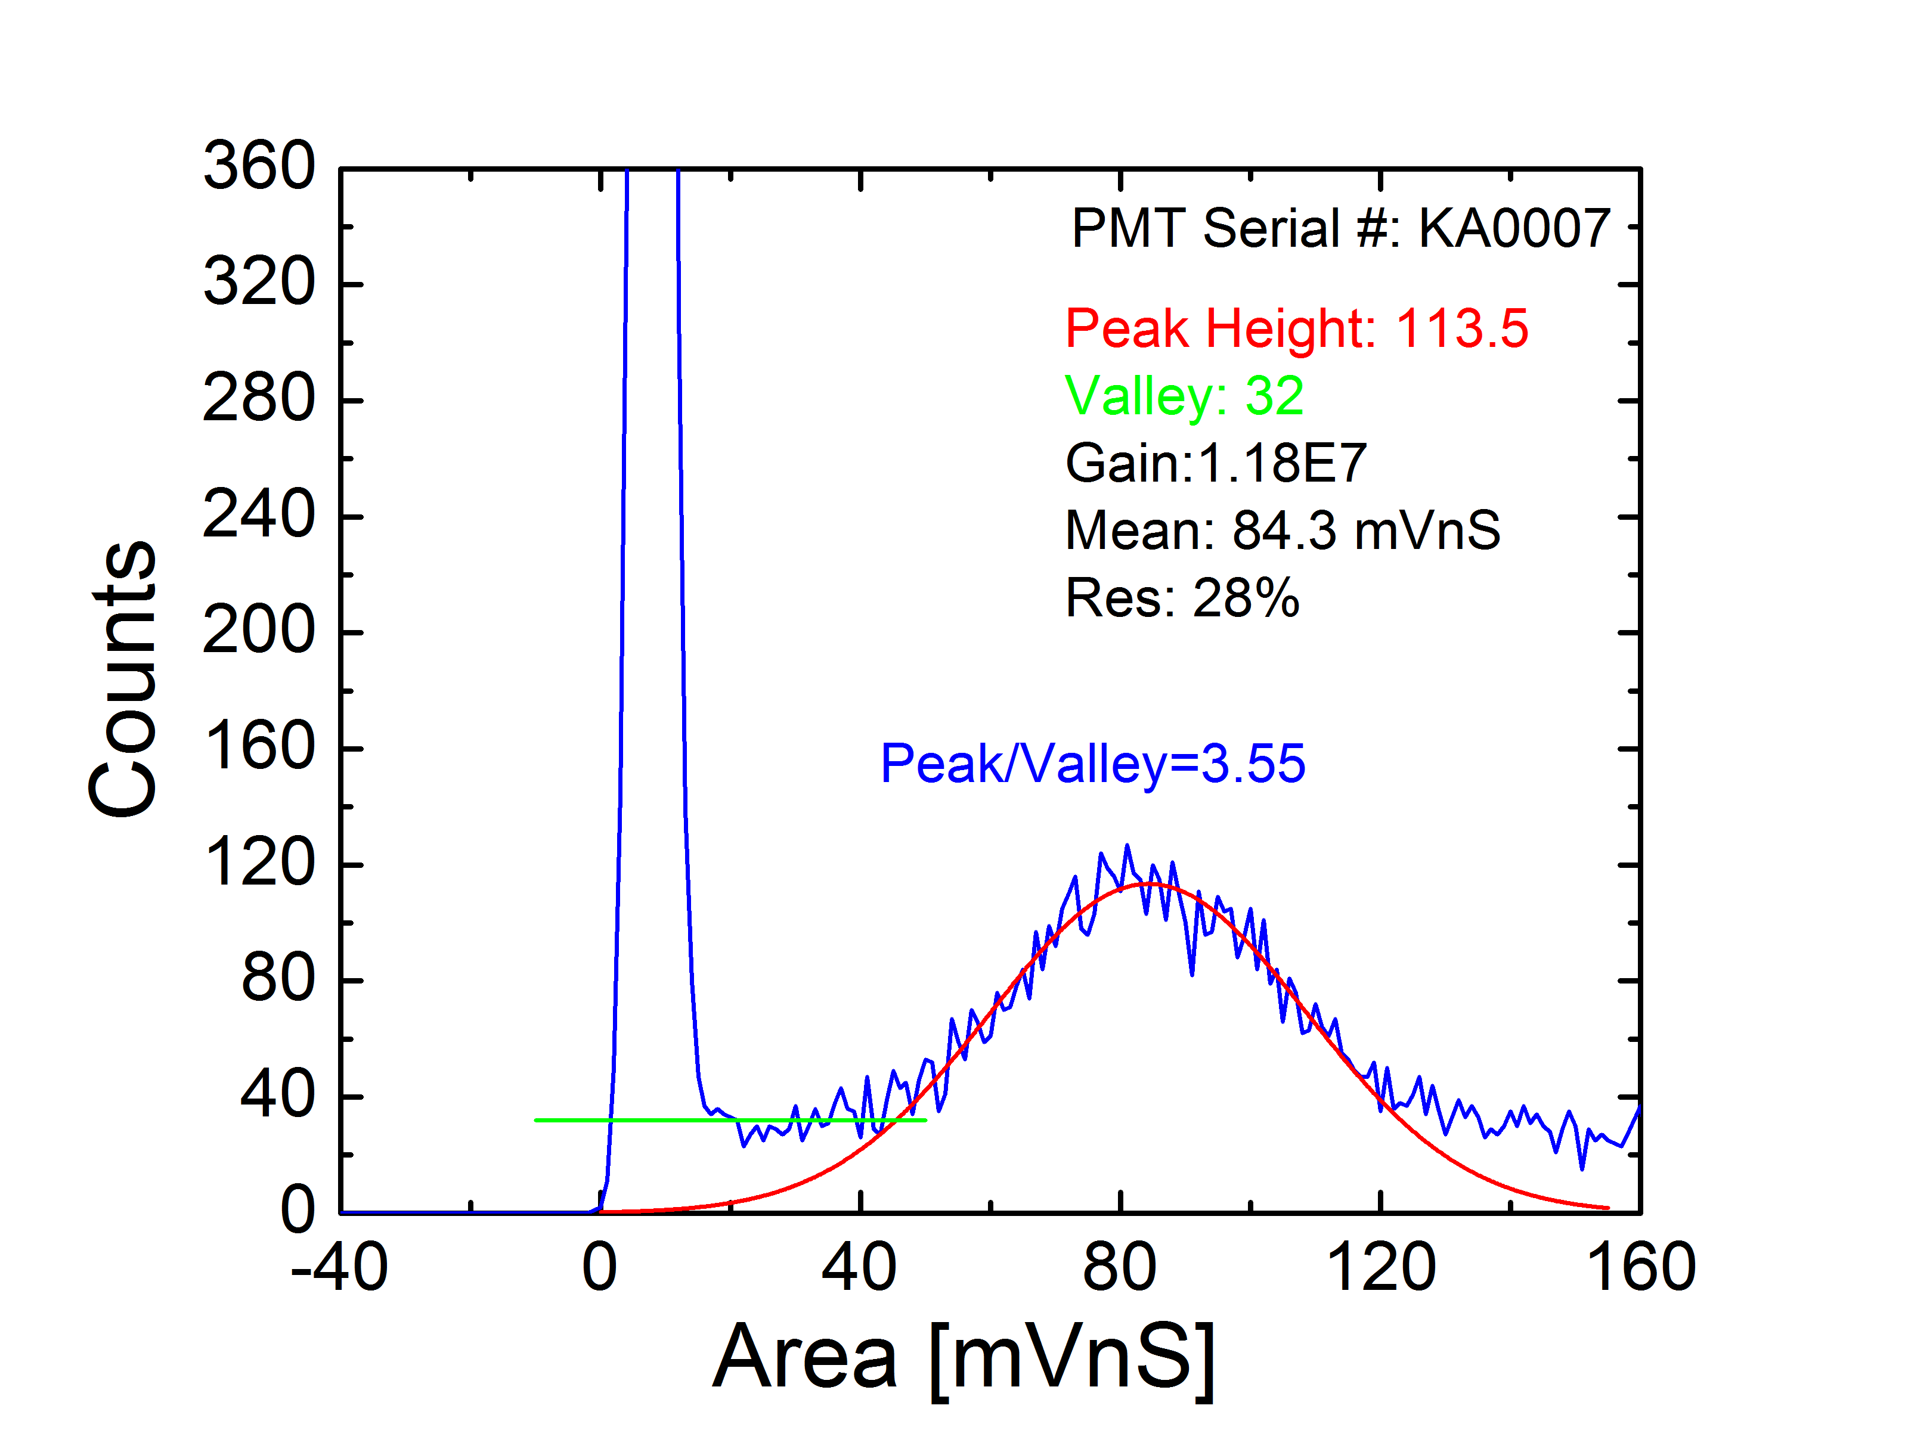
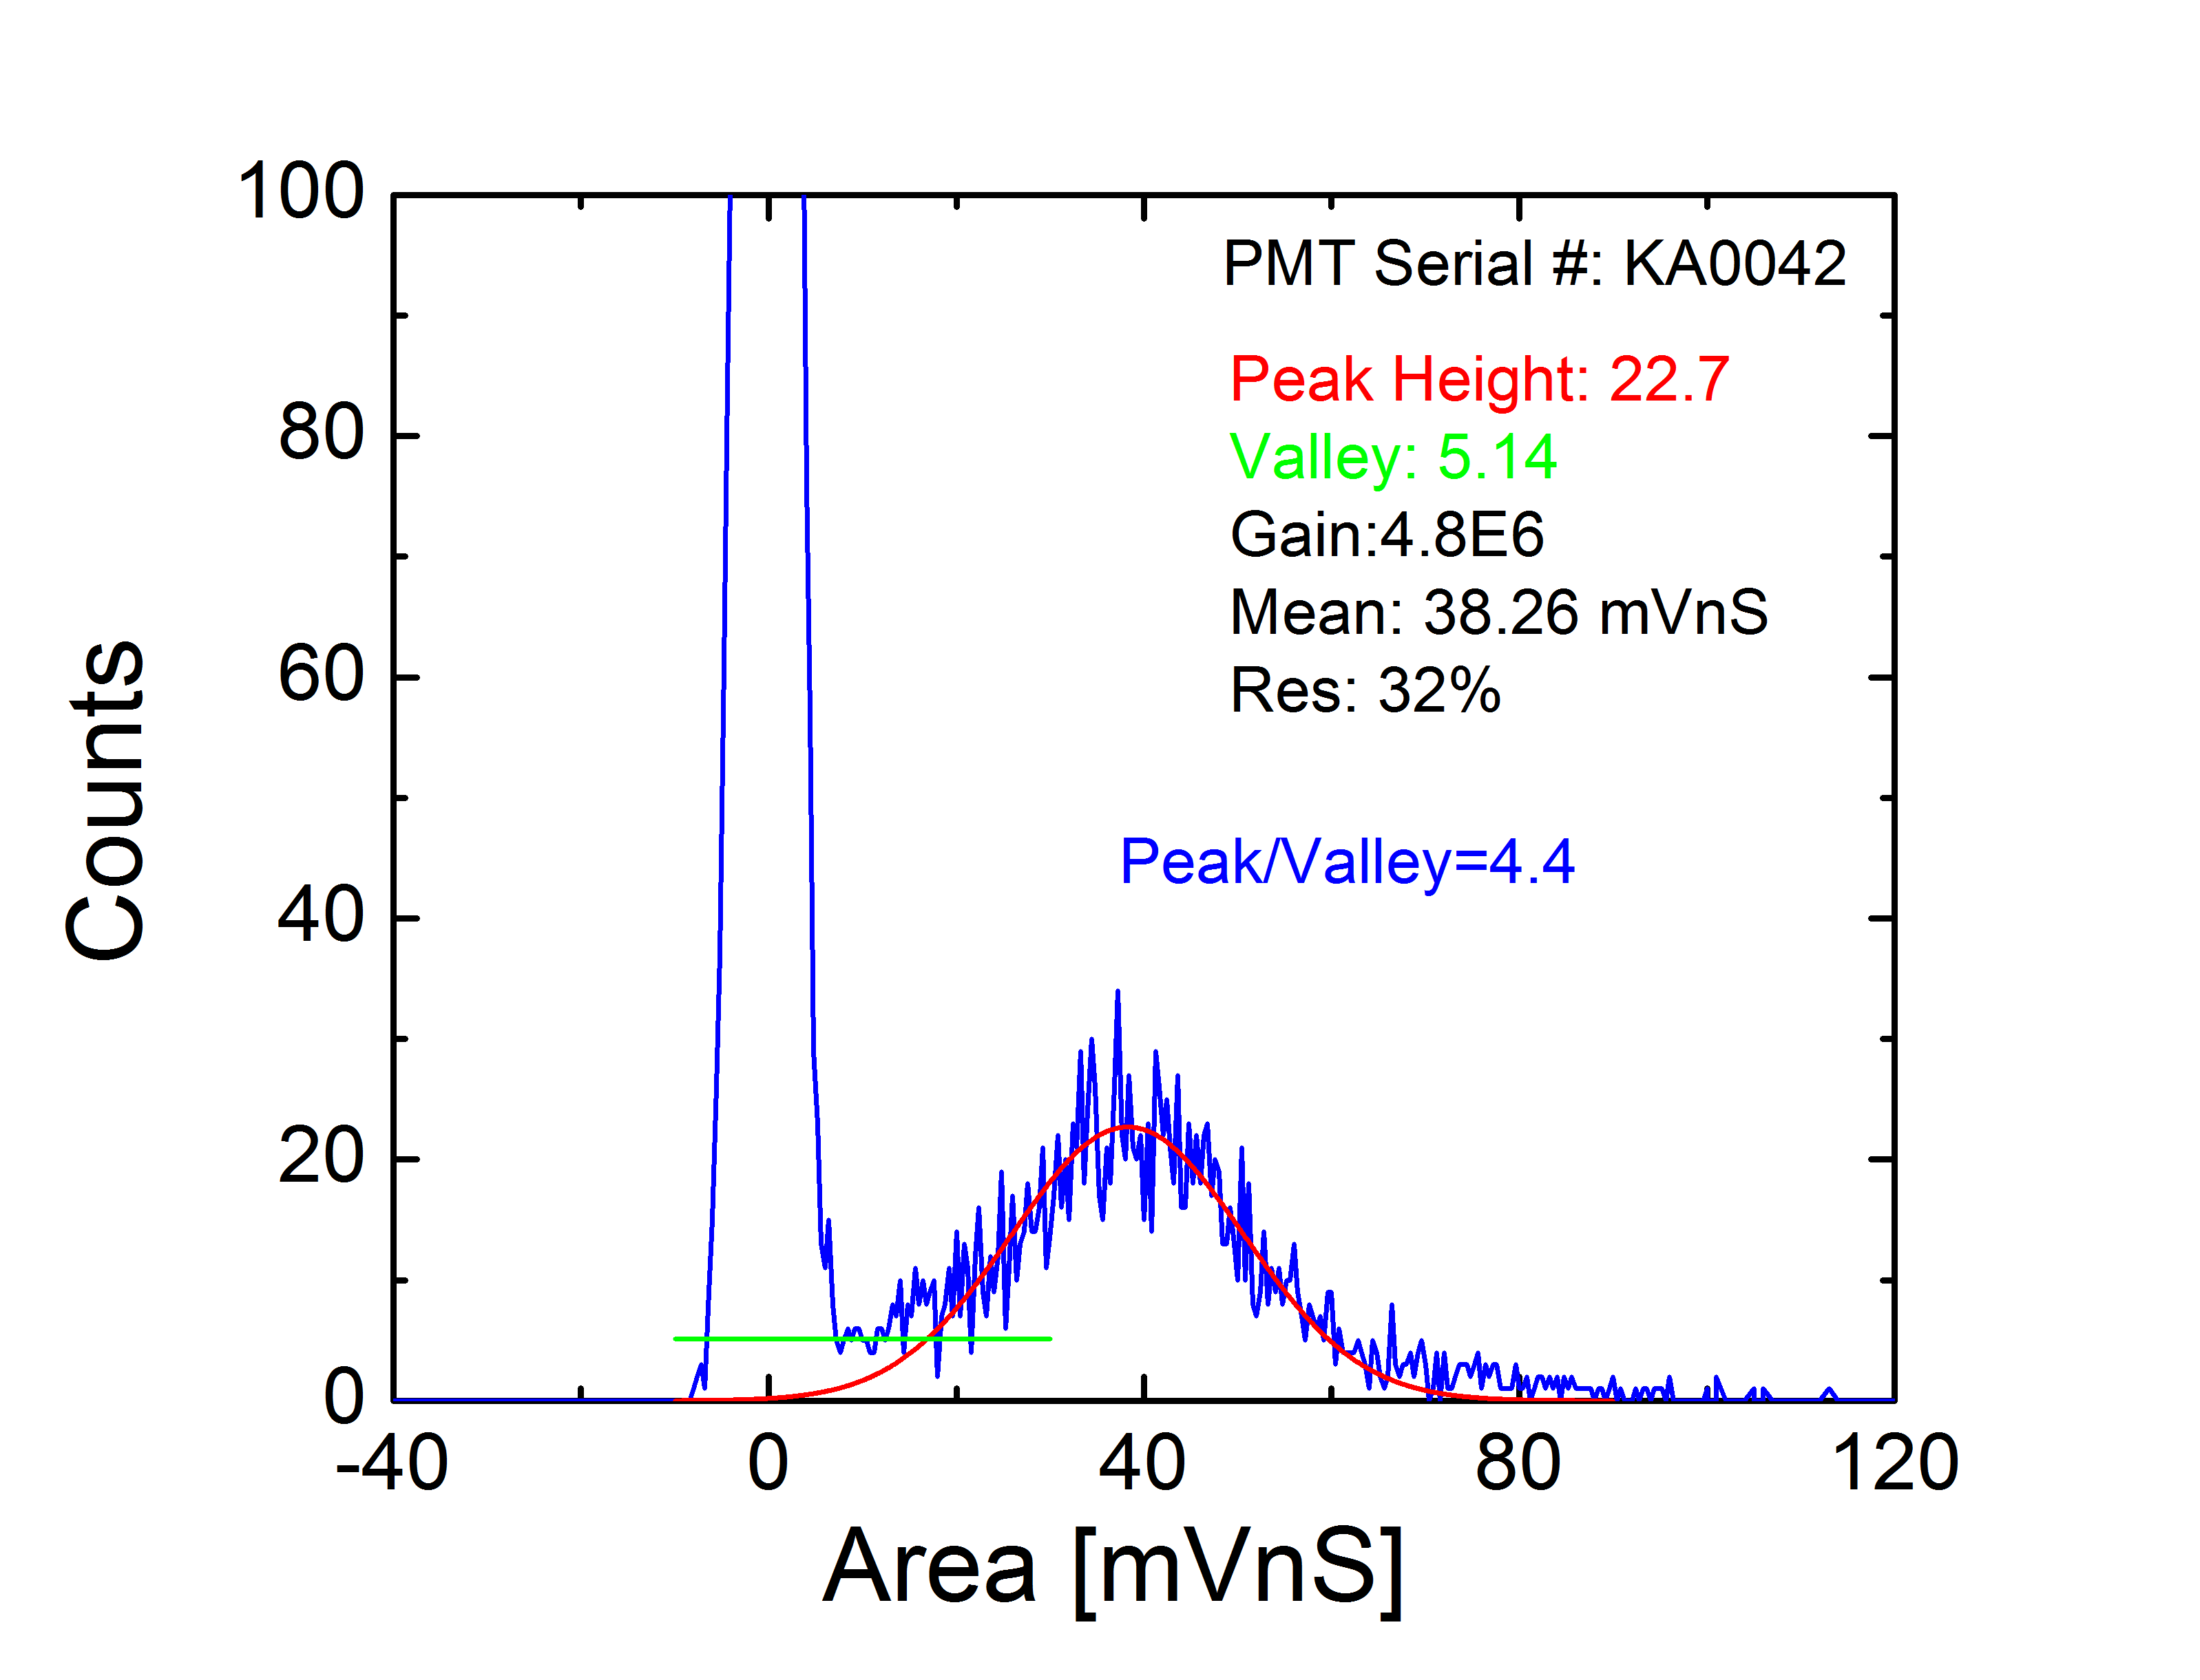
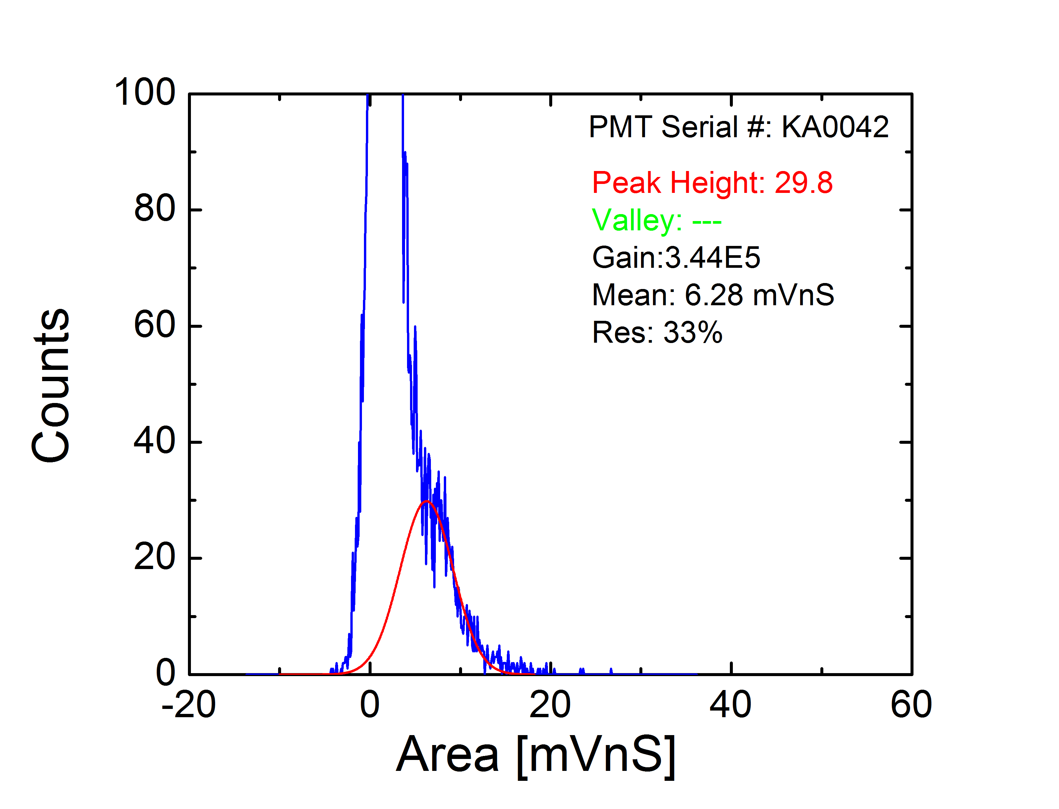
R11410-21 SPE Peak
1250 V
1500 V

Slide 17
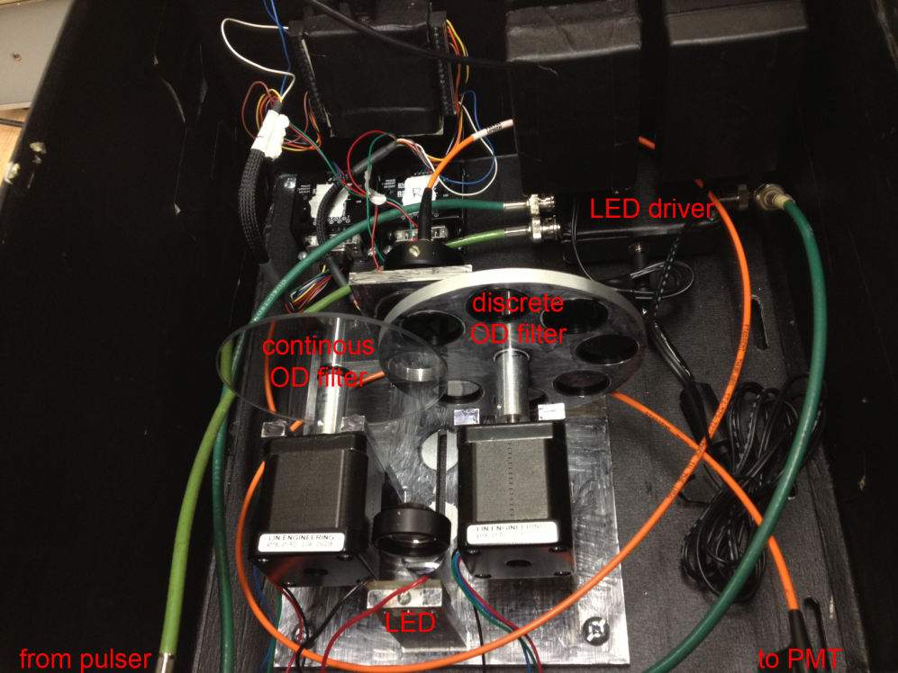
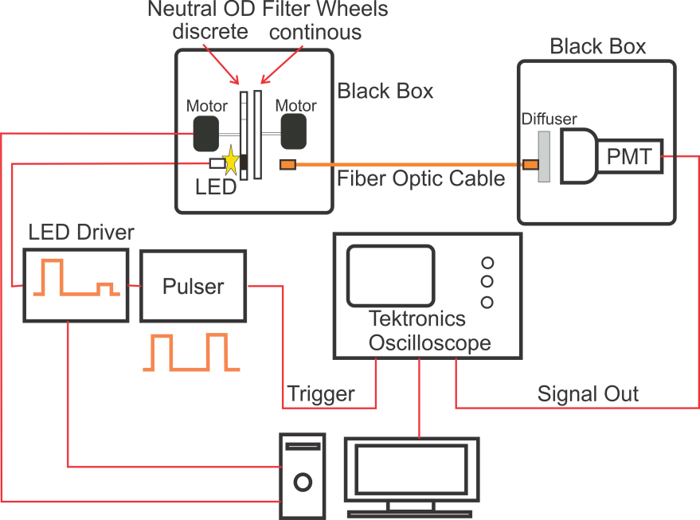
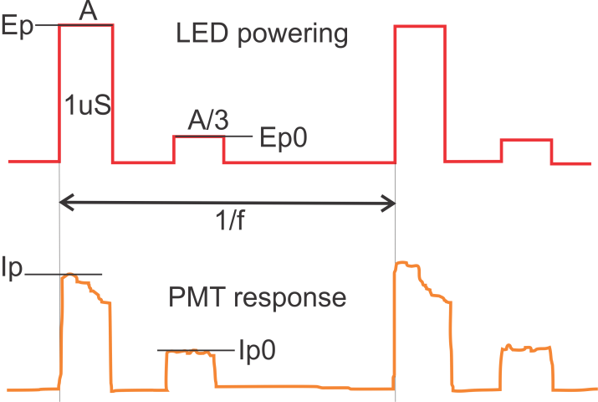
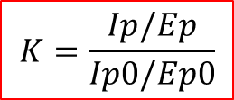
R11410-21 Linearity
Linearity Coefficient
$$K=\frac{Ip/Ep}{Ip0/Ep0}$$
Use of ratios improves systematics

Slide 18
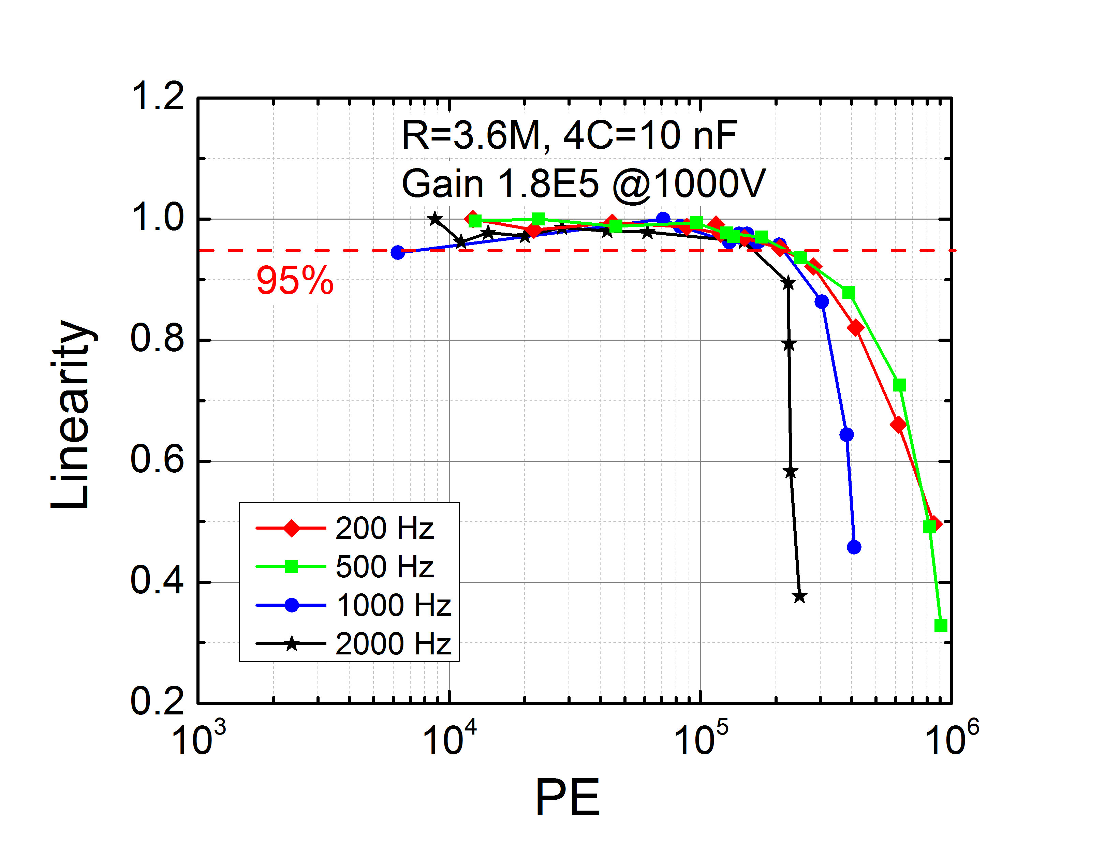
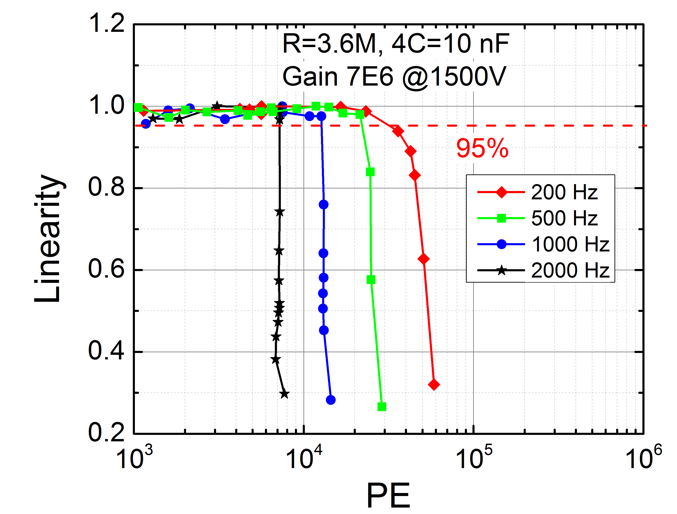
R11410-21 Linearity
High Gain
Low gain
662 keV @ ~250Hz
3MeV @ 2000Hz

Slide 19
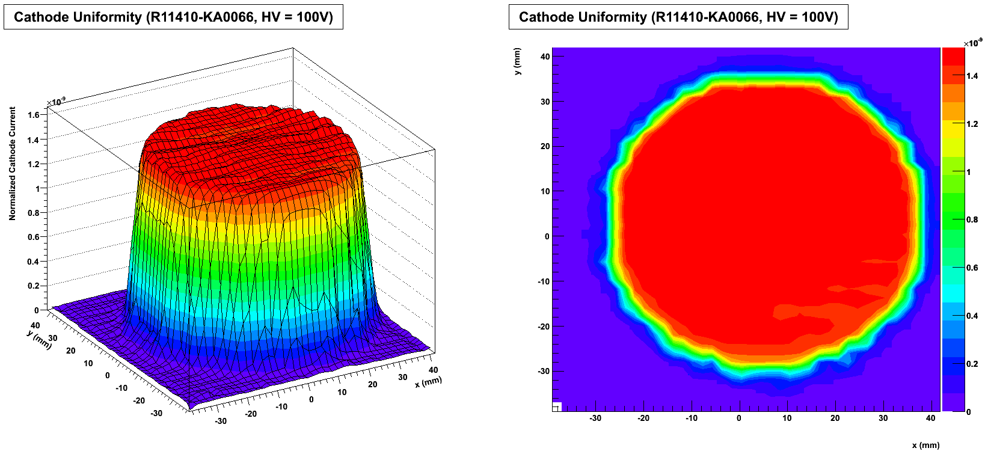
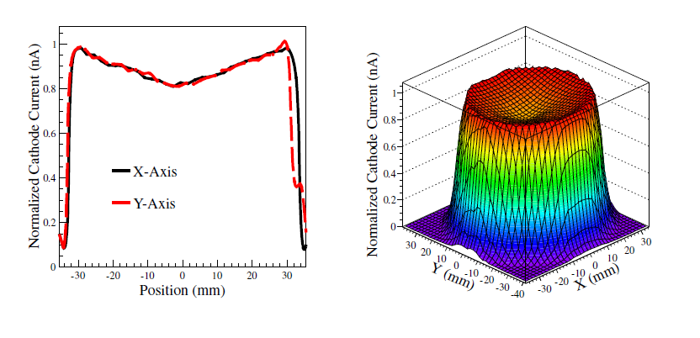
R11410-21 PC Uniformity
Photocathode Linear to ~80%

Slide 20
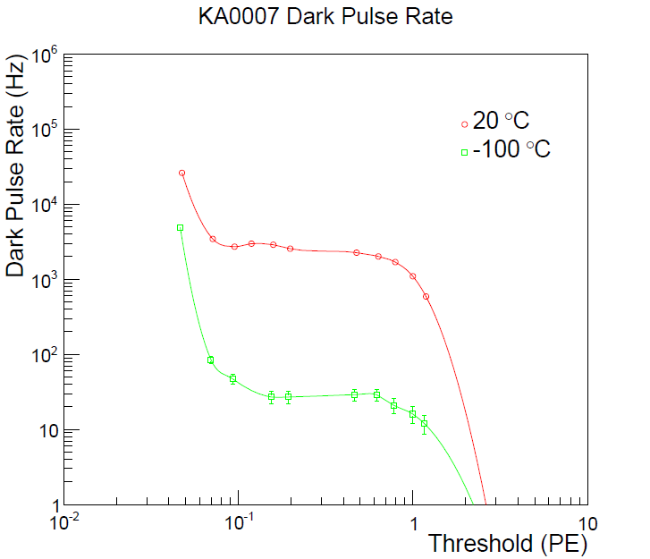
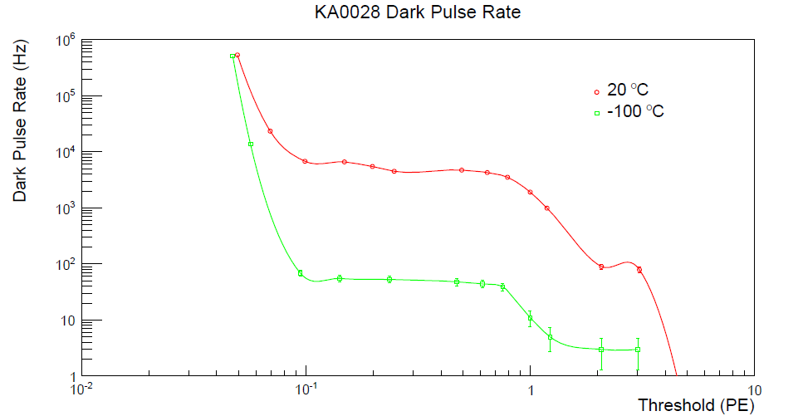
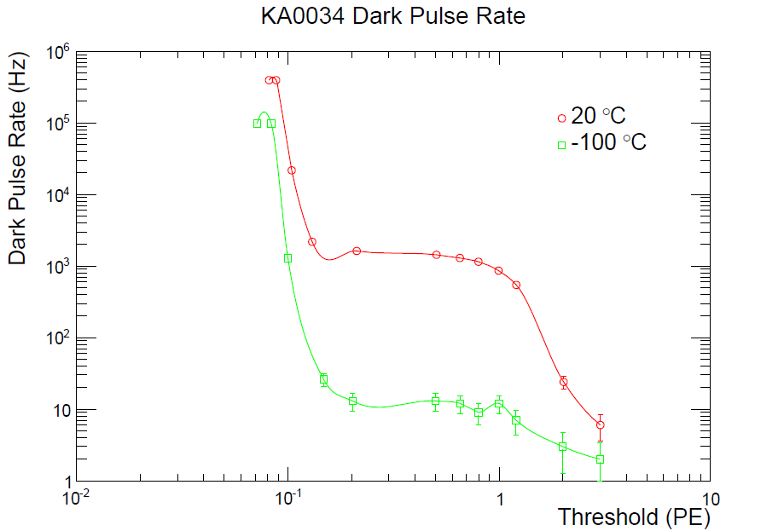
R11410-21 Dark Count Rate
50Hz @ 1PE threshold
70Hz @ 1PE threshold
10Hz @ 1PE threshold
Most PMTs showed Dark Count Rate
<100Hz @ -100C

Slide 21
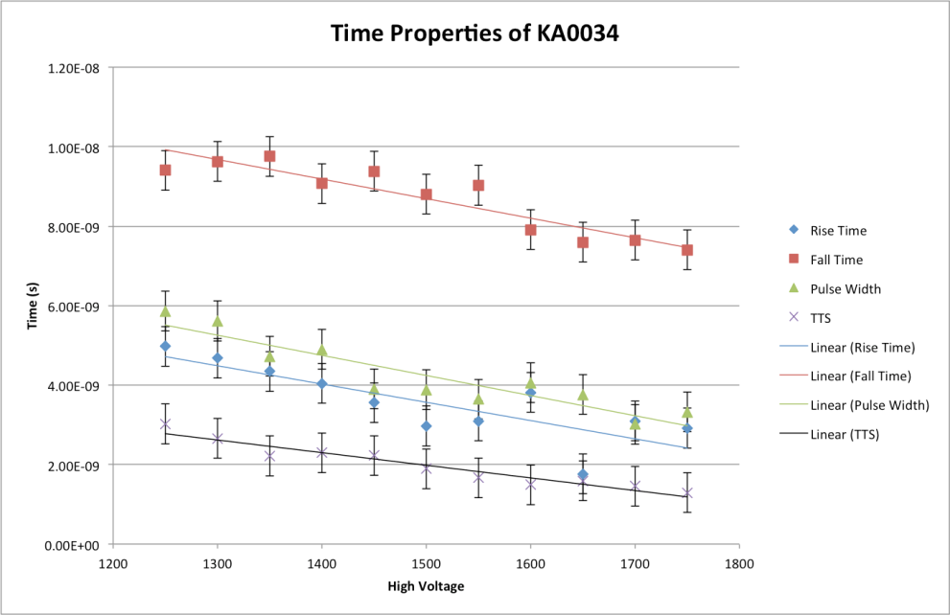

R11410-21 Timing Properties
Rise Time: 5nS
Fall Time: 10nS
Pulse Width: 5nS
Transit Time Spread: 2nS

Slide 22
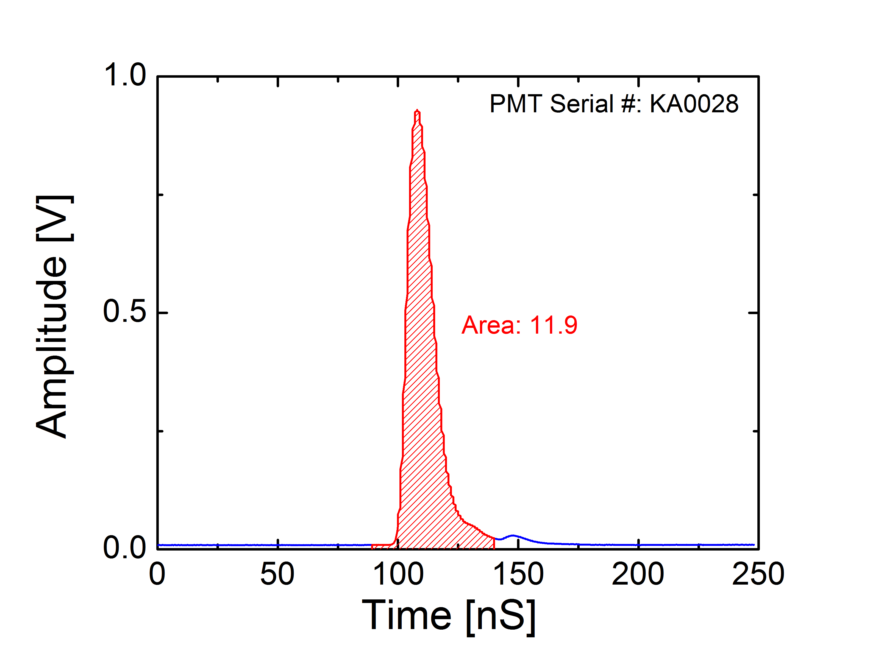
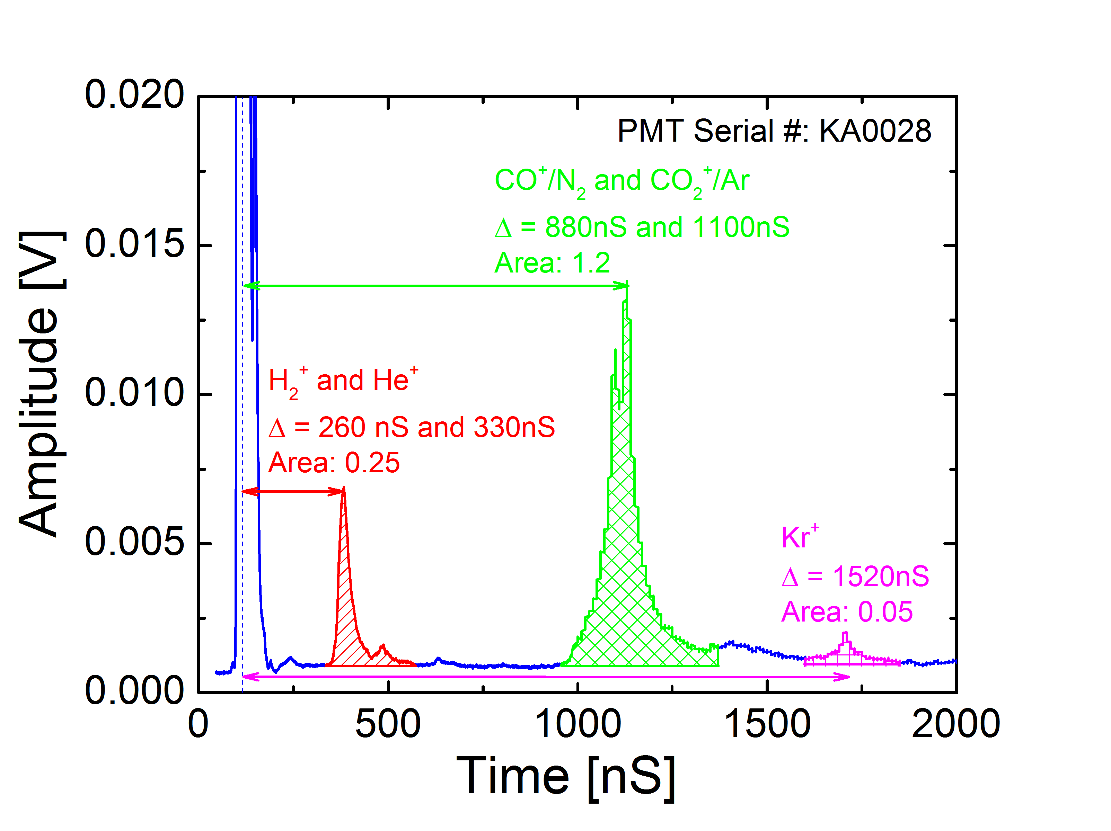
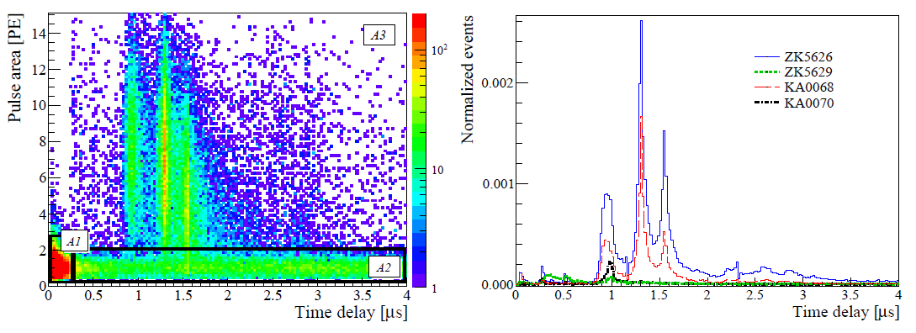
R11410-21 Afterpusing
Total area: 11.9
Total area: 1.5
Rate: 1.5/11.9 =12.6%
L. Baudis et al., JINST 8 P04026 (2013)

Slide 23
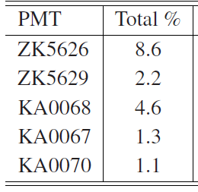
R11410-21 Afterpusing
PMT Serial # | Afterpulsing Rate
KA0028 | 12.6%
KA0034 | 0.7%
KA0045 | 1.57%
Most PMTs showed afterpulsing rate <10%

Slide 24
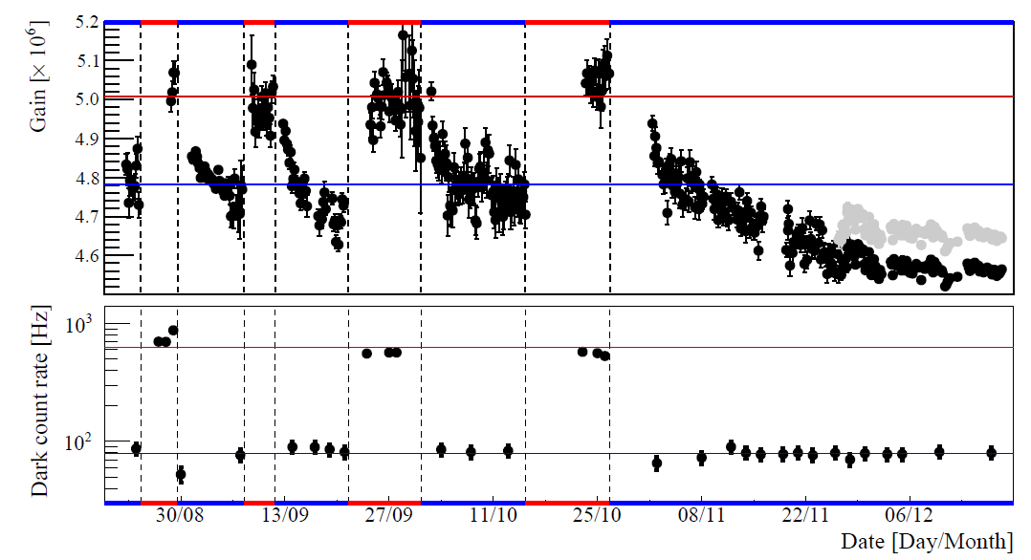
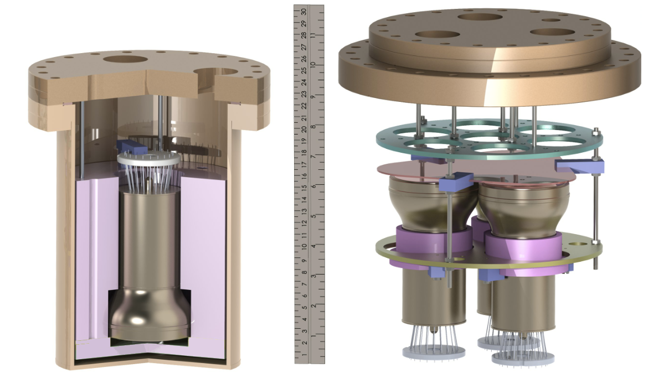
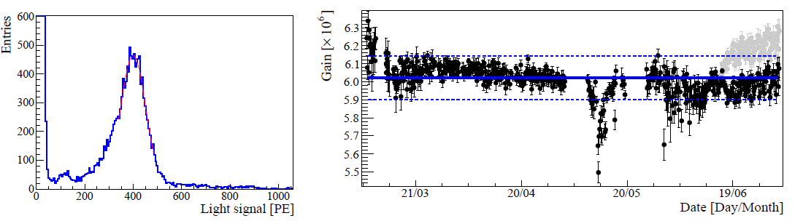
R11410-21 LXe operation
Dark Count Rate
<100Hz in LXe
Gain Stability in LXe
57Co
For details see: http://lanl.arxiv.org/abs/1303.0226, L. Baudis et al., JINST 8 P04026 (2013)

Slide 25
Summary
Screening resulted in
0.15 neutrons/year/1T, 0.03 gammas/year/1T
QE>30%
Gain ~ 1E7
Clear SPE peak
Linearity allows Cs-137 calibration at 250Hz
PC Uniformity to ~80%
Dark Count Rate <100Hz @ -110C
Afterpulsing Rate <10%
LXe tests showed stable operation

