Slide 1
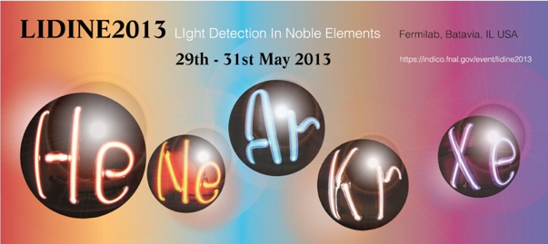
VUV-VIS optical characterization
of Tetraphenyl-butadiene films
on glass and specular reflector substrates
from room to liquid Argon temperature
F. Cavanna
R. Francini, R.M. Montereali, E. Nichelatti, M.A. Vincenti,
N. Canci, E. Segreto, F. Di Pompeo, F. Carbonara
G. Fiorillo, F. Perfetto

Slide 2
Investigated TPB samples were grown at the
Gran Sasso National Laboratory LNGS, INFN L’Aquila, Italy
Evaporated TPB Films | Layer density (µg/cm²)
Glass substrate | 165
 | 200
 | 350
 | 725
 | 900
 | 1175
 | 1450
 | 1875
Polymeric reflector substrate VM2000 - VIKUITI | 50
 | 75
 | 175
 | 370
 | 475
 | 550
 | 600
 | 770
 | 810
 | 1045
 | 1375
 | 1500
Samples obtained by dip-coating
of glass substrates in polystyrene containing TPB
Fraction of TPB in polystyrene (Weight fraction %)
1
10
20
40
Samples obtained by evaporation of TPB on different substrates

Slide 3
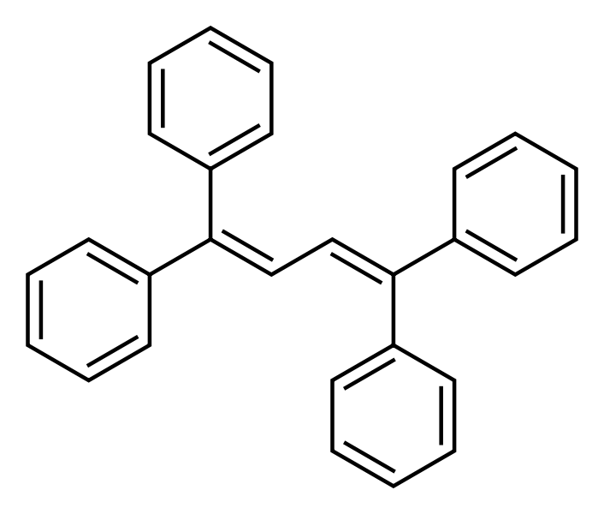
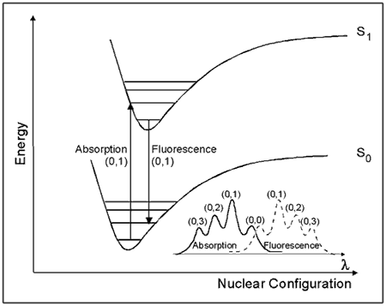
Configurational coordinates
diagram
PhotoLuminescence
(PL) Spectra
Absorption Spectra
Photo Excitation (PE) Spectra

Slide 4
Emission Spectra Excited at 128 nm
TPB
evaporated on glass
a fraction of the emitted radiation can undergo severalre-absorption and re-emission processes before escaping from the sample surface. This results in a red shift of the emission band peak
Notes:
italiano

Slide 5
TPB evaporated on VIKUITI:
the Temperature Effect
unresolved vibronic structures at 300 K, spaced by ~170 meV, become clearly visible at Lar T and below
Emission Spectra Excited at 128 nm

Slide 6
TPB in polystyrene on glass
Emission Spectra
Excited at 128 nm
Absorption Spectra
re-absorption mechanisms at about 350.It corresponds to the HOMO-LUMO transition of TPB
(Highest Occupied Molecular Orbital)-to-((Lowest Unoccupied Molecular Orbital)
Notes:
Correggere italiano

Slide 7
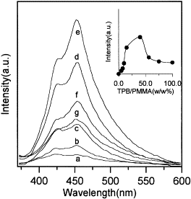
TPB in
polystyrene
TPB in PMMA
J. Huang et al., J. Lumin. 81 (4), 285 (1999)
Notes:
italiano

Slide 8
TPB in polystyrene on glass
Temperature effects
Emission Spectra Excited at 128 nm
Emission Spectra of TPB
on VIKUITI and in polystyrene
Excited at 128 nm
Temperatura 87 K (LAr)
vibronic structures not observed neither at room temperature nor at lower temperatures. This behavior closely resembles that of TPB in liquid solutions, where the randomness of the environment geometry around the TPB molecule induces the observed inhomogenous broadening of the vibronic structures, which merge in a single, unresolved band
Notes:
italiano

Slide 9
Photoluminescence (PL) and Photoexcitation (PE)
in the UV-VIS range
TPB in polystyrene on glass – T = 300 K
TPB evaporated on VM2000 – 600 μg/cm² – T = 300 K

Slide 10
Detail of the PhotoExcitation Spectra
around 128 nm for two representative samples
of TPB on VIKUITI and
TPB in polystyrene on glass.
The Spectra are nomalized
to a Sodium Salicylate reference
Notes:
italiano

Slide 11
Hemispheric optical reflectance R and transmittance T
(and absorbance A)
sample
photoluminescence PL
incident light
hemispheric
reflectance R
hemispheric
transmittance T
R + T + A = 1

Slide 12
In a typical spectrophotometer, while the impinging probe beam is filtered in wavelength, the reflected (transmitted) beam is detected with no spectral filtering.
PROBLEM!
Measurements of R and T (and A) of an optically-active sample are heavily affected by unwanted Stokes-shifted PL which is excited by the probe beam.
Is there a way to “clean” measured photometric spectra of TPB from PL?

Slide 13
Let us insert a suitable low-pass filter…
Photoluminescence affects the measurement of R
… no more detected photoluminescence!
TPB
integrating sphere
Of course, some data elaboration is needed…

Slide 14
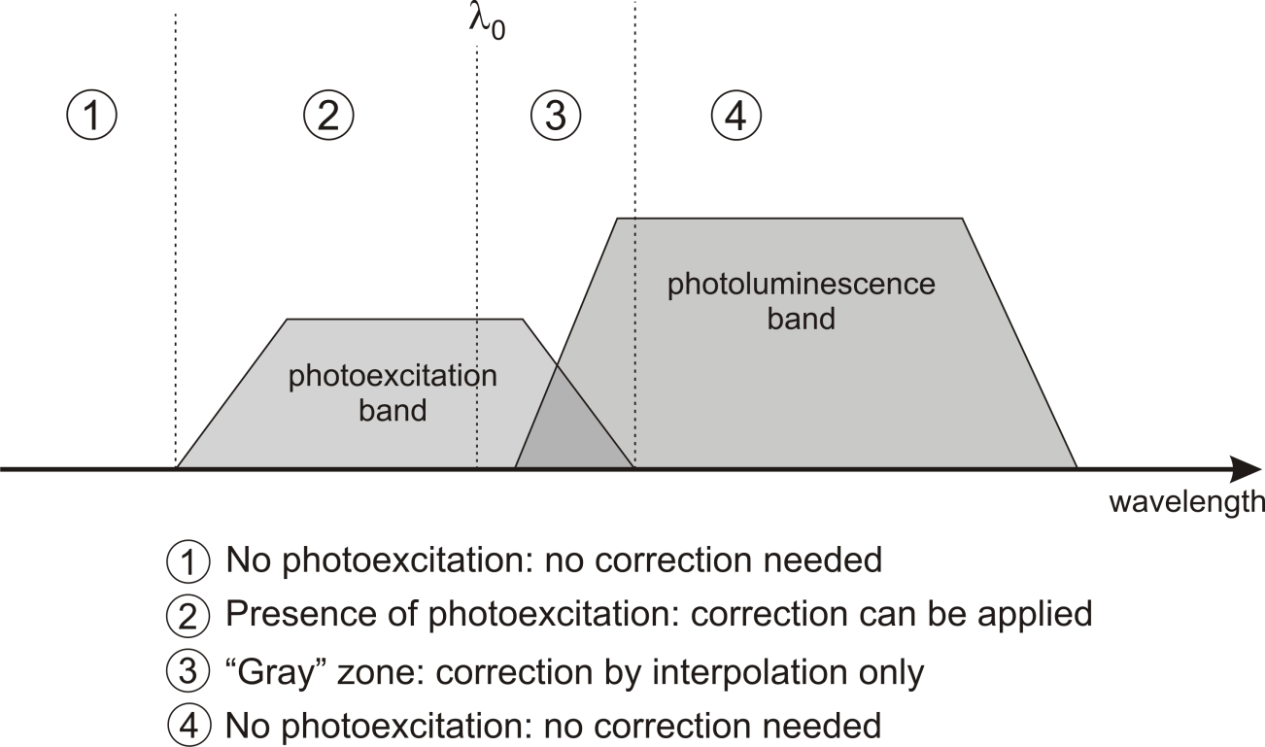
For TPB, range 2 spans from well below λ = 250 nm (lower measurement limit) up to λ ~ 380 nm. Range 3 is roughly 380 nm < λ < 420 nm.
A suitable low-pass filter is needed…

Slide 15
Measurement correction (reflectance):
low-pass filter requirements
as measured spectrum (without filter)
spectrum with filter placed between sample and detector
evaluation of true sample reflectance
LEGEND

Slide 16
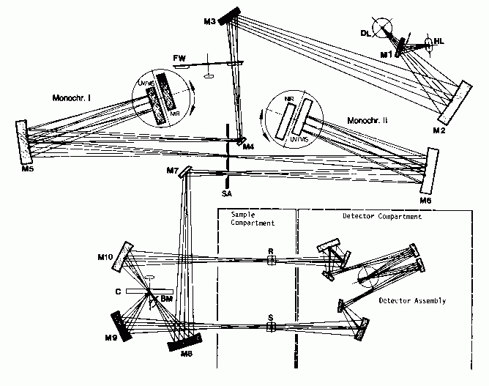
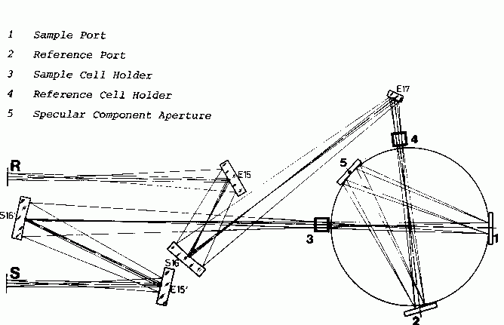
Spectrophotometer and integrating sphere
Perkin-Elmer mod. B013-8277
(15 cm diameter integrating sphere)
ENEA, C.R. Casaccia, V. Anguillarese 301, 00123 Rome, Italy
enrico.nichelatti@enea.it
Perkin-Elmer Lambda 19
(dual-beam UV-Vis spectrophotometer)

Slide 17
TPB on Reflector Substrate
VM2000 naked foil
TPB (350 μg/cm²)
over VM2000 foil
TPB layer over Reflector: null transmittance over all the examined range.
High R at λ > 420 nm due to TPB and/or Reflector.
Low R at λ < 380 nm, lower than R of Reflector, ascribed to low R and high absorbance A of TPB itself .

Slide 18
glass slab
polystyrene-diluted
TPB over glass slab
polystyrene over glass
TPB (356 μg/cm²)
over glass slab
The plots demonstrate that TPB has an absorption band at about 350 nm (3.54 eV). The further absorption cutoff at λ < 300 nm for the polystyrene-diluted TPB is ascribed to the glass substrate.

Slide 19
Comparison of spectral properties of TPB layers as a function of surface density
Hemispheric T and R, and direct T for various TPB surface densities of TPB layer on glass.

Slide 20
Conclusions
The main spectral features and optical characteristics of TPB films on different substrates, commonly employed elements of DM detector optical systems, have been investigated and presented here to provide means for more accurate simulations and designs of current and future LAr experiments.
TPB emission spectra by VUV excitation at 128 nm with lineshape and relative intensity variation down to LAr temperature were measured.
For TPB films evaporated on specular reflector substrates, the unresolved vibronic structures at room temperature become clearly visible as the temperature is decreased.
At 87 K one can observe at least four distinct structures and the PL intensity
increases of about 10% with respect to the luminescence at room temperature.

Slide 21
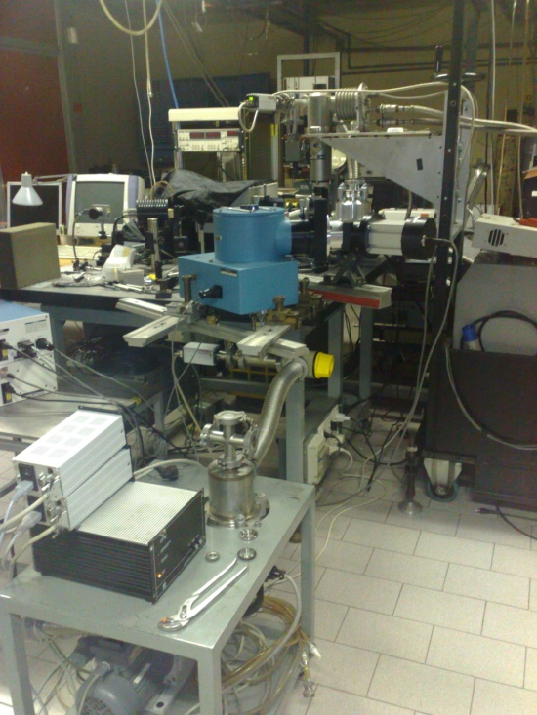
Vacuum Monochromator McPherson model 234/302
Focal length 0.2 m equipped with a 30 Watts Deuterium lamp model 632
with MgF₂ window,
Spectral range 115 – 380 nm.
Closed-cycle Helium Cryostat
Temperature range
12 – 300 K

Slide 22
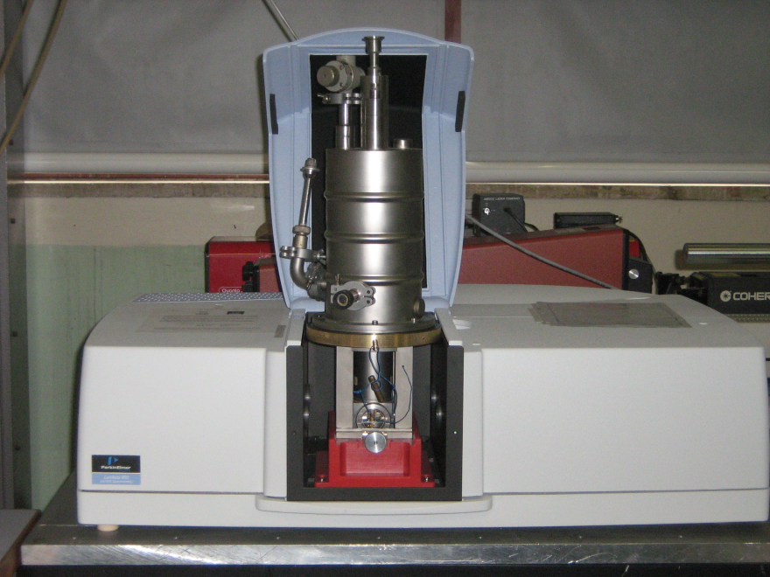
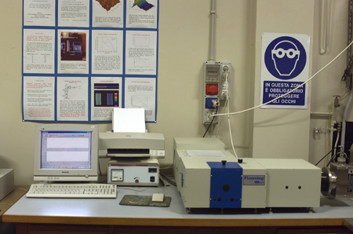
Spectrophotometer Lambda 950
PERKIN ELMER UV/VIS/NIR,
compatible with optical cryostat
cooled at LNT
Spectrofluorometer Fluorolog 3
ISA JOBIN YVON-SPEX
Mod.FL3-11 compatible with optical cryostat cooled at LNT
ENEA, C.R. Frascati, V. E. Fermi 45, 00044 Frascati (Rome) Italy, rosa.montereali@enea.it,
http://www.frascati.enea.it/UTAPRAD/lab_mnf.htm

