Slide 1
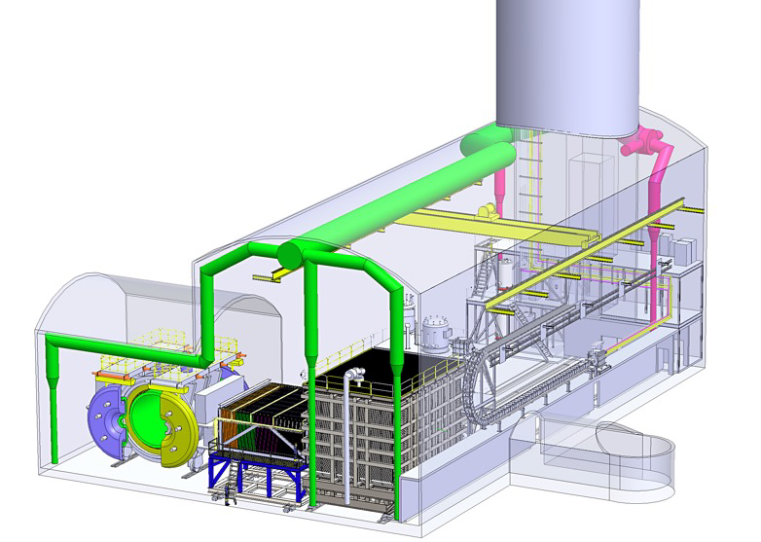
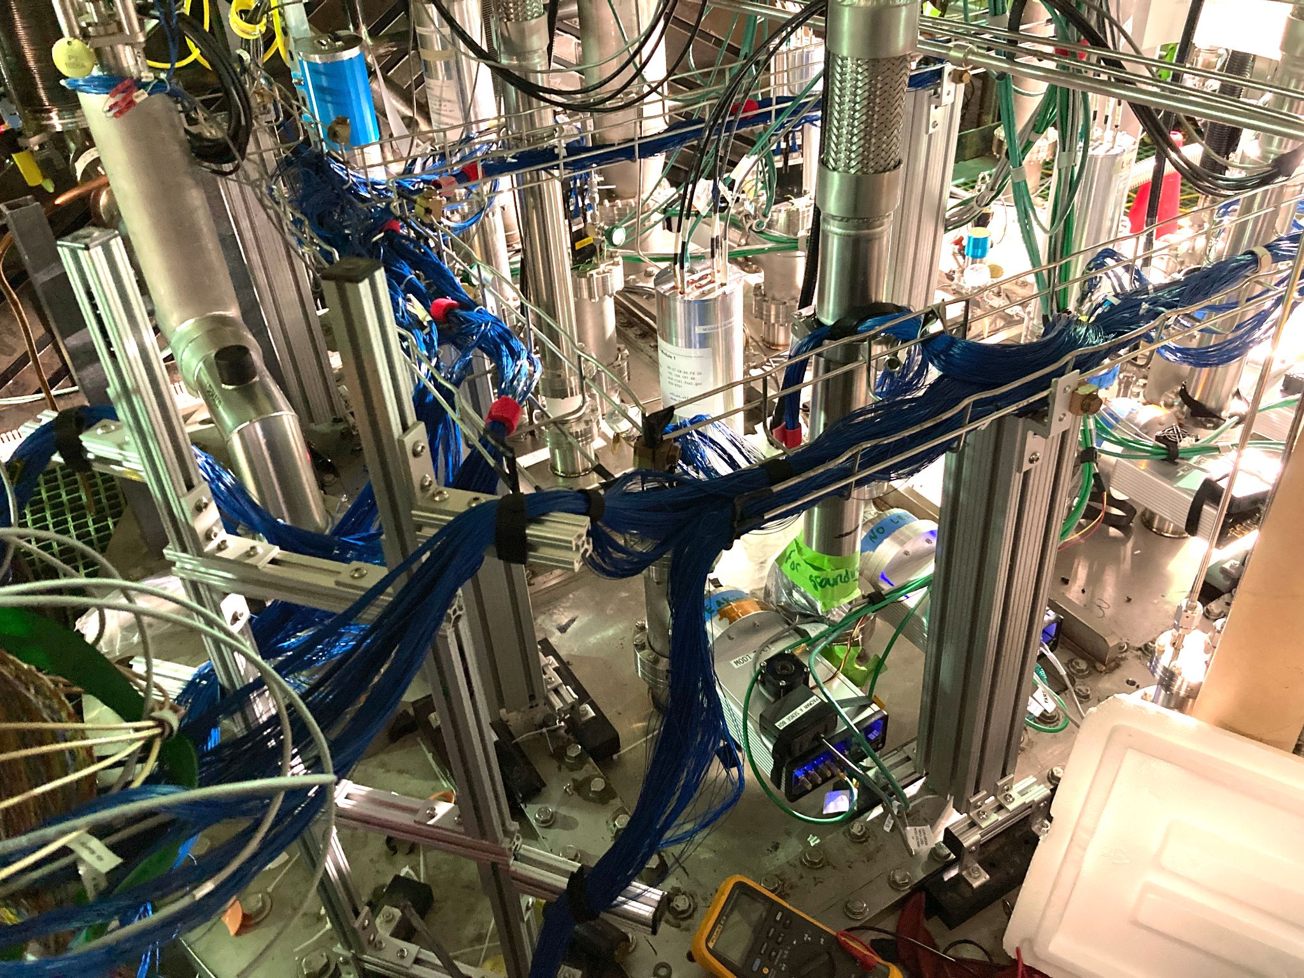
DUNE ND-LAr 2x2
M. Weber, D. Dwyer
July 2024, FNAL PAC

Slide 2
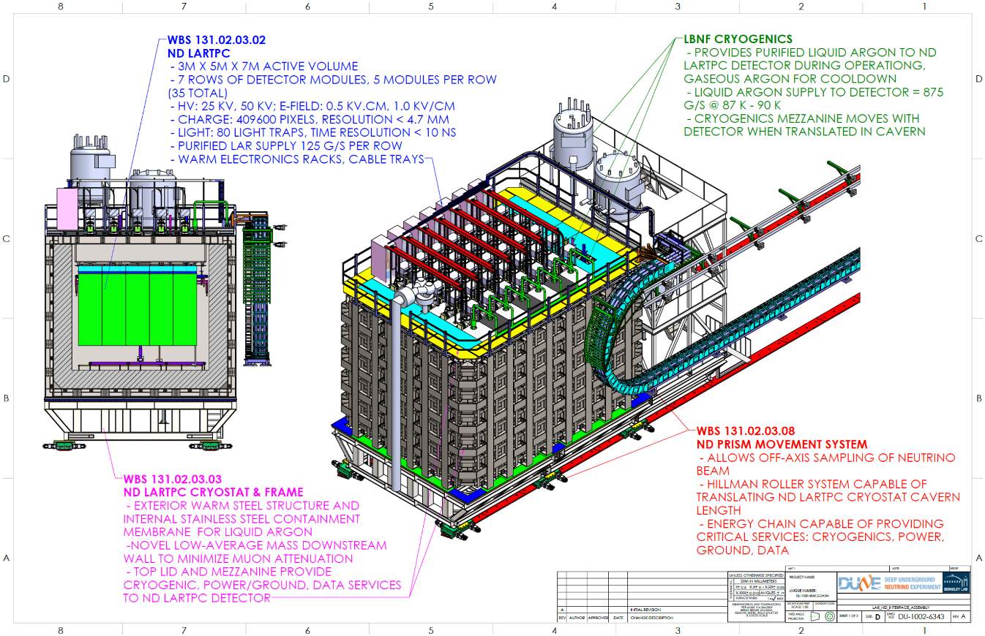
ND-LAr
https://edms.cern.ch/project/CERN-0000220117
Instrumented LAr target for the DUNE Near Detector
35 TPC modules (70 TPCs)
Identifies and classifies each neutrino interaction and measures outgoing particles, including nu-e in a high rate environment
Modular design for light containment
Pixelated readout for event disambiguation and reconstruction (native 3D)

Slide 3
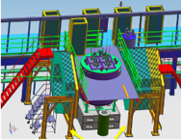
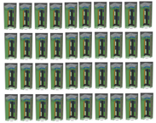
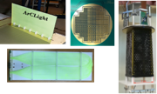
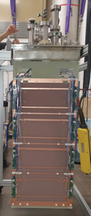
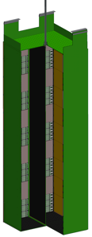
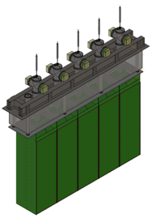
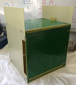
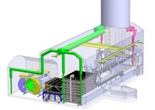
ND-LAr Plan
2022-2025
“2x2”
Physics Demonstrator
Four mid-scale
TPC modules in
neutrino beam
2026-2028
Production
35 (+5) production
modules, each
fully tested
2016-2019
ArgonCube R&D
2021
2025-2026
Demonstrations of
component technologies
ArgonCube
Module 0
Five-Module Row
Pre-production
& Cryostat Lid
Integration Test
full functionality
prototype
TRL-7 (physics)
PDR 2022
TRL-4
- Ready
for CD-1
2028-2030
2020
Installation
SingleCube
Support of TPC module
installation in Near Site
Activity driven by Near
Site Integration (NSI)
Integrated TPC test
at small-scale
125 cm
300 cm
2023-2025
Full-scale ND
Demonstrator
32 cm
70 cm
70 cm
TRL-7
(engineering)
1 Full-scale
ND-LAr TPC
module
100 cm
32 cm
32 cm
100 cm
TRL-5

Slide 4
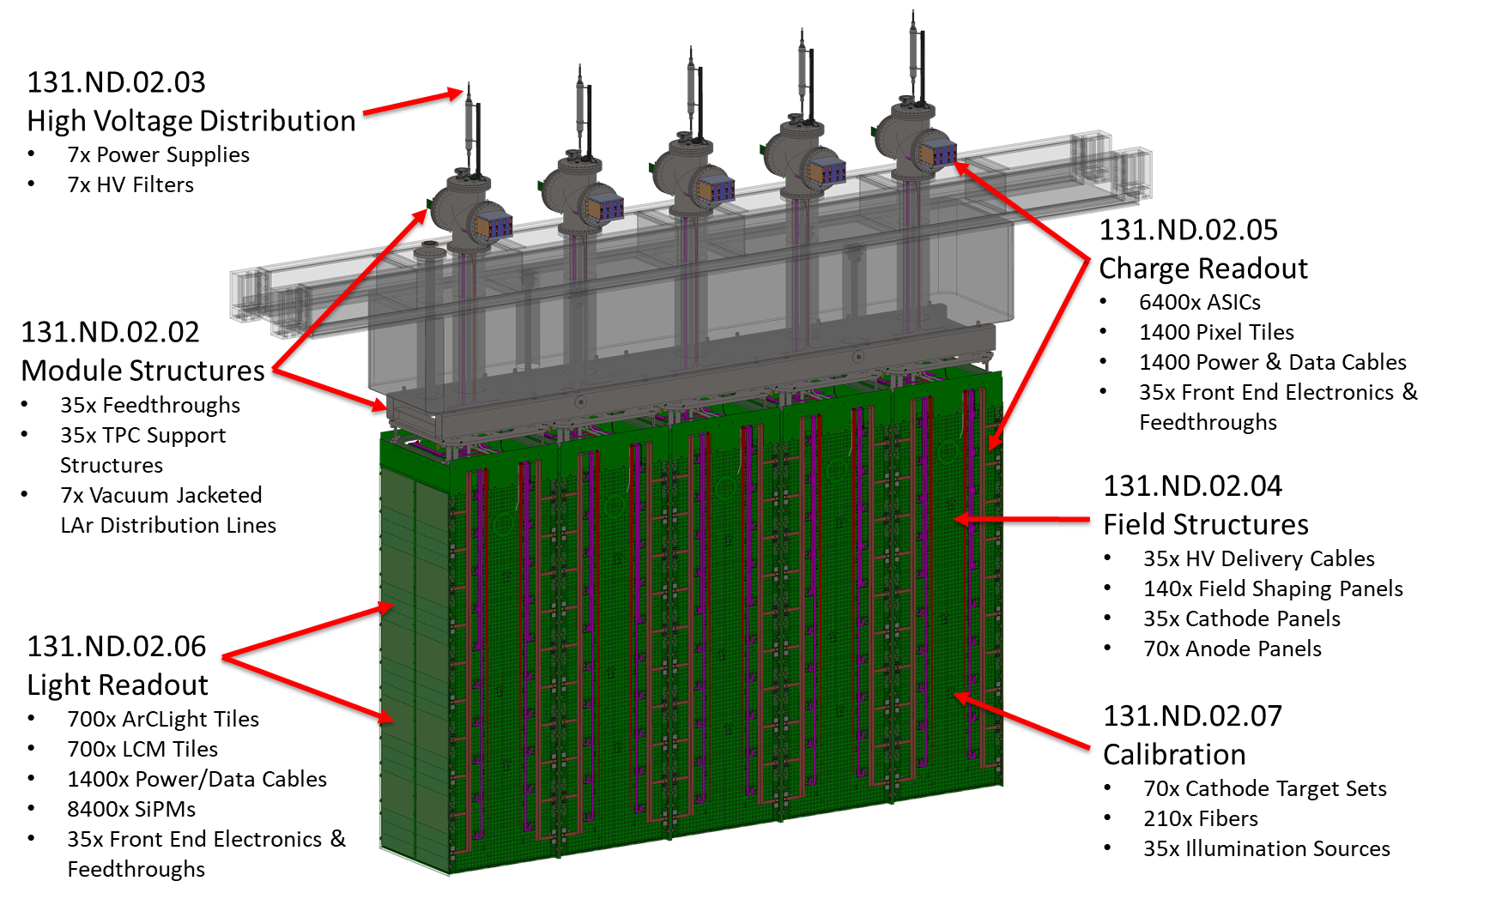
ND-LAr subsystems
ND-LAr consortium scope covers all TPC subsystems (of ND-LAr+TMS), excluding cryostat and cryogenics
Note: Cryostat Lid Section not in ND-LAr Scope
288000x ASICs

Slide 5
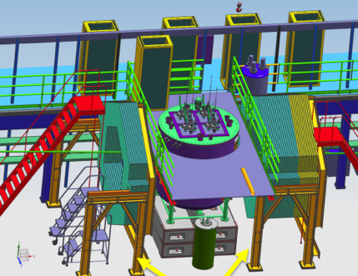
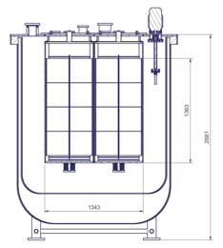
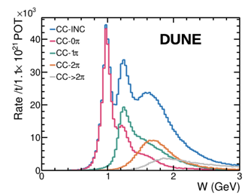
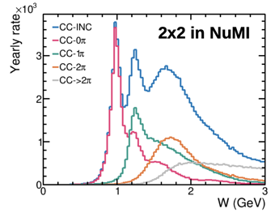
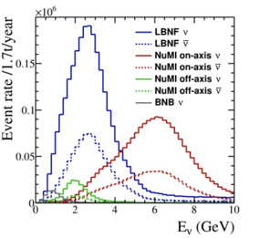
ND-LAr 2x2 @ NuMI
Operation in NuMI Neutrino Beam
- Install four TPC modules in former location of MINOS-ND
- Includes upstream/downstream trackers, repurposed from Minerva
Goals:
High level physics performance demonstration
Develop neutrino signal analysis and reconstruction techniques
Reconstruction of native 3D neutrino signals (pixels)
Charge-light signal correlations, tolerance to beam pileup
Event matching among several drift regions (modular)
Track matching with external trackers
The 2x2 program (with some significant NuMI running) offers the ability to study the highly complex topologies and pileup that we expect at DUNE
Energy
Invariant mass
Notes:
The 2x2 Demonstrator will be the first DUNE prototype to collect neutrino data!
On-axis NuMI flux
Antineutrino mode for the foreseeable future
Main con: limited containment
Most muons can only be tagged
Partial shower containment for sizable fraction of events
But important pros:
Intensity comparable to LBNF
Unique measurements compared to previous LArTPCs and of high relevance to DUNE
Building the prototype at the lab facility where the future detector would be located

Slide 6
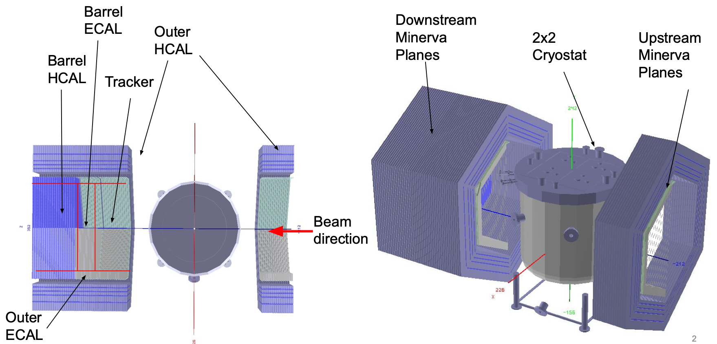

Slide 7
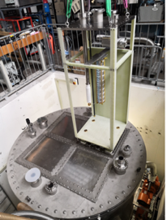
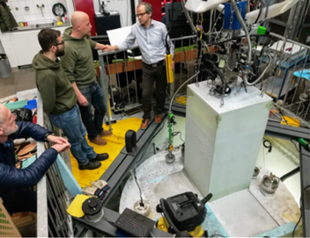
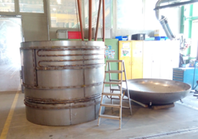
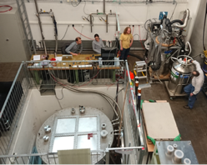
2x2, history
Idea born together with the “modular” LArTPC (ca. 2014) → a modular setup needs to be tested in cosmic rays or in a neutrino beam
Preparations underway for the cryostat and modules in 2016—2018 in Bern
2019 first cryogenic operations in Bern (cryostat and early prototype)
As the ArgonCube technology was chosen as core component of the DUNE ND a dedicated effort started to operate the 2x2 in the NuMI beam
→ Agreements with FNAL/DoE, LoI, proposals, funding (starting 2019; Bern/FNAL/SLAC/LBNL)
2019
2017
2016
2018
2x2 Cryostat refurbishment, validation, and purity demonstration

Slide 8
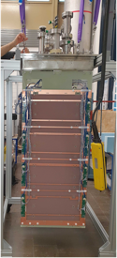
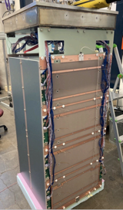
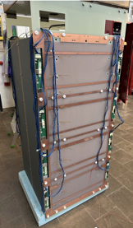
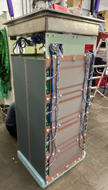
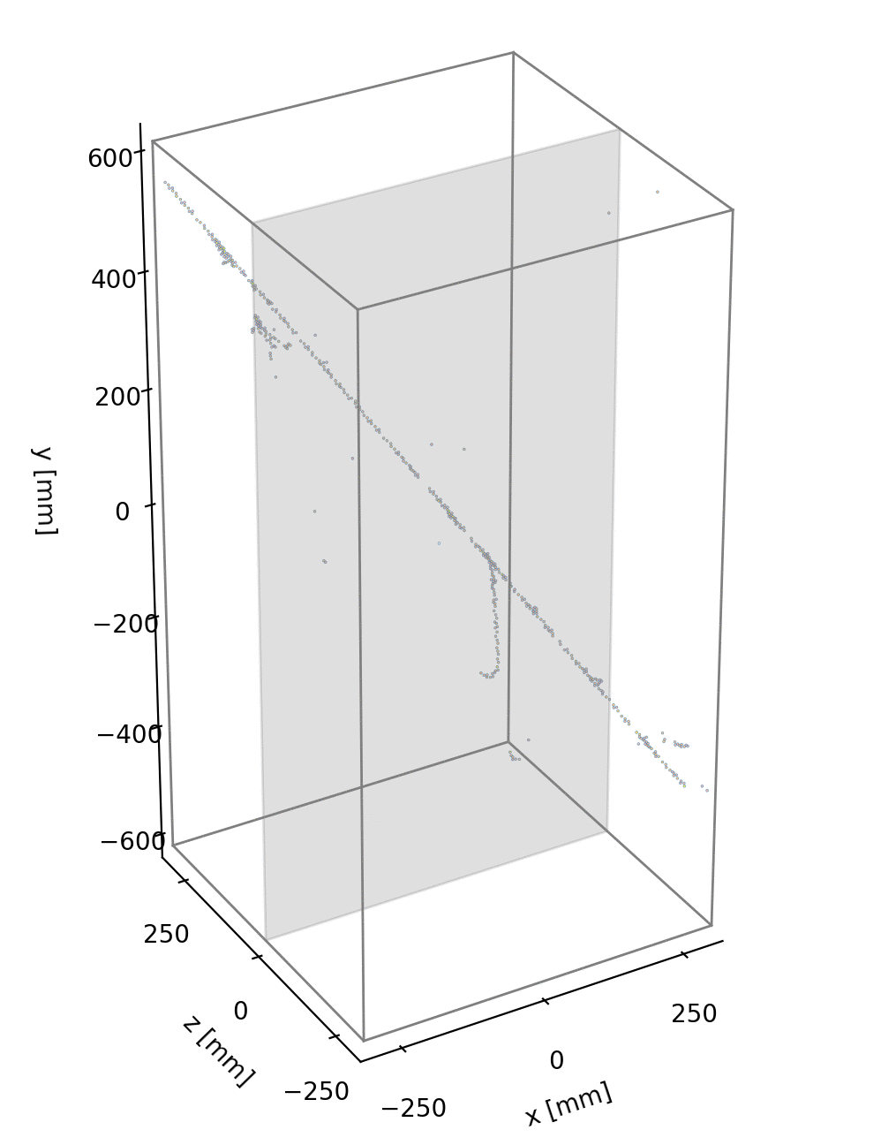
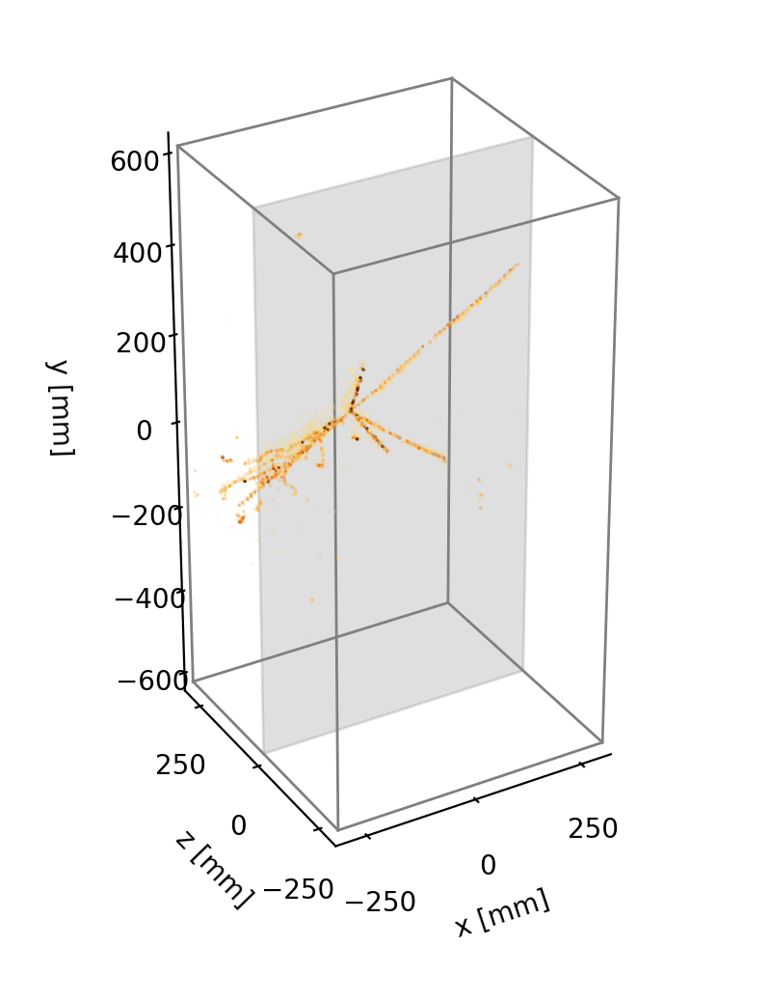
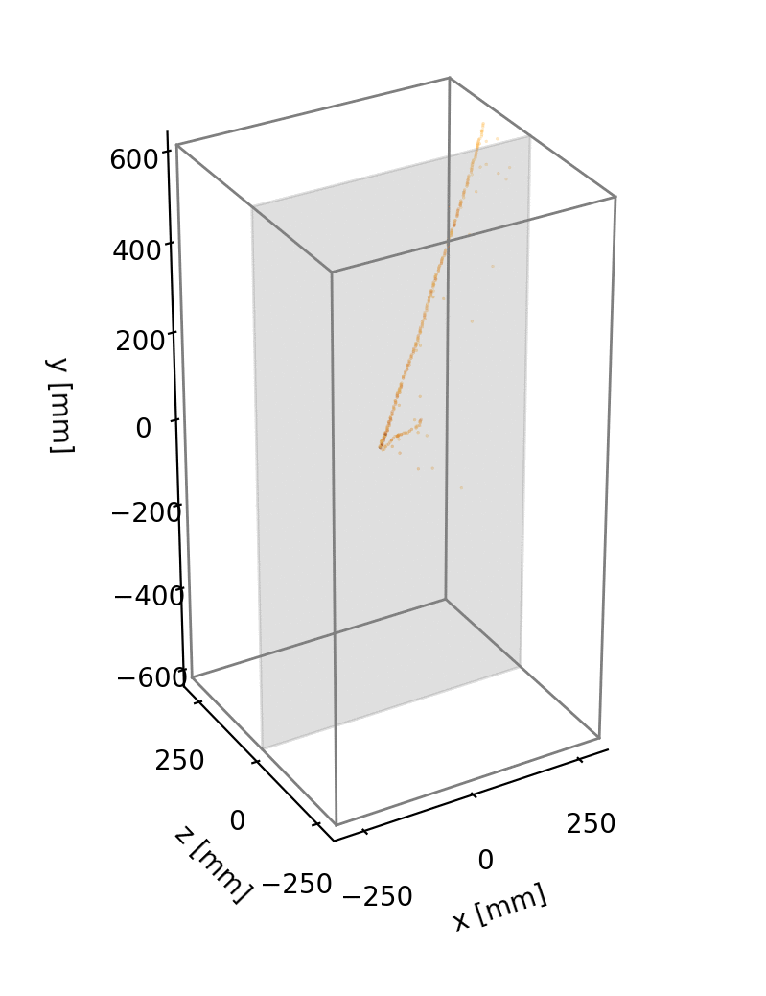
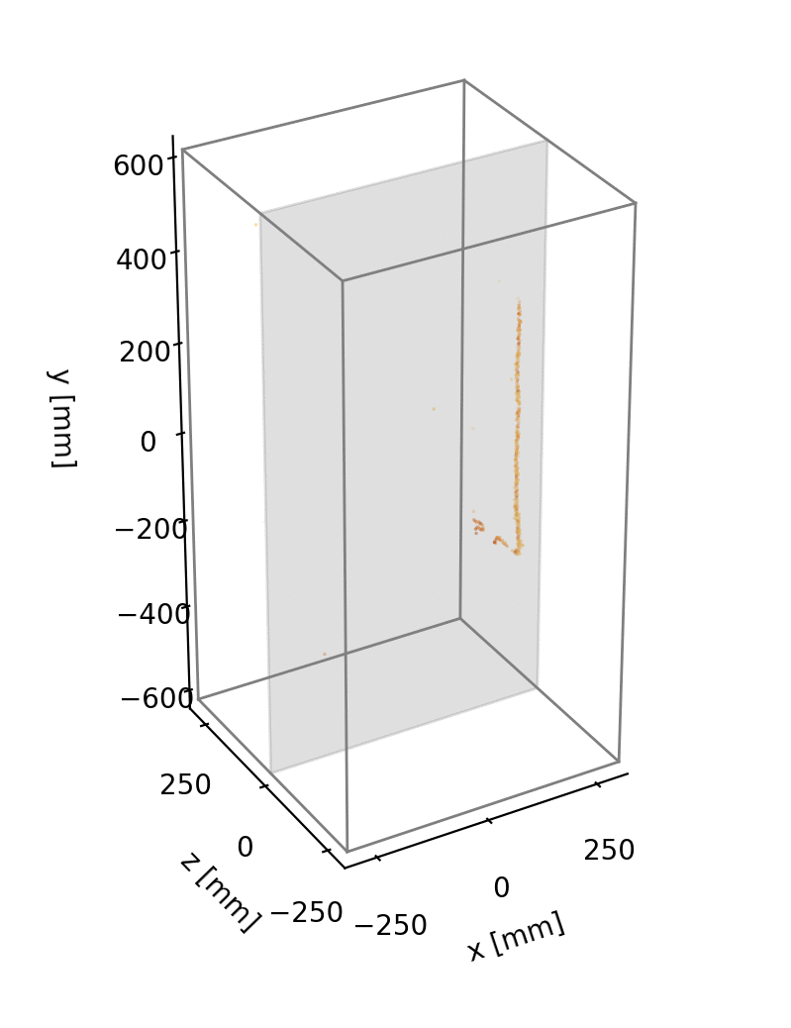
The ArgonCube 2x2 Demonstrator Program @ Univ. of Bern
Produced and operated all four modules in LAr,
with a total of ~300k pixel channels
Roughly 100 million cosmic events collected!
Probably the highest resolution sample recorded
Module 0
Module 1
Module 2
Module 3
Operations:
Apr. 1-10, 2021
Jun. 21-26, 2021
Operation:
Feb. 5-13, 2022
Operations:
Nov. 14-22, 2022
Nov. 29-Dec. 6, 2022
Operations:
Jan. 27-Feb. 5, 2023
Feb. 21-23, 2023
Mar. 13-16, 2023
DUNE Collab., “Performance of a modular ton-scale pixel-readout liquid argon time projection chamber”, arXiv:2403.03212, (2024)
P. Madigan, “Measurement of Muon Capture on Argon with a Pixelated Liquid Argon Time Projection Chamber”, UC-Berkeley Ph.D. Thesis (2023)

Slide 9
2x2 Status of Installation, Assembly & Checkout
All LAr-TPC modules at Fermilab and acceptance-tested Spring 2023
Underground area prepared 2023, detector installed in Fall 2023
Infrastructure work (electrical and ventilation), detector connectivity, and cryogenic installation work proceeded 2023 / 2024
Elevator failure March 19th 2024 prevented access until May 10th
We were about two weeks from completing cabling of the detector
Quick progress since restoration of hall access:
Detector cabled and warm commissioning completed
Cryogenic controls and checkouts completed
Cooldown and fill started May 20th, finished May 31st
Hiccup: Elevator removed from service again, Jun. 7-13.
Detector HV: initial test on June 11 (working on LAr level), full HV ramp on July 1-2 (working on purity), and July 7-8 (final ramp)
Operating since July 8th

Slide 10
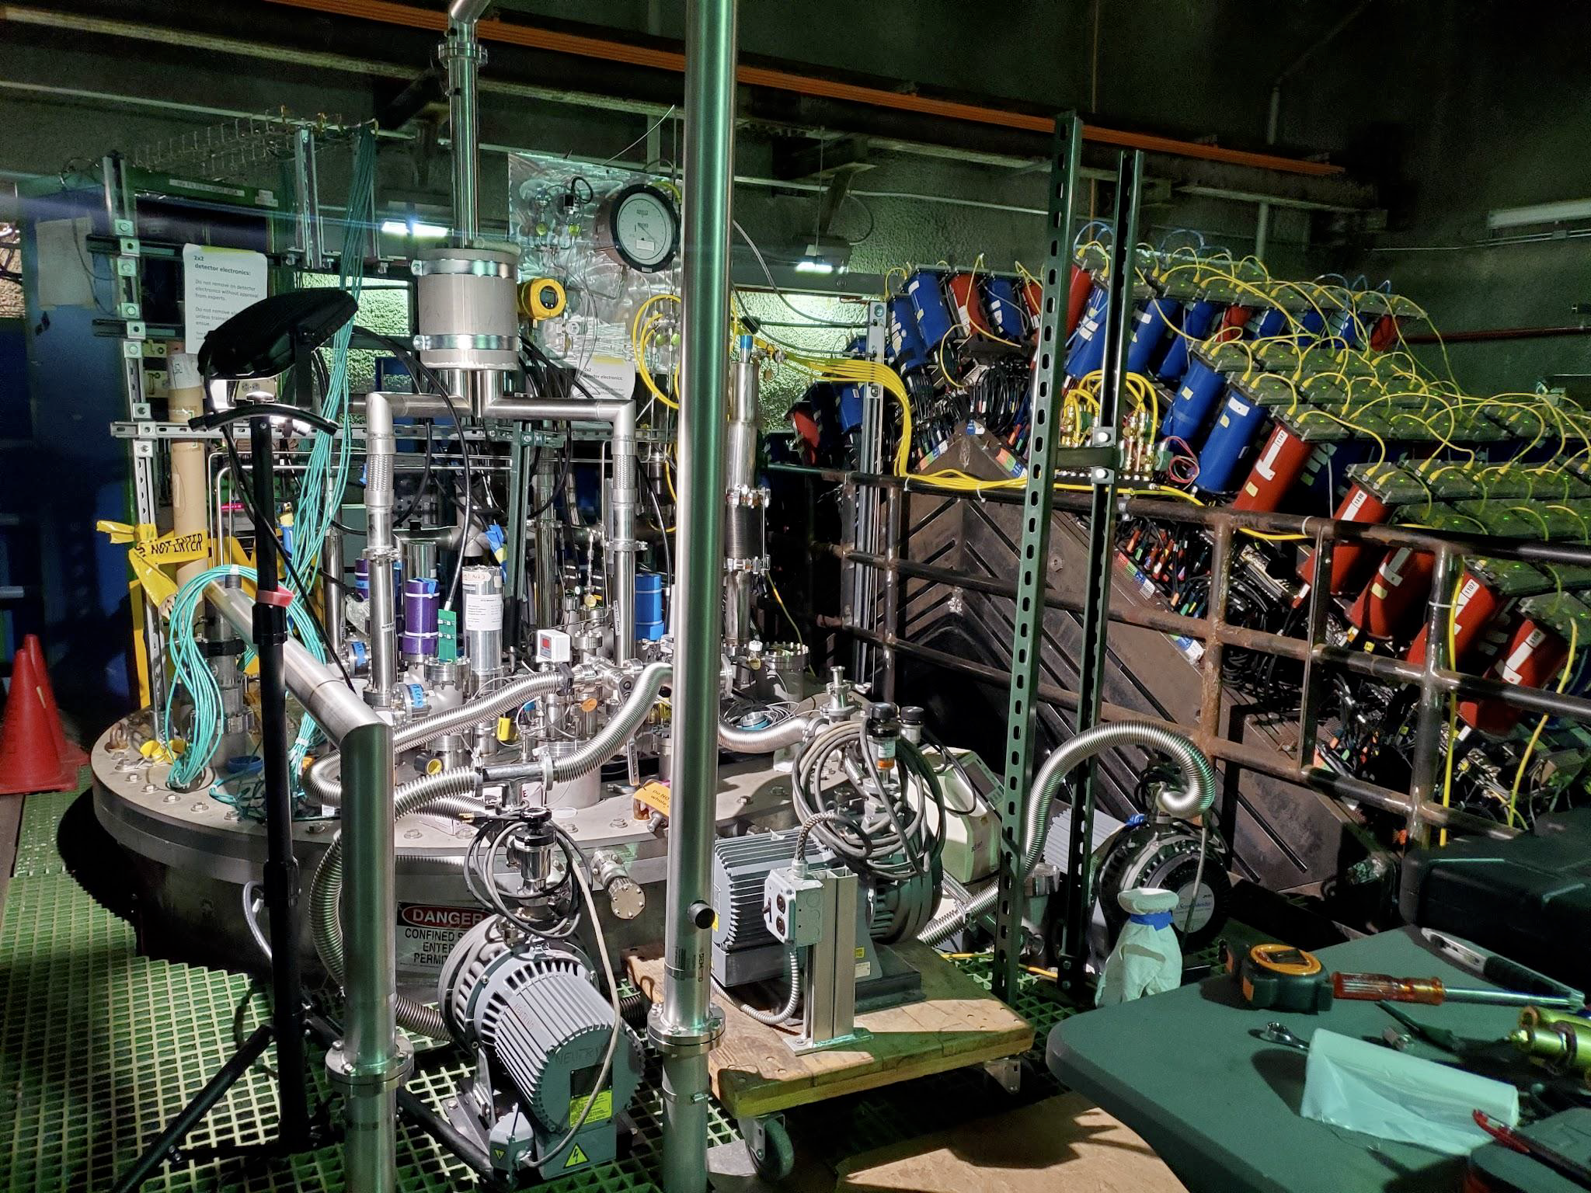
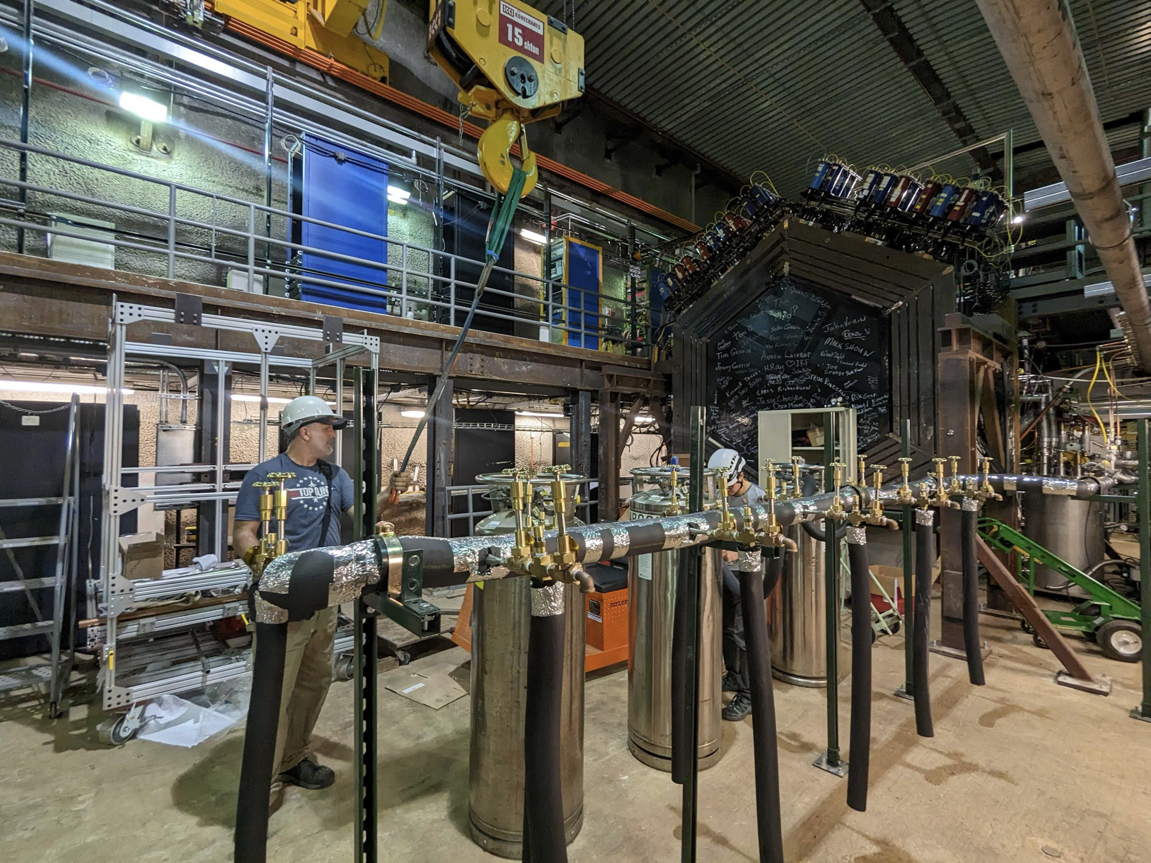
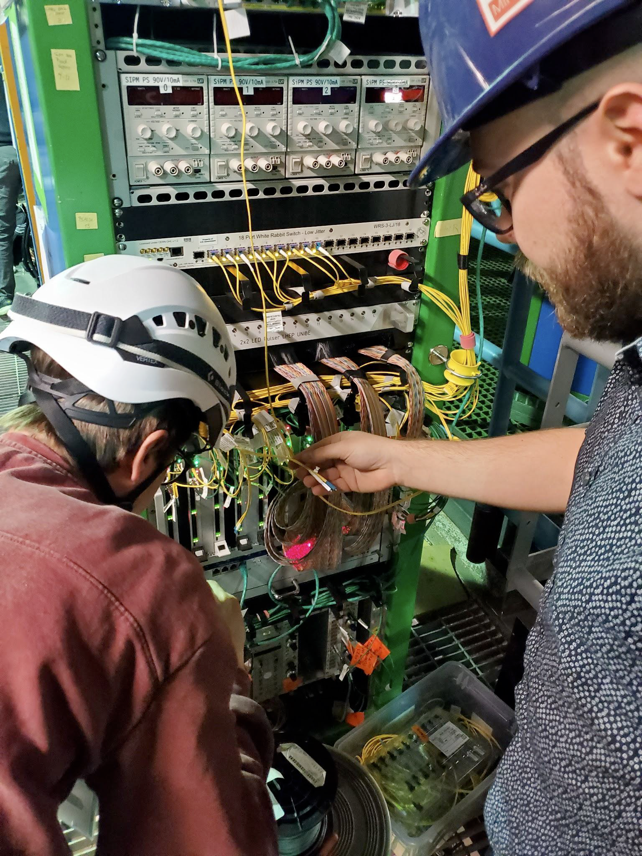
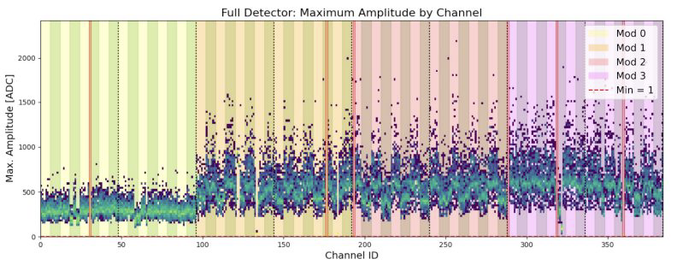
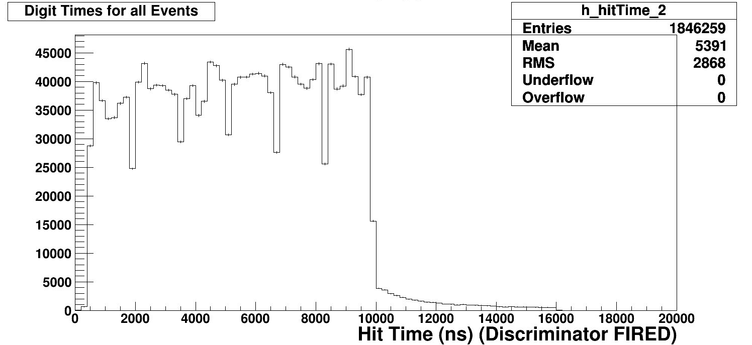
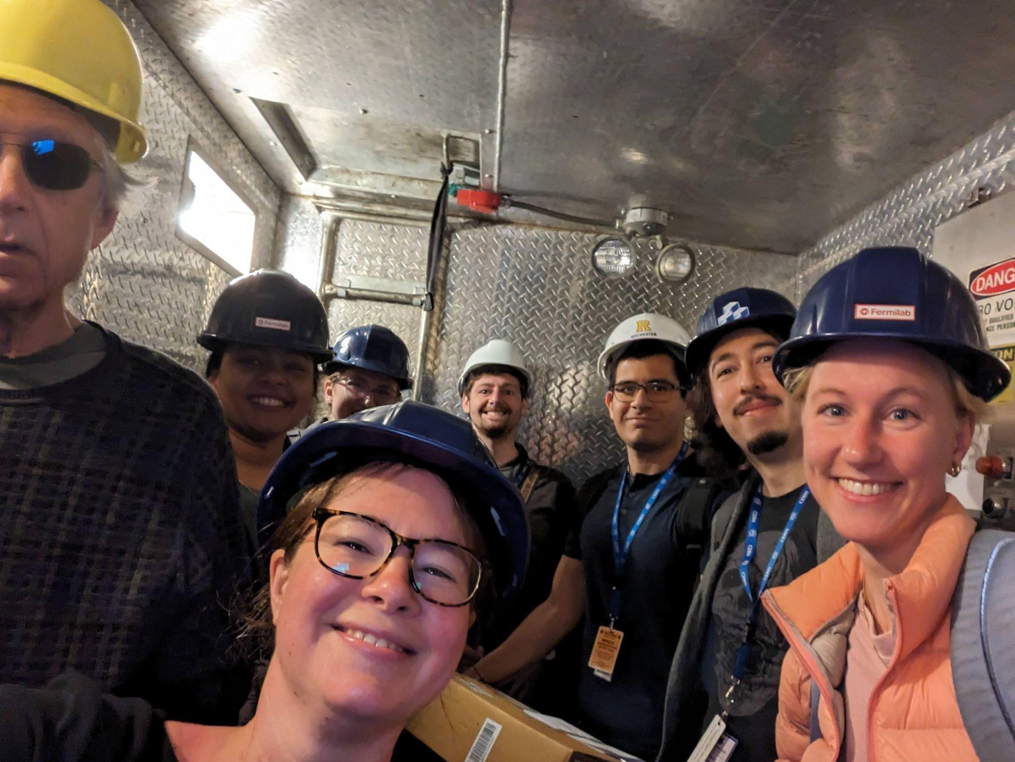
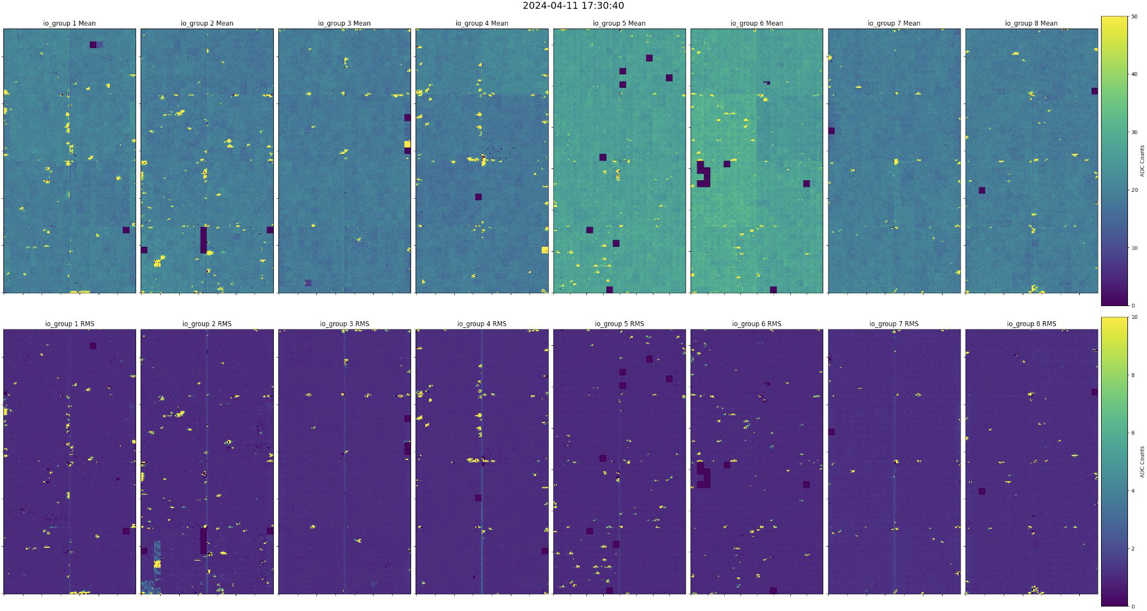
“Warm” checkout of light (above) and charge (right) readout
MINERvA beam timing
May 2024

Slide 11
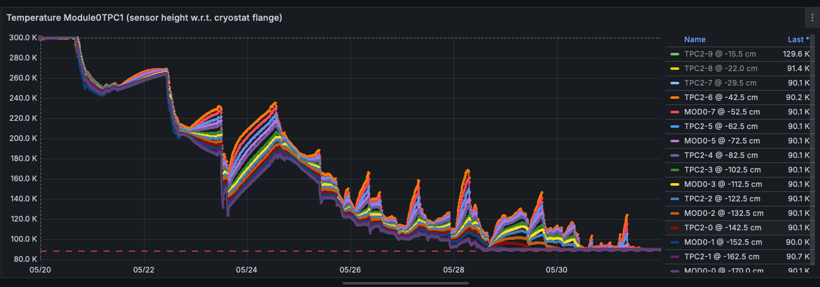
Cooldown and Fill: Faster than expected
Cool-down May 20th - May 31st
Temperatures in one of the modules from RTD distributed vertically (90K = LAr)
Successful campaign to have ND-LAr partners (Bern, MIT, U-Chicago, LBNL)
deliver LAr to FNAL advanced cooldown and fill from estimated 4 weeks to actual 10 days.

Slide 12
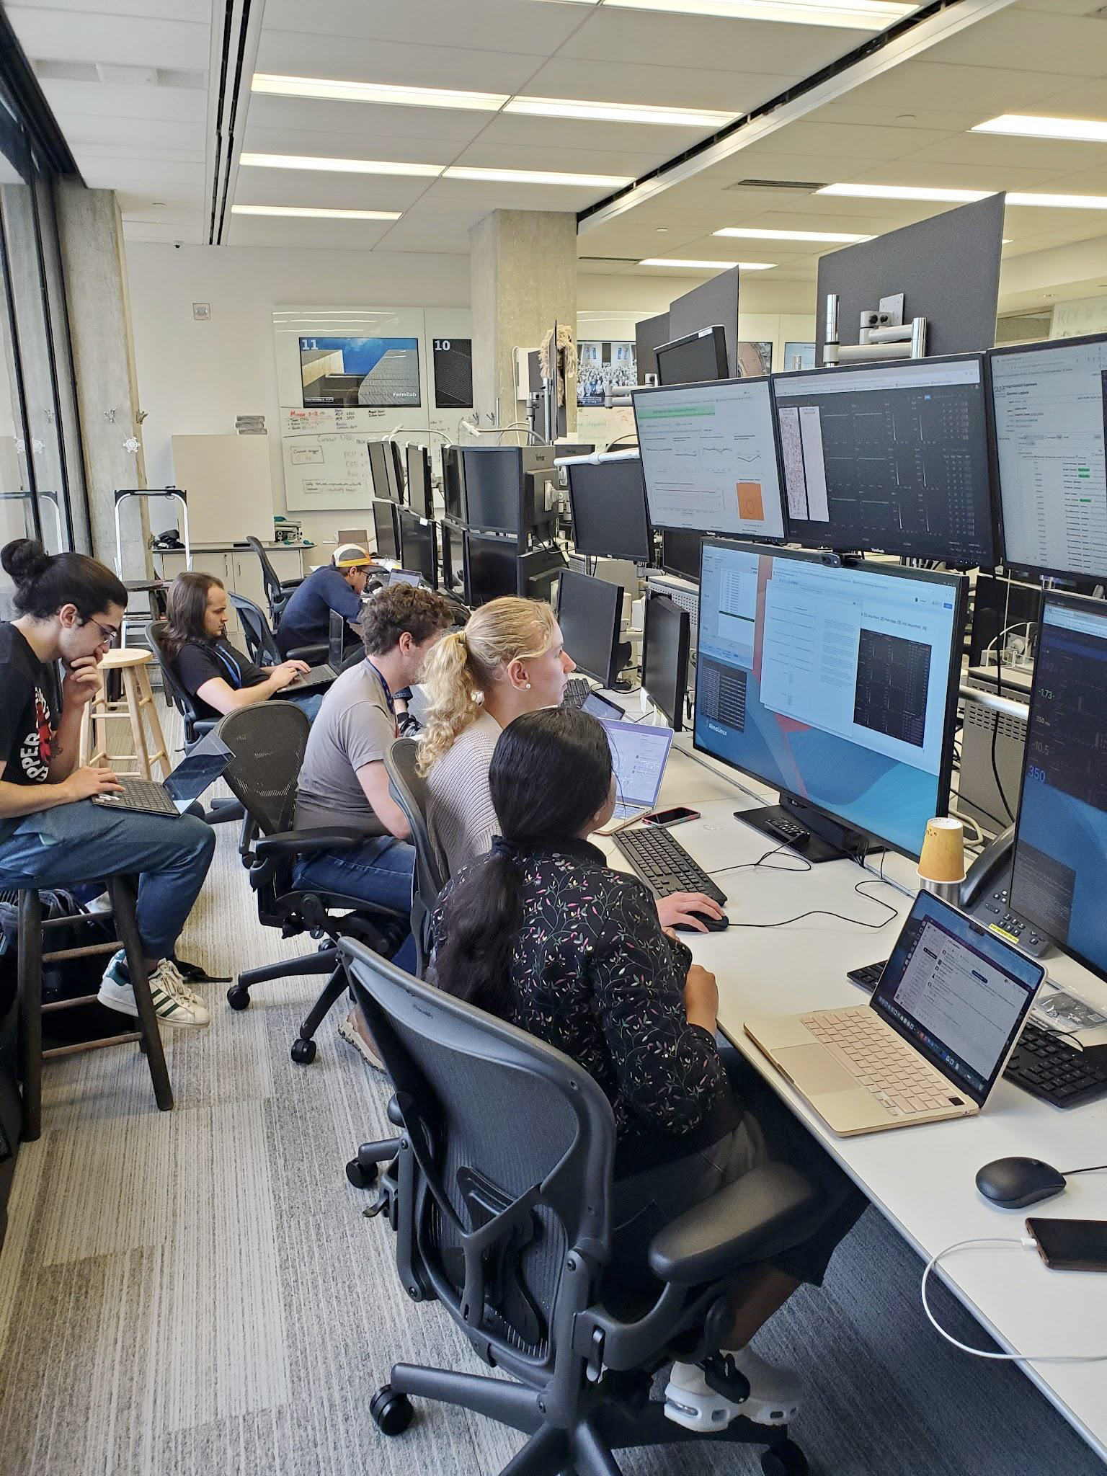
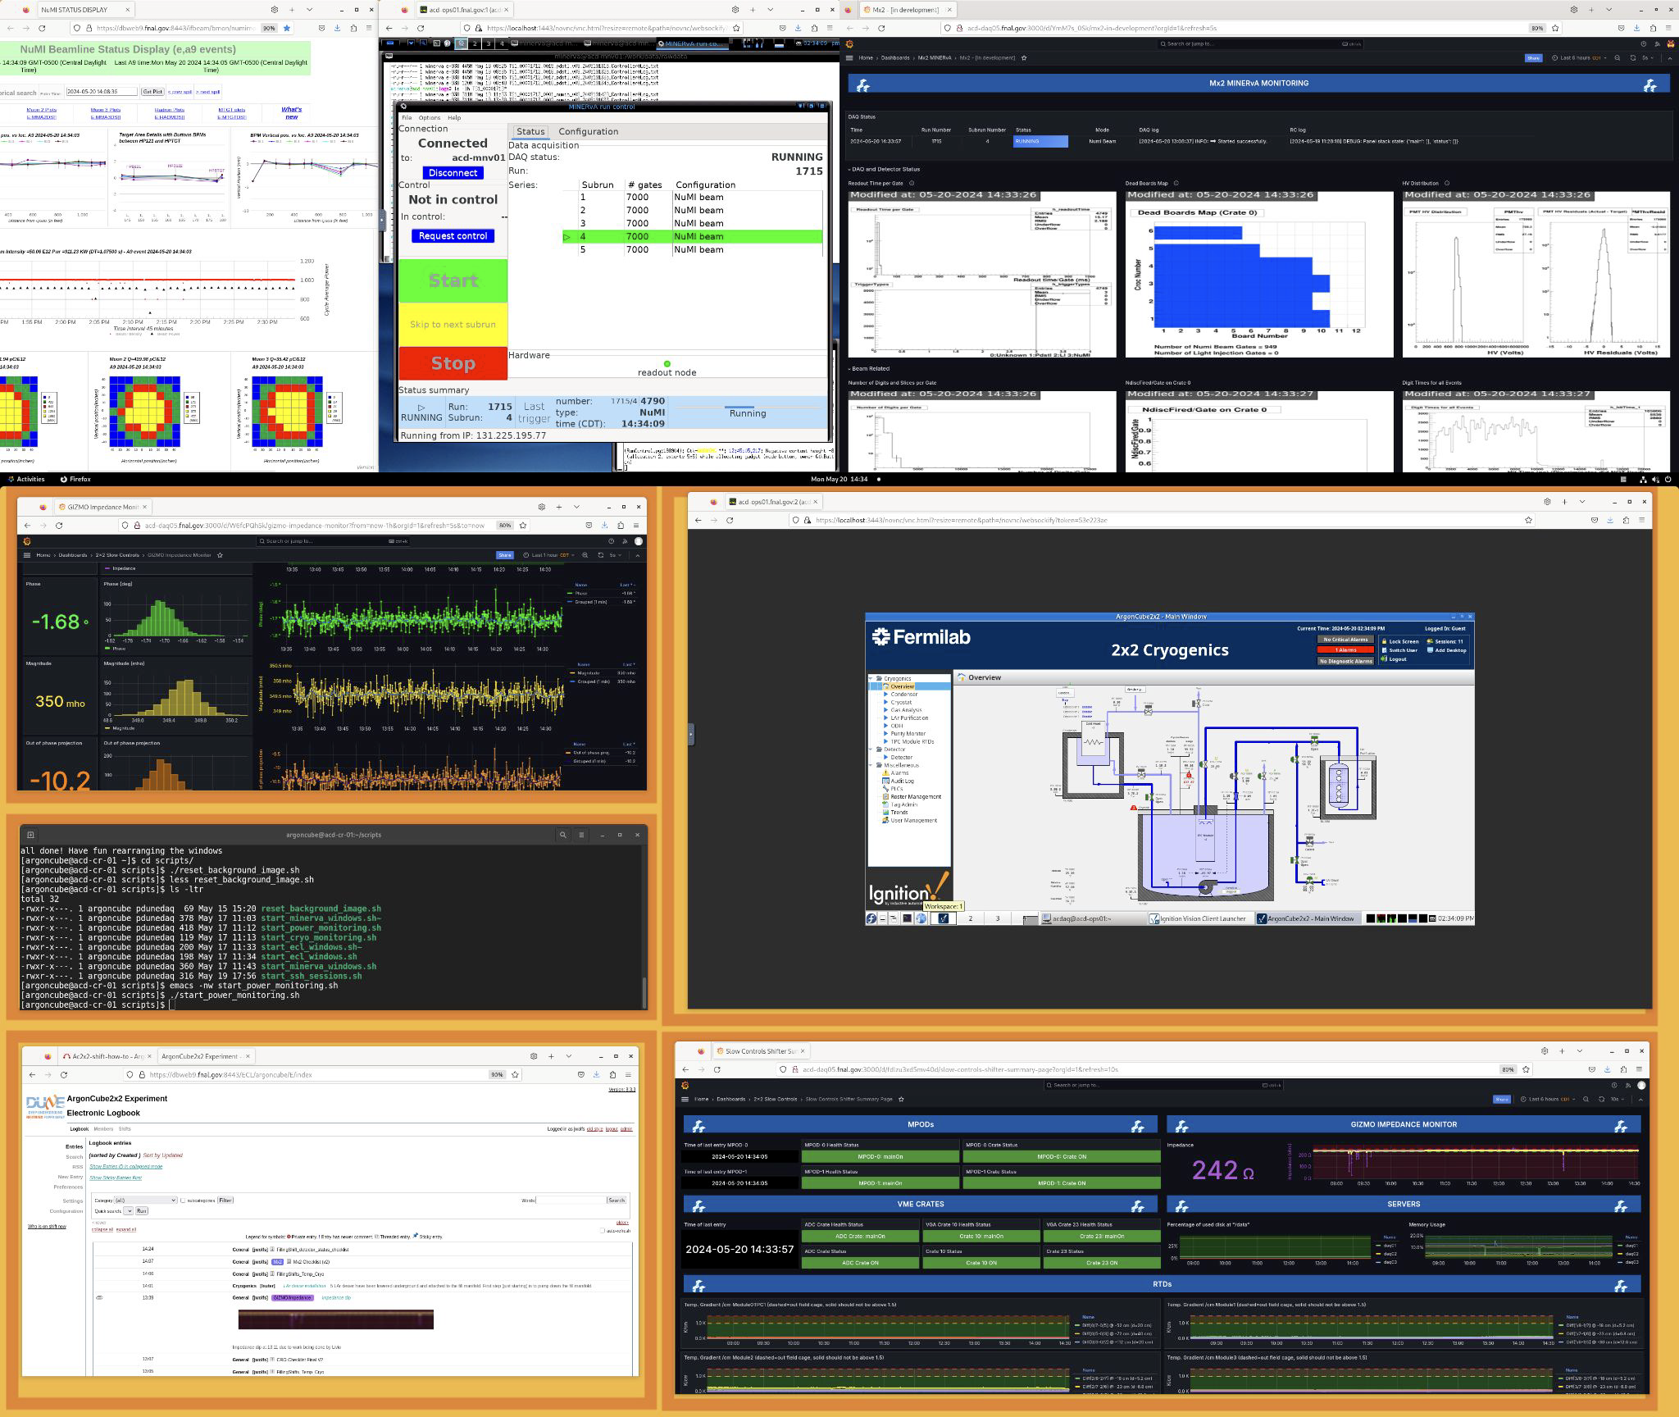
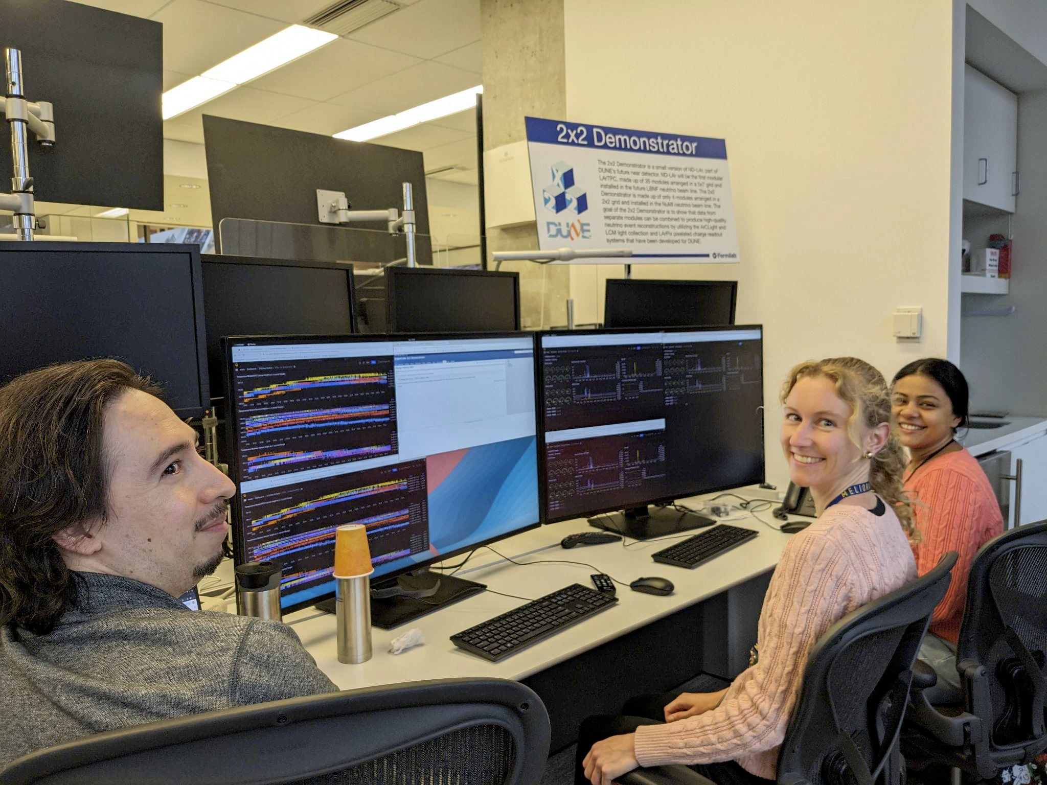
2x2 operation and shifter station / monitoring
24/7 shifting established in May

Slide 13
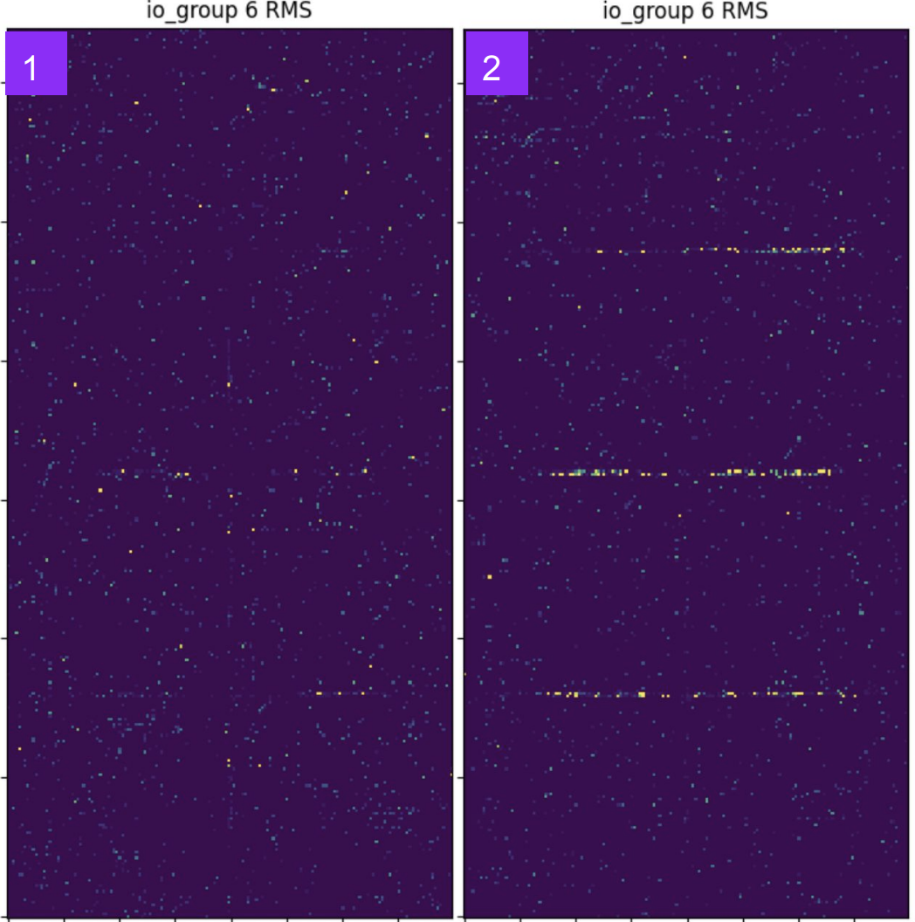
Detector Commissioning
Pixel Charge Readout:
System fully-commissioned:
>330,000 pixels
~200 keV pixel energy thresholds
>97% active pixels
Identified and mitigated new noise:
Microphonics from cryocooler vibration

Slide 14
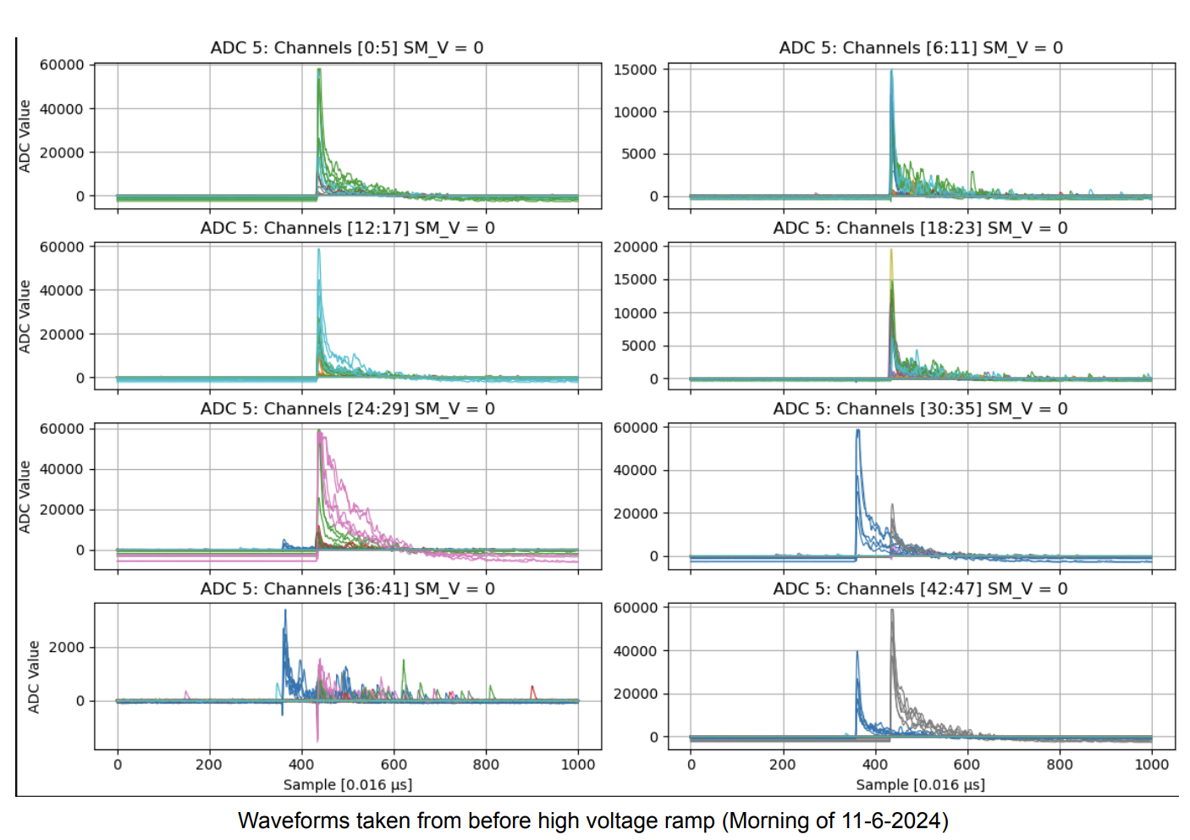
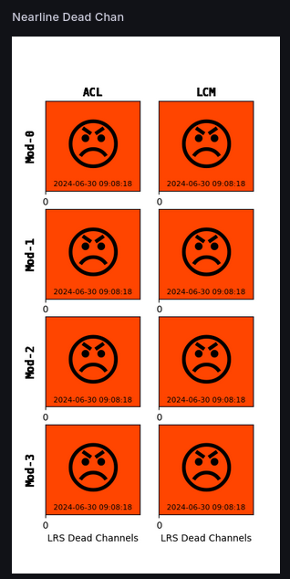
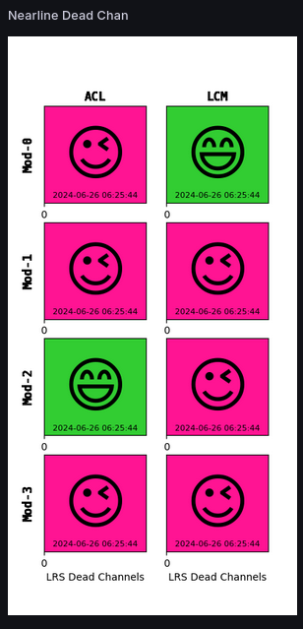
Detector Commissioning
High-coverage Light Readout:
System fully-commissioned:
64 Light Trap Assemblies
384 SiPMs
Observed signals in-time with NuMI neutrino beam pulses

Slide 15
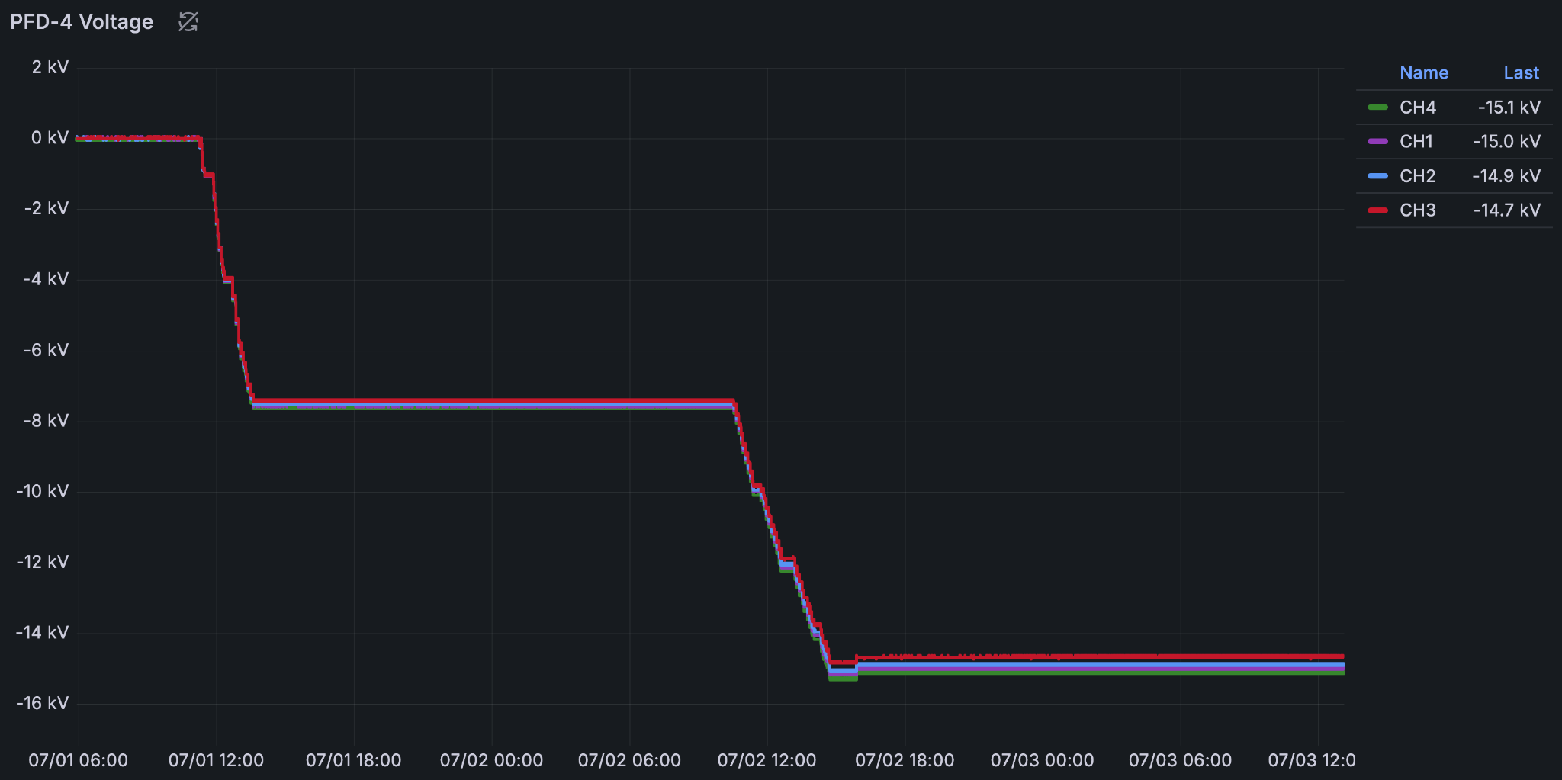
Detector Commissioning: High Voltage
July 1-2:
Ramp to 500 V/cm (target)
Uneventful, aside from some minor discharges observed in two light modules near ~500 V/cm.
Maintained HV on detector
Start of preliminary operations / data collection!
June 11:
Successful test ramp to 250 V/cm (½ target)
Complicated by unstable LAr level
Cathode Voltage
0 kV
-7.5 kV (-250 V/cm)
July 1
July 2
-15.0 kV (-500 V/cm)
-15 kV

Slide 16
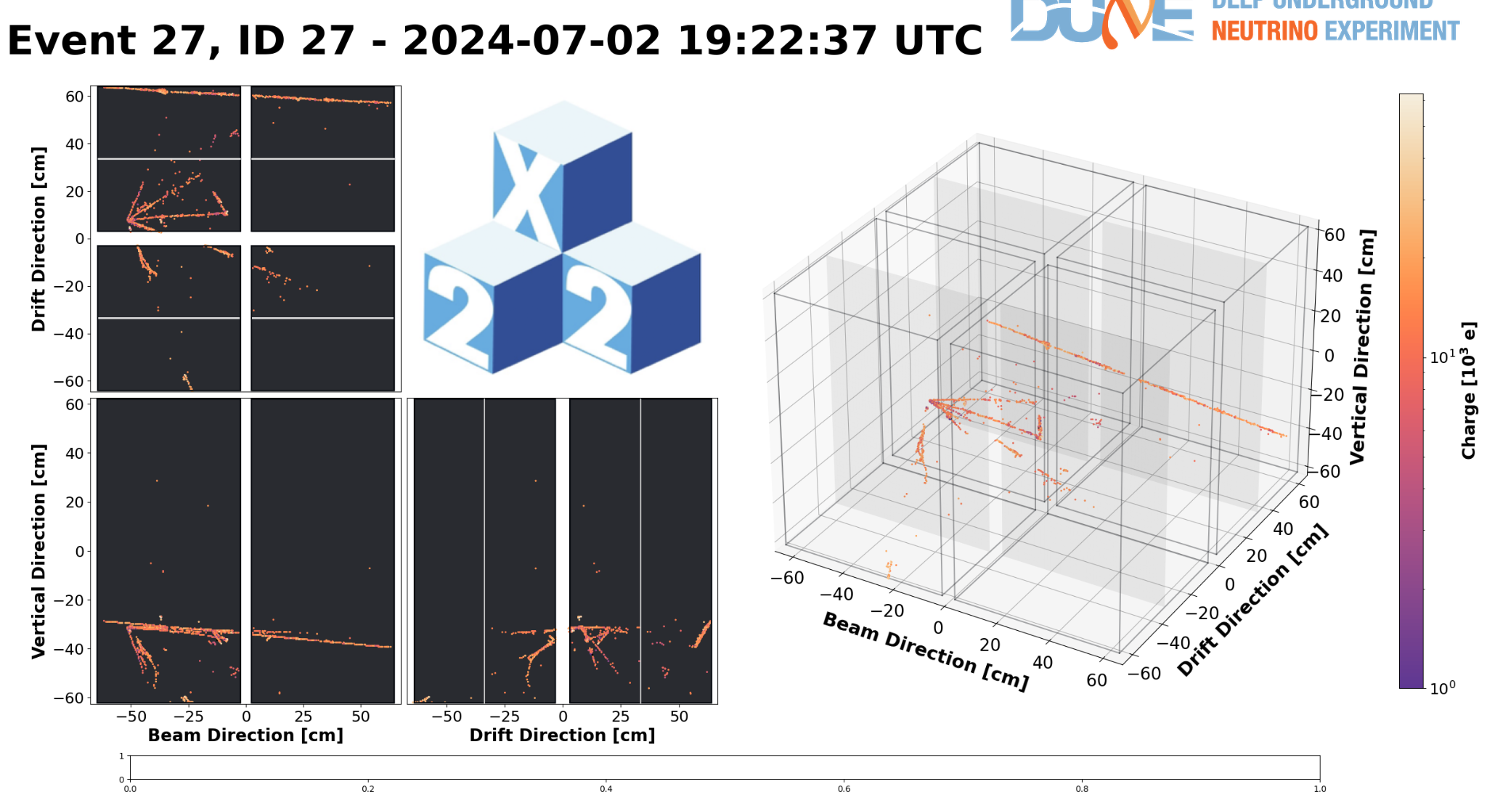
Detector Commissioning: Initial NuMI Signals

Slide 17
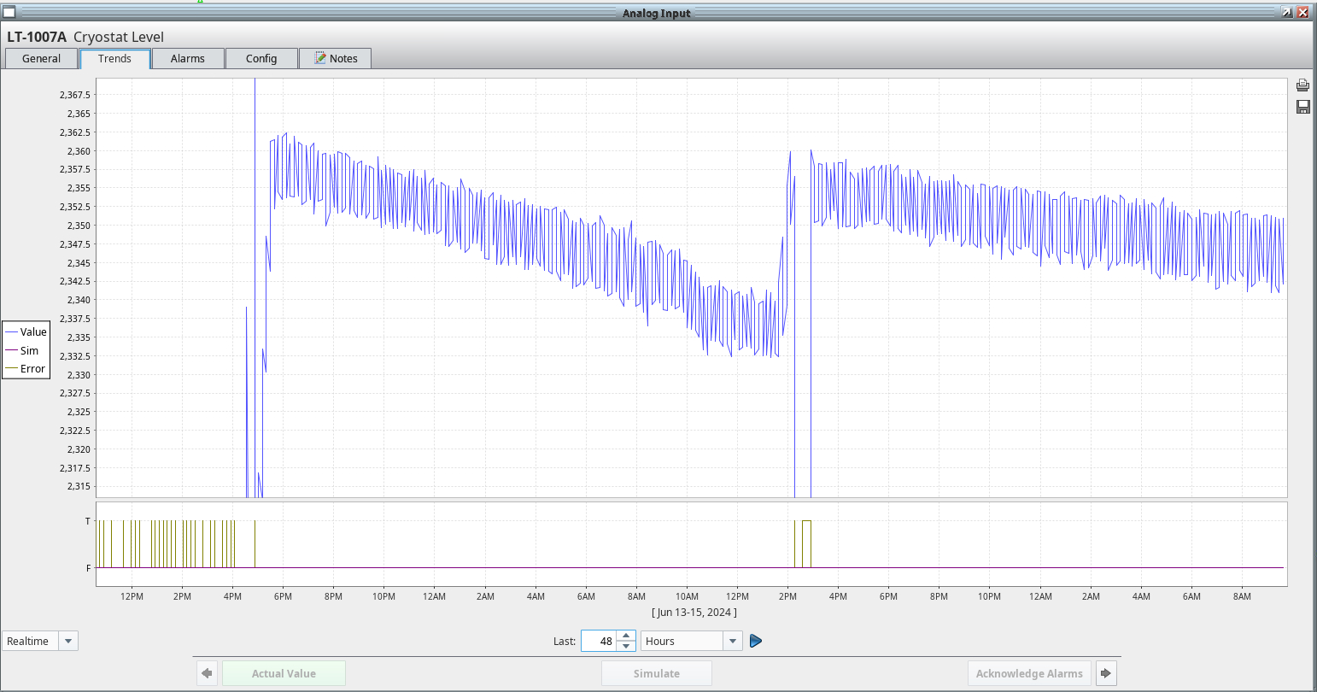
Cryogenics Commissioning
Significant focus for past month
Addressed multiple obstacles to 2x2 operation:
Leak in LAr purifier ✅
Regeneration of LAr purifier ✅
Resolution of electrical interference for LAr level sensor ✅
Installation of make-up gas system to compensate for leaks ✅
Repair of broken cryocooler ✅
Stabilization of LAr level ✅
Demonstration of LAr purity (>2 ms electron lifetime, 4x target) ✅
Achieve target purity while simultaneously maintaining LAr level ✅
To do:
Execute planned variations in cryo operations to inform ND-LAr cryo-system design (no beam needed)
Many thanks to M. Zuckerbrot and Brandon Howe for hard work over the past month to commission this LAr system
LAr Level

Slide 18
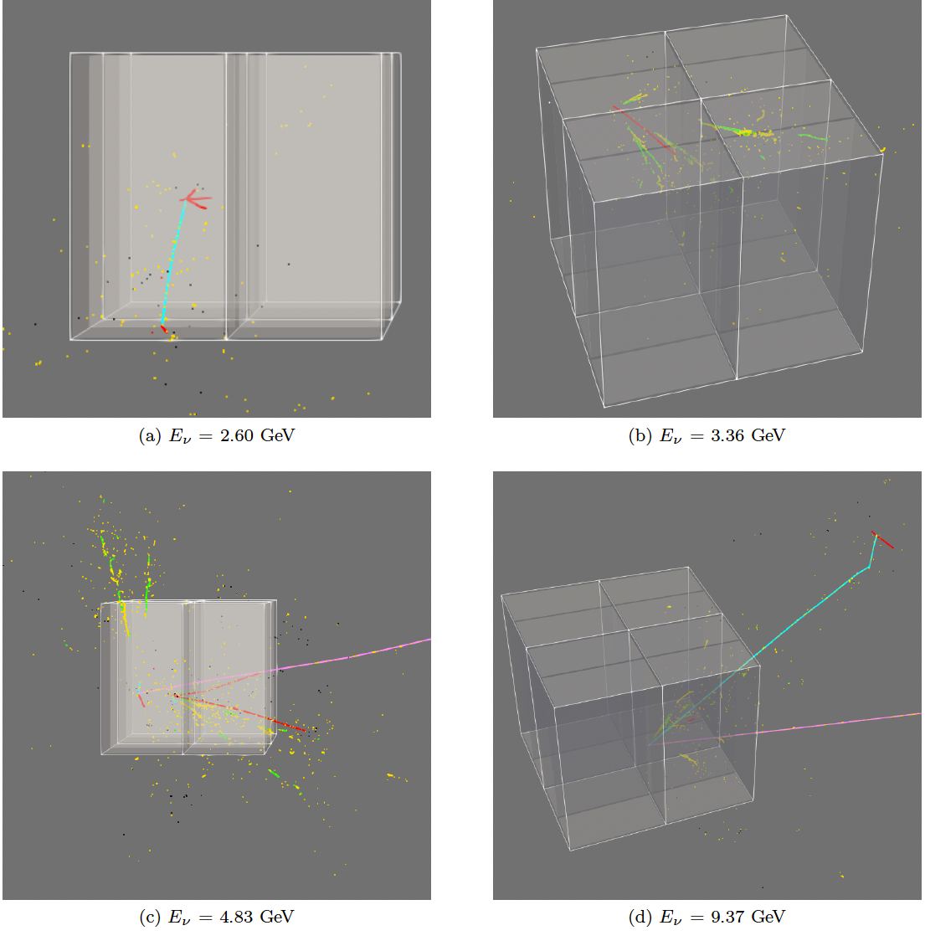
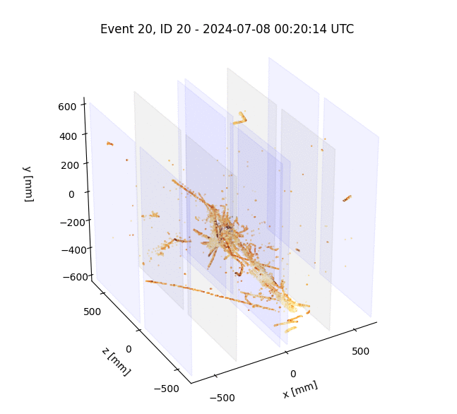
2x2 Simulation
2x2 Data (7/8/24)

Slide 19
Initial beam plans for completing review stages (FDR)
ND FDR 2024 to early 2025:
Establish that the detector meets technical specifications
Reconstruct 𝜈 interactions, match data across detectors, cope with high-rate environment
Complemented by Full-Size Demonstrator program for technical readiness
Defined two benchmark analyses for the 2x2:
Track multiplicity Limited reconstruction need (vertex, tracks), counting. Requires matching tracks between TPCs.
Charge-to-light matching Fundamental aspect of the ND-LAr design for pile-up mitigation Needs events with multiple neutrino interactions (high intensity or more POT)
We estimated O(30) days of beam data to complete this, we collected several days in FY24.

Slide 20
Track multiplicity initial data (simulation)
Benchmark Analysis #1
10% statistical uncertainty in 4-5 track events with 1E20 POT (about 20 days)
Notes:
At 4.5E13 POT/pulse, 1Hz (~800 kW NuMI beam power), RHC, we expect about 50 neutrino interactions per hour with a vertex within the detector and an exiting muon.
We aim at an (anti-)neutrino 80% sample purity (combining information with MINERvA planes) at a selection*acceptance efficiency of 10%.
Track reconstruction efficiency of around 30% (average for 1 cm to 10 cm track lengths) from simulation. Apply a factor of two adjustment expected for initial data.

Slide 21
Charge-to-light matching (simulation)
Benchmark Analysis #2
30 days of data, roughly 1.5e20 POT,
resulting in 10k events reconstructed with 3 vertices or more (= percent-level benchmarking of charge-light association fidelity with non-trivial multiplicity, >2)
0.3% of spills
3 interactions in a spill

Slide 22
ND-LAr Analysis Workflow
Example simulated spill
in the 2x2 Demonstrator
Robust analysis infrastructure built essentially from scratch
Strategy and most developments directly portable to ND-LAr and the ND complex
e.g. replace MINERvA with TMS
Still undergoing improvements, but already operational

Slide 23
LAr Simulation, Calibration and Reconstruction
Mature detector simulation and calibration
Detector simulation benchmarked with cosmic data
Robust calibration routine (flow) exercised with both simulation and cosmic data
Have undergone many iterations:
Addressed feedback from reconstruction, CAF, and analysis teams
Advanced analysis stage:
Development of common selection and calibration tools
Exercising production of calibration and configuration files
Event building for cosmic and beam data
Development of event displays
Reconstruction for ND-LAr’s modular, pixelated output
Development of two independent reconstructions well underway: ML reco and Pandora
Have working version with good performance, optimization in progress
Additional improvements under development:
Track & shower building across 2x2 and MINERvA
Use of light information → essential for pile-up mitigation
DUNE Paper: Published in JINST (2023)
Highly-parallelized simulation of a pixelated LArTPC on a GPU
Real cosmic event from Module-1 visualized with new event display
Performance of current version of ML reco for 2x2

Slide 24
MINERvA, CAFs and Systematics
Summary of MINERvA for 2x2 calibration status
MINERvA for 2x2
Detector simulation and reconstruction successfully adapted for 2x2 configuration
Collecting real data!
Detector is calibrated
Data management exercised with data, automation in progress
High-Level Analysis Files (CAFs)
Led CAF structure overhaul that benefits full experiment
Several generations of CAFs have been produced
Many improvements and fixes now implemented
Common toolkit “CAFAna” in advanced stages of development
Handles messy details (e.g. interface with systematic tools, POT counting)
Systematics
Have working interface with cross-section and beam systematic tools
Geant4 reweight and detector systematics under active development
Varied samples being produced at NERSC and ANL
New methods being investigated (e.g. Snowstorm)
Example of NuSystematics used with 2x2 CAFs

Slide 25
2x2 Analysis: Towards Physics
2x2 Production: the Road to Maturity
Fully Operational Production Chain
Developed at NERSC to benefit from extensive GPU resources
Successfully exercised in small productions of 1x10¹⁹ POT each
Many improvements still happening, but approaching maturity
Analysis Preparations
Expect many interesting physics results
Focusing on topics that can be released relatively quickly
e.g. track multiplicity and CC0π
Vibrant Group
5 in-person workshops in the last 18 months
7 subgroups focused on different areas
May 2024 Workshop @ FNAL

Slide 26
2x2 program in NuMI beam delivery scenarios
As we just started operating the detector a few days ago, we are not in a position to present firm and robust physics capabilities based on fully reconstructed data to discriminate between scenarios 2,3,4.
We only collected a few days of physics data in FY24, which are below our expectation for initial analysis (“30 days of good quality data”).
Option 1, without NuMI neutrino beam, would prevent major progress on reconstruction, analysis and physics commissioning (native 3D data, calorimetry, showers, particle ID, neutron reconstruction) that are critical for the DUNE near detector and overall program.
Option 1 has significant risk of losing critical engagement
About 50 early career scientists depend on 2x2 data

Slide 27
2x2 (Anti-)neutrino data samples to be collected
The 2x2 offers unique opportunity to collect data samples for antinu-Ar interaction studies in a phase space of relevance to DUNE
2x2’s on-axis position and neutrino energy unique among other SBL detectors
Almost no multi-pion data available at DUNE energies → significant modeling challenge
Sensitive to inclusive distributions (no muon momentum or neutrino energy determination)
As POT increases, we gain access to more channels
Potential for many interesting PhD physics topics for our O(30) PhD students
MicroBooNE-NOTE-1129-PUB
Similar phase space to DUNE + benefit from MINERvA’s characterization of NuMI beam
Unique position to evaluate RES & DIS cross-sections
2x2

Slide 28
Multi-Pion samples
Numbers obtained by selecting high-purity muons punching through back of the detector, and pions contained within the active volume with E_{π} < 0.5 GeV. Full NuMI RHC + detector simulation (no reco)
0ᴨ⁰ | Option 2 | Option 3 | Option 4
1ᴨ± | 26320 | 39760 | 66080
2ᴨ± | 6683 | 10096 | 16780
3ᴨ± | 1457 | 2201 | 3658
1ᴨ⁰ | Option 2 | Option 3 | Option 4
1ᴨ± | 1673 | 2528 | 4201
2ᴨ± | 458 | 692 | 1149
3ᴨ± | 100 | 151 | 250

Slide 29
Summary
2x2 Progress:
Built, tested, integrated a modular TPC
Successfully started detector operation July 8th at nominal E-Field
Analysis Progress:
Simulation & reconstruction (pixelated readout, native 3D, modular setup)
Complete workflow established and exercised on simulation ‘mini-run’ scale
Workflow also tested on single-module cosmic and 2x2 commissioning data
More NuMI beam:
We do need to collect more data to complete prototyping, validate component longevity, spur analysis development, and inform ND-LAr Final Design Review and DUNE ND Technical Design Report
Scope achievable with OPTION 2, RHC with short period at FHC (pile-up, comparison). More data will offer more options for PhD theses.
Around 50 junior collaborators depend on data, significant risk of people drain w/o data
Expect to optimize and stabilize cryogenic operation during shutdown.

Slide 30
ND-LAr International Consortium
~40 institutions
Consortium Lead: M. Weber (Univ. of Bern)
Technical Lead: D. Dwyer (LBNL)
Lead Engineer: A. Lambert (LBNL)

