Slide 1
9 O’Clock Meeting
Kit Danison-Fieldhouse
Friday, April 12th, 2024

Slide 2
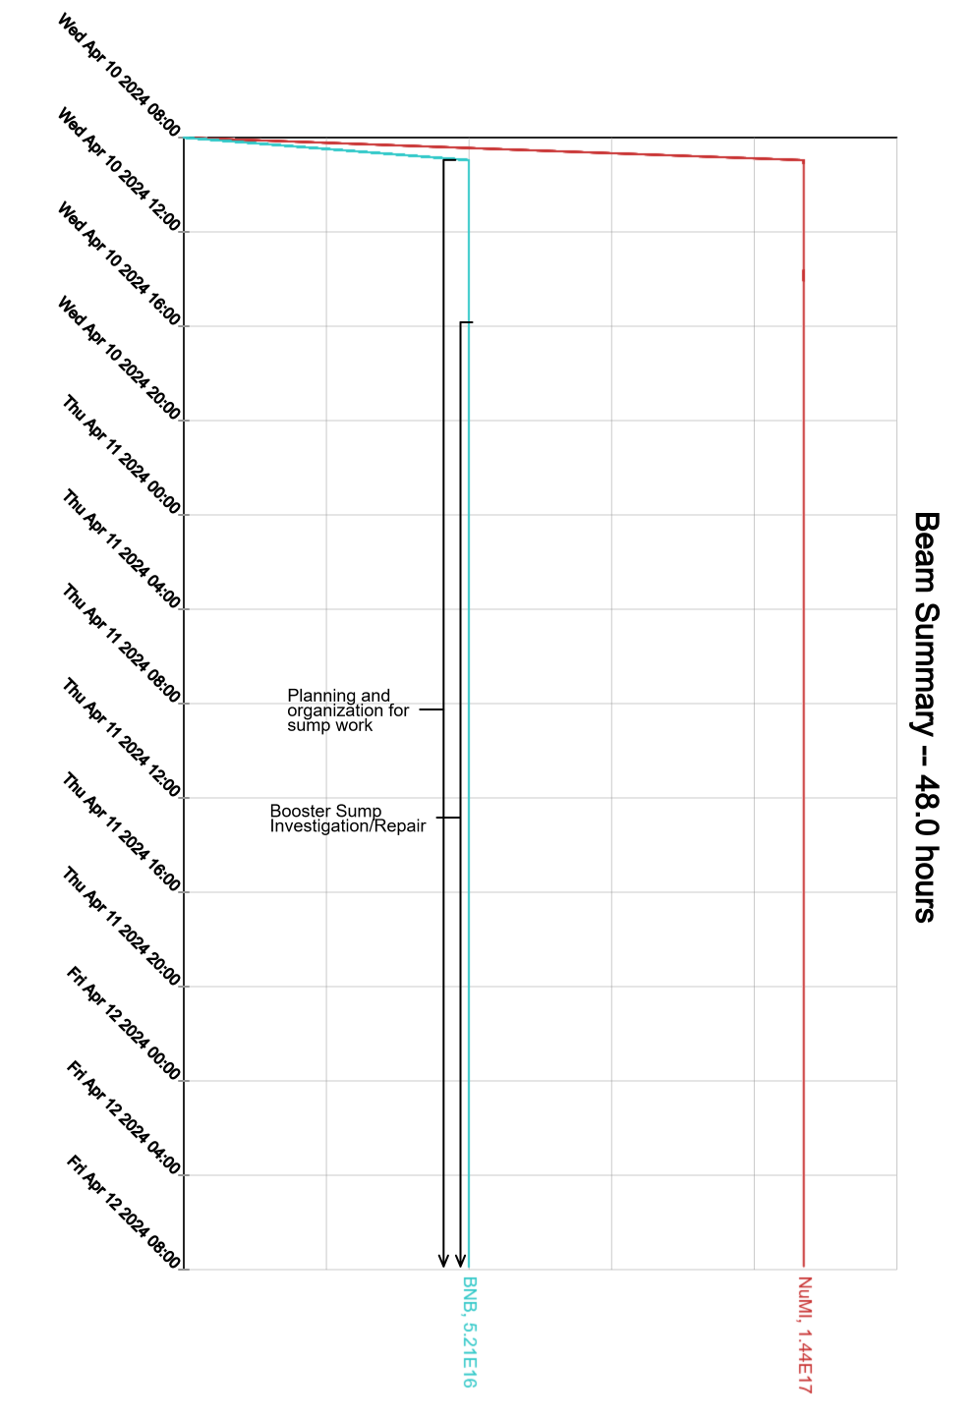
Since Wednesday…
HEP down since Wednesday morning.
Ran some studies beam in Linac.
Various opportunistic gallery work.

