Slide 1
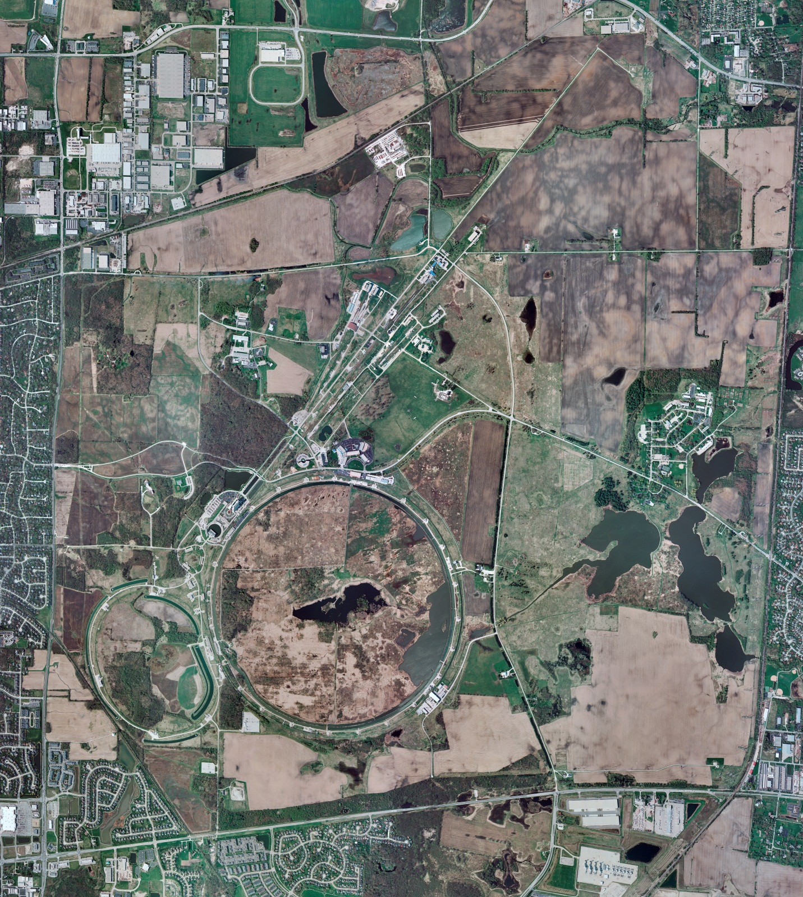
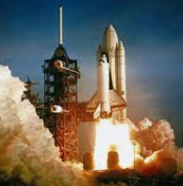
Helium Cryogenics
Status 4/12/2024 J.Makara
CMTF: SCP is cold running fine with 40 K heater repaired
CMTS: HECM29 connections in progress though helium to vac leak hampering cooldown
PIP2IT: South CM stand being modified for SSR2 pCM
North CM stand w/HB650 installation in progress
MCTF: cryo system startup in progress, with 3 conprs and purifier online; Frig cooldown as well
MDB/HTS: at RT
MDB/STC: at RT but to be cooled down for SSR2
MDB Magnet: at RT
NML/FAST: Cryo system is shut down and isolated for extended shutdown period;
CC1: at RT
CC2: at RT
CM: at RT
IB1: cryo system cold at 5 K and 2 K operations
Muon Campus: at RT with comprs off and system depressurized; LN2 off
Misc:…

