Slide 1
Muon Campus Operation Report
Jim Morgan
Friday 09:00 Operations Meeting
April 12, 2024

Slide 2
Muon Campus status
ESS1 & ESS2 Electrostatic Septa
ESS1 high voltage conditioning began Wednesday at NWA
ESS2 assembly has been paused while other work took place in the A0 Clean Room
Working towards permission for beam operation, beginning sign-offs
Half-way through beam sign-offs
Finishing vacuum work in D30 straight section
Finishing punch-list items from shutdown work
Power supply inspections
Plan to r-core Delivery Ring, Extraction and M4 Enclosures to operational keys
AP-0 A/C work continued
Performing tunnel inspections of water valves and cabling
Study – M1-M3 Optics
Study – Alternative M5 optics

Slide 3
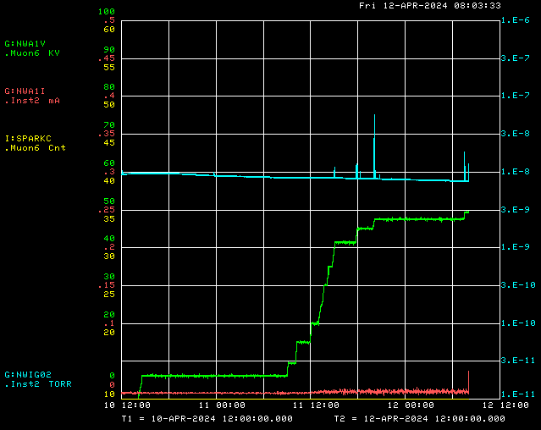
ESS1 high voltage conditioning at NWA
Ion Gauge
ESS1 P.S. Voltage
ESS1 P.S. Current
Spark Detector

Slide 4
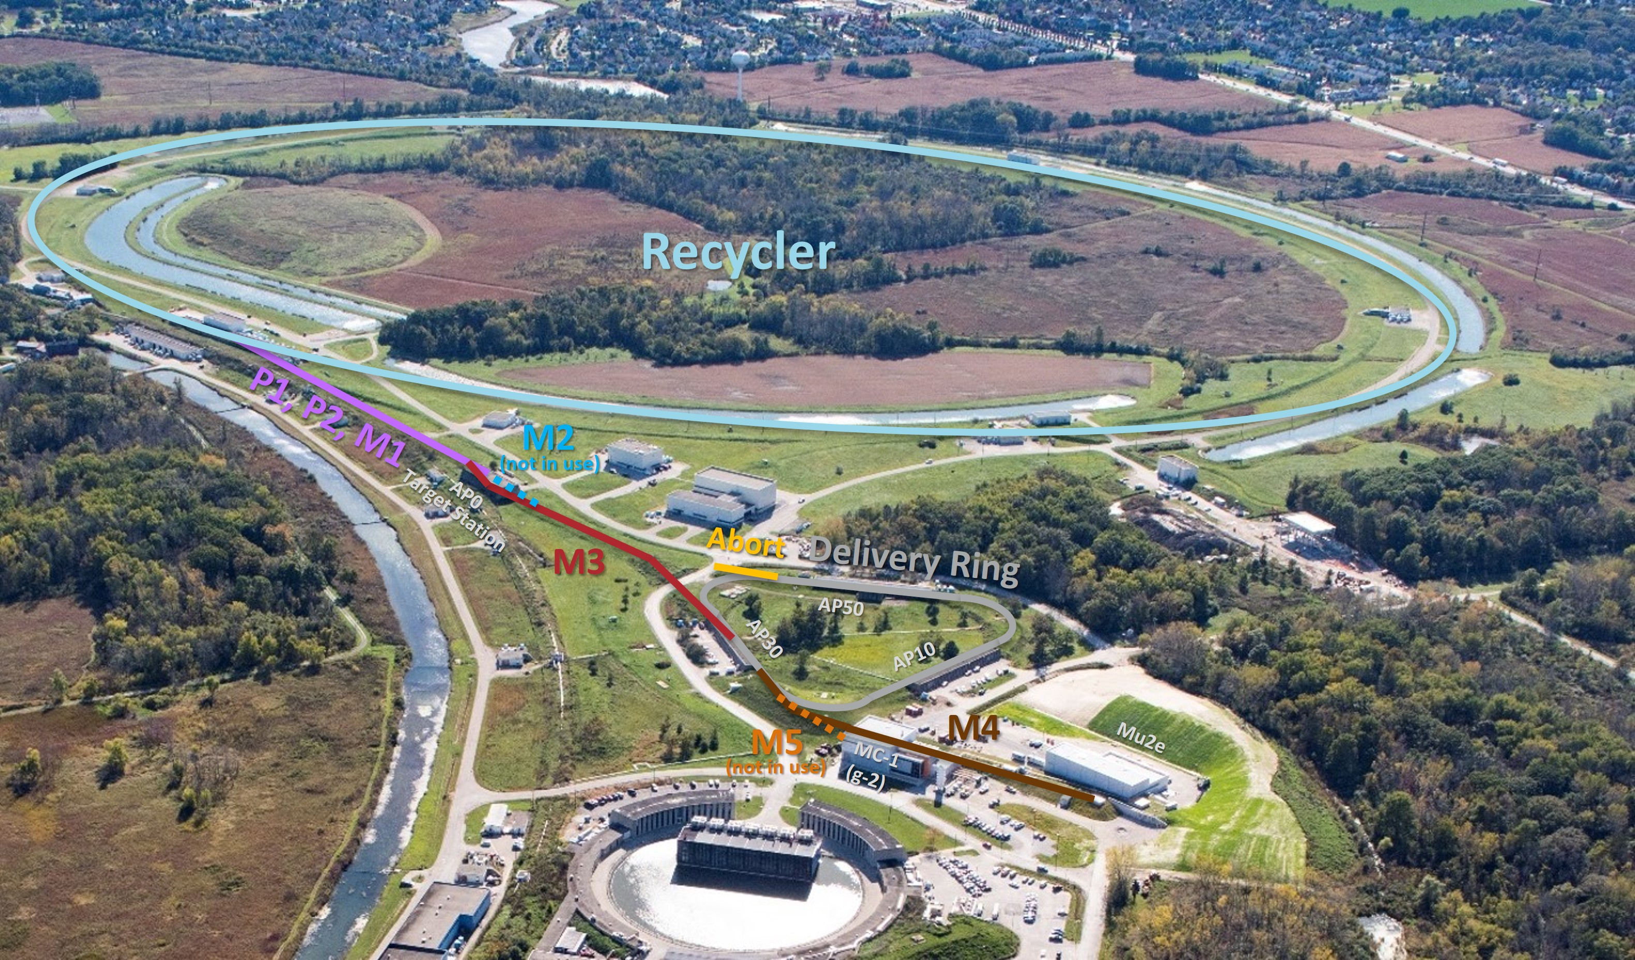
Muon Campus in Mu2e mode

Slide 5
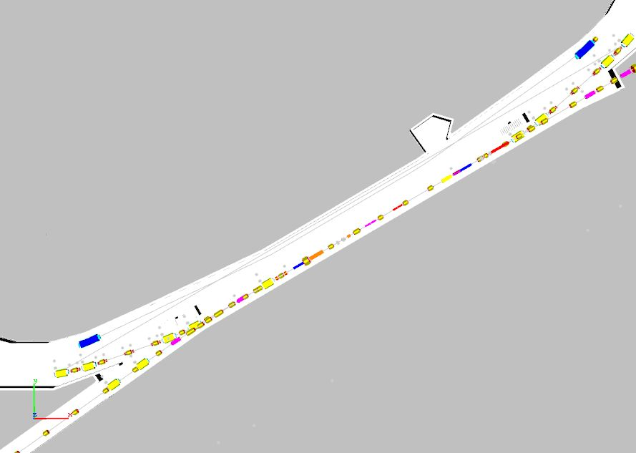
D30 Vacuum work
Final area to be pumped down

Slide 6
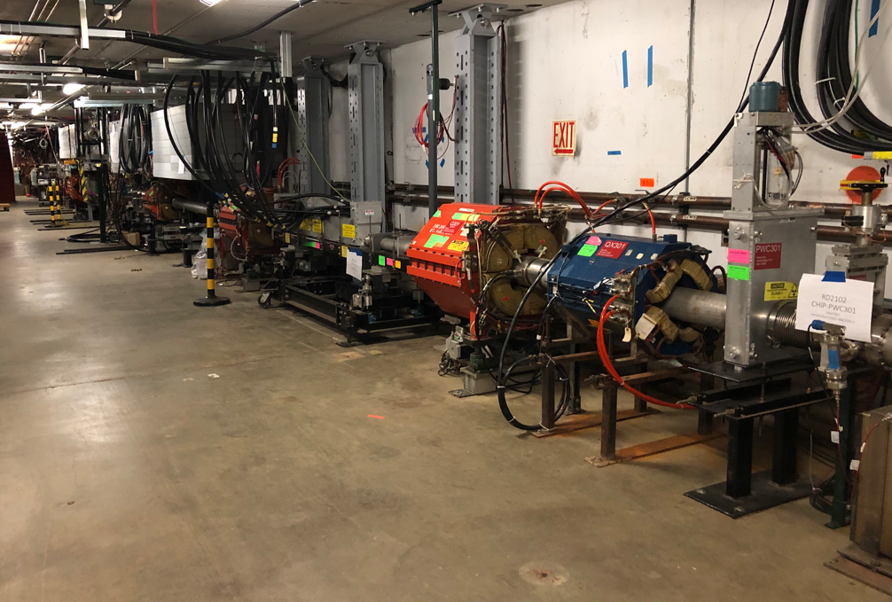
Final vacuum interval to be pumped down
ESS2 & BVH203
BVH301

Slide 7
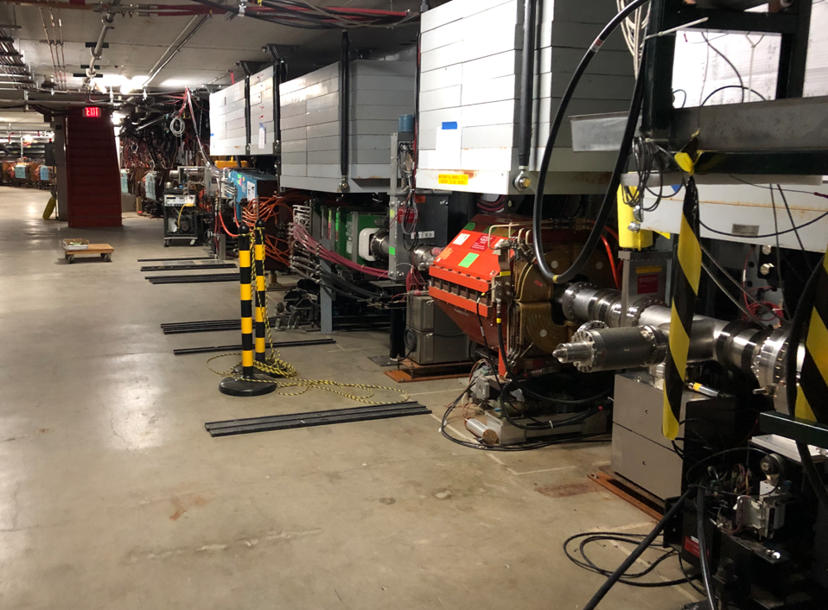
Downstream D30 and upstream M4 Line pumped down
BVH209 & BV907
BVH203

Slide 8
Upcoming work
ESS1 and ESS2
ESS1 high voltage conditioning continues at NWA
ESS2 assembly will resume at A0 Clean Room
Need to finish up D30 vacuum work
Working towards pumping down final area not at vacuum, which includes ESS2
Hope to be finished with mechanical work next week
AP-0 A/C work continues
Access to AP-0 Water Cage and rad fence area simplified while not running beam
Hope to resume beam operation later this month
Working on beam sign-offs
Plan to re-core Delivery Ring, Extraction & M4 Enclosures from Shutdown keys next Tuesday beginning at 16:00
Still need to safety test these three enclosures
Will start nagging people to remove LOTO locks at the end of each day

