Slide 1
MI/RR machine report
Meiqin Xiao
Friday 9 O’clock meeting
12 April 2024

Slide 2
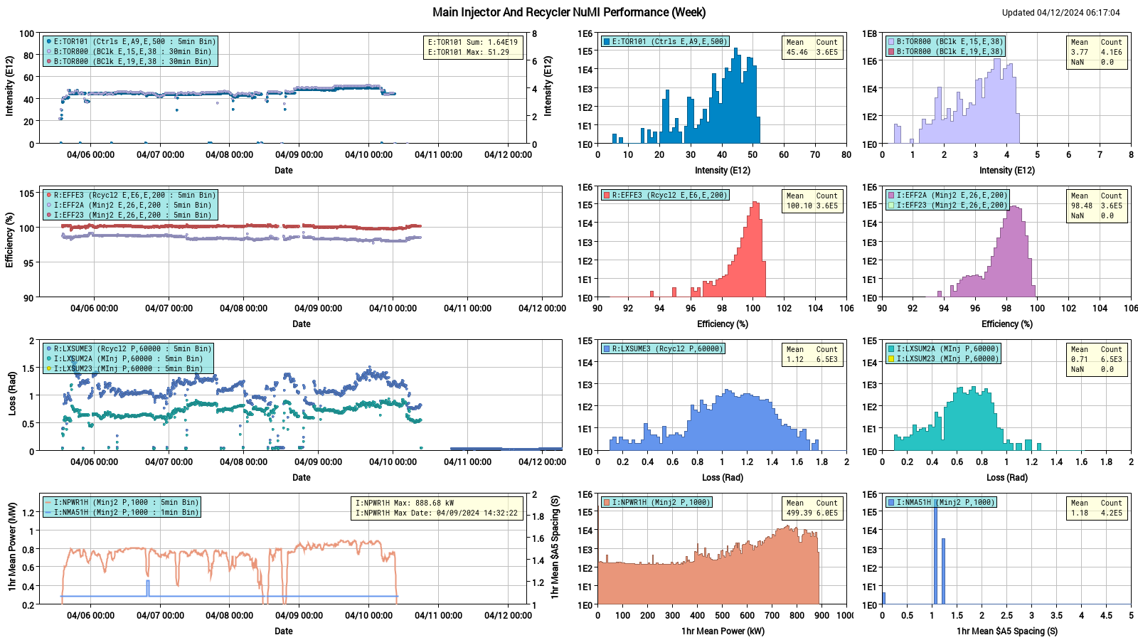
NuMI performance

Slide 3
Weekly summary
MI:
MIRF08 and MIRF 20 tripped due to bias supplies failed with offset PS AC overcurrent. MIRF06 had intermediate issues, got by passed after lots of trips. RF groups recovered them and get 19 stations running on Monday. MIRF06 coming back up
MIRF13 tripped on FBS LCW Off. It reset without issue, but this has been an issue in the past
several aborts in MI early in the cycle around 608F. The issue with MECAR errors was tracked down to the tier behavior of the quad buses. EE group expert changed MECAR settings, MECAR quad bus errors at start of cycle are now significantly improved
Instrumentation group is trying to calibrate MI DCCT, and efficiency related devices R:TOR853, R:TOR903, E:TOR101 and R:TOR853 (R:SE3853)
MI8 line:
MI9 line BPMs has been running stable.
RR:
Finished New ramp corrections into RR Horizontal and Vertical trims
KPS4D thyratron replacement work started a bit before 0700, should be done before noon.

Slide 4
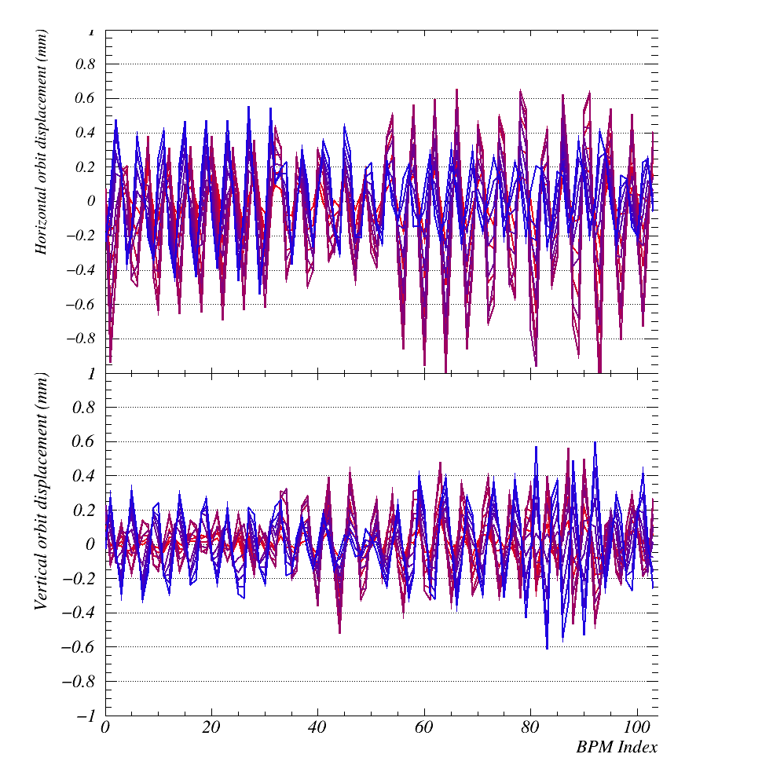
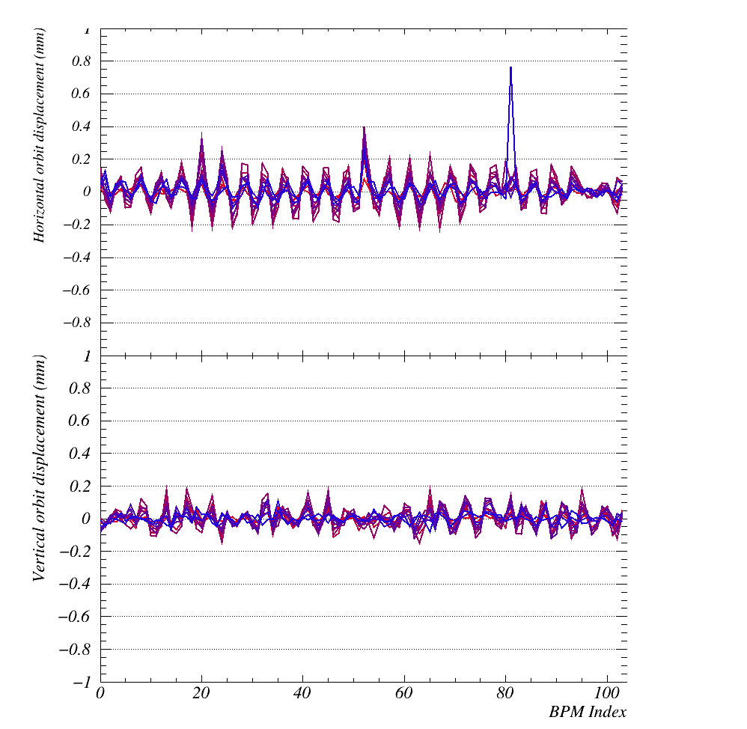
Study
Before
after
R:HP426
R:HP100
R:HP100
R:VP101
R:VP101
Different colors are different injections; all orbits taken relative to first injection. Colors start at red for injection 2, and shade towards blue for injection 12.

Slide 5
Plan
Run beam to Numi
Dedicated study for placing orbit on the center of trim quads in RR30 and RR60 ,
Looking into local losses appeared at 321 and 327 in recycler. re-visit local aperture scan.
Re-take RR TBT data for the lattice measurement

