Slide 1
Project Activities for MSD
Mayling Wong-Squires
AD Operations Friday 9am Meeting
12 April 2024

Slide 2
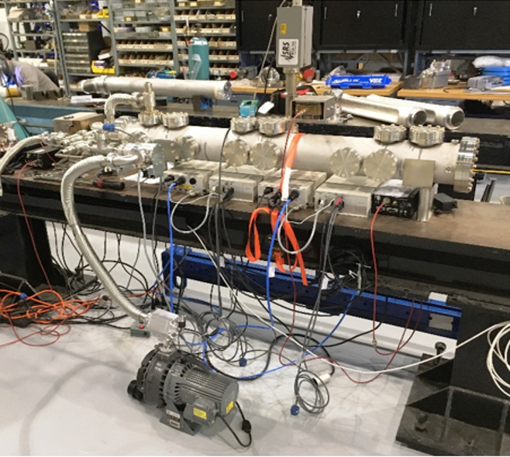
LBNF Primary Vacuum and Magnet Installation Kevin Duel, Ty Funk, Rob Ridgway, Monika Sadowski, Jason Morin, Scott Oplt, Dirk Hurd, Matthew Volante, Peggy Jones, James Williams, Dan Vrbos
Primary Vacuum
Releasing beamline drawings
Working on transportation chapter FESHM requirements for production kicker beam tubes
Working on top level assembly drawings of kicker magnet and beamtube
Kicker ceramic beam tube TiN coating outgassing testing in progress and 1st results expected today
Waiting for 12” long tube samples from vendor
Magnet Installation
Addressing comments and recommendations for Primary Beam Enclosure (PBE) dipole stand and multiwire stand engineering note
PBE dipole stand design/drafting in progress
Multiwire stand drawings in final review
Magnet vehicle technical specification updated and being reviewed
Outgassing test setup at NWA

