Slide 1
LBNF - Beamline – Target Complex
Horns
Redesign of Horns B & C outer conductors
Design and modeling has just finished
Investigated vendors’ capabilities
Will start with designer to redo many drawings
Friction Stir Welding
Vendor 0:SDSMT reworked horn stripline failed x-ray quality – will continue for doing vibration studies…eventually a nice display piece
Vendor 1: small German company sample piece passed xray and mechanical testing; sending Test Stand stripline stub for welding; will follow with Horn A Prototype stripline
Vendor 2: PNNL to do sample pieces; agreement has been sent to procurement
Investigation into spider support within horn and possible spark issue due to people working on outer conductor redesign
Large ceramic insulating ring – Kyocera has given a budgetary estimate at nearly twice it was five years ago.
Assembly of Prototype hangers is nearly completed
Looking into thermocouple electrical standoff for conductor monitoring
LBNF Beamline Highest priority

Slide 2
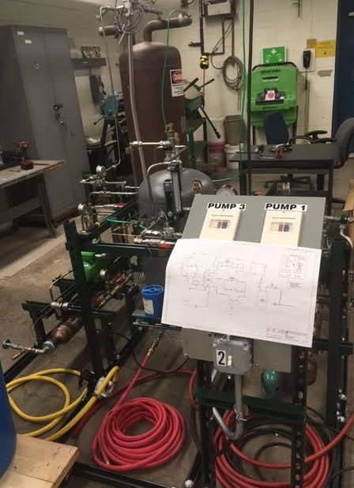
LBNF - Beamline – Target Complex
Horns Power Supply
Many procurements in process
Issues with chokes continue; fixes are being implemented
Water systems
Test Stand Skid preparing drawings and documents for procuring vendor to build skid
Nearing the completion of drawing sets for Horn B & Horn C RAW systems
Newly assigned engineer is now familiar with Water Cooling Panel RAW system; await designer to be assigned.
Design of controls for water systems has come to a stand still.
Gas control system prototype installation @ C0 and ORC completed; instrumentation and control tested.

