Slide 1
9am Operations Meeting – 12 Apr 2024
Neutrino Muon – Kmag Testing

Slide 2
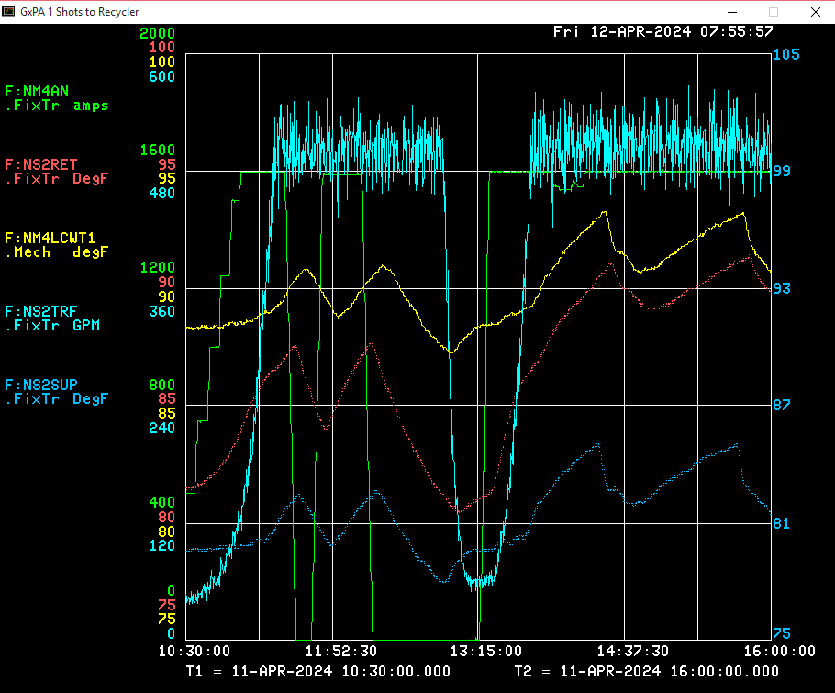

Slide 3
