Slide 1
The Liquid Argon TPC DR Project
1 February 2013
Christopher Mauger
LANL

Slide 2
Outline
2
The LDRD Program and our Project
Current Status of the Detector
Goals of this meeting

Slide 3
LANL LDRD Program
6% tax on ~$2B annual budget
Major programs:
  Director’s funded postdocs
  Exploratory Research (ER) – 3 year duration
    single PI with some M&S
    part-time PI with postdoc
  Directed Research (DR) – 3 year duration
    multi-investigator project
    significant M&S funding
Until last year, 8 ``grand challenges’’, one related to fundamental nuclear and particle physics:
  Beyond the Standard Model (BSM)

Slide 4
LANL-speak
LANL is organized into:
  Principal Associate Directorates
  Associate Directorates
  Divisions
  Groups
  Teams
Relevant for LBNE:
  Theory Division, T-2 group
  Physics Division
    P-23: Neutron Science and Weak Interactions Group
    P-25: Subatomic Physics Group
Groups in P-Division have ~30 staff scientists (like small/medium physics departments)
Physics Division is primarily an experimental division
There are four groups in Physics Division, two of which do fundamental nuclear and particle physics. There is a lot of overlap between them.

Slide 5
LANL LBNE-related LDRD
We were awarded a DR project to support effort associated with LBNE - FY12-FY14
Multi-division project with three groups: T-2, P-23 and P-25
  PI: Mauger (P-25), Co-PI: Carlson(T-2), P-23 lead: Sinnis
  Explore three major physics goals of LBNE associated with BSM Grand Challenge (Leptonic CP Violation, Nucleon Decay, Burst Supernova Neutrinos)
Theoretical Effort
  CP Violation: neutrino-nucleus interactions important for extracting CPV signature in long-baseline oscillation physics, Non-standard interactions
  Nucleon Decay: BSM model predictions, nuclear physics calculations to understand event signatures
  Burst Supernova Neutrinos: Imprint of BSM physics on neutrino spectra
Experimental Effort
  Absolute neutrino flux determination – NA-61
  Simulations of event signatures (Nucleon Decay, Burst Supernova)
  Develop experimental apparatus to explore important physics signatures:
    Leptonic CP violation
    Burst Supernova

Slide 6
Scientific Goals for this part of the DR
6
Successfully, build, commission and run the liquid argon TPC, reconstruct cosmic-ray muons
CP Violation:
  The LBNE far detector will not be magnetized, cannot do μ⁺/μ⁻ separation by track curvature
  Approximately 75% of μ⁻ are captured by the argon nucleus – gamma and neutron cascade
  All μ⁺ will decay
  If we can identify the captures with high purity and with reasonable and quantifiable efficiency, we can do neutrino/anti-neutrino separation
  This allows CP studies of long-baseline and atmospheric neutrinos
Supernova-related studies – spallation backgrounds, low energy particle identification, optical photons vs. ionization
Calibration development – laser calibration

Slide 7
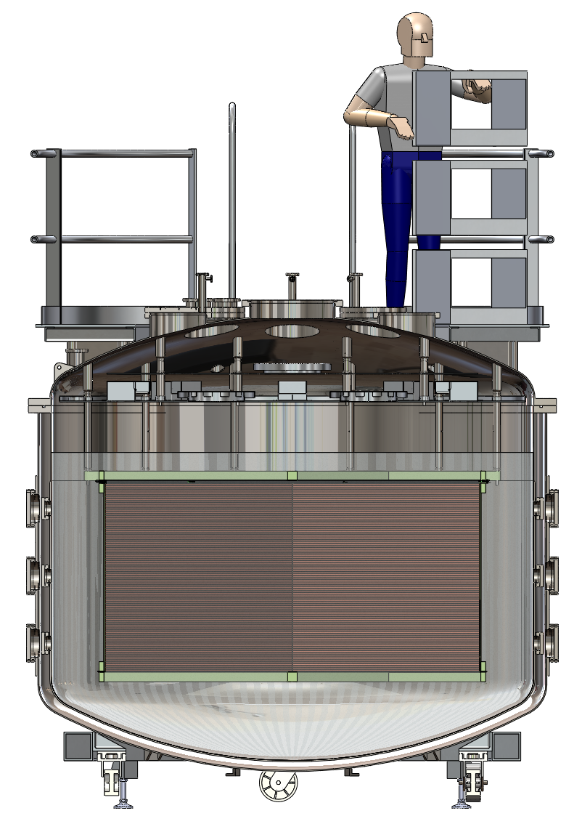
Future Scientific Goals
7
Neutron beam (on-site at LANL)
  spallation studies
  surface running backgrounds
  neutrino energy reconstruction
  beam-induced backgrounds for the near detector
Neutrino Running
  SNS running – energies relevant to supernova
    cross-sections
    reconstruction demonstration with real data
  NUMI running – energies relevant to long-baseline oscillations: bread-and-butter LBNE, NSI
    exclusive and inclusive neutrino interaction in resonance and DIS region
    explicit experience with neutrino energy reconstruction

Slide 8
Timeline of Development
8
Proposed to the LDRD Office to change the major hardware portion of this LDRD project in February, 2012
Developed the basic design and underwent review in April 2012
Held a workshop in Santa Fe in July 2012 with many external participants
  Included a broad survey of liquid argon efforts in the U.S.
  Good engagement and advice from the community
  Resulted in a design change to the cryostat and TPC (UCLA)
Made design decisions on electronics (BNL)
Should this be part of the FNAL beam-test program? (FNAL)
  LArIAT two phases, one faster (smaller), one longer-term (larger)
Moving forward with crucial procurements

Slide 9
Organizational Structure (would like to see your name here)
9
Cryostat
Cryogenics and Purification
Electronics, High Voltage, TPC and DAQ
Laser
Photon Detection System
Infrastructure and Installation
Simulation and Reconstruction
Physics Analysis
Ramsey
Sondheim
Van de Water
Sinnis
Rielage
Sondheim
Yarritu
Yarritu/Mauger
Electronics
High Voltage
TPC
Purity Monitor
DAQ
Mirabal
Mirabal
Lee
Van de Water
Ketchum
Modules
Field Cage
Cables
Feed-through
Field Simulations
Mirabal
Ramsey
Sondheim
Laser
Monitor
Optical Feed-through
Photodetector
Wavelength Shifter
Electronics/HV/DAQ
Danielson
Danielson
Sinnis
Rielage
Rielage
Rielage

Slide 10
Simulations to validate the cryostat size (Kevin Yarritu)
10
Quasi-elastic
Resonant
Plots show the distance from the vertex to the endpoint of the longest track in the event for contained CC events
Contained event: everything contained except the lepton
10⁶ neutrino interaction per 10²⁰ POT for NUMI ME tune
10% containment
Anticipate 4 x 10²⁰ POT per year
Would get 400,000 contained CC events per year during a NUMI ME run
Complementary neutrino energy spectra to MicroBooNE
Deep Inelastic

Slide 11
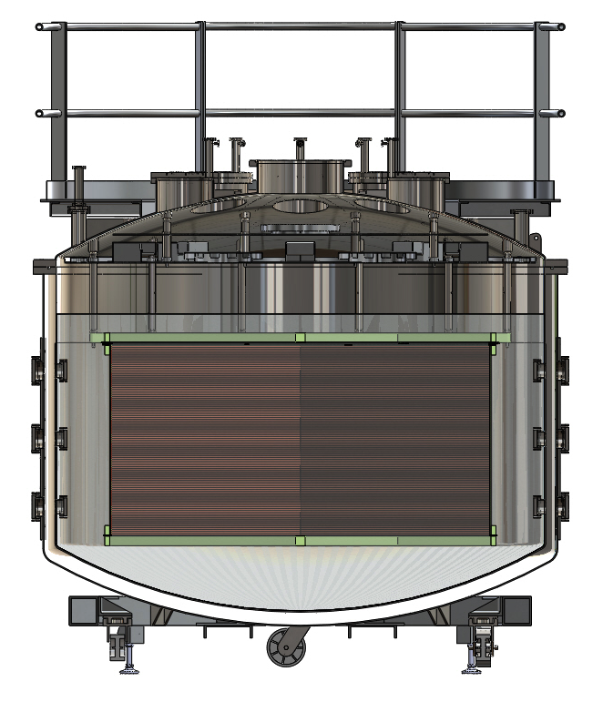
LANL TPC and Laser Design
11
4 optical ports
  2 set 15cm from anode
  2 set 15 cm from cathode

Slide 12
Current Risk Status
12
Date Identified | Risk | Status
April 2012 | Space not identified at LANL | Acquired lab space at the end of the calendar year Currently undergoing refurbishment Move-in expected in a few weeks time
April 2012 | Cryostat procurement a challenge across fiscal year boundary | Due to redesign, the procurement was delayed and now will take place in a single fiscal year (LDRD funds do not carry over)
April 2012 | LISC process may exacerbate the procurement risk | While it is extra work (and therefore cost), we have not had procurements hung up by the LISC process
June 2012 | Electronics acquisition | The cost has increased, but the procurements should happen on time

Slide 13
Goals of this meeting
13
White papers for Snowmass
  neutron beam running
  running at the SNS
  running at NUMI
  produce by this weekend!
Proposal for the scientific program for this detector
  Thorough document that describes the science case for each aspect of the program, potential role of participants, need some simulation work here
  Document that can be circulated to funding agencies and major stakeholders (e.g. LBNE management)
Collaboration formation: define and carry out simulations and calculations for the proposal, define and begin longer term simulations and calculations, define participants and schedule for commissioning
We need a name!

