Slide 1
Neutron-Induced Cosmogenic Backgrounds on Argon
R.Svoboda

Slide 2
Potential Problems
Running on the near surface will expose the detector to a steady flux of fast neutrons
These neutrons will produce gammas that could mimic electron neutrino events. It is thought that these will not be important based on simulations.
They will also produce spallation products that will cause a steady "glow" at energies typically < 20 MeV. Only important if LBNE underground and there is a low energy program.
These backgrounds have not been well measured, as typical detectors have had high thresholds, or else been located deep underground

Slide 3
Full Simulation
From C.Zhang
3 meters Standard Rock
10km * 10km flat surface
LAr
Casting on 10km*10km flat surface 85E+11 events equals to live time: 85E+11/(1e+8 * 100) = 850s data. Assuming beam running time 2e+7s per year with maximum drift time 1.4ms and recycling time 1.33s, the live time equivalents to 850*1.33/(0.0014 * 2e+7) = 4.0375E-2 year beam continuous running.
Single muons are tracked from surface down to the detector. they are falling into the following categories:
  No muons but with other secondaries instead hitting the detector
  One muon with possible other secondaries hitting the detector
  Multiple muons with possible other secondaries hitting the detector
3

Slide 4
Result - Breakdown
From C.Zhang
Collection of all category #2 events
Statistics:
4.0375e-2 year beam running
4

Slide 5
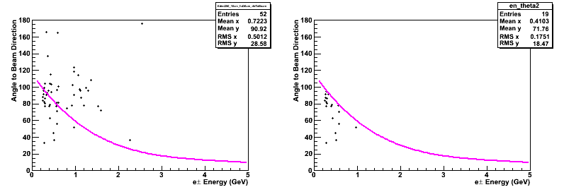
Muon Missing the Detector
From C.Zhang
Collect all category #1 events
Statistics:4.0375e-2 year beam running
E>0.25GeV & fid 30cm
2/2/13
5

Slide 6
Update on Mary’s Background Budget

Slide 7
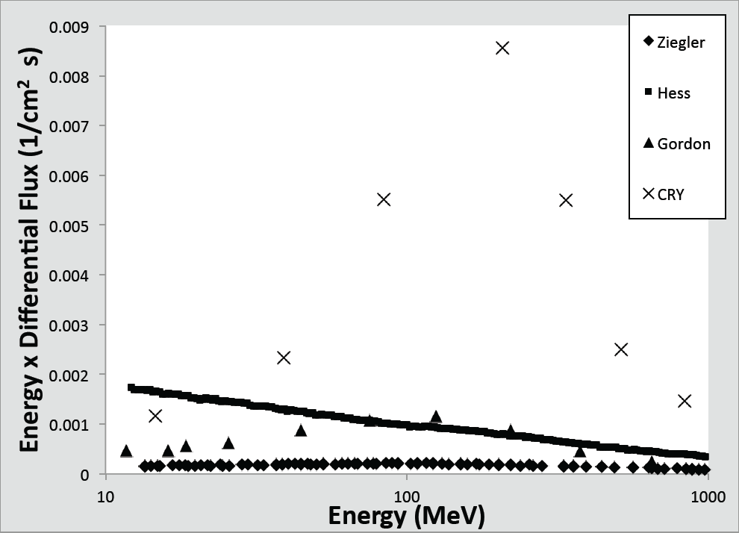
Neutron Flux Models Vary
From PNNL-21302 (2012)
Neutrons at Sea Level

Slide 8
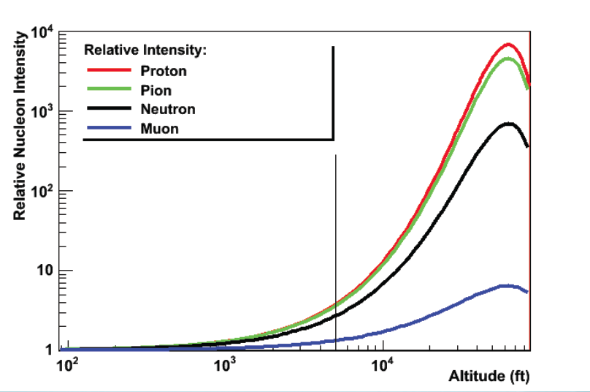
Surface at Homestake
LANL

Slide 9
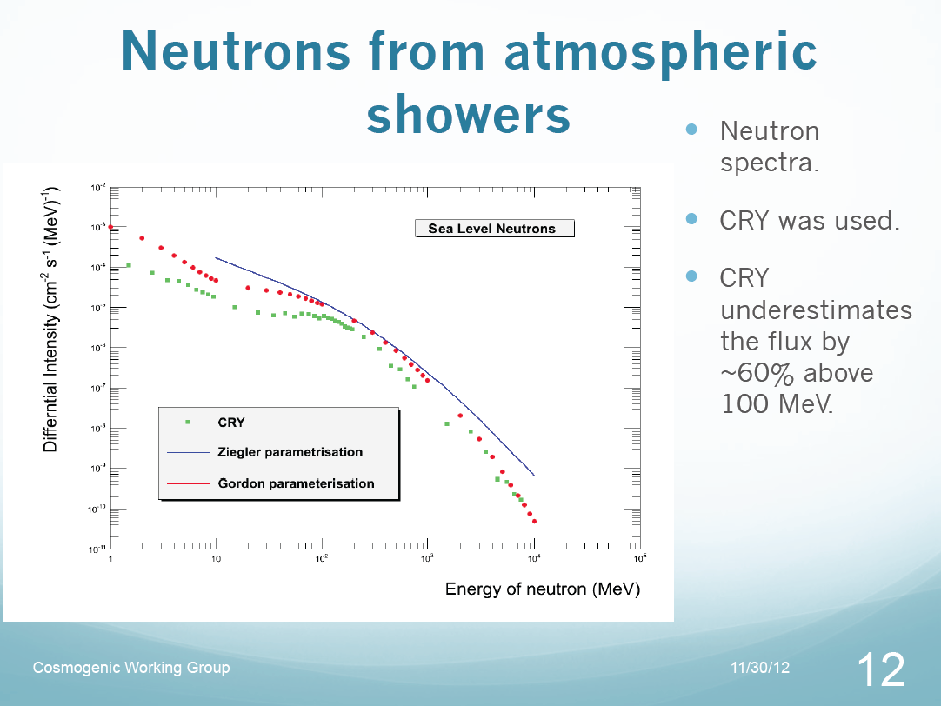

Slide 10
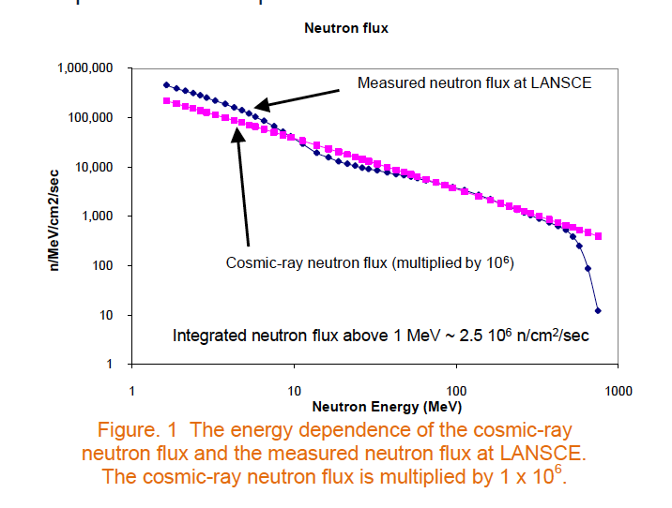
LANSCE ICE House

Slide 11
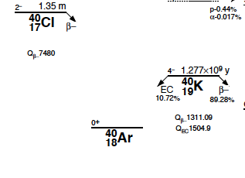
SN Detection
ν_{e} + ⁴⁰Ar ge⁻ + ⁴⁰K*
While bulk of events at in range 15-30 MeV, much of the science is at energies <15 MeV visible energy
Therefore the ability to trigger at this level, and reject backgrounds is critical for SN detection
NC events have only nuclear de-excitation – even lower energy
What are possible
backgrounds?

Slide 12
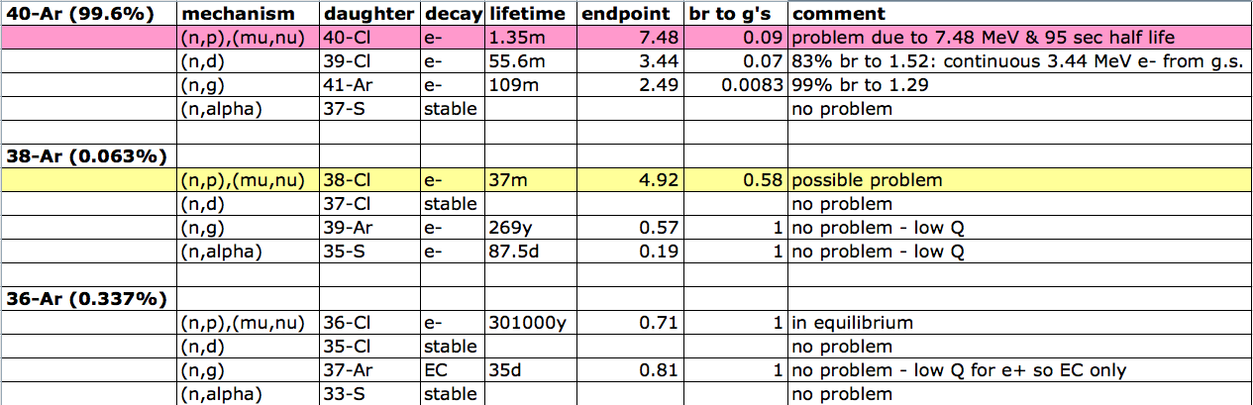
Typical spallation interactions
These are the typical reactions that would certainly be present and have
significant production rates. Note: it is certain that other isotopes with A<40
would also be made, but production cross sections are more uncertain.

Slide 13
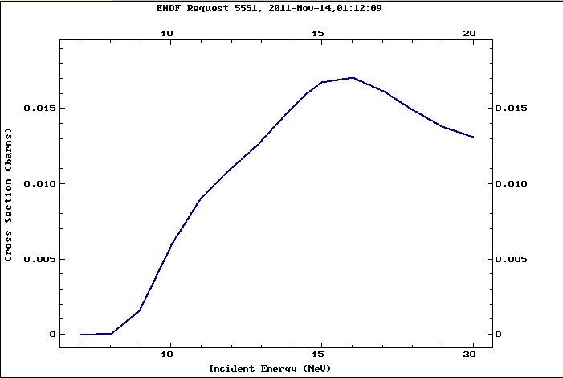
⁴⁰Ar(n,p)⁴⁰Cl

Slide 14
Conclusions
It would be useful to verify the simulation results that neutrons will not be the dominant background by measuring pizero production as a function of energy
The production rate of 40-Cl could also be measured
"Out in the open" test at LANL for neutron detection may also be possible
A practical demonstration that a liquid argin detector can do a SN watch would be useful.

