Slide 1
LANL LAr Cryostat
Ramsey 2/1/2013

Slide 2
Cryostat design criteria
Physics requirements
Accommodate as large a TPC as possible within budget
Allow optical access to the liquid argon volume for laser calibration system
Shape considered
Mechanical
Provide mechanical provisions for instrumentation as well as cryogenic services
Maintain transportability
User safety

Slide 3
Major design revision
Based on input from UCLA collaborator Hanguo Wang
Significant improvement to system robustness and reduced risk associated with TPC work
Minimized disturbance of cryogenic and instrumentation connections when accessing the TPC
No large cryogenic seals
Larger argon volume
Larger instrumented volume/total volume ratio
Enables all TPC wire planes to be mechanically identical (hexagonal TPC)
Change is supported by simulation work (Kevin Yarritu)

Slide 4
Schedule and cost impacts of design change
Procurement of the cryostat is a major milestone in the LDRD project
Original plan was to be prepared to place cryostat order at the beginning of FY13
Cryostat delivery currently expected to arrive by end of August, 2013, based on expected bidding and delivery times
Though new cryostat cost is higher than the original, the cost increase is within the contingency as originally presented

Slide 5
Overview of current design
VME CRATES
Capacity: ~7700 L
External dimensions
Flange diameter – 111”
Work deck height - ~101”
All cryogenic and instrumentation connections made through top head
Work deck for worker safety and convenience
WORK DECK
TOP HEAD
BAFFLE
ASSEMBLY
TPC ASSEMBLY
DEWAR ACCESS PORTS
LIQUID ARGON VOLUME
VACUUM JACKET
Notes:
Add labels for major components

Slide 6
Overview (continued)
6X TPC
INSTRUMENTATION
1X HV FEEDTHROUGH
Top Head Port layout
8X 12” instrumentation/services ports (1 unsubscribed)
1X 18” port (currently unsubscribed)
6X 3” ports (5 currently unsubscribed)
1X CRYO SERVICES
EMERGENCY VENT

Slide 7
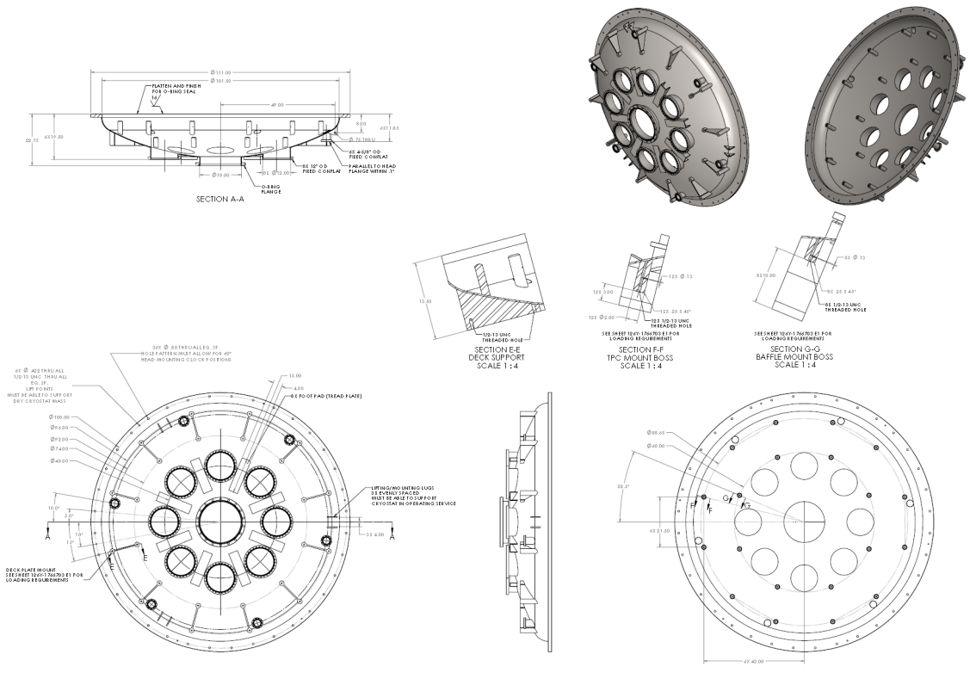
Overview (continued)
Preliminary drawings have been prepared for cryostat RFQ
Vendor will provide final drawings for LANL approval prior to commencing with fabrication

Slide 8
Safety
Pressure safety
Design work has been done in coordination with LANL pressure safety personnel
Cryostat design uses all conventional features, and will thus be an ASME Section VIII Division 1 pressure vessel
ASME certification provides an independent QA check on the design and fabrication
Can also ease approval overhead when vessel is transported to other labs
Vacuum jacket relief per CGA-341
Liquid volume relief via burst disk/vent pipe
Work deck
Included to provide safe access to top ports for workers
Mounts to the top of the cryostat
Inner Volume Surface Area (m2) | 15.920 | Wetted IVC Surface of Liquid Volume
Heating Rate (W/m2) | 1800 | Cryogenics 52 (2012) pp 331-335
Latent Heat of Evap (J/kg) | 16081
Total Heat Input (W) | 28656
Mass Flow Rate (kg/s) | 1.782
Flow through Straight Vent Pipe |  | STP Gas
Diameter (m) | 0.161 | 6" Schedule 10 Pipe (6.357" ID)
L (m) | 20 | length estimate
Flow Area (m2) | 0.0203
STP Density (kg/m3) | 1.784
STP Flow Rate (m3/s) | 0.999
Vsonic @STP (m/s) | 283.75 | per DUC Design Doc, App. C
Average Flow Velocity (m/s) | 49.06
Mach Number | 0.17 | <.3 - Incompressible
STP Viscosity (Pa-s) | 0.0000752 | NIST
Reynolds Number | 187400
Friction Factor (Moody) | 0.0320 | e/D=.006
K1 (Straight Vent Pipe) | 3.975 | Crane, 1999
dP (Pa) | 8535.93 | Darcy Formula
dP (psi) | 1.24
Additional Ks (STP) and Resulting DP | K | dP (Pa) | dP (psi)
Sudden constriction to vent pipe | 0.5 | 1073.7 | 0.16 |  | Crane, 1999
90° radiused tubing elbows | 0.64 | 8245.7 | 1.20 |  | (r/D=1), quantity estimated at 6
Fike Axius Rupture Disc | 0.45 | 966.3 | 0.14 |  | Ref Fike Technical Bulletin
Abrupt exit | 1 | 2147.3 | 0.31 |  | Crane, 1999
Total dP (psi) | 3.040

Slide 9
Assembly/maintenance(continued)
TPC may be accessed by lifting the insert, removing the dewar, and placing the insert on a support stand

Slide 10
Assembly/maintenance(continued)
Process may be reversed to re-insert TPC

Slide 11
Procurement process and status
Define cryostat requirements (physics/mechanical) | COMPLETE
Create preliminary design | COMPLETE
Preliminary drawings | COMPLETE
Coordinate with LANL pressure safety | COMPLETE
Obtain budgetary quote from vendor | COMPLETE
Compile procurement documentation | COMPLETE
Exhibits D (SOW) and H (Q/A) | COMPLETE
Form 410 approval (pressure safety) | COMPLETE
Purchase Request | COMPLETE
LISC (Laboratory Integrated Stewardship Council) Approval | COMPLETE
Buyer assignment | COMPLETE
Formal RFQ | IN PREPARATION
Bidding process
Contract award | EXPECTED BY FEB 28th, 2013
Fabrication
Vendor provides final fabrication drawing for LANL approval
Materials order
Machining/welding
QA check
Delivery to LANL | EXPECTED BY AUGUST 30TH, 2013

Slide 12
Questions?

Slide 13
Projected heat load - backup
Note: cryostat vendor to provide heat load estimate with final drawings for LANL approval
Calculated Heat Load Summary
Liquid Argon Prototype
Ramsey 1/2013
Argon Volume Rad Load (W) | 30.25
TPC Supports (W) | 55.01
L Ar Volume Support (W) | 202.66
Instrumentation Wiring (W) | 13.56
HV Conductor Wiring (W) | 0.34
Viewport Light Load (W) | 2.40
Laser Heat Load (W) | 0.90
Total Heat Load (W) | 305.11

