Slide 1

O.Prokofiev
APA Prototype Tests at FNAL
APA design and technology
Mechanical tests
Electrical tests
Cold tests in liquid nitrogen
Summary

Slide 2


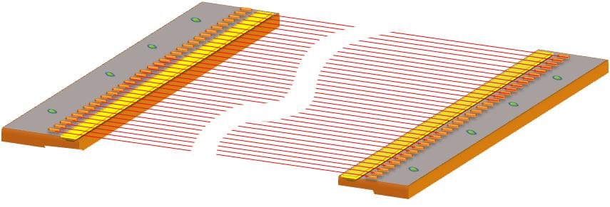
APA Prototype
Frame pin
Epoxy
FR-4 ( 5 mils)
Soldering
Module
64 wires
pc-board
35 mm
Idea of alternate APA design is based on construction of preassembled wire modules which will be stretched and mounted on the frame pins.
The wires in the modules have a specific length so that when wires are being stretched on the frame the wire tension will reach a nominal value.
The epoxy strip applied above FR-4 board of for keeping of wire tension.
Wire soldering is served just for electrical connection.

Slide 3
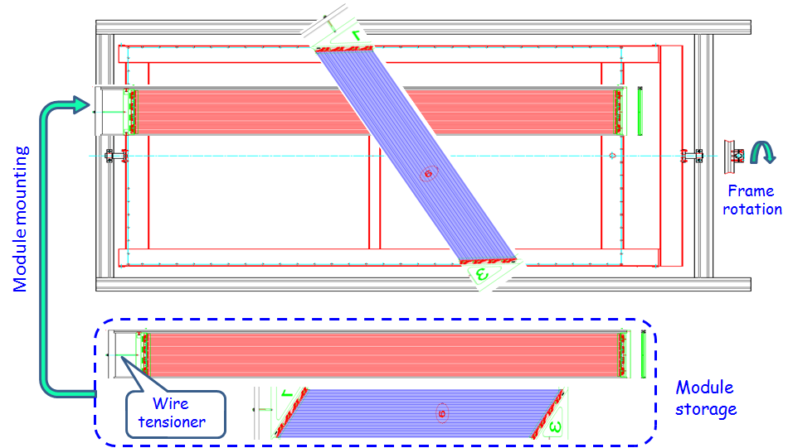
APA Assembly with Wire Modules
The APA assembly with using prefabricated modules is simple, clean and labor effective procedure. Also, the modules could be easily replaced.

Slide 4
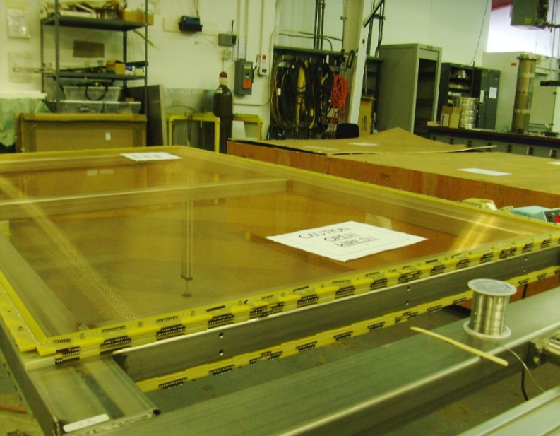
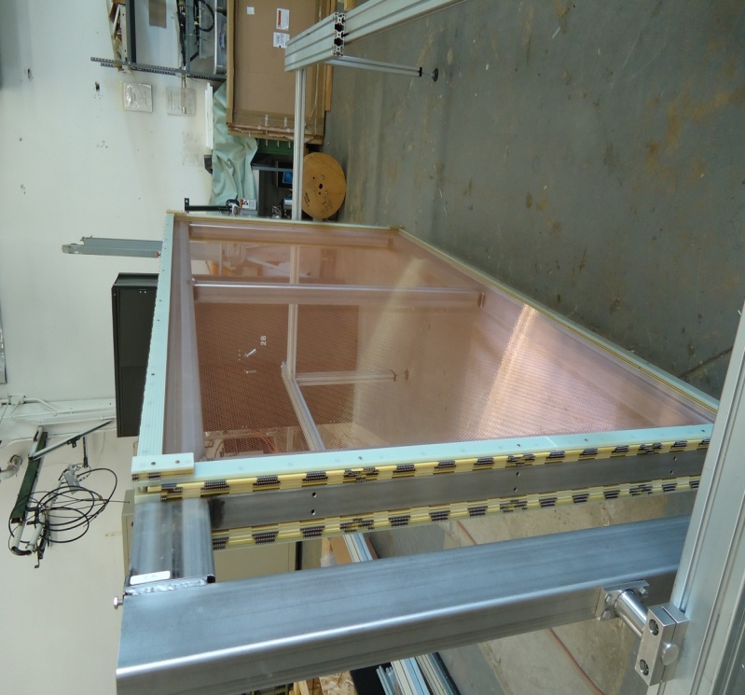
APA Prototype Construction
Prototype features:
- 1.2 x 2.5 m prototype dimensions
- 200 lbs weight
- 4 wire planes (mesh, X, U & V planes)
- 45⁰ U & V planes
- 150 μm diameter CuBe wire
- 500 gr wire tension
- 64 wires for X and Mesh module, 4 modules/plane
- 48 wires for U,V module, 11 modules/plane
- 60 wire modules
- 3136 wires
- 1280 readout channels (~ 50% of full scale)
First planes assembly
Details of prototype design, technology,
fabrication and test results are available
at LBNE docdb 6044, 6335, 6531
Completed prototype

Slide 5
Mechanical tests
    Frame flatness
    Tension
    Wire spacing

Slide 6
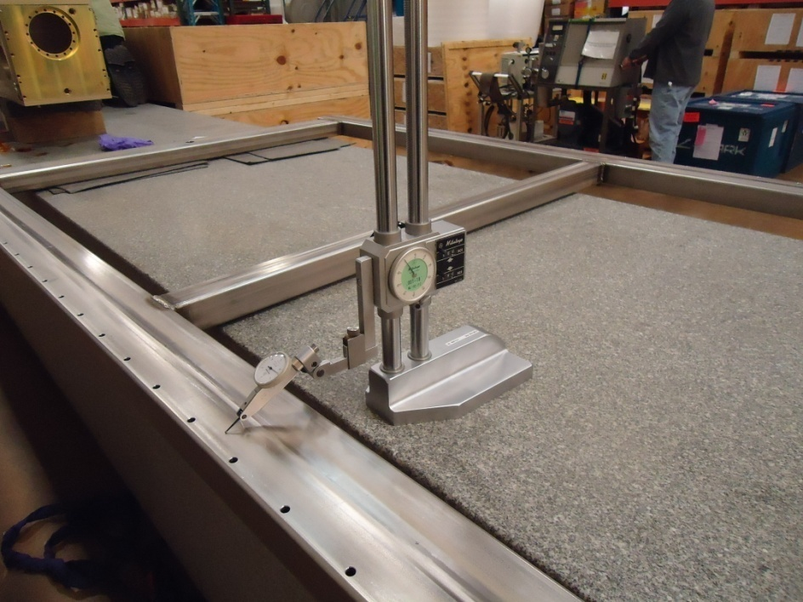
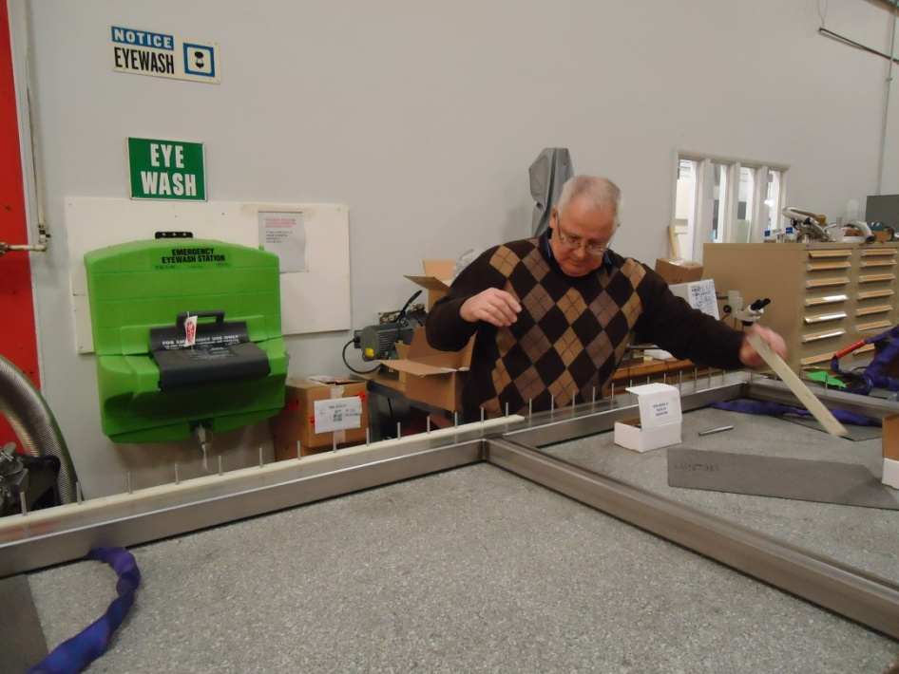
Frame Flatness
The frame (1.25m x 2.5m) was fabricated by vendor.
Measured frame flatness (1.25m x 2.5m) was in range of 20 mils
The frame was straightened to meet these tolerances.

Slide 7
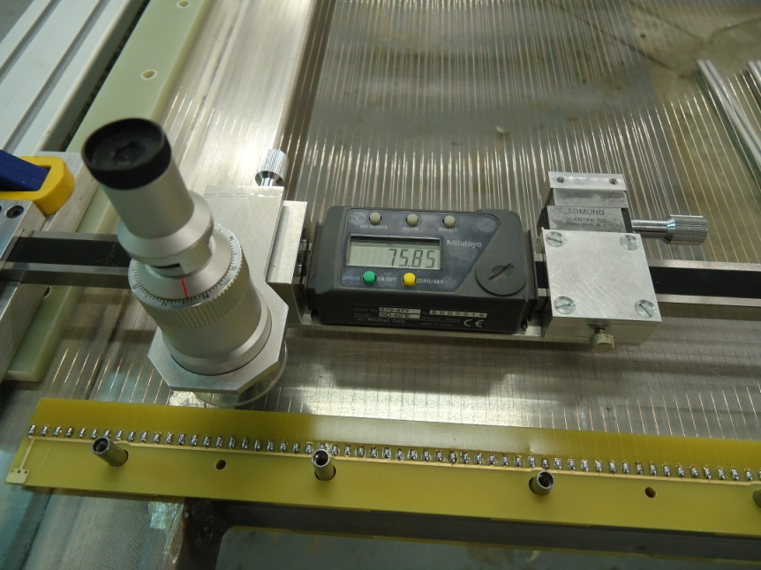
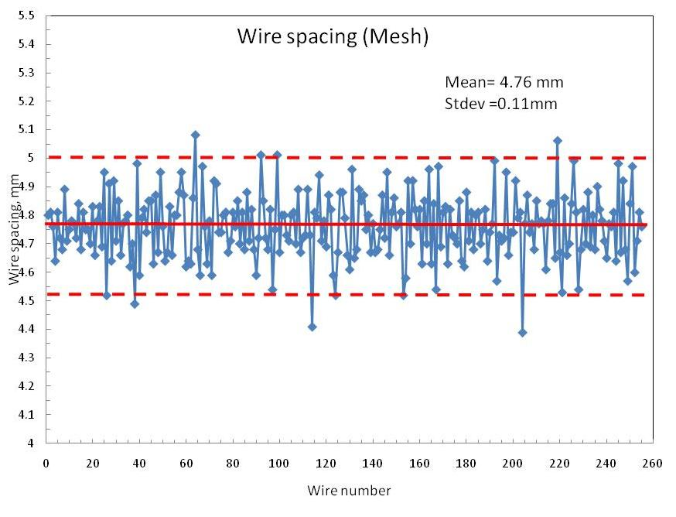
Wire Pitch Measurements
Optical digital scale of 1 m long (10 μm resolution).
Scale has USB output that allowed to record data
automatically.
Wire pitch accuracy was provided by
winding machine (no comb used).
The measured pitch (RMS) was ~0.11mm

Slide 8
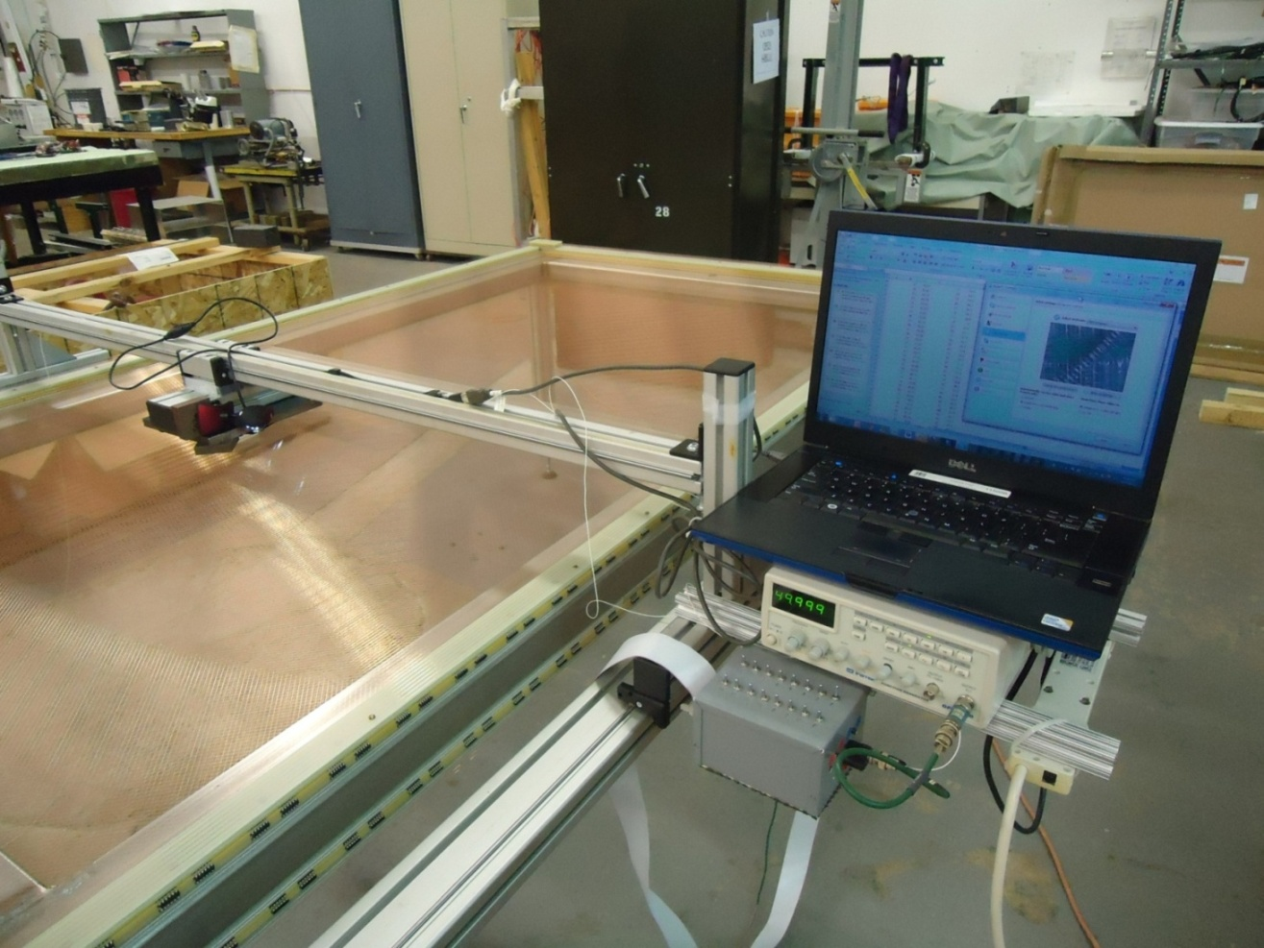
Wire Tension Measurements
Tension measurements was performed with using magnet, switch box, pulse
generator and USB camera. It is required a wire connection with both side.
A setup is simple but measurements are labor intensive.
Automatic multichannel tension measuring device is needed.

Slide 9
Tension Measurements
Visible wire tension structure demonstrates a tension variation for different wire modules.
A reason for that was connected with insufficient stiffness of transfer frame and stability
of wire tensioner of the winding machine.

Slide 10
Electrical tests
    Capacitance measurements
    HV tests

Slide 11
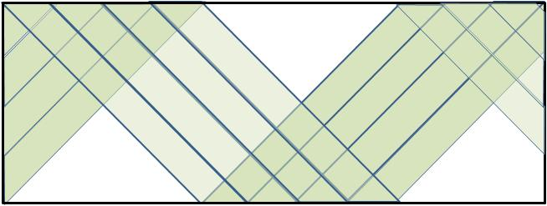
Capacitance Measurements
X-plane
All other planes grounded
1
2
3
4
Wire group 1
Wire group 2
Switch box
Wire group 3
Wire group 4
LCR meter
U &V planes
1
2
3
4
Wire group 4
Wire group 1
Wire group 3
Wire group 2
Wire group 2
Wire group 3
Wire group 1
Wire group 4
Wire length:
  Mesh & X-wires - 2.1 m
  U & V wires (zig-zag) - 4.7 m
Automatic multichannel capacitance measuring device will be very useful.

Slide 12
X-Wire Capacitance Measurements
Average capacitance is about 11 pF → 5.2 pF/m

Slide 13
V-Plane Wire Capacitance Measurements
One of the wire group has lower capacitance.
A reason for that is a different number of FR-4- boards
and jumpers.
Wire groups 1-3 have 3 jumpers but group 4 only 2.
Average capacitance (1-3 groups) is about 37 pF → 7.9 pF/m
1
2
3
4
Wire group 1
Wire group 4
Wire group 3
Wire group 2
Wire group 2
Wire group 3
Wire group 1
Wire group 4
Wire jumpers

Slide 14
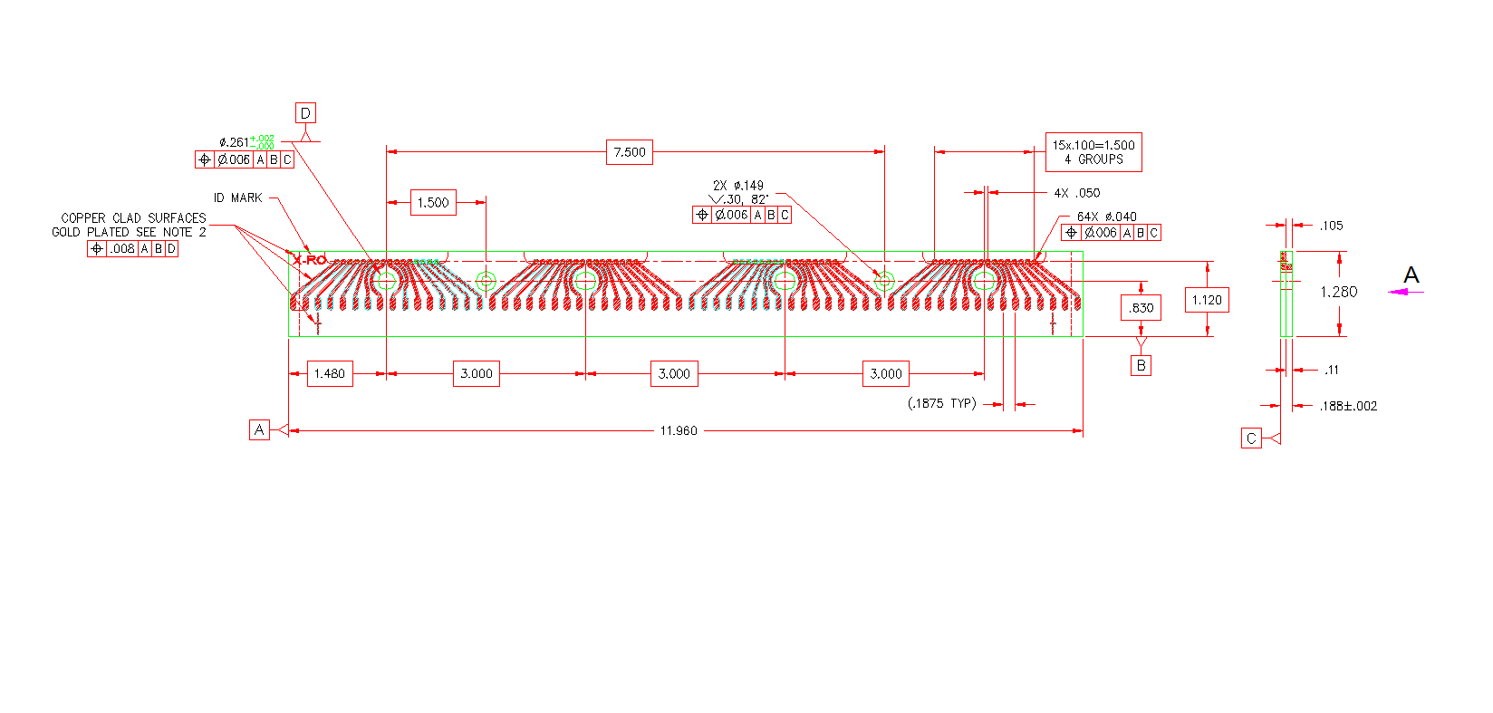
APA High Voltage Tests
Bias voltages
- 355V (U)
0 V (V)
490 ( X)
0 V (Mesh)
Frame and pins are grounded
Pins
FR-4 pc-board
Holes for pins
Distance from hole edge to
board artwork is 2.0 mm
Reasons for HV current leakage:
- from wire boards artwork to pins and frame
- from board to boards

Slide 15
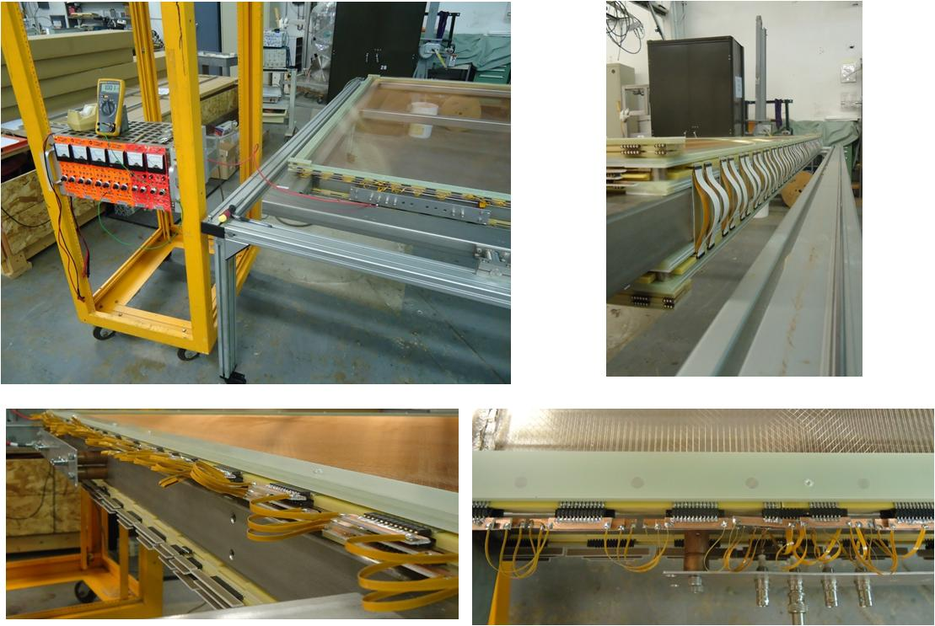
Setup for High Voltage Tests

Slide 16
High Voltage Leak Measurements
Frame and pins grounded only
Up to 3.5 kV a leak current is less
than 200 nA except Mesh because .
artwork traces are slightly closely
to pin holes.
Frame and pins + nearby planes grounded
A current is higher but still is very
small (~100 nA) at voltages up to 2 kV.
Expectation, that a current in liquid nitrogen will be less.

Slide 17
Cold Tests in Liquid Nitrogen
    Cryostat construction
    Cooling down procedure
    HV tests

Slide 18
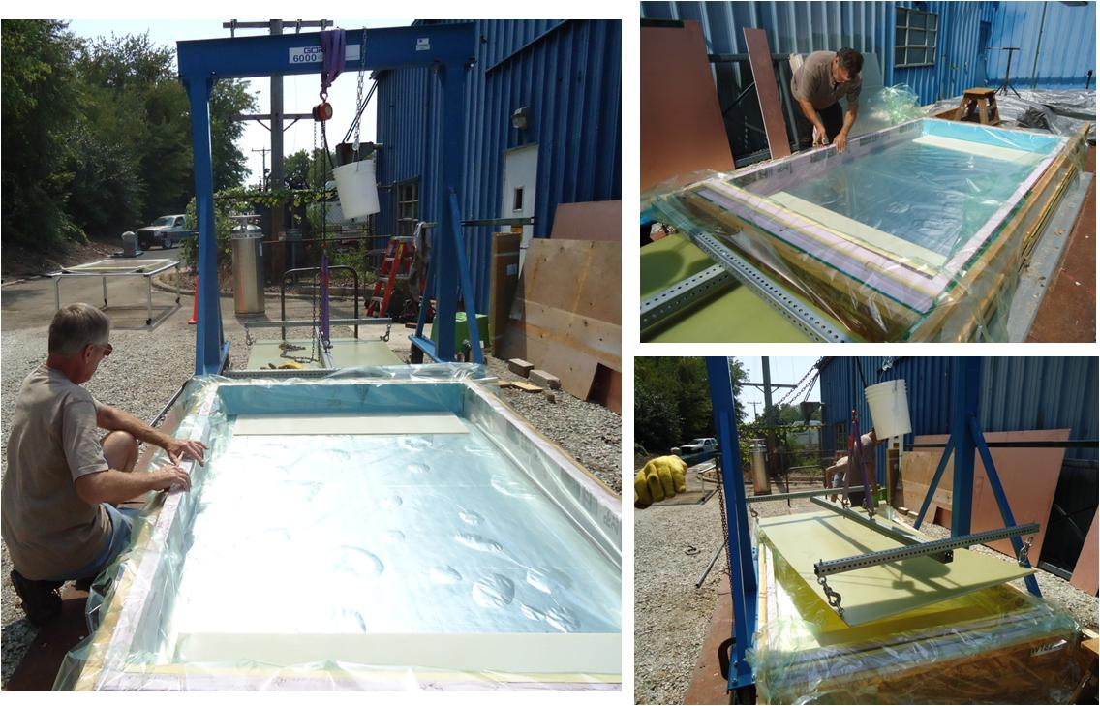
Cryostat Preparation for APA Cold Tests
Simple cryostat with foam isolation installed into the wooden crate.
Nylon film was placed inside foam box to prevent leak of liquid nitrogen.
A cryostat cost (M&S) ~$200 , labor (fabrication and tests) ~20 hours (tech)

Slide 19
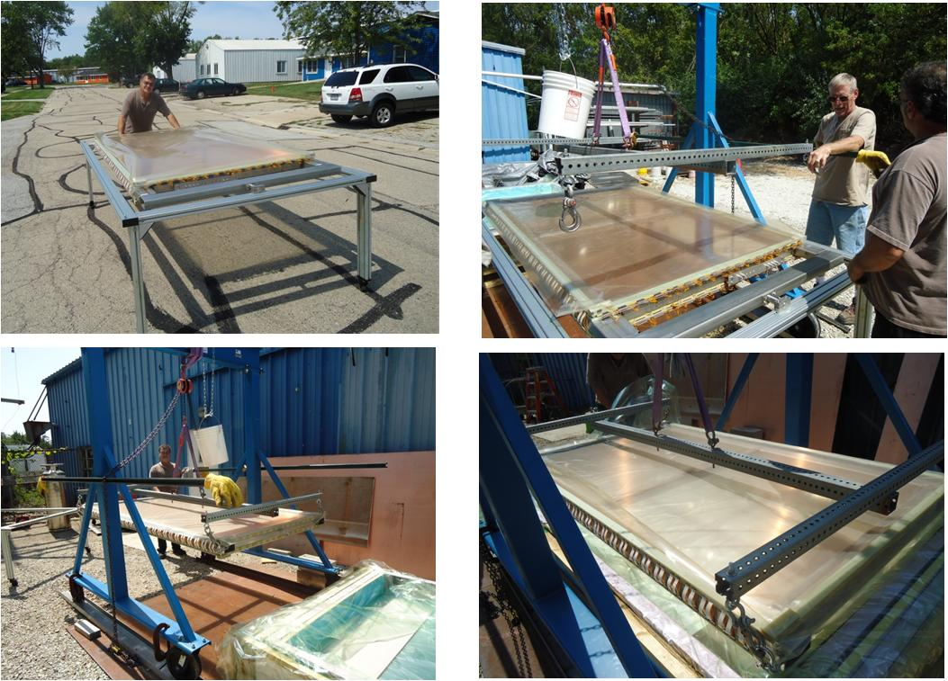
APA Transportation and Loading
Additional mechanical test on robustness and reliability

Slide 20
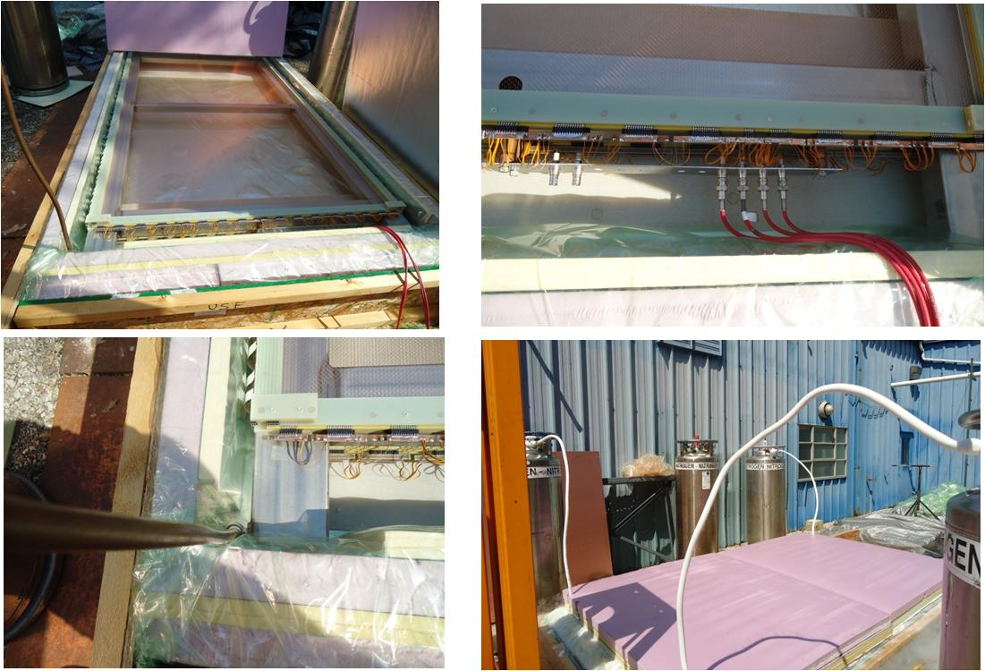
Starting Cold Tests
Liquid nitrogen was supplied from 4 Dewars, simultaneously.
The hoses were mounted at cryostat corners.
. Filling time was about 1 h 10 min (6 Dewars of 160 liter each.}

Slide 21
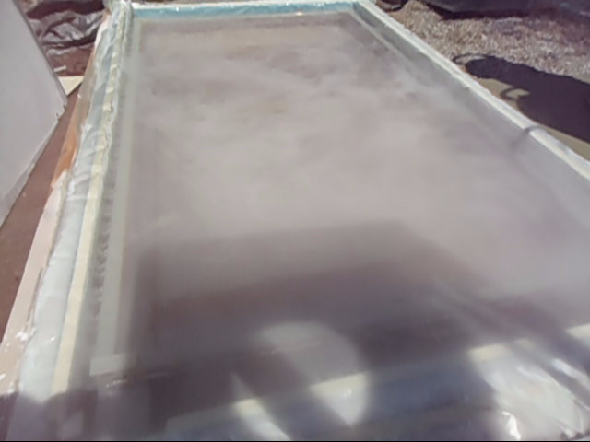
Cryostat Opening
Double click on the picture to watch movie
After APA inspection no broken wires, epoxy cracks,
damaged connectors or frame deformation were found.

Slide 22
HV tests in Liquid Nitrogen
Mesh, X, U and V planes for both sides were connected together
Measurements before filling
Measurements 10 min later
After about 10-15 min a current for all planes dramatically increased for all planes.
It is indicated a water appeared and condensed on the FR-4 surface during of fast cooling.
A reason for that may be connected with high level of water absorption of FR-4 boards.
No any reference on HV leakage in FR-4 boards in liquid nitrogen was found on that score.
Need to investigate this problem to understand cool down procedure for TPC.

Slide 23
Plans
1. Investigation a reason of high current in liquid nitrogen.
- small setup for HV test with boards, stud,….
- different mode of cool down procedure (gas flashing/liquid nitrogen)
- analysis of water contamination in FR-4
- developing a procedure for cooling down
2. Wire tension measurements in liquid nitrogen
- procedure of tension measurements
- setup with X-wire module (64 wires)
3 Integration APA prototype with front-end electronics
- decouple pc-boards, capacitors, connectors
- board connection to APA and readout electronics

