Slide 1
Human Resources, Mission Support
Deanne Randich, Human Resources Project Manager
Luke Mickelson, HR Generalist
Katie Rave, Technical Recruiter
Kaitlyn Alhabshi, HR Project Administrator

Slide 2
Agenda
Current State
SD HR Efforts
DEA
Holidays
Support of Matrix Employees – Breakout Groups
Wrap-up

Slide 3
Current State
What are the major priority areas that your organization is focusing on to support SD operations?
Extensive work has been done for expansion readiness. We have updated orientation and onboarding and several other far site workflow efficiencies Our current top priority is support for Matrix employees. We also have a few updates from our last Mission Support Workshop regarding clarification of the DEA (Domestic Extended Assignment) policy and Lab Holidays vs. SDSTA holidays.
2. Have the proper labor resources been allocated to support SD operations? If not, what is the plan to allocate those resources?
We are functioning to max capacity in HR which is critical. However, I see other operational areas that need more support in SD from a Mission Support prospective. The risk of not filling other operational needs in a timely manner can be a burnout or other non desirable result.
3. What actions still need to be accomplished to execute your organizations plan to support SD operations?
An all-hands on deck approach for SD expansion.
4. What worries you about supporting SD operations?
Not having "buy in" or support from all areas of the Laboratory. To get away from the "out of sight out of mind" mentality.

Slide 4
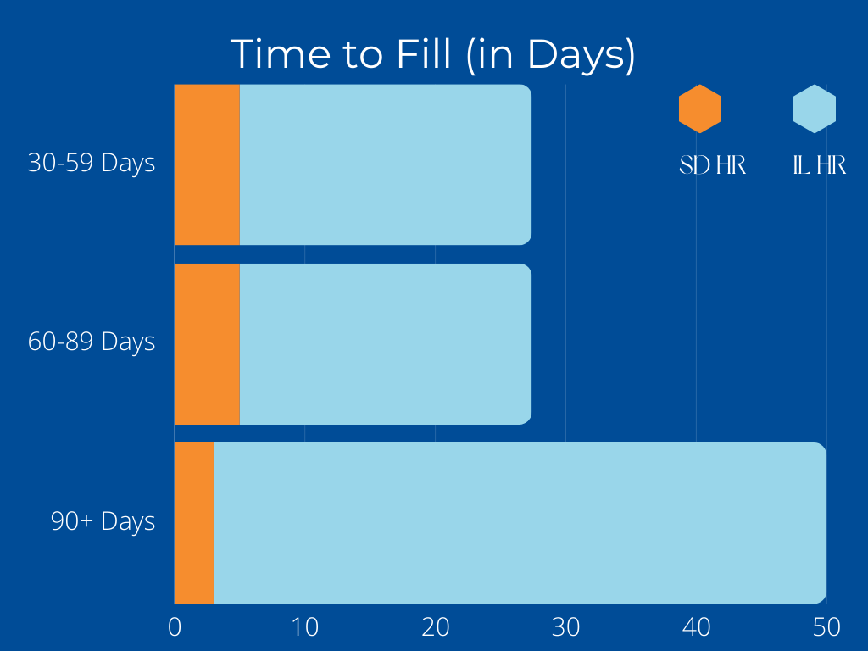
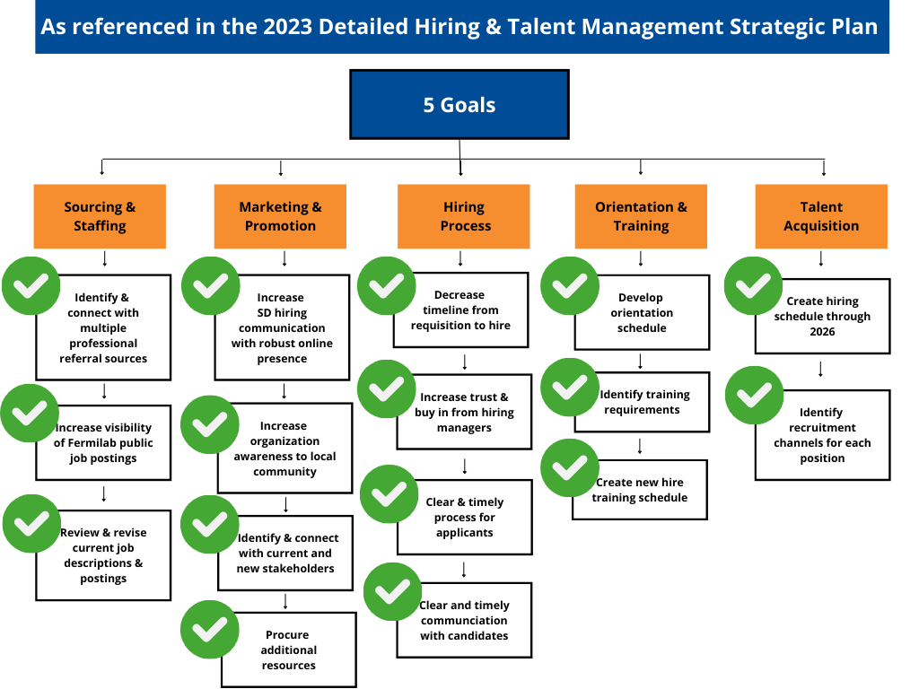
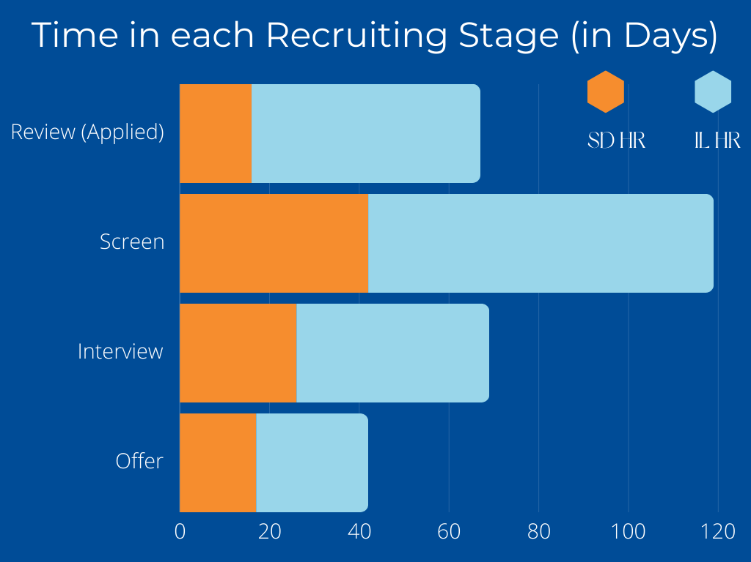
Efficient Recruiting
Our SD based candidates spend half the time in each phase of hiring

Slide 5
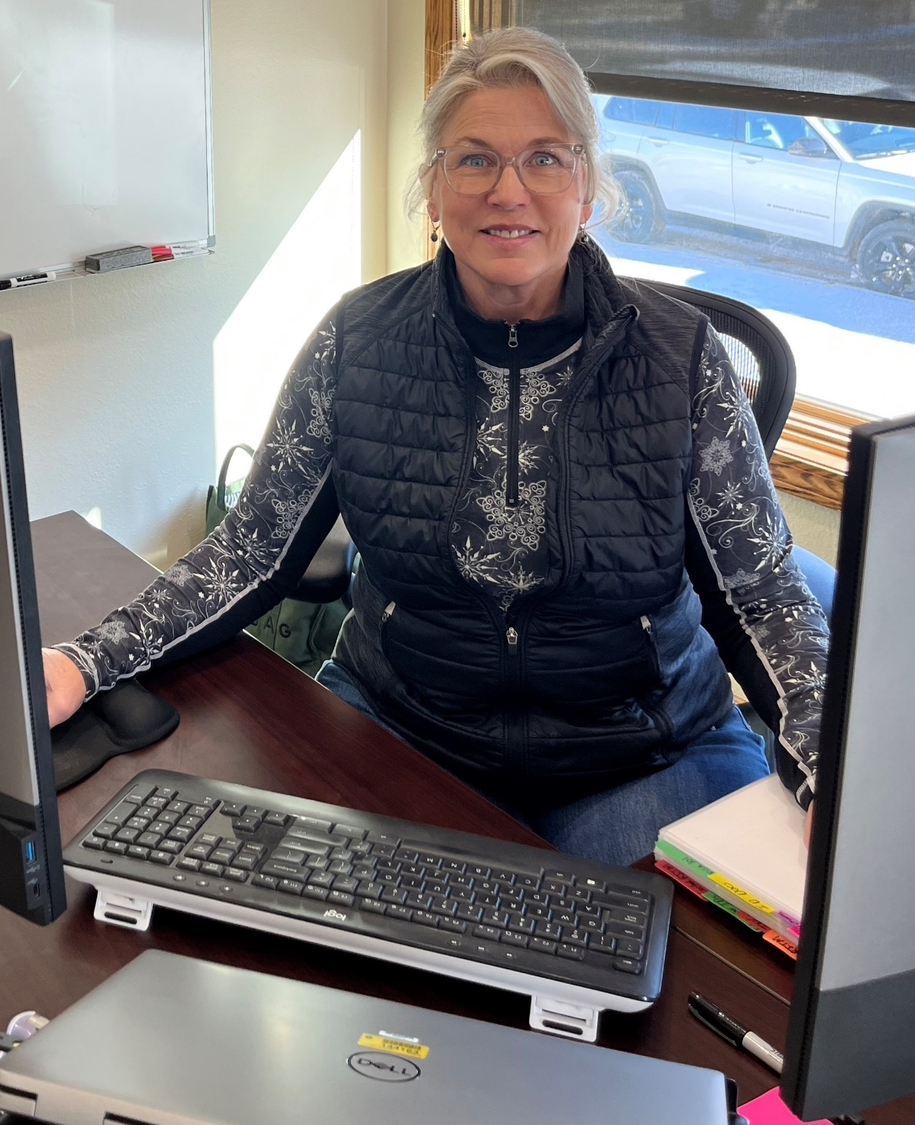
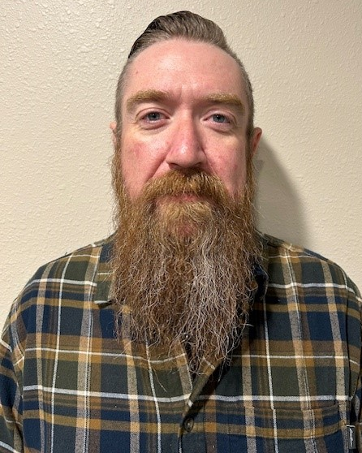
Onboarding &
Orientation
Marsha Nichols
Excellent hiring experience overall. Being a local, I learned more about the project and Fermilab in my first week than I have in years. Proud to be part of the team
Ian Farnsworth
Onboarding was a pleasant experience. This is something that is very difficult to do correctly. Your team was exceptional. Very welcoming, quick to assist with or answer questions. I am impressed. Thank you for welcoming me to FermiLab. Let's do great work!!

Slide 6

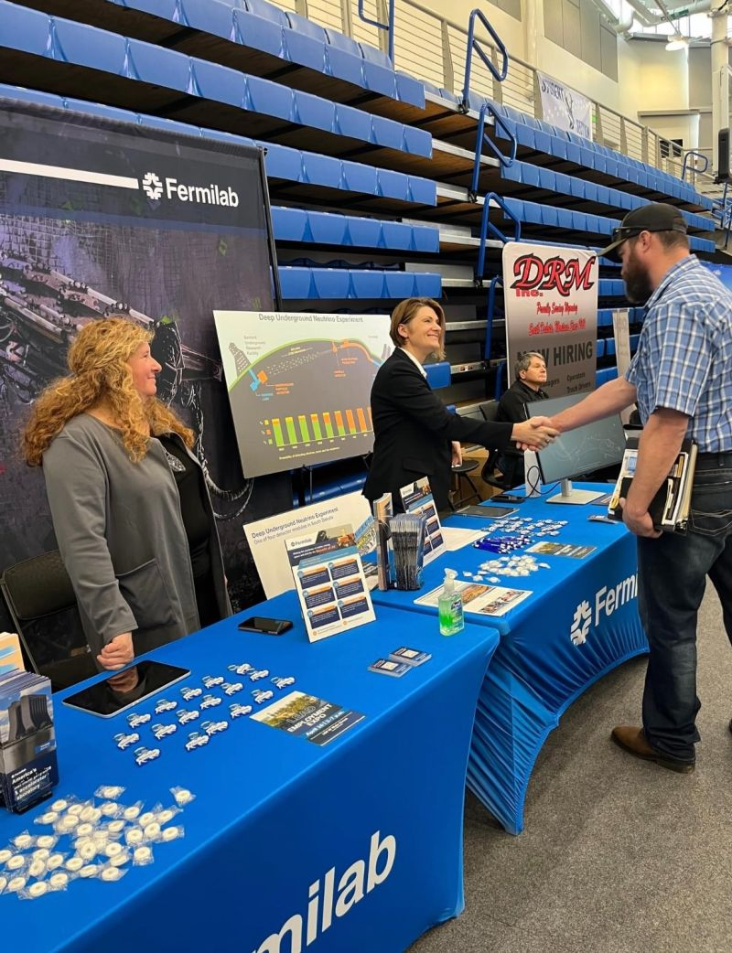
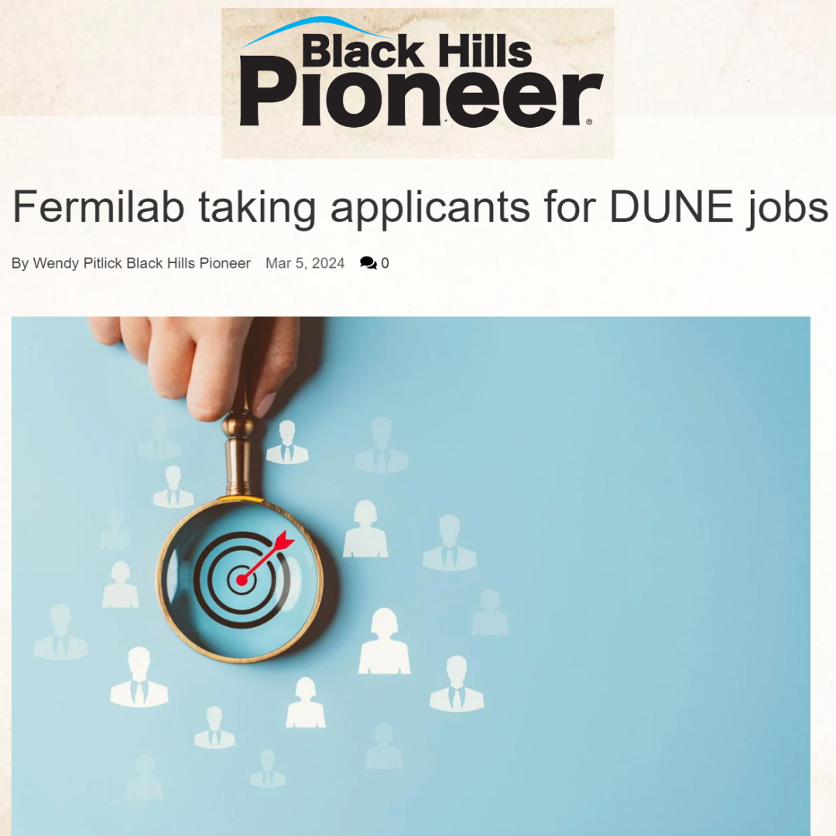


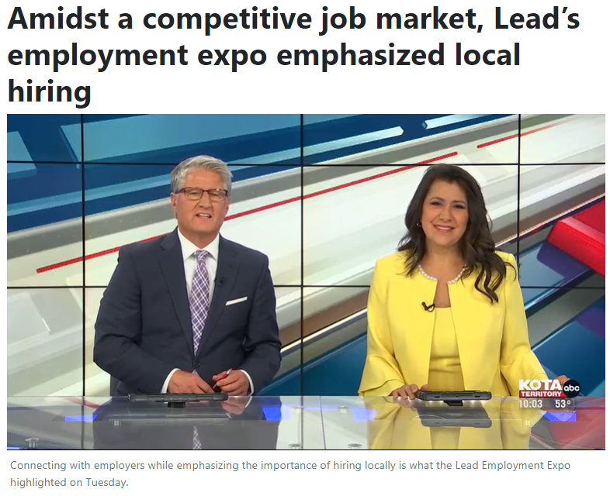

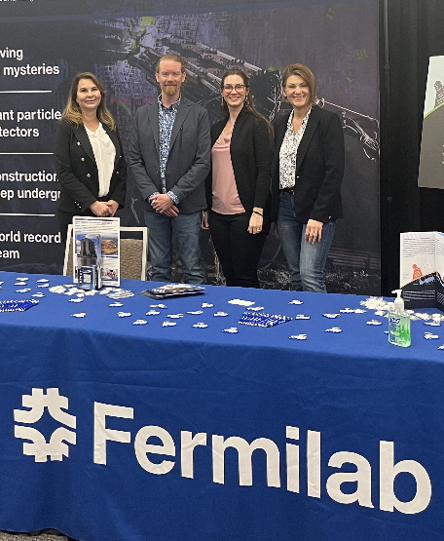
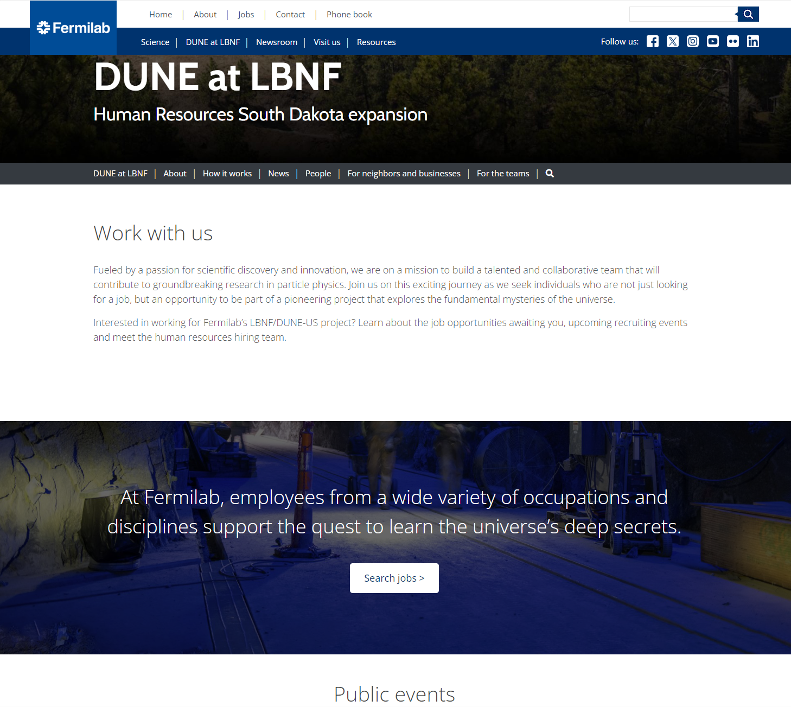
Marketing and Outreach
=
Sasquatch Baseball Games – brochures & live announcements
https://www.kotatv.com/2024/04/17/amidst-competitive-job-market-leads-employment-expo-emphasized-local-hiring/

Slide 7
Domestic Extended Assignment (DEA)
What has changed?
FAQ for interested employees on our South Dakota Expansion page. Includes great information on how to apply, questions about per diems, getting there and back, etc. The policy is also available from our webpage.
How does an employee benefit from a DEA?
  Keeps home in IL (home base)
  Receives MI&E & Lodging per diems
  Retention Bonus upon completion of each year on a DEA
  Objective is to return to the same or similar position you left at home site
DEAs will only be utilized for critical skills/highly technical positions that require direct Fermilab experience

Slide 8
Domestic Extended Assignment (DEA)
When needed, internal Job Postings will specifically indicate if they are DEA eligible
Interview process is same as when you originally applied – you will interview and if chosen, be given a Letter of Understanding (LOU) which details your specific terms to sign/accept
Must be less cost expensive than a relocation per DOE
DEAS can not be longer than 3 years
Procedure for SD & Generic have been created - phase 1 of 5 workflows to the right

Slide 9
Holidays
SDSTA HOLIDAY (11*) *Plus administrative holidays not listed below | FERMILAB (10 + Floating)
New Year Day | New Years Day
Martin Luther King Jr. Day | Martin Luther King Jr. Day
Presidents Day
Memorial Day | Memorial Day
Juneteenth | Juneteenth
Independence Day | Independence Day
Labor Day | Labor Day
Native American Day
Veterans Day
Thanksgiving Day | Thanksgiving Day
 | Day After Thanksgiving
 | ½ day Christmas eve
Christmas Day | Christmas
 | ½ day NYE
Current process:
  Our employees follow Fermilab’s Holiday schedule
  11 Federal holidays
  SDSTA holidays where Fermi still works – SDSTA mission-critical team works and receives regular pay + holiday pay to support the science so we can report to work
Cultural consideration to better align to SD Holidays
Subtopic for further conversation: Inclement Weather

Slide 10
Support of South Dakota Matrix Employees
What is a South Dakota* Matrix employee?
*South Dakota is a Fermilab site
Employee Type | Employee/Manager Work Location
Matrix Employee (SD-based Mission Support) Manager is based in different state and may or may not be in the same Division/Project | South Dakota
Remote Employee | 50 miles or more from Batavia, IL or Lead,SD. May work from home or a nearby Fermilab-associated location
Matrixed, Remote Employee | 50 miles from HQ. May work from home or a nearby Fermilab-associated location

Slide 11
Support of Matrix Employees
What are we doing?
Current Setup
  Checkpoints in WorkDay
  Ask for feedback
  Manager and Matrix Manager can see Performance Review and weigh in
  -Communication encouraged but not part of a formal process
  -Joe Pygott is supportive and an excellent resource for us!

Slide 12
Support of Matrix Employees
What are some of the perceived issues effecting Matrix Employees?
Lack of Visibility
Trust and Accountability
Isolation
Access to Resources
Career Development
Cultural Differences
Performance Evaluations

Slide 13
Support of Matrix Employees
ACTIVITY
Instructions:
You will be put into breakout groups – if you are online and want to participate, drop your answers into the chat
Discuss the two questions below and write down your answers
Delegate a speaker to present your answers
What are the potential issues you see? | Pick the top 3 issues. What are some solutions for improvement?
GROUP 1 Time change Overloading workload from 2 bosses Operations being different in IL v SD " That's how we do it here" GROUP 2 Lack of 1:1 – scheduled v hallway impromptu Translate practices to SD High level ...out of loop which leads to assumptions Mis-match of local management to Matrix manager (shared resource alignment) | GROUP 1 Specific goals – well-written, granular goals Communication is key If you're doing extra work, let both bosses know - "be more boastful about accomplishments" If an employee is having a problem in the area, 360 review might help – survey people they work with Facetime/Zoom - just a check-in GROUP 2 "Schedule it" – policy? Educate on unique SD challenges "start-up" & cultural differences Don't take a "cookie cutter" approach Learn to start from scratch Front-line inclusion and reporting up and down (manage your manager – bring me into your world) Communicate/collaborate

Slide 14
Support of Matrix Employees
Wrap-Up: Highest Priority
What are the top 3 issues? | What are the solutions for improvement?
Lack of 1:1 facetime Balance of matrix & direct manager – workload & expecting to meet with both managers, what is the timing of that? SD Culture & start-up mentality | 360 reviews Collaboration/communication between managers Learn to start from scratch and don't take "Batavia cookie cutter" approach

Slide 15

Questions

