Slide 1
72 Hour Summary
Patrick Dowdle
MCR Crew Chief
April 15, 2024

Slide 2
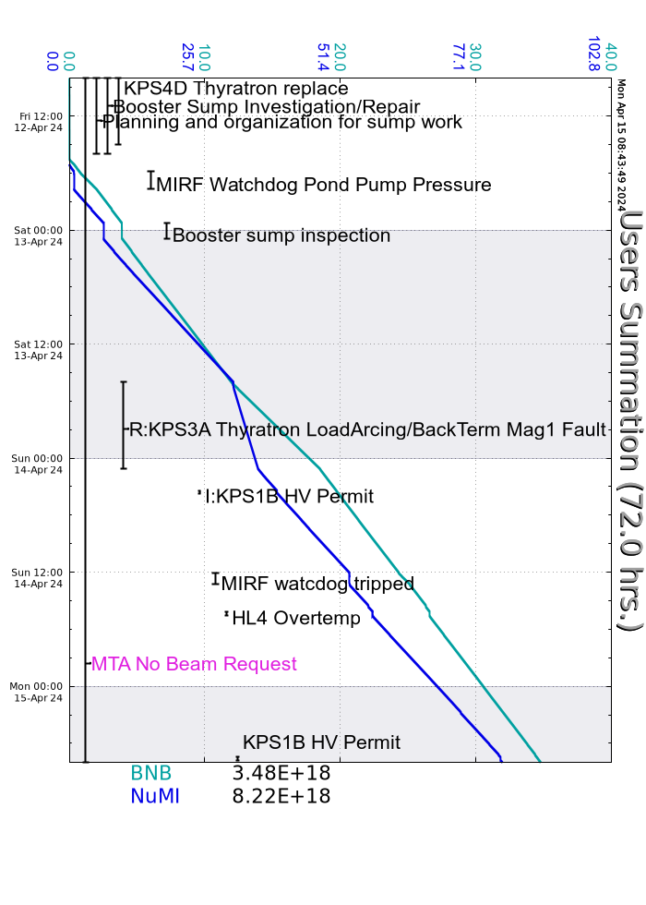
Summary
In general:
Tuning up the machines
NS2 tower 1A trips
Friday:
Recovered from the Booster sump work/access
Secured NM4 after interlocks accidentally dropped
MIRF watchdog trip on PV-7 pond pump pressure, ISD/RF cleaned strainer
Late Friday, high water level sump 9 initiating Booster access, Booster group adjusted the float
Saturday:
R:KPS3A fault, PS replaced but still had PFL issue, thanks to EE support for the repairs, ran MI only mode while work was ongoing
Sunday:
F:NM4AN tripped, remains off
MI abort vacuum increased after a beam abort, experts aware
BOOST1 and BOOSTR stopped responding, rebooted and passed on to the keeper
MIRF watchdog trips on control room temp, Ops posted fans to circulate air, ISD replaced an air filter
B:HL4 Overtemp fault, regulator replaced
KRF6 CS dripper
Today:
I:KPS1B faults, EE support investigating, masked from MI permit for now
B:SQL5 trips
Currently:
Beam to NuMI 902 kW
Beam to BNB 5.5 E16 P/hr

