Slide 1
NIH/NCBI 100gb Architecture, Plans and Rollout
-- Don Preuss NCBI/NLM/NIH

Slide 2
National Center for Biotechnology Information
Created by Public Law 100-607 in 1988 as part of National Library of Medicine at NIH to:
Create automated systems for knowledge about molecular biology, biochemistry, and genetics
Perform research into advanced methods of analyzing and interpreting molecular biology data.
Enable biotechnology researchers and medical care personnel to use the systems and methods developed.
The NCBI advances science and health by providing access to biomedical and genomic information.
Builders and providers of GenBank, Entrez, BLAST, PubMed, dbGaP, SRA, dbSNP, Pubchem and much, much, more….
Center for basic research and training in computational biology.
Notes:
Our mission is to make accessible, knowledge, information and data

Slide 3
NCBI Daily Users
Web page views: 28 million per day
Web users: 3.1 million per day
Data downloaded: 35 TB per day
Peak web hits: 7,000 per second

Slide 4
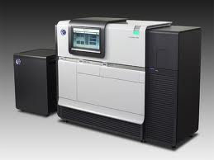
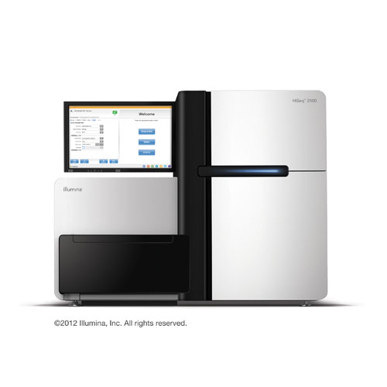
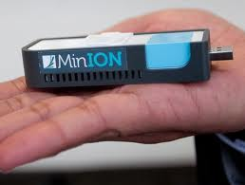
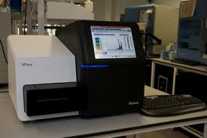
Sequencers

Slide 5
Growth of Storage at NCBI (2002 - 2013)

Slide 6
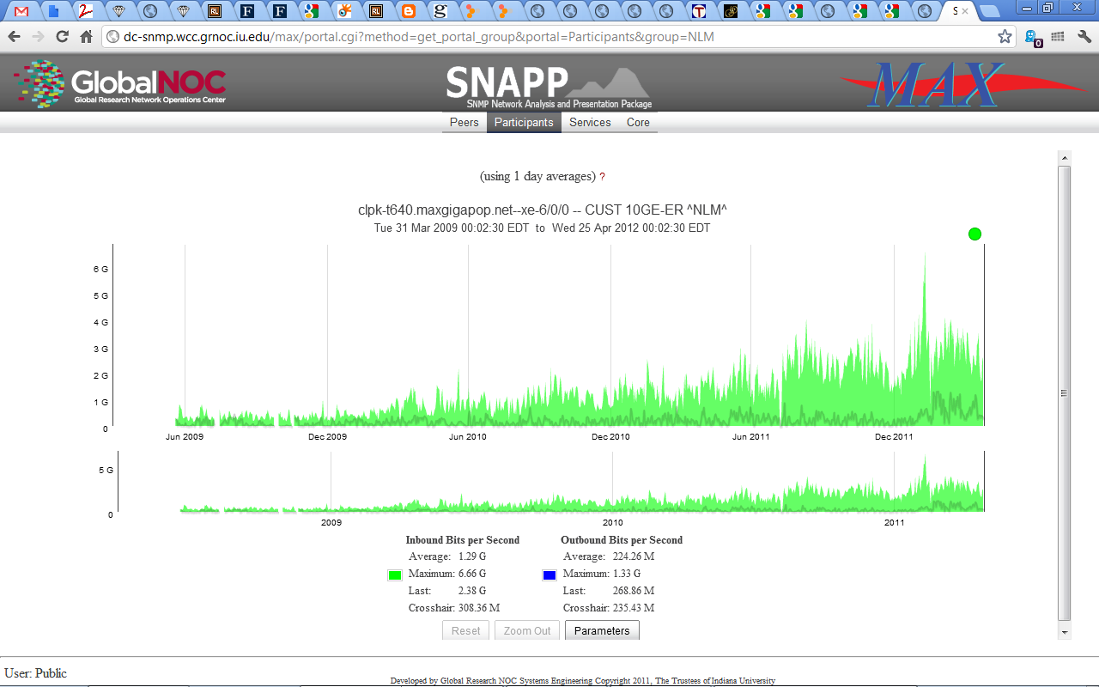
NLM I2 Traffic Stats 2009-2012 2013 –peak 14gb traffic, moved CPS to backup link

Slide 7
NCBI Data Center and WAN Interconnection
Current Environment
Nexus 7000. 5000, 2000
Standard Core, aggregation, ToR (Nexus FEX)
Switches are linked with Twinax two or four links
More 10gb nodes
HPC nodes are 10gb
Database servers, data distribution servers, internal production
Running out of BW
Sustained 33gb on aggregation switches (30 second avg, for hours)
Peaking at 25gb between two cores
Upgrade Path
Two 40gb to ToR
100gb or 4 x40gb to aggregation
Splitting off HPC onto own core
Work around by rebalancing links
ScienceDMZ
Five hosts in Bethesda, three in Sterling (10gb)
100gb/multi 10gb internally
100gb link to I2

Slide 8
Status?
100GB Router Purchased, awaiting delivery
DWDM Upgrade Purchased, awaiting delivery
Internet2 100gb – trying to order
Campus Upgrade will start this FY
Vendor TBD

Slide 9
NCBI Data Drivers
Downloads of Genomic Sequence Data
Sequence data continues to increase
Adding Data as a Service
High speed connection via I2
Data Transfer
Largest component of traffic
Web traffic is around 3TB/day
30+TB/day
Peak of 90TB/day
Cloud users access data at NCBI
Use aspera for high speed transfers
SRA-toolkit features reduce data transfer
Need a new protocol for big data transfer

Slide 10
On-demand page delivery by http and fasp
SRA Toolkit Applications understand uri – based access to SRA files
Pages are just-in-time-delivered as they are needed to perform a job
Only needed pages travel across the network
Http server is optimized for Keep-Alive and caching of open files.
Local Caching
When local disks are available, SRA Toolkit can cache incoming pages
Prefetch
User prefetch –pre-download data, full or partial
Site prefetch – sites like Universities, Labs, DCCs may maintain a selective subset of SRA for common use
Accession resolution service
SRR/ERR/DRR Accessions are automatically resolved to their location on the network, site repositories, and local caches.
Decryption
SRA data subject to dbGaP protection is delivered encrypted
User does no decryption of SRA data, instead SRA Toolkit is configured with user’s keychain
Decryption of SRA data is done on-demand
Local Caches remain encrypted
Maintenance of post-decryption-derived data
A user may use SRA Toolkit to decrypt and convert SRA data into non-SRA format (f.e. fastq)
SRA Toolkit supports encrypting non-SRA files with configured project password to prevent accidental access to sensitive data.

Slide 11
Near term Next Steps
JET Demo – SC13
Data Analysis sra-toolkit and AWS
Data Analysis sra-toolkit and Bionimbus
Expand 100gb to DR Site in Sterling, VA
Transfer Optimization
International connections to R&E Networks
Internet2 for Science and big data transfers
InCommon authentication – Especially globally
Network Expansion
Work with key partners to improve data transfer
Additional Backup 100gb links
As we and they add > 10gb networks
Internet2 101 for Program Officers
Internet2 day
BD2K
Software Repositories, sharing
Data repositories, Cloud

