Slide 1
View from Washington and Germantown
Vincent Dattoria
ESnet Program Manager, Facilities Division, Office of Advanced Scientific Computing Research
July 15th, 2013

Slide 2
Talk Outline
ASCR Org Chart
2013 ASCR Budget Request
ECS for Travel Reductions?
ASCR SBIR Program
Notable Activities

Slide 3
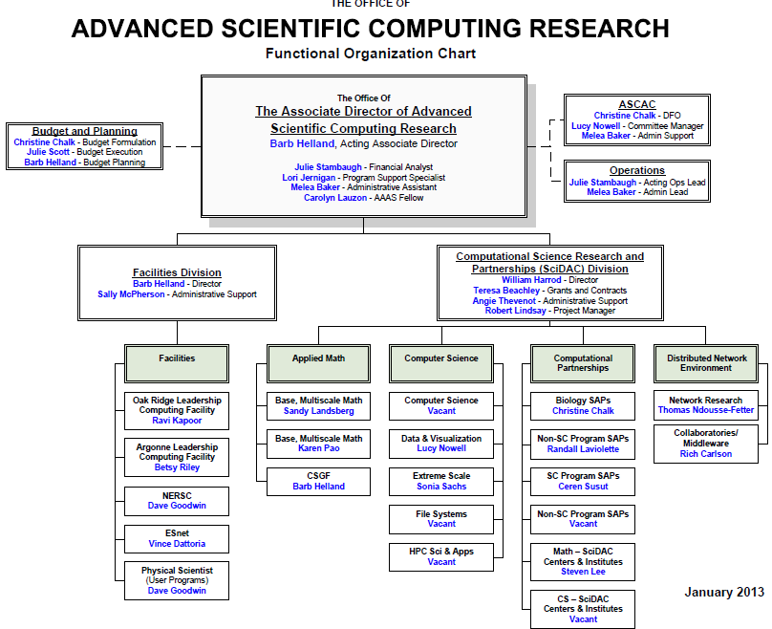
ASCR Org Chart

Slide 4
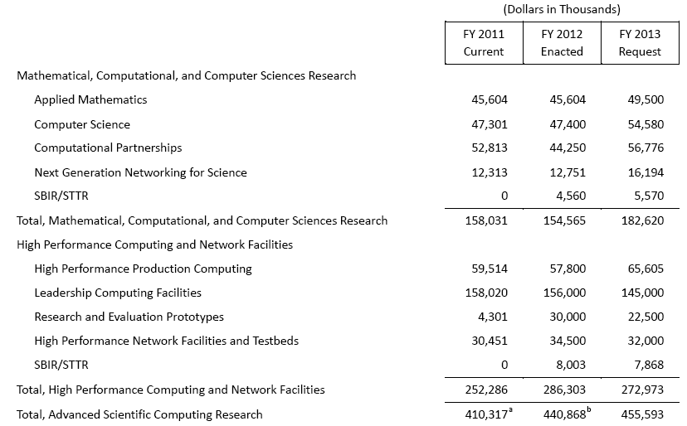
2013 ASCR Budget Request

Slide 5
ECS for Travel Reduction?
OCFO Collecting Information
OCFO Analyst Data Call
video conference rooms
10 SC labs
OCFO Inquiries of ReadyTalk
Capabilities
Usage
OMB Memo 12-12 (May 11, 2012)
>30% less on travel in FY13 than in FY10
Maintain level through FY16
H.R. bill 2643
OMB plan to use video conferencing by FY2017
Acheive 50% reduction in travel costs from 2013 levels
Recission of FY2017 travel budgets

Slide 6
ASCR SBIR Program
Two Topics - same as last year
Advanced Network Technologies and Services
Increasing Adoption of HPC Modeling and Simulation in the Advanced Manufacturing and Engineering Industries
Subtopic Changes
Video Conferencing topic deleted
Technology Transfer Opportunity with ORNL added
Important Dates
Topics issued July 15, 2013
FOA issued August 12, 2013
LOI’s due September 3, 2013
Applications due October 15, 2013

Slide 7
Notable Activities
Upcoming-
HEP/NP/ESnet Program Requirements Review Workshop (Gaithersburg, MD): 20-22 Aug
ESnet European Extension Mission Need Review (GTN, MD): Aug 22
ASCAC (Wash, AGU): TBD (Sep/Oct)
SC13 (Denver, CO): November 17-22
SDN Workshop (NSF): Dec 15-16

