Slide 1
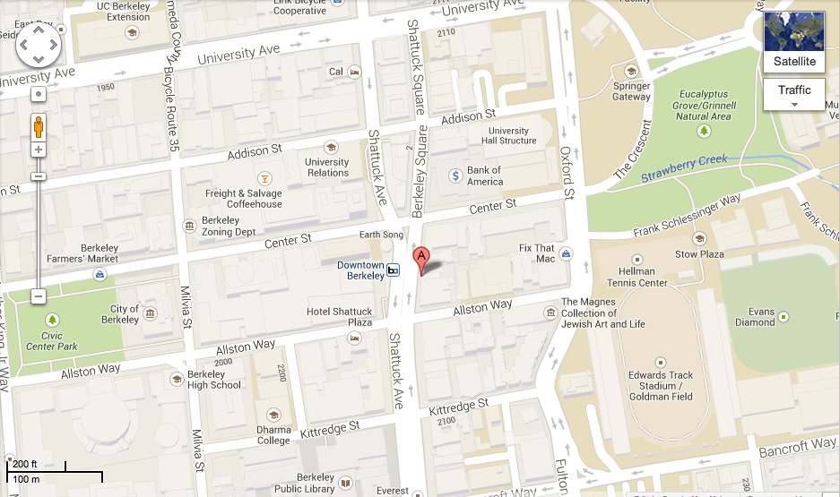
Directions to Jupiter - 2181 Shattuck Ave, Berkeley, CA
Shuttle: Blue Downhill or Orange Route to Downtown Berkeley Stop, walk south on Shattuck one block. Restaurant is between Center and Allston on the same side of the street as the shuttle stop.
Driving: http://goo.gl/maps/vJP6X

