Slide 1
ORNL Site Report
ESCC
July 15, 2013
Susan Hicks
David Wantland

Slide 2
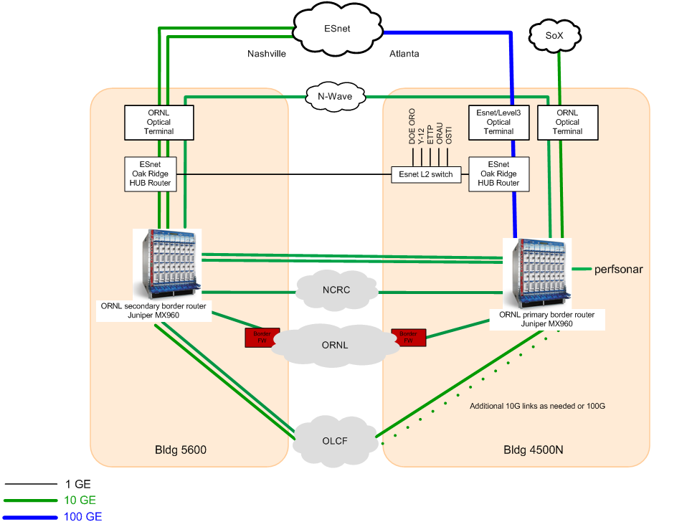
ESnet Oak Ridge Hub @ ORNL

Slide 3
Optical Upgrade Phase I

Slide 4
Optical Upgrade Phase II

Slide 5
Optical Upgrade Phase III

Slide 6
ORNL IPv6
Received /44 assignment
Continued deployment at DMZs
Services
  WWW
  DNS
  Email
New projects
Visitor wireless pending

Slide 7
ORNL IPv6 Deployment

Slide 8
Mobile Device Support Goals
Bruce Wilson, wilsonbe@ornl.gov
policies relating to mobile devices are in the process of being revised
ORNL’s strategy for mobile devices (including phones, tablets, and laptops) supports a broader goal of enabling mobility for unclassified work ensuring:
  ORNL workers can conduct most research and business tasks from any place and any device
  ORNL takes advantage of mobile device capabilities to enable incremental and major changes to research and business methods, including a high degree of portability, persistent connectivity, location awareness, cameras with substantial image processing capabilities, rapidly-evolving “there’s an app for that” ecosystems, security models that reduce many current threat vectors, and a broad range of available devices.

Slide 9
Mobile Device Strategy
Focus on usability and end-user productivity, while layering security in up front, to ensure that solutions are both user-friendly and secure.
Enable secure and user-friendly access to ORNL email, files, applications, and web sites for BYO and ORNL devices by procuring and implementing tools to manage access. To the extent possible, these tools should separate business and personal information and enable secure deletion of ORNL data.
Develop and revise ORNL applications to enable use from mobile devices (including BYOD).
Make a sufficient variety of ORNL-managed mobile devices available to meet core needs; promote the use of BYOD for cases where government-owned devices are not required.
Ensure that research projects are able to use and develop mobile solutions to deliver scientific discoveries and technical breakthroughs.
Ensure a robust and secure network infrastructure that enables mobility and connectivity for ORNL staff and visitors.
Use technology, policy, and training to help users and managers “do the right thing” to protect ORNL information, select cost-effective options, monitor usage, and be compliant with laws and policies.

Slide 10
Mobile Device Support
Current government owned devices
  Blackberry
  iPad
Employee BYOD
  Stipend
  Good
Evaluating Zen Mobile
  More capability
  Leverage existing infrastructure

Slide 11
Wireless
David Wantland wantlanddm@ornl.gov
Wireless Infrastructure
  Cisco wireless controller and mixture of autonomous access points
  Tunneled through campus infrastructure
  IPS, web proxy
Enterprise wireless
  ORNL registered devices only
  WPA
  Future plans with Cisco Identify Services Engine (ISE)
Visitor wireless (open)
  Non-ORNL devices
  Un-validated registration (acceptance page)
  Filtered to ORNL, open to Internet
  Separate DNS/DHCP servers

Slide 12
Wireless Radio Infrastructure
Physical wireless implementation is a mixture of controller based and autonomous access points.
Currently in the process of migrating all autonomous access points to controller based. Approximately 90% of ORNL’s wireless infrastructure is controller based.
Access Points are limited to channels 1,6,11 for b/g radios, no restrictions set on channels for A radios. Cisco Clean Air automatically adjusts channels as needed.

Slide 13
Enterprise Wireless
Uses WPA with TKIP for authentication and encryption with using ORNL user ids and passwords for authentication.
Only ORNL owned machines are allowed on the WPA network. If non ORNL machines are used then they are blocked once they are detected. Currently this block takes place at the Layer-3 switch that routes the WPA network.
Currently working on deploying Cisco Identity Services Engine (ISE) throughout both the wired and wireless networks. The ISE will provide machine specific access control lists that will be enforced by the Wireless Controller.

Slide 14
Visitor Network
For all practical purposes the ORNL visitor network is the network for “BYOD”. Both visitors and employees are allowed to use it. However ORNL owned systems are not allowed on the visitor network.
Remote access in to ORNL from the visitor network is currently only provided via Citrix.
DNS and DHCP services are distinct systems from the ORNL Enterprise DNS and DHCP.
The DNS service is a forward only service that resolves hosts to the same IP address that the general internet would.

Slide 15
Visitor Network and IPv6
Currently developing IPv6 support for visitor wireless.
Wireless controller can answer Neighbor Solicitation packets on behalf of hosts for IPv6 to MAC entries that it currently has cached.
Wireless controller also provides Router Advertisement throttling to prevent routers that are configured with high rates of advertisements.

Slide 16
ORNL Wireless

Slide 17
Questions
?

