Slide 1

Wi-Fi Current Issues and Trends
Jon Green, CISSP
Aruba Networks jgreen@arubanetworks.com
© Copyright 2012. Aruba Networks, Inc.
All rights reserved

Slide 2
Agenda
802.11ac/ad
Centralized vs. Distributed Architectures
Wi-Fi for High Security / Classified
Wi-Fi and Cellular Data

Slide 3
Gigabit Wi-Fi (802.11ac/ad)

Slide 4
IEEE P802.11ac Basics
Title: Enhancements for Very High Throughput for operation in bands below 6GHz
Scope: Modifications to both the 802.11 physical layers (PHY) and the 802.11 Medium Access Control Layer (MAC)
  At least 1 Gbps Multi-station (STA) throughput and a maximum single link throughput of at least 500 Mbps.
  6 GHz below carrier frequency operation excluding 2.4 GHz
  Backward compatible and coexistence with legacy IEEE802.11 devices in the 5 GHz unlicensed band.
Project Purpose: Significantly higher throughput for existing WLAN application areas and to enable new market segments for operation below 6 GHz including distribution of multiple multimedia/data streams.
Source: P802.11ac Project Authorization Request (PAR)
© Copyright 2012. Aruba Networks, Inc.
All rights reserved
Notes:
Primary Goals:
Minimum Throughput
Single Station Throughput: 500Kbps
Multi-Station Throughput: 1Gbps
Backwards Compatibility: must be backwards compatible with 11n (5Ghz) and 11a
Coexistence: must work together with 11n and 11a networks operating in the same band
4

Slide 5
802.11ad ≠ 802.11ac
IEEE 802.11ad:
  60GHz specification
  Appropriate for shorter range in-room use cases
  Gigabit data rates
  Expected approval in Dec 2012
© Copyright 2012. Aruba Networks, Inc.
All rights reserved
Notes:
5

Slide 6
802.11ac Timeline
June ‘13- Wi-Fi Alliance draft certification
Critical mass – enterprise infrastructure
Critical mass – clients
Apr ‘13 - Gen I enterprise-class APs– up to 1.3Gbps
Nov’13 IEEE Standard ratified
2012
2013
2014
2015
2016
Consumer
802.11ac
products
Gen II enterprise-class APs– up to 7 Gbps
Replacement of
802.11n
Jun ‘13 First embedded
client products

Slide 7
Key Technical Components
Wider channels: 80 MHz &160 MHz channel bandwidths
New modulation & coding: 256-QAM, rate ¾ and 5/6, added as optional modes
More spatial streams: Up to 8 (had 4 in 802.11n)
Multi-user MIMO (MU-MIMO)
Source: IEEE 802.11ac framework document, see
https://mentor.ieee.org/802.11/dcn/09/11-09-0992-21-00ac-proposed-specification-framework-for-tgac.doc
© Copyright 2012. Aruba Networks, Inc.
All rights reserved
Notes:
7

Slide 8
80 MHz and 160 MHz channel bandwidths
  80 MHz mandatory, 160 MHz optional
  80 MHz channels are ‘new’ channels:
    Like two 40 MHz channels but with tones in the middle filled in
  160 MHz channels are defined as two 80 MHz channels
    May be contiguous or non-contiguous
© Copyright 2012. Aruba Networks, Inc.
All rights reserved
Notes:
8

Slide 9
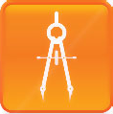
Deployment Considerations – RF Planning
160MHz
  It is unlikely we will see wide adoption of 160MHz channels, but no doubt some special applications will emerge to use this option.
80MHz
  Five available 80MHz channels (three require DFS) should be sufficient for overlapping access points to provide contiguous coverage
<80MHz:
  Some networks will have reasons to prefer a higher number of smaller-width channels
© Copyright 2012. Aruba Networks, Inc.
All rights reserved
Notes:
9

Slide 10
More Spatial Streams
  Up to 8 spatial streams in both single-user (SU) and multi-user (MU) (was 4 max in 802.11n)
    8SS performance will only be possible where both devices have 8 antennas.
    Without innovative antenna designs, this probably precludes handheld devices, but access points, set top boxes and the like will be able to use multiple streams.
  Adding spatial streams increases throughput proportionally – assuming multipath conditions are favorable,
    Two streams offer double the throughput of a single stream
    Eight streams increase throughput eight-fold
© Copyright 2012. Aruba Networks, Inc.
All rights reserved
Notes:
10

Slide 11
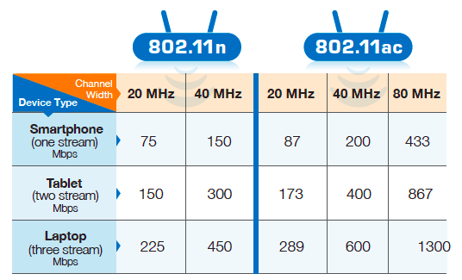
Expected Data Rates for 802.11ac

Slide 12
Phases of 802.11ac
CY 2013/2014: Draft 802.11ac
5GHz only
Up to 8 spatial streams
Up to 160MHz wide channels – even fewer 5GHz channels
Multi-User MIMO - Increased Capacity with simultaneous transmit to multiple receivers
Up to 3 spatial streams
Up to 80MHz wide channels – reduced number of overall channels in 5GHz
CY 2014/2015: IEEE ratified 802.11ac
Max data rate 1.3Gbps - 4x performance compared to 2x2 802.11n
Client devices start shipping mid-2013; Mass adoption early-2014
Wi-Fi Alliance certification based on draft IEEE standard
Max data rate of 6.93Gbps – 10x performance & 50% better range compared to 2x2 802.11n
Mass adoption mid-2015
Notes:
2013 Better speeds
2014 Multi-user MIMO

Slide 13
Centralized / Distributed Architectures

Slide 14




Distributed Architecture
ACCESS
DISTRIBUTION
CORE
DATA CENTER
EMPLOYEE
E
3
3
G
103
203
3
RADIUS
GUEST
203
E
103
103
4
4
G
ACCESS BLOCK 3
203
EMPLOYEE
202
102
E
2
2
2
G
102
202
GUEST
E
202
102
201
G
ACCESS BLOCK 2
101
EMPLOYEE
1
5
5
E
1
1
G
101
201
GUEST
E
101
201
G
ACCESS BLOCK 1

Slide 15
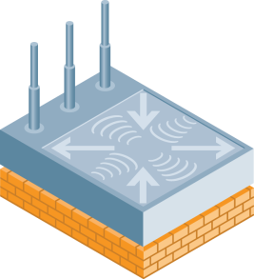

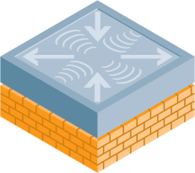


Centralized Forwarding Architecture
Overlay to existing wired infrastructure
Mobility
Controller
Wireless LAN
Mobility
Controller
Access
Distribution
Core
Data Center

Slide 16











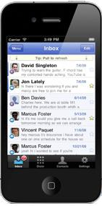
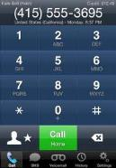
Centralized Encryption Architecture
End-to-end crypto boundary
Per-user virtual connection
AAA
RADIUS
LDAP
AD
PKI
Command
Virtual AP 1
SSID: Secure
Staff
Applications
Services
Partner
Virtual AP 2
SSID: Guest
Guest
AP is Untrusted
Centralized Crypto
Sessions
Flow / Application Classification
Role-based Firewalls
Security
Boundary
Role-Based Access Control
Notes:
16
Utilize stateful firewall for L3-L7 security
Enforce group policies defined within the AAA infrastructure – instead of VLANs
Enable per-user separation – even when they are part of the same VLAN
Enforce time of day restrictions per application and per user group
Blacklist against violation of firewall rules
Bandwidth limits for upload, download
Enable two factor authentication
Aruba’s approach to network security is modeled after the best security practices widely used in the defense and intelligence sectors. Every user is treated as un-trusted entity until they prove themselves to be trustworthy and after that each users activities are monitored and usage rights are constantly enforced. This capability is achieved through a combination of centralized encryption and built-in firewall in the Aruba controller.
Each user’s identity is not based on just their username or MAC address; a user’s identity is validated through 802.1X authentication and other contextual information such as the device type, location and application. This identity is then used to apply access control on the user. This is the opposite of a model where networks assumed that because you are plugged into a particular port you must be user “A” – in the new world, users are mobile and can plug in anywhere in the building or at another location even; this is the reason why we need to ensure access based on identity and not on physical LAN port.
Aruba’s user-centric approach to mobility provides the level of security that IT administrators are used to deploy in wired networks - Aruba’s security architecture with built-in stateful firewall defines a method to enable wireless networks & mobility without comprimising security.
Users of the WLAN, independent of the SSID they are associated to & independent of the VLAN they are in, are defined based on who they are, where they are – their time of day access, their access rights to application and corporate services, application level troubleshooting per user, logging of users activities, per application source / destination NAT, etc. can all be defined within Aruba’s stateful firewall.
IT administrator benefit from the scalability and flexibility of Aruba’s approach to tying security policies to mobility by enabling different layers of service across different class of users without any additional hardware components and additional operational expenses.

Slide 17
Wi-Fi for Classified

Slide 18






Classified Wi-Fi Networks
Today’s Legacy Architecture based on Type 1 / Suite A
TYPE-1 Crypto Boundary
802.11i / WPA2 Crypto Boundary
firewall
WLAN Controller
UNCLASS
SECRET
TYPE-1 Adapter
HAIPE
(High Assurance IP Encryptor)
Wireless AP
Advantages:
  Strong security
  Well understood
  Covered by existing policy
Disadvantages:
  Very expensive
  Doesn’t support modern COTS devices
  Usability challenges with CCI
Under-utilization of mission-critical networks and applications

Slide 19

Best of Both Worlds: Suite B
Suite B is a set of public cryptographic algorithms promulgated by the National Security Agency as part of its Cryptographic Modernization Program
Three goals:
  Information sharing with partners
  Enable rapid adoption of new technology
  Lower cost/complexity of CCI
In the US, authority to use Suite B granted by CNSSP-15
Suite B does NOT, by itself, permit commercial devices in classified networks

Slide 20
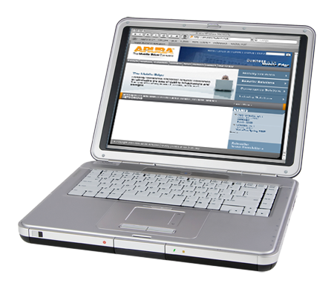
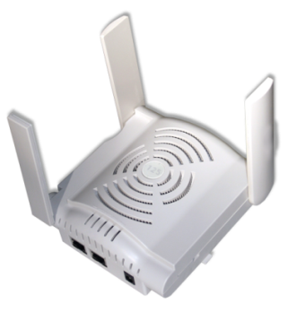
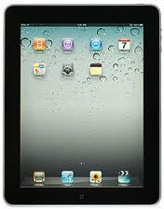
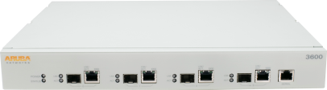
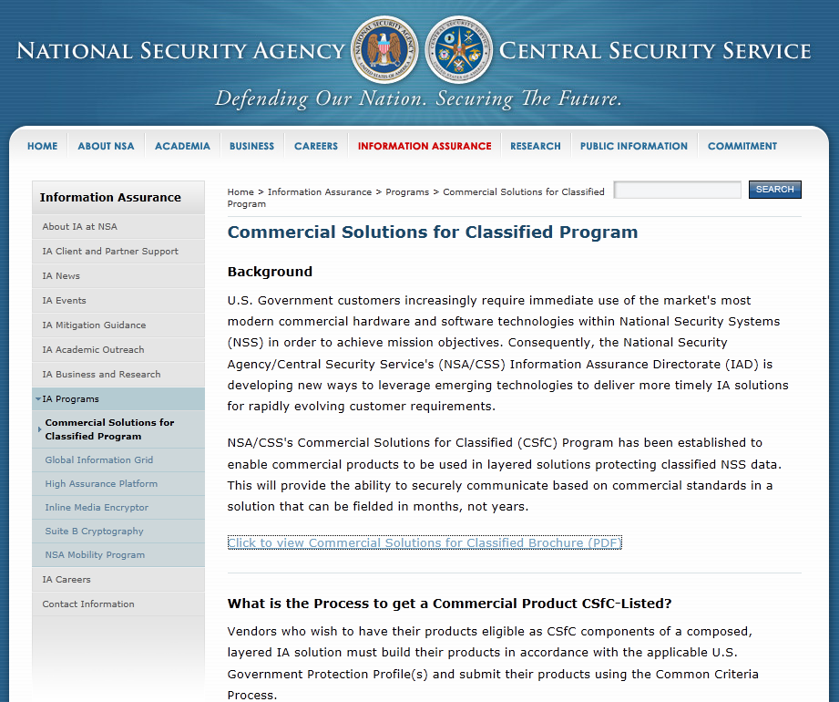
How do we accredit COTS products?
“Commercial Solutions for Classified”
NSA Program to enable Commercial rather than Government-designed products
Requirements:
  Suite B support
  FIPS 140-2 and Common Criteria validation
  Signed agreement with NSA
Other countries planning similar programs, but watching NSA first

Slide 21

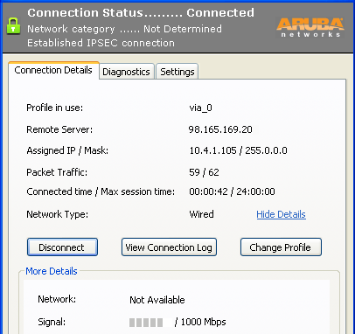

Example: Suite B at L2 and L3
IPsec Tunnel (Vendor B)
WPA2 - Vendor A (Aruba + Client Stack)
firewall
WLAN
Aruba Controller
SECRET
WLAN Controller
IPSEC (Suite B)
Microsoft WPA2 Client
VPN Concentrator
Aruba CAP
Follows NSA WLAN Capabilities Package
Cannot mix NIPR and SIPR on same WLAN equipment (controller is red)

Slide 22
Wi-Fi and Cellular Data

Slide 23
Highlights
Major importance to cellular carriers
  Running out of capacity
  How do we make cellular offload seamless? New standards like Hotspot 2.0 under development.
  Want to keep control of the user experience
What about enterprises?
  Unless outsourcing entire WLAN to a carrier, not a major concern
  Very large enterprises/large public venues may have opportunities to lease their WLAN to a carrier
  Colocated Wi-Fi APs and cellular radios can cause interference – use caution

Slide 24
Jon Green
jgreen@arubanetworks.com

