Slide 1
Juniper 40 and 100G LaN/WAn
Robert Marcoux – Systems Architect
Ben Hromyk – Major Account Manager
JJ Jamison – Senior Solutions Architect

Slide 2
PTX Series

Slide 3
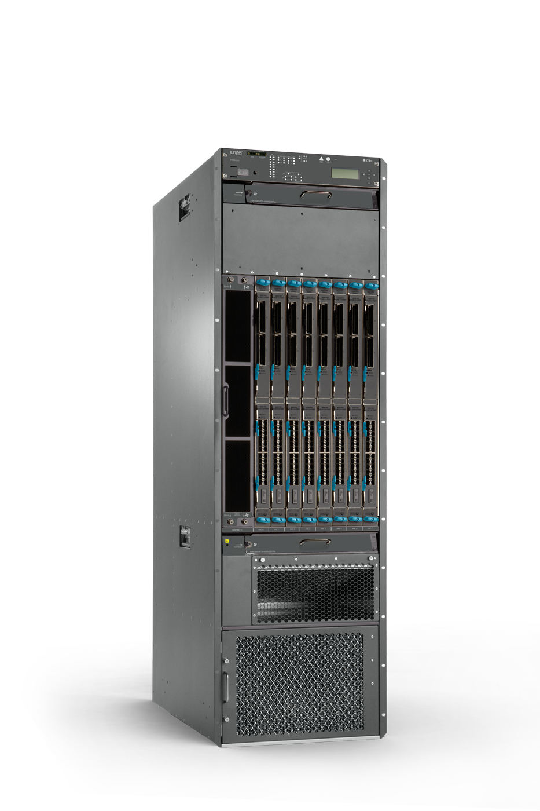
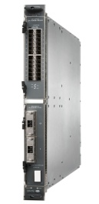

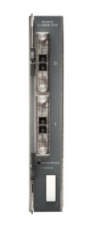

PTX 5000
PTX 5000
  17.6’’ (19’’ rack) x 33’’x62, (WxDxH)
  1000lbs loaded
  Max power consumption:10.4kW
  Typical power consumption:6.2kW
  8 line card slots,
  2 PICs per slot
Port density
  10GE: 384
  40GE: 32
  100GE: 32
Note: 100GE SR10 timeline depends on 3rd party availability
FPC
10GE PIC
40GE PIC
100GE PIC
480G/Slot
8FPC/PTX5000
24x10GE
SFP+ SR,
LR,ER
2xPIC/FPC
2x40GE
CFP LR4, 2xPIC/FPC
2x100GE
CFP LR4, SR10
2xPIC/FPC

Slide 4
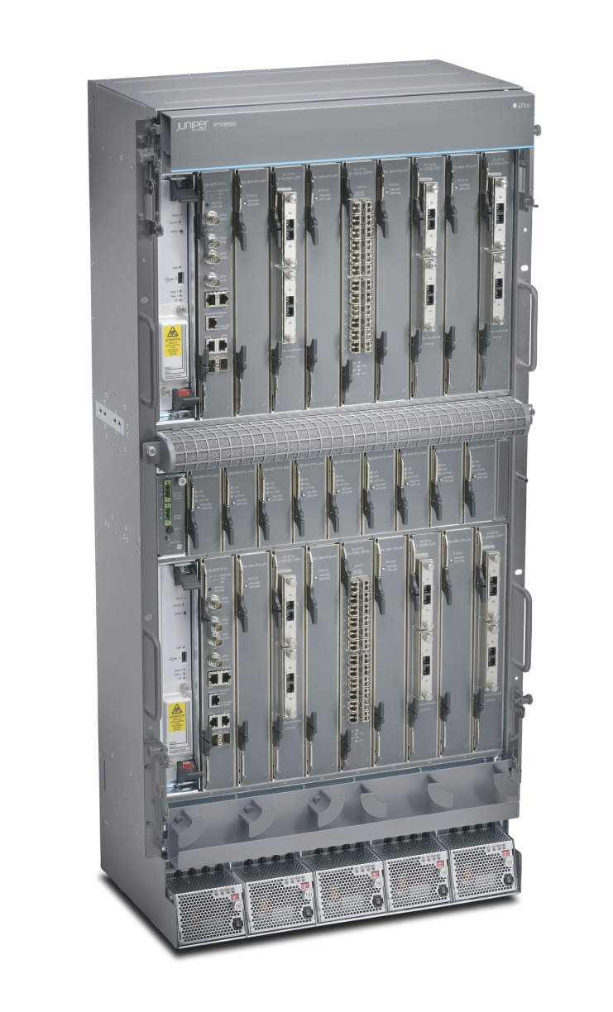
PTX3000
PTX 3000
  17.6’’ (19’’ rack) x 10.6’’x 38.5, (WxDxH)
  200lbs loaded
  Max power consumption: 4.4kW
  Typical power consumption: 3.2kW
  8 PIC slots + 8 FPC slots
Port density
  10GE: 192
  40GE: 16
  100GE: 16
Note: 100GE SR10 timeline depends on 3rd party availability
Same PICs as PTX5000
FPC
10GE PIC
40GE PIC
100GE PIC
240G/Slot
8 FPC per PTX3000
1 PIC per FPC
24x10GE
24x10GE LAN+WAN+OTU
SFP+ SR, LR, ER, ZR
2x40GE
CFP LR4
2x100GE
CFP LR4, ER4, SR10

Slide 5
MX Series

Slide 6
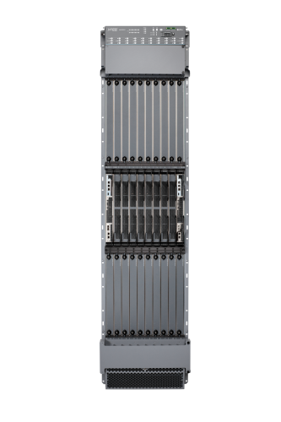
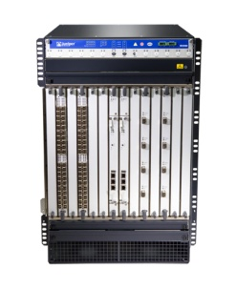
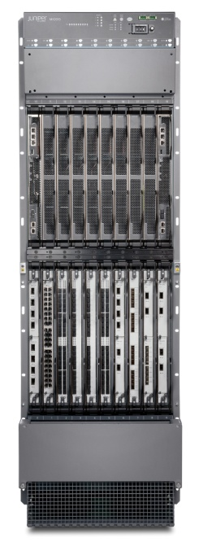


MX Series Chassis (current)
 | MX240 | MX480 | MX960 | MX2010 | MX2020
Max system witching Capacity (1/2 duplex) | 1.6Tbps | 4.8Tbps | 8.8Tbps | 40Tbps | 80Tbps
Height (RU) | 6 | 8 | 16 | 34 | 45
Slots | 2 | 6 | 11 | 10 | 20
Forwarding* capacity/slot | 240Gbps | 240Gbps | 240Gbps | 860Gbps | 860Gbps
10GE Ports* | 48 | 136 | 256 | 260 | 520
Redundant RE | Yes | Yes | Yes | Yes | Yes
Redundant Fabric | Yes | Yes | Yes | Yes | Yes
Redundant Power | Yes - AC/DC | Yes - AC/DC | Yes - AC/DC | Yes – AC/DC | Yes – AC/DC
* Current capacity, system capacity is higher

Slide 7
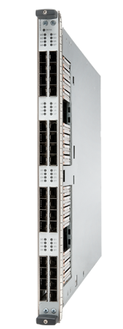
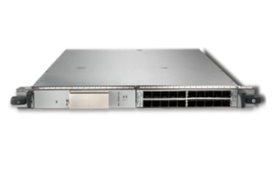


MX Series 40/100G Line Cards
130G MPC3
260G MPC
2x100GE
4x40GE
2x100GE + 8x10GE
SHIPPING
Shipping
240G HQoS MPC
½T MPC on MX2000
10GE
2x100GE
6x40GE
4x100GE
2014
2014

Slide 8
EX Series

Slide 9
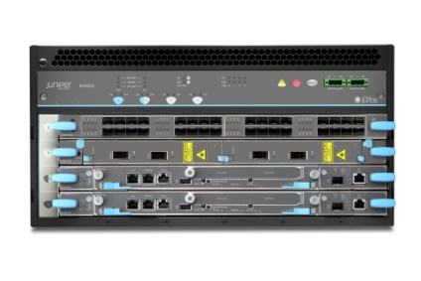
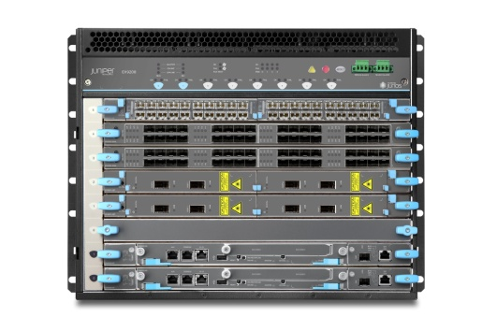
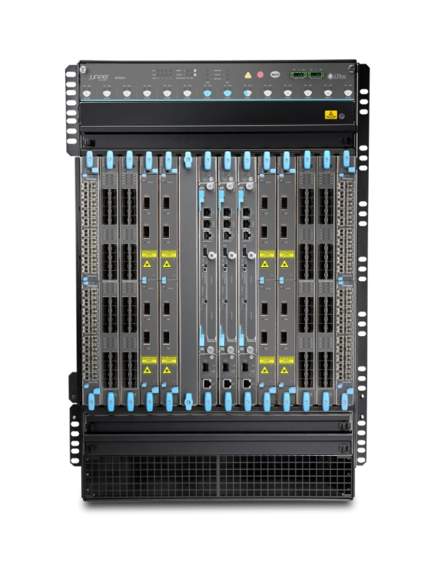
EX9200 Systems
  4 slots
  Switch Fabric, Routing Engine, power supply and fan tray resiliency
  Up to 1.6 Tbps chassis capacity
  EX9204
  Chassis
  40 x 10/100/1000BASE-T
  40 x 100FX/1000BASE-X SFP
  8 slots
  Switch Fabric, Routing Engine, power supply and fan tray resiliency
  Up to 4.8 Tbps chassis capacity
  EX9208
  Chassis
  14 slots
  Switch Fabric, Routing Engine, power supply and fan tray resiliency
  Up to 13.2 Tbps chassis capacity
  EX9214
  Chassis
  Scalable switching & routing
  MPLS (VPLS, L3VPN, P2MP)
  Sub 50 msec convergence
  1M MAC addresses
  256K ACLs
  256K IPv4/IPv6 routes
  32K VLANs

Slide 10

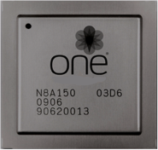
EX9200 Overview
  Programmable
  Programmable ASIC (Junos)
  Programmable control and management
  planes via open APIs
  Automation
  Flexible
  Campus- and data center-optimized
  Extensive protocol support
  Feature rich
  Future ready
EX9208
EX9214
EX9204
  Scalable
  Logical scale
  High density
  Up to 13.2 Tbps chassis capacity
  100G ready
Juniper One Custom Silicon

Slide 11


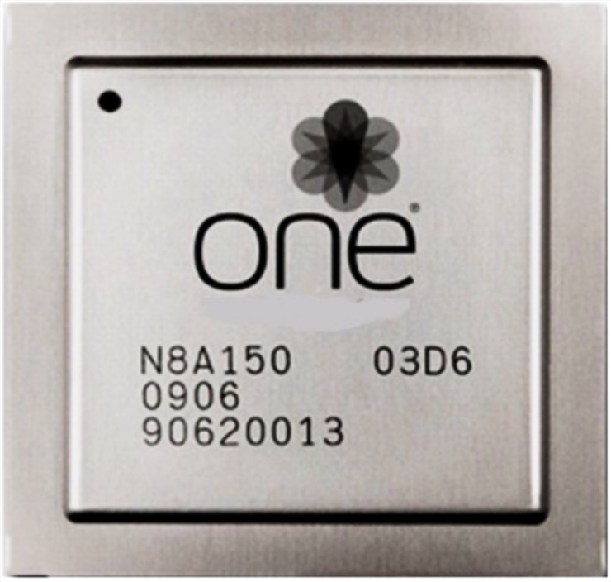






EX9200 programmability
Silicon
System
Network
Custom Juniper ASIC
Programmable packet forwarding engine
Junos Automation
Junos SDK
Native interfaces
Integration with
leading orchestration applications
VXLAN
NVGRE
SDN
MPLS over IP

Slide 12

EX9200 protocol Flexibility
Combined Campus
& Data Center
Campus
Data Center
IP
MPLS
IS-IS
GRE
VPLS
Investment
Protection
CAPWAP
VXLAN
NVGRE
Extensive protocol support for campus and data center
Representative of future capabilities

Slide 13
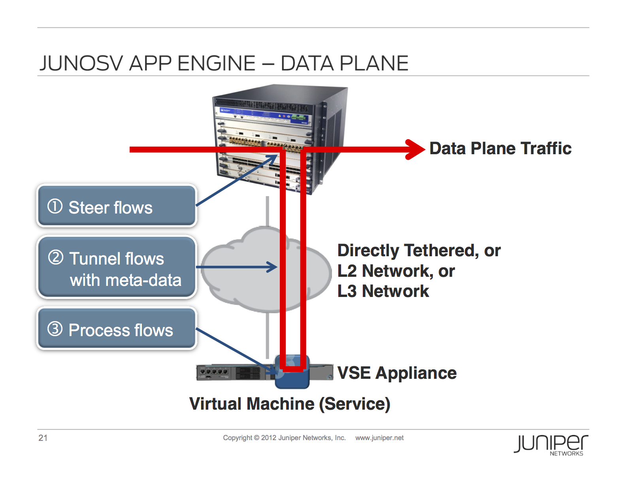

Slide 14
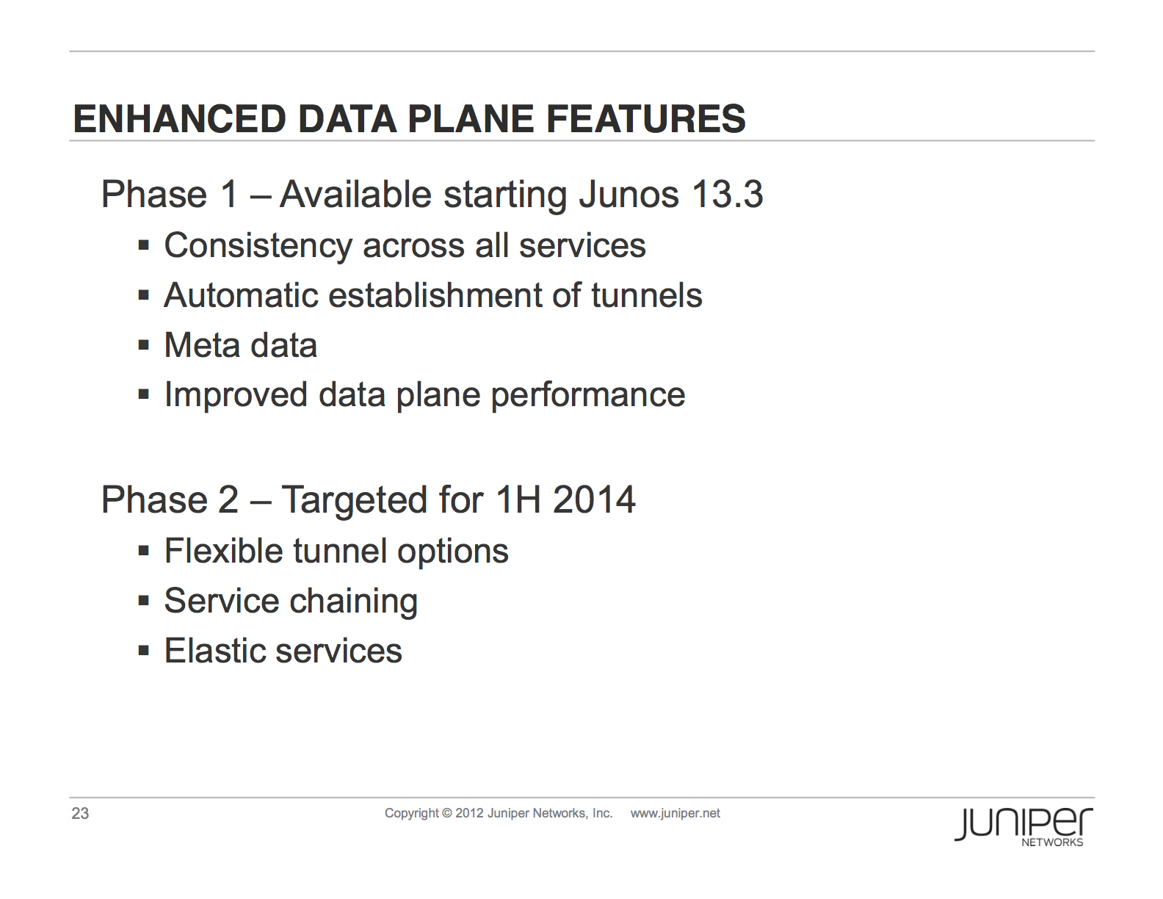

Slide 15
EX9200 Line cards

Slide 16
EX9200 40GbE Line Card
  4-port 40GbE QSFP+
  4:3 oversubscription
  1 PFE per line card
  PFE capacity:
      130G of PFE capacity
      160G of fabric capacity
  Fabric capacity
      14-slot: 80G per SF
      8-slot: 160G with SF per PFE
  Port-based queuing
  Supports MPLS, L3VPN, VPLS, scalable switching and routing
4x40GE QSFP+ ports

Slide 17
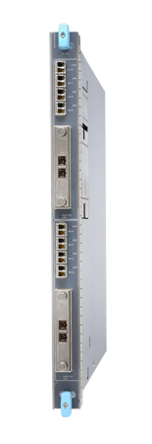
EX9200 100GbE line card
  2x100G CFP + 8x10G SFPP
  Supports CFP and SFP+ optics
  2 PFE per line card
  Fabric capacity
    14-slot: 40G per SF per PFE
    8-slot: ~80G + ~40G with SF per PFE
    ~120G per PFE
    ~240G per LC
  Port-based queuing
  Supports MPLS, L3VPN, VPLS, scalable switching and routing
  In EX9208, only 5 out of 6 slots can be populated with 100GbE LC and in EX9214 10 out of 11
  In EX9214 slots 0-5 can have up to 5 100GbE LC and slots 7-11 can have up to 5
2x100G CFP + 8x10G SFPP ports
 Roadmap

Slide 18
Maximum Port Density
Redundant Configuration
 | EX9204 | EX9208 | EX9214
Switch Fabrics | 2 | 2 | 3
Routing Engines | 2 | 2 | 2
1GE ports | 80 | 240 | 440
10GE ports | 64 | 160 | 320
40GE ports | 8 | 24 | 44
100GE ports | 4 | 10 | 20
Non-redundant Configuration
 | EX9204 | EX9208 | EX9214
Switch Fabrics | 1 | 1 | 2
Routing Engines | 1 | 1 | 1
1GE ports | 120 | 280 | 480
10GE ports | 96 | 160 | 320
40GE ports | 12 | 28 | 48
100GE ports | 6 | 10 | 20

Slide 19
Questions

Slide 20
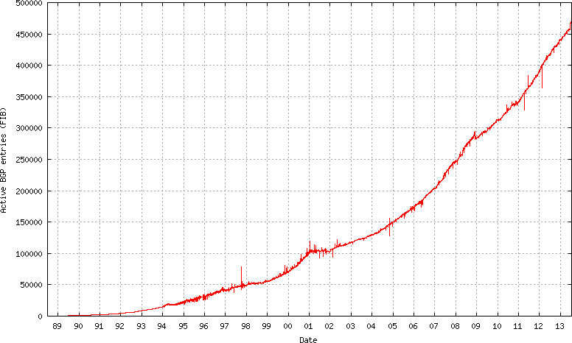
Active BGP Entries IPV4

Slide 21
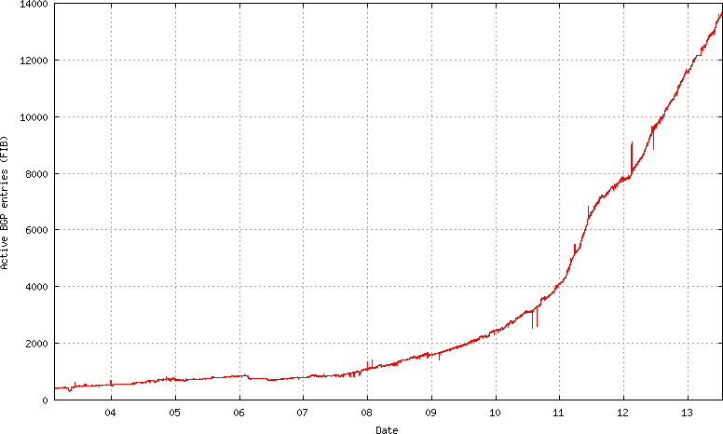
Active BGP Entries IPV6

Slide 22
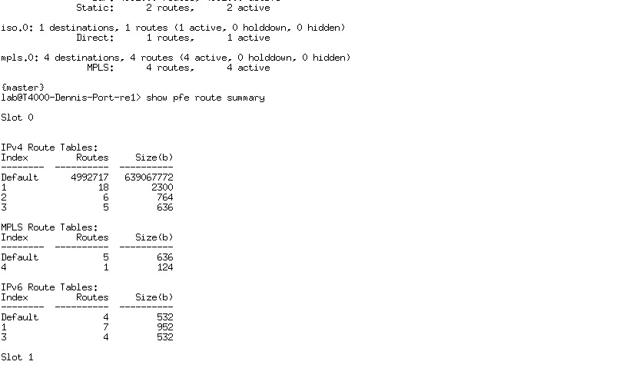
Juniper Systest with 5M Active Bgp Entries

