Slide 1
ESCC Beyond 10GE Discussion
Phil DeMar
Summer 2013 ESCC meeting
July 16, 2013

Slide 2
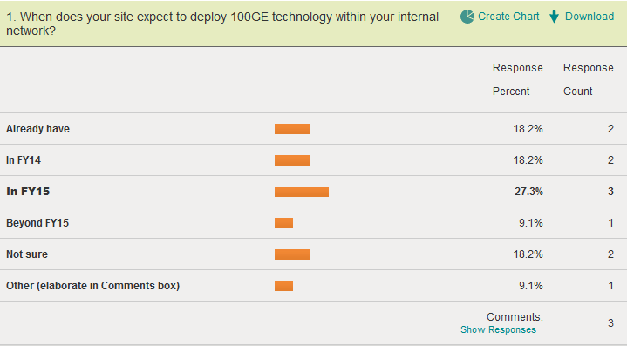

Slide 3
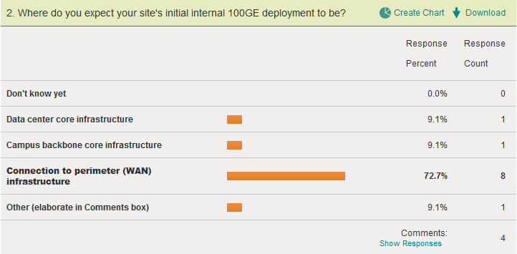

Slide 4
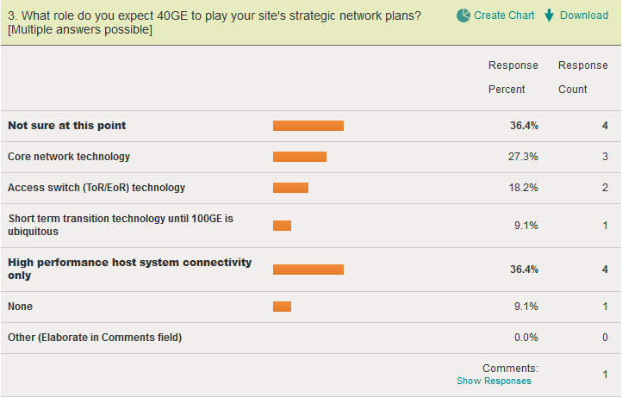

Slide 5
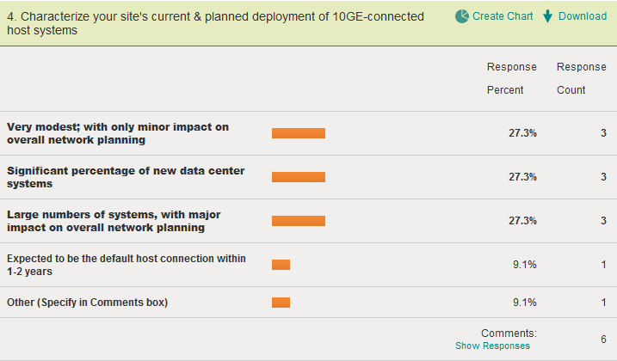
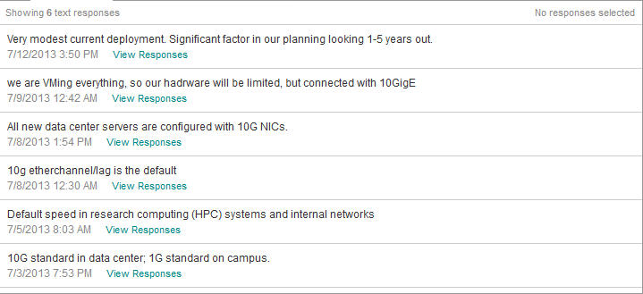

Slide 6
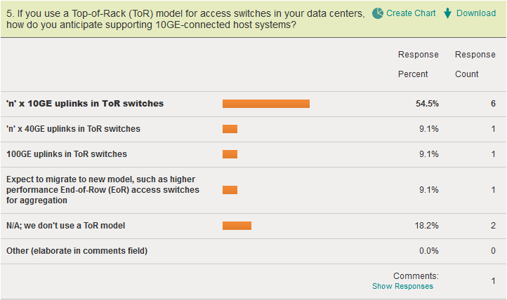

Slide 7
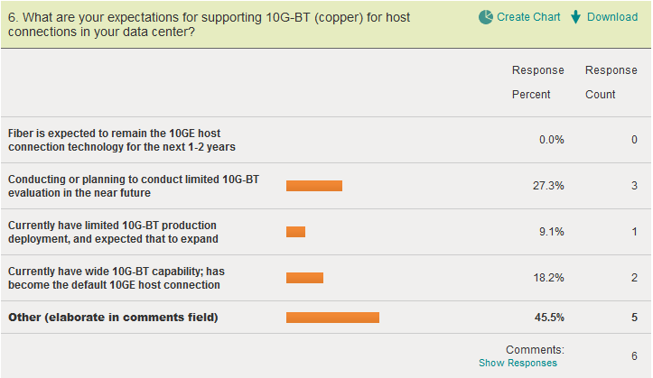
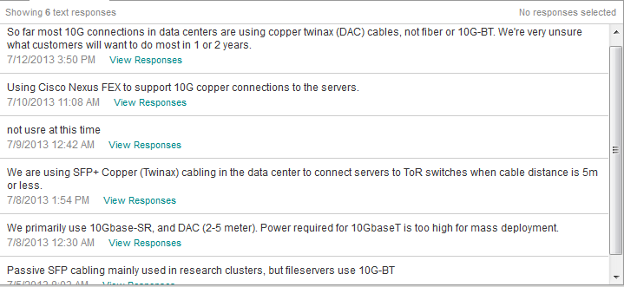

Slide 8
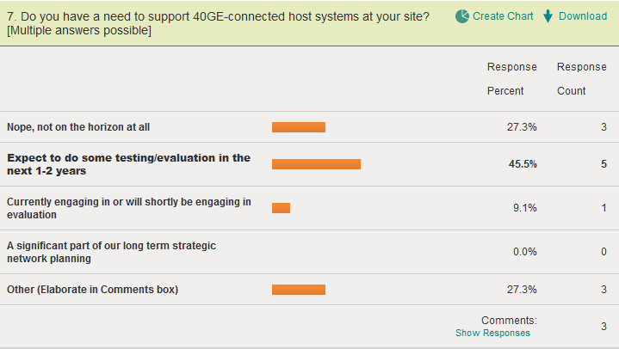

Slide 9
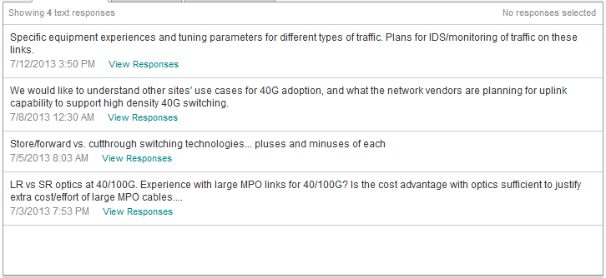
What issue or issues would you like to see discussed with regard to 40GE/100GE network technologies in the campus network, and/or 10GE/40GE-connected host systems?

Slide 10
Discussion points with the vendors?
How do they project the 100GE marketplace?
What do they expect the role of 40GE to serve?
How do they see ToR approaches aligning with high network I/O 40/100GE environments?
What else?

