Slide 1
DUNE Timing System
Introduction
DUNE Timing System interim PRR for
DUNE-variant AFC
19/April/24

Slide 2
Overview
System Requirements
Implementation
Redundant paths
uTCA based
Components in system
System Design
Role of AFC in system
How many AFCs
2
19/Apr/2024
Notes:
2

Slide 3
System Requirements
Described in EDMS 2389053 .
Key requirements:
Alignment of clock/timestamp between endpoints in a single cavern better than 5ns (RMS).
Relaxed w.r.t. v1 of requirements. Can be satisfied by measuring to single bit-time.
Global alignment with respect to TAI/UTC better 1us
Detection of failed endpoint in O(1s)
High uptime ( > 99.9% ) – DUNE is a neutrino observatory as well as detecting beam neutrinos.
High reliability – when the system delivers a time, the time must be accurate.
We will aim to show that the DUNE-variant AFC is part of a system that will meet these requirements
3
19/Apr/2024
Notes:
3

Slide 4
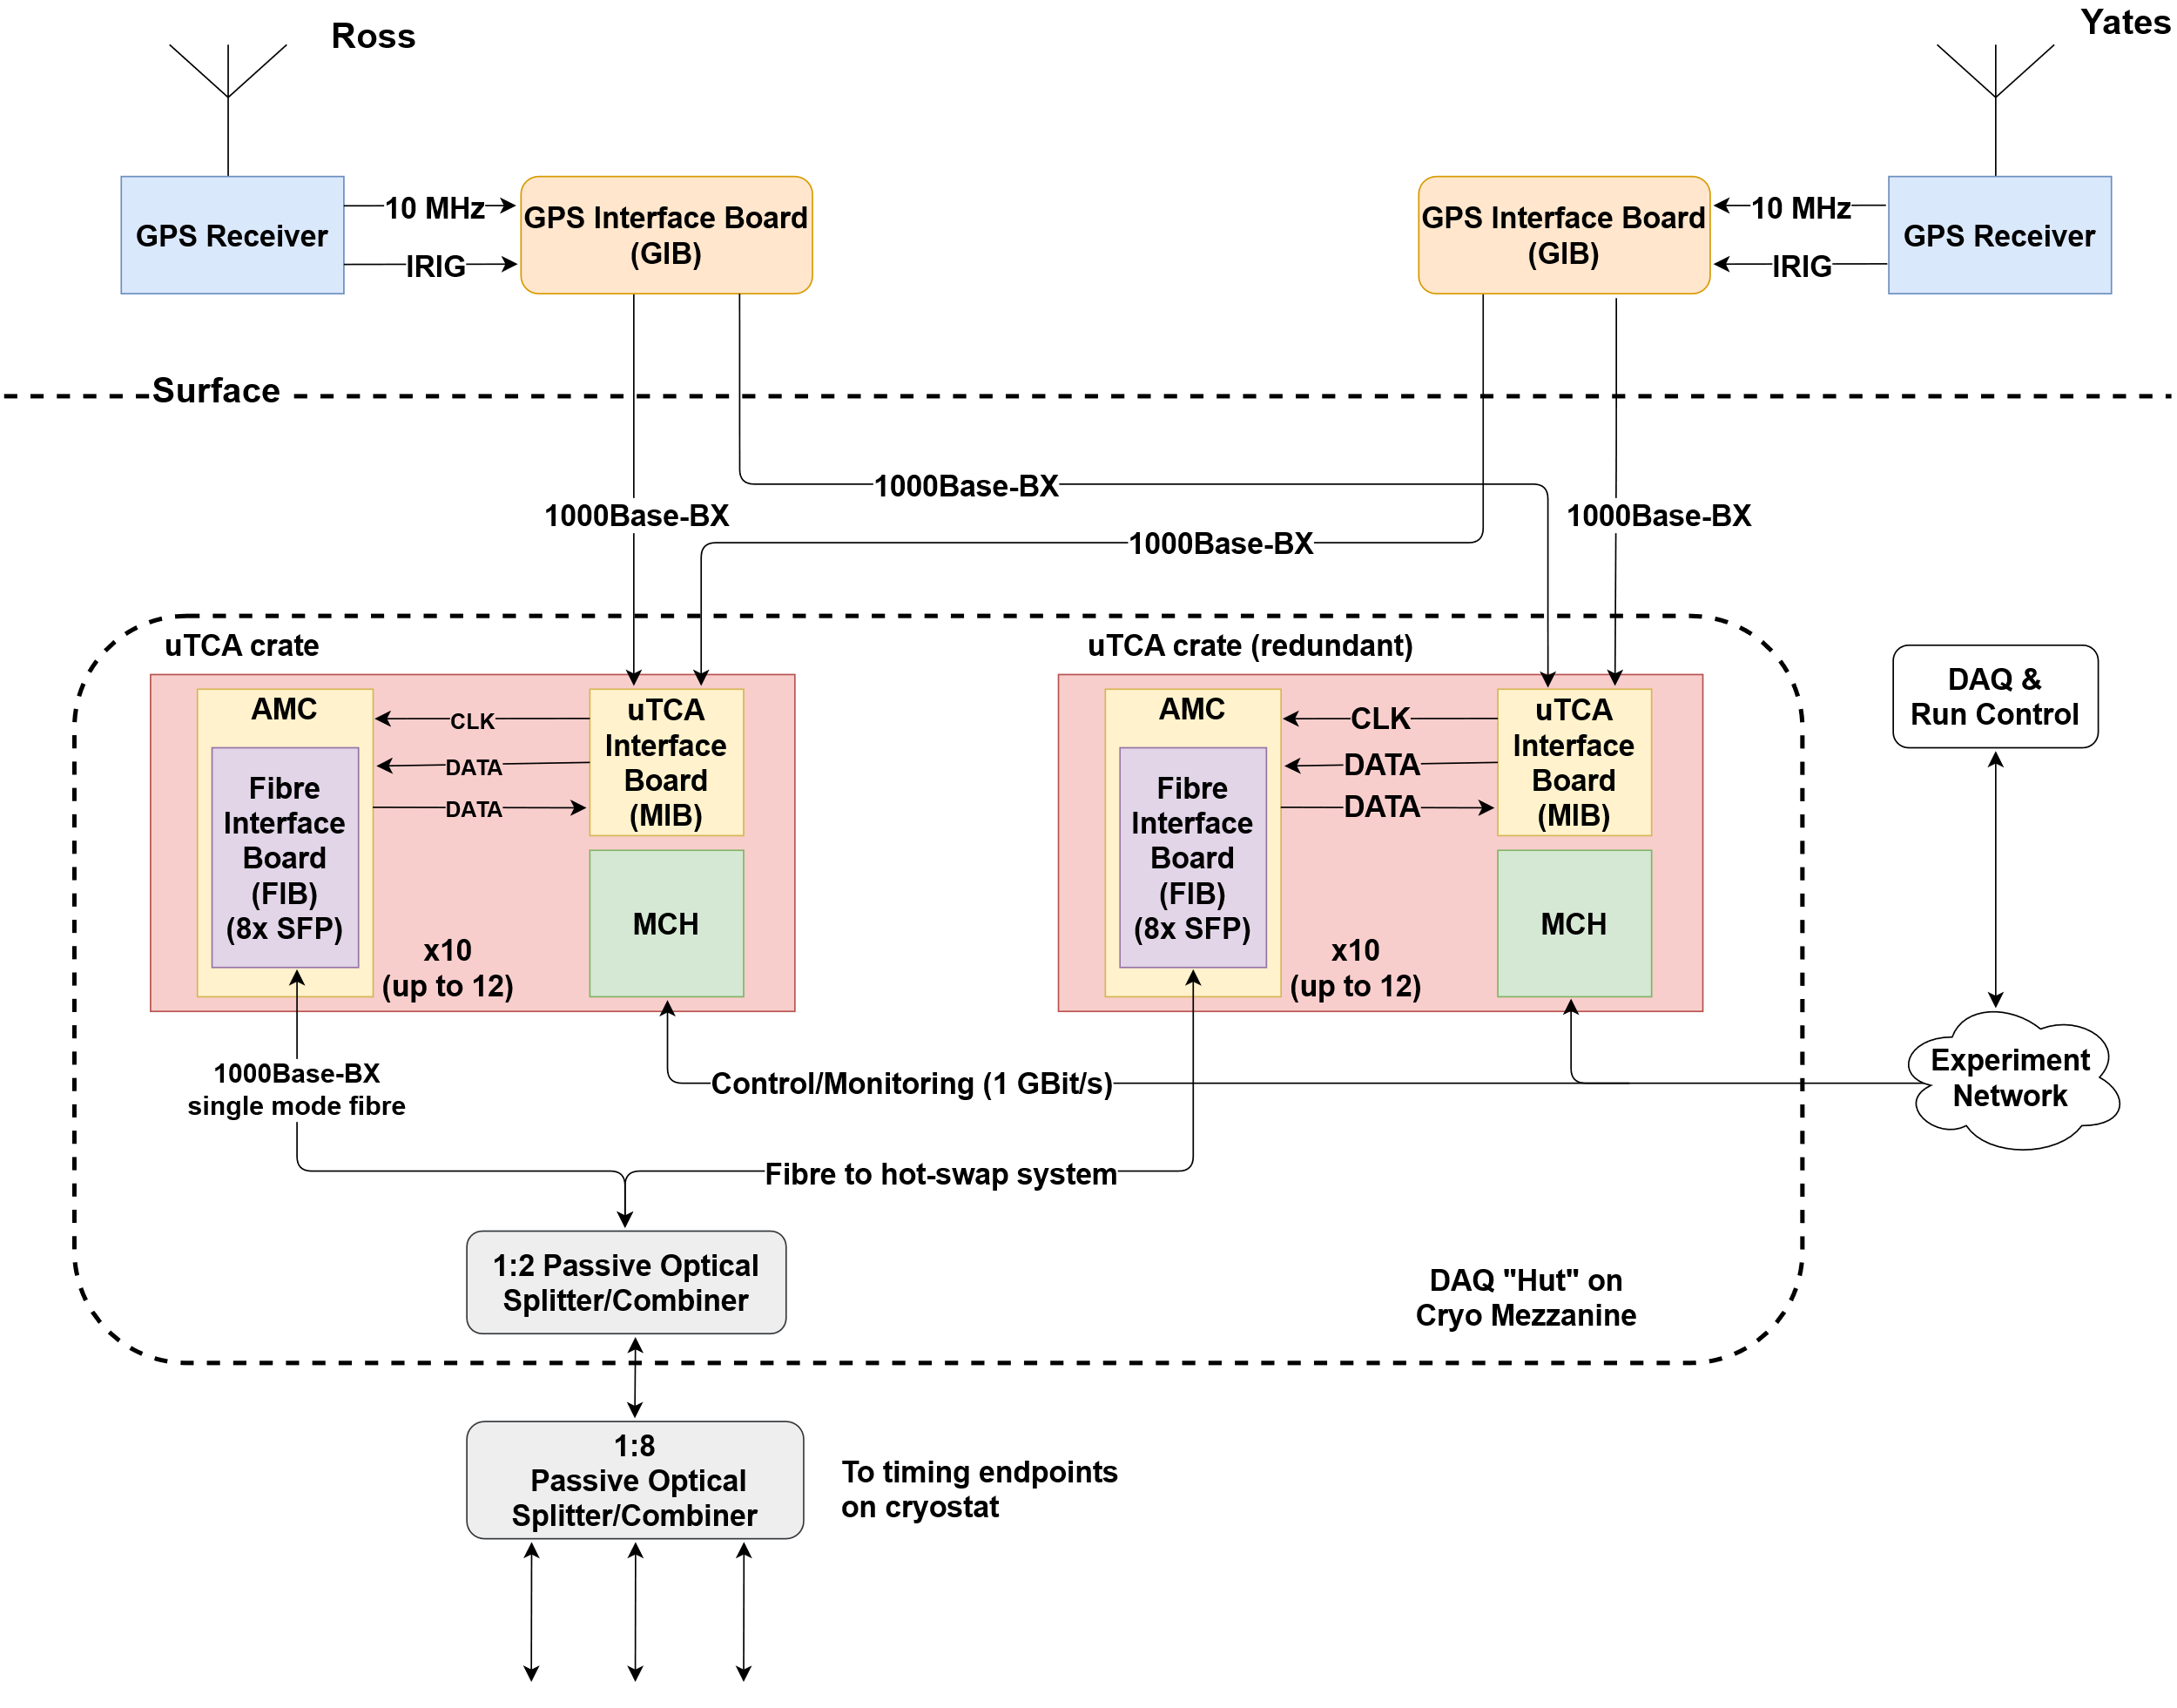
Implementation
4
19/Apr/2024
Notes:
4

Slide 5
Implementation
Redundancy
GPS receiver at each of: Ross, Yates.
5
19/Apr/2024
Notes:
5

Slide 6
Implementation
Redundancy
Two uTCA crates.
One active
One standby
Outputs combined optically
6
19/Apr/2024
Notes:
6

Slide 7
Implementation
uTCA based
Hot swap PSU
Hot swap fans
Hot swap AMC (AFC) boards
Voltage, Current, Temp, Fan monitoring
7
19/Apr/2024
Notes:
7

Slide 8
Implementation - AFC
uTCA AMC FMC carrier boards host interface to detector.
AFC chosen (simple, low cost, open hardware)
Crate can host up to 12 boards
8
19/Apr/2024
Notes:
8

Slide 9
Implementation
Transmit/Receive between timing master and endpoints over optical fibre.
1000Base-BX SFPS – both directions on same fibre.
Passive Optical Splitting used to:
Drive multiple timing endpoints from one timing fibre
Allow redundancy: 2:1 combiner/splitter between active and stand-by crates.
9
19/Apr/2024
Notes:
9

Slide 10
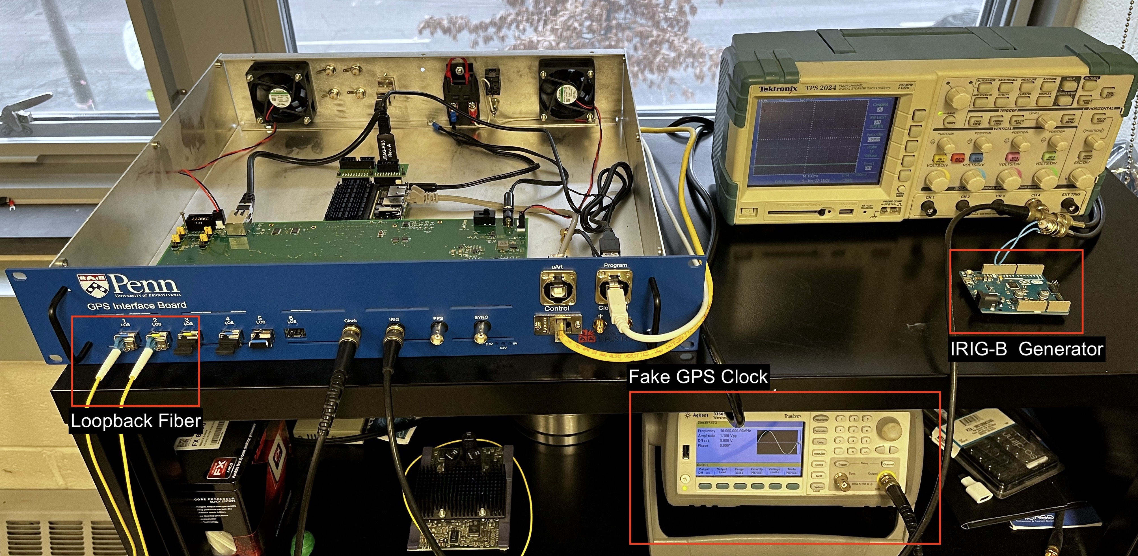
Components – GPS Interface Board
Above ground. Link to GPS.
Prototype under test
Pre-production version Q2/24
Covered by PRR Q3/24
Covered by full PRR
10
19/Apr/2024
Notes:
10

Slide 11
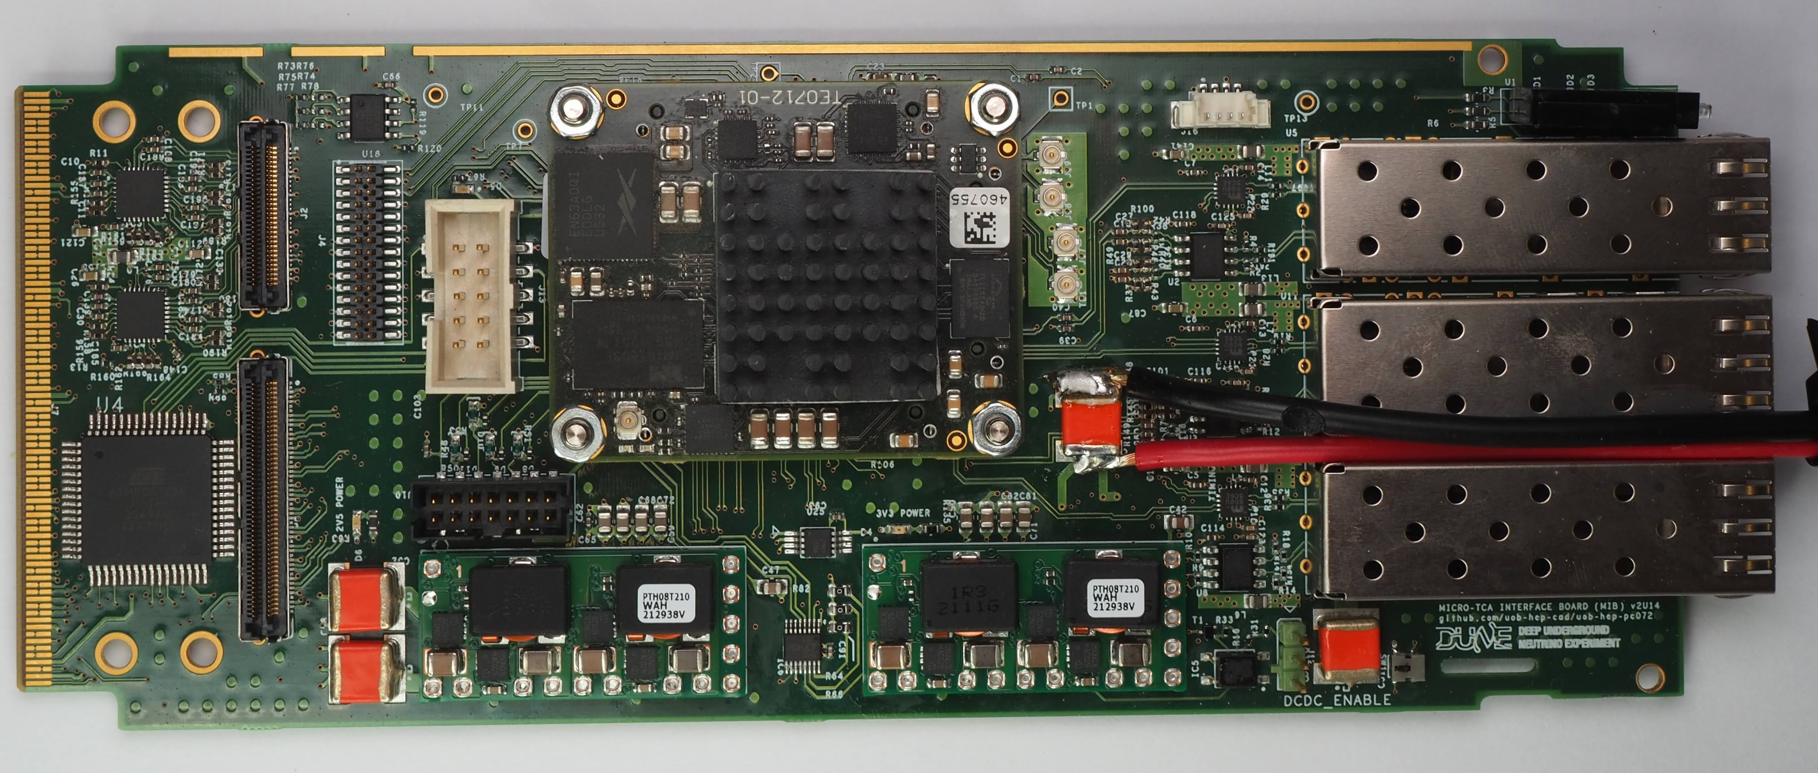
Components – MicroTCA Interface Board
Receives timing from GIB
In MCH1 slot of uTCA crate
Second prototype under test
Pre-production version Q2/24
Covered by PRR Q3/24
Covered by full PRR
11
19/Apr/2024
Notes:
11

Slide 12
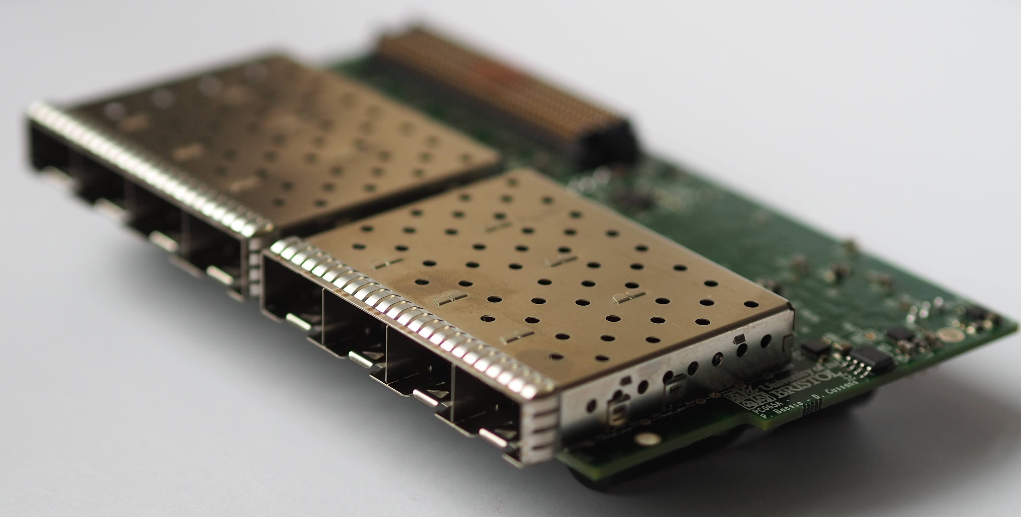
Components – FIB
Houses optical interfaces to detector
Hosted by AFC
Double width FMC format
Prototype under test
Pre-production version undergoing checks before manufacture
Covered by PRR Q3/24
Covered by full PRR
12
19/Apr/2024
Notes:
12

Slide 13
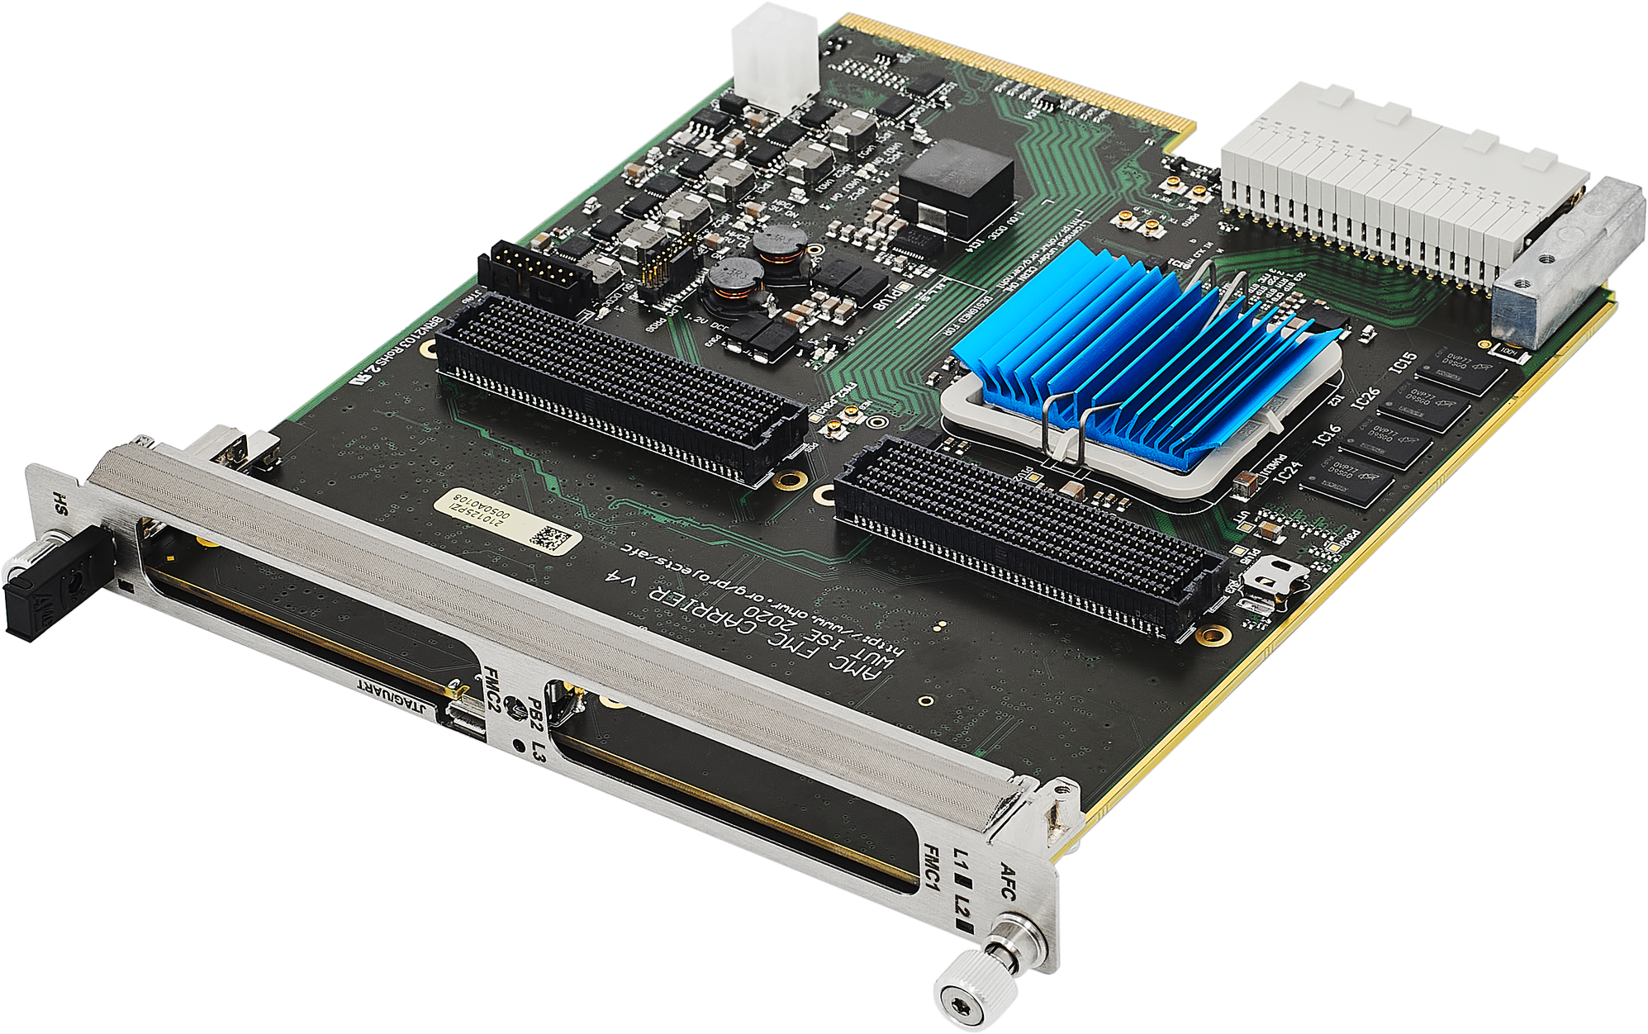
Components – AFC
Hosts FIB
Standard format AMC
Open Hardware
Hot swappable
Needs minor modification for DUNE use.
Covered by this iPRR
Subject of this interim
PRR
Photo: https://ohwr.org/project/afc/wikis/home
13
19/Apr/2024
Notes:
13

Slide 14
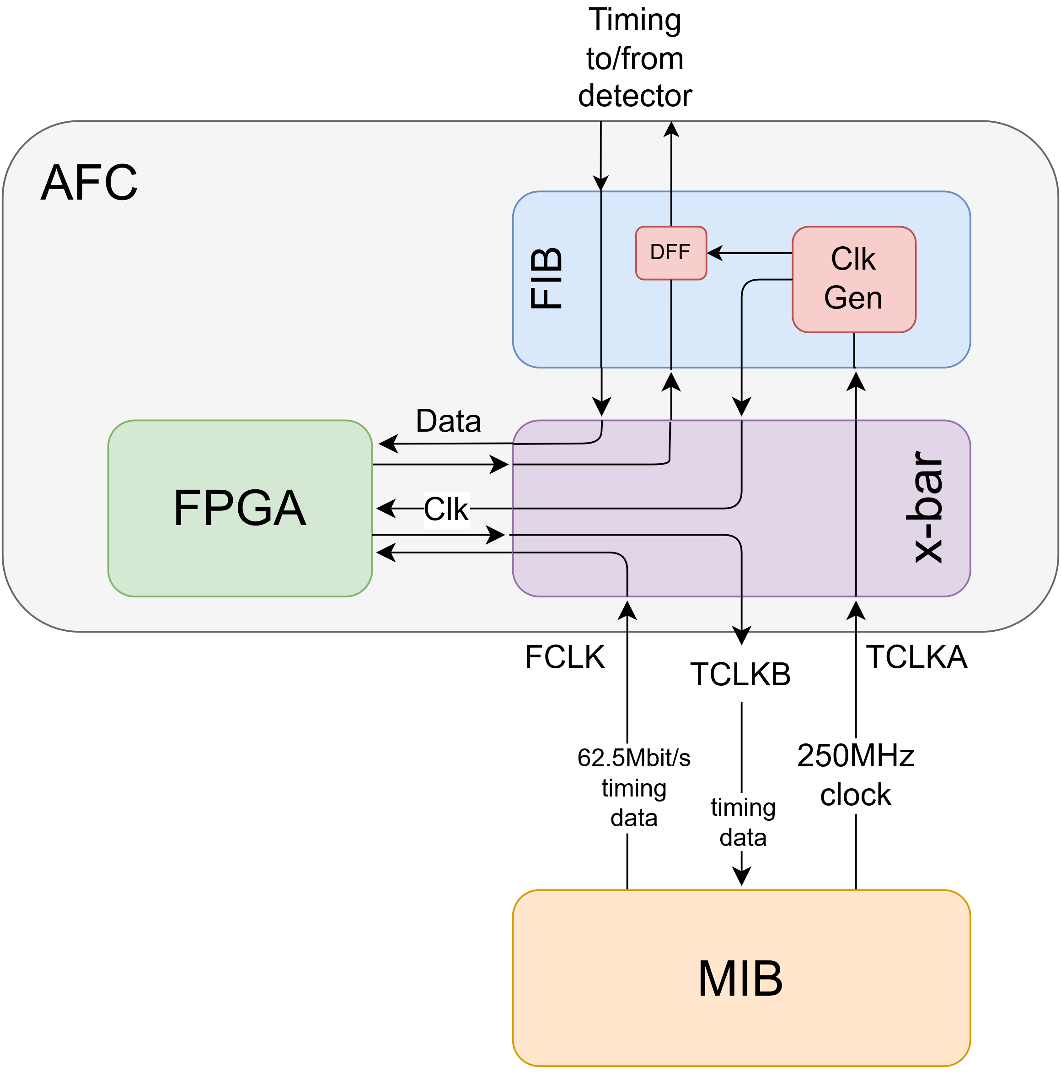
Role of AFC
Routes clock and timing data from/to MIB to/from FIB
At heart of AFC – a low-jitter clock cross-bar
250MHz clock from MIB (four times bit-rate) transmitted over dedicated point-to-point uTCA backplane differential lines (TCLKA)
14
19/Apr/2024
Notes:
14

Slide 15
Role of AFC
FPGA on AFC receives timing data from MIB via cross-bar.
Carried from MIB to AFC on dedicated point-to-point FCLK lines.
Timing ``master’’ in each crate in MIB FPGA handles polling on endpoints attached to FIBs
15
19/Apr/2024
Notes:
15

Slide 16
Role of AFC
FPGA on AFC receives data from 8 SFPs on FIB and multiplexes onto single point-to-point TCLKB line to MIB
16
19/Apr/2024
Notes:
16

Slide 17
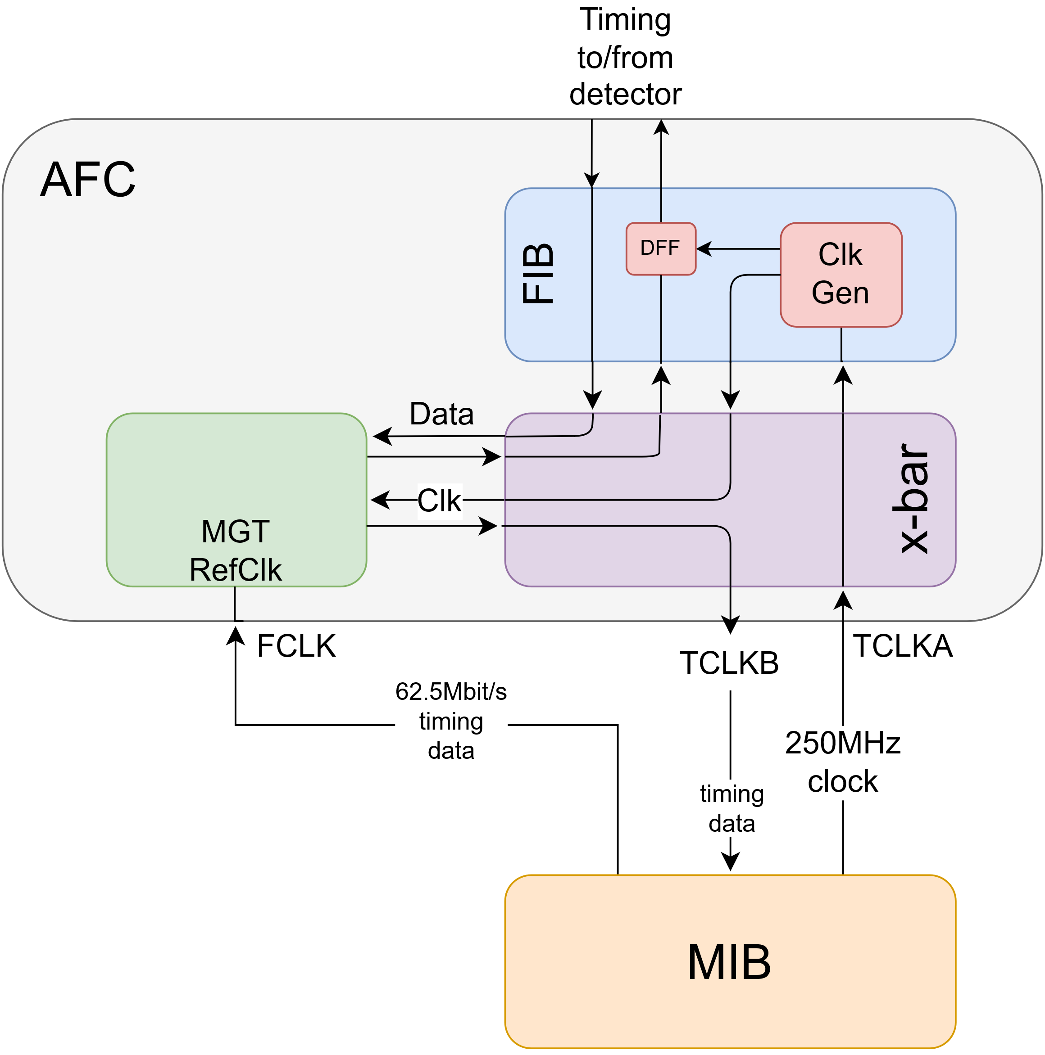
AFC Modification
Standard AFC routes FCLK to FPGA Gigabit transceiver reference clock input
→Signal not accessible to logic inside FPGA
→Modify design to route FCLK to clock cross-bar
17
19/Apr/2024
Notes:
17

Slide 18
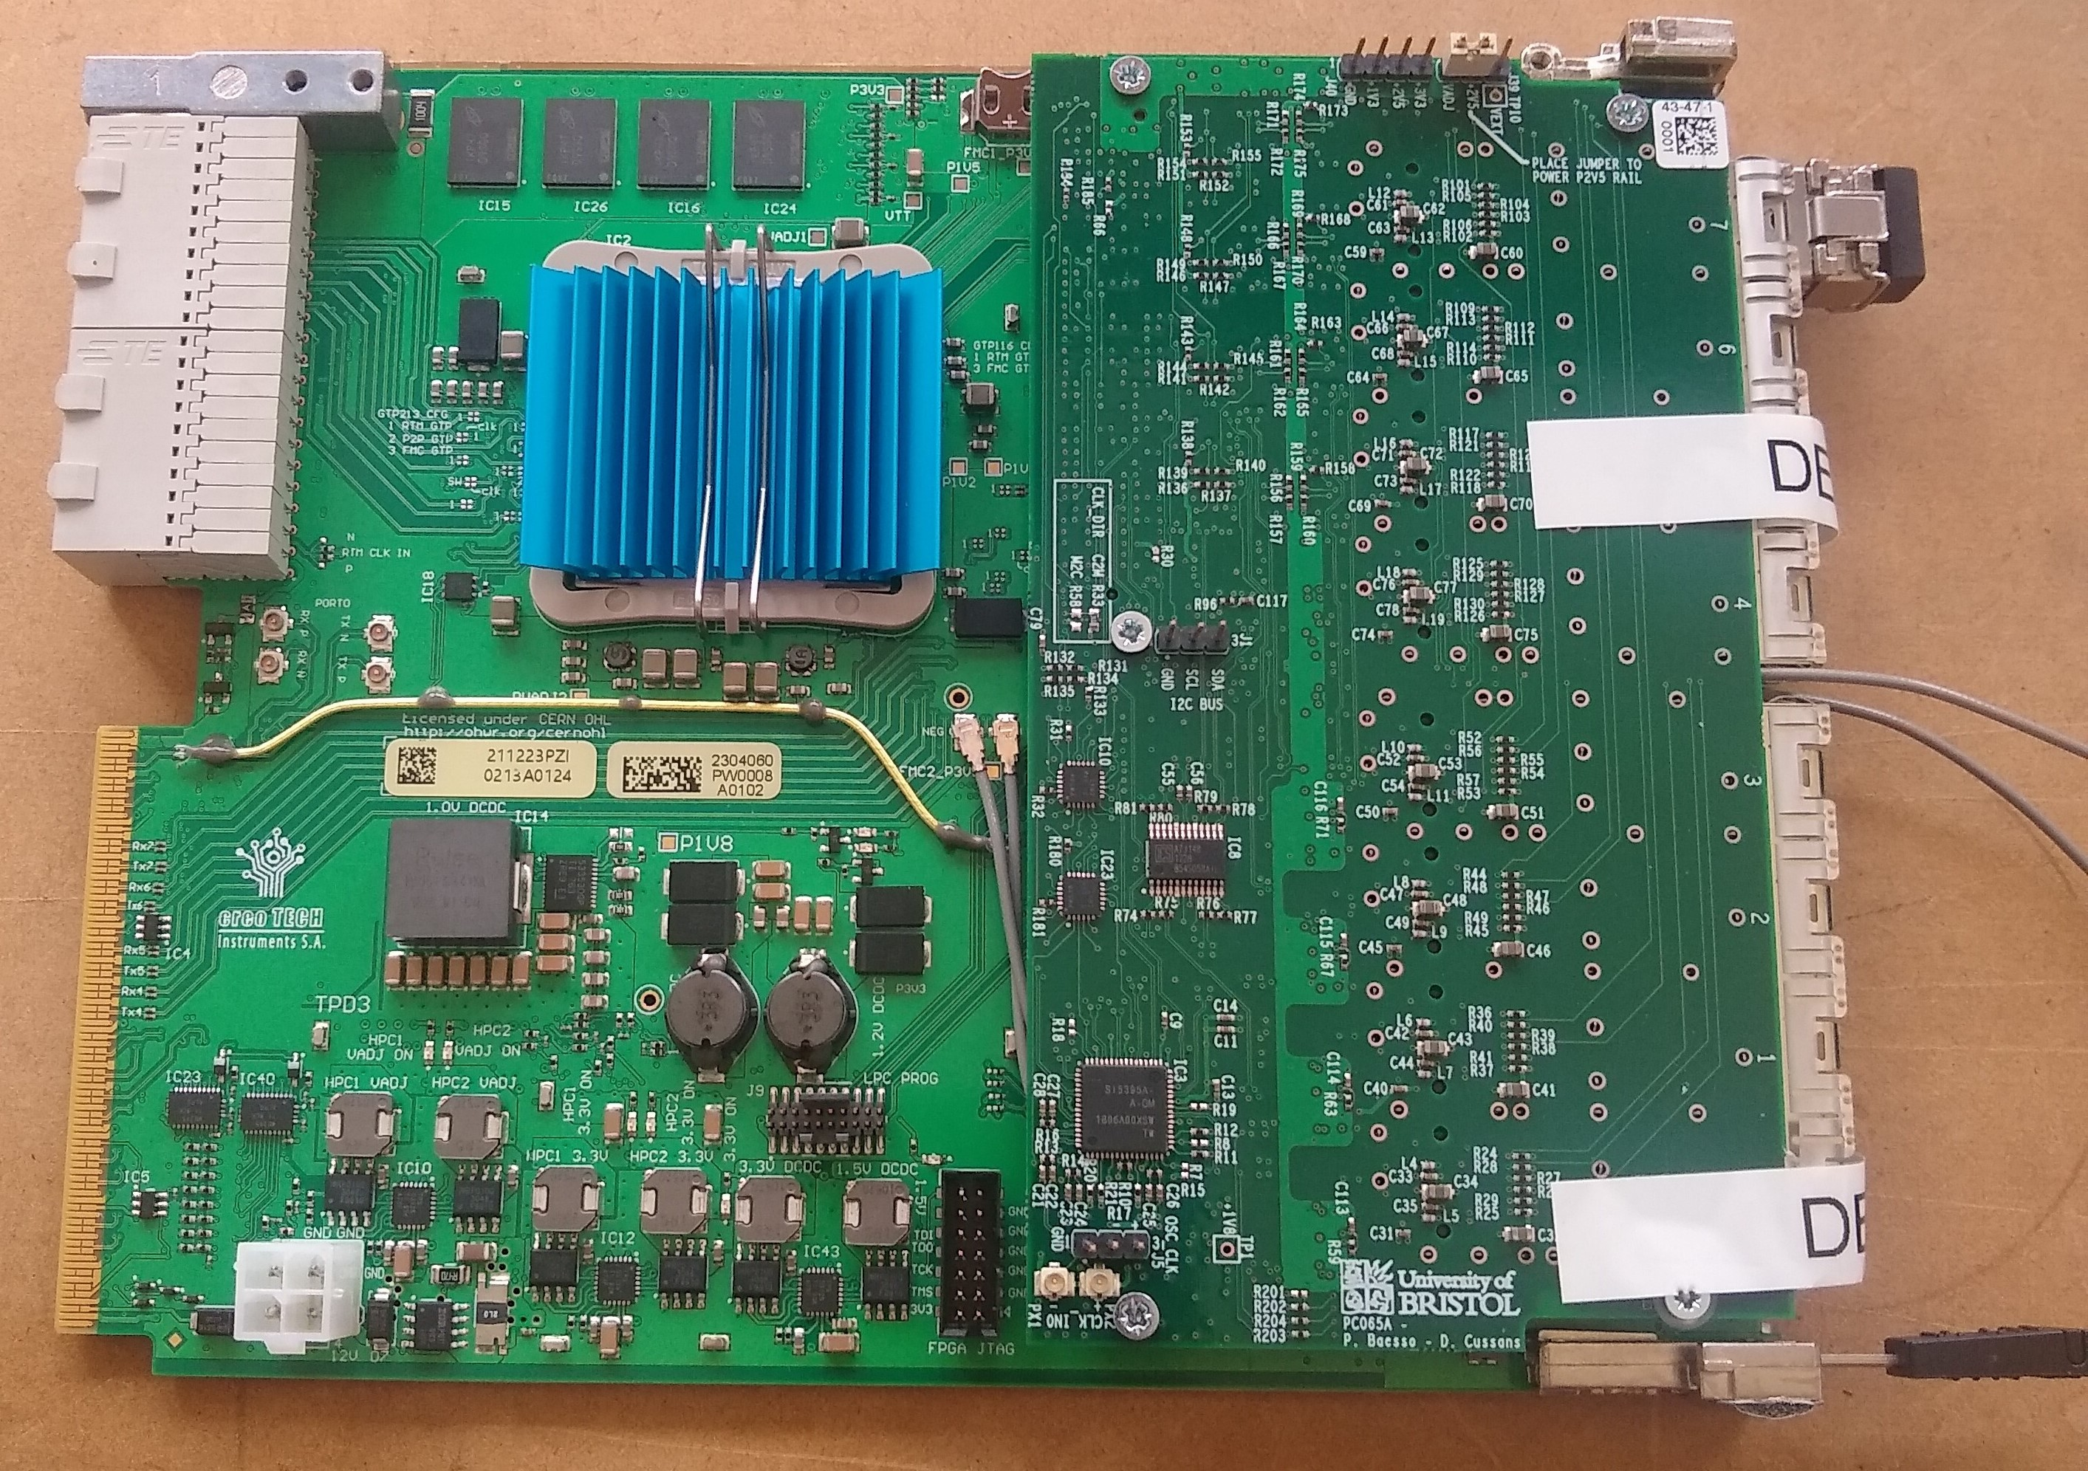
AFC Modification
Tested on standard AFC by routing FCLK signal on “twinax” cable.
18
19/Apr/2024
Notes:
18

Slide 19
AFC Modification
Need for modification to standard AFC drives the need for this interim PRR
Move FCLK on AFC from Gigabit transceiver reference clock to clock cross-bar
Modification minor, but want to produce pre-prototype boards with modification and test before production
→ Long lead time
→ iPRR
(More detail of schedule in following talk)
19
19/Apr/2024
Notes:
19

Slide 20
AFC Numbers
System will need:
Twenty AFC/FIB for Horizontal Drift Cavern
Ten in each crate
Ten AFC/FIB for Vertical Drift Cavern
Five in each crate
Will provide spare timing connections at cryostat for tests and flexibility
See introduction to EDMS 3069484 for details of fibre/board numbers
(See next talk for spares policy, pre-production boards and boards for permanent test/development set-up,)
20
19/Apr/2024
Notes:
20

Slide 21
Changes as a result of FDR
Has the consortium responded appropriately to the relevant recommendations from past design reviews and are they closed?
Timing System FDR recommendations still open, (Review-022 paraphrased):
Rec 12, 13 “A full system test should be performed before PRR and production.” Will be done at NP04/02 before PRR in Q3/24
Rec 7 “Tests should include a full range of endpoints.”
Will be done at NP04/02 before PRR in Q3/24.
Existing data shows timing master / endpoint combination factorizes. ( No bad master/endpoint combinations)
→ Since all endpoints tested with prototype hardware don’t need to wait for tests with AFC at ProtoDUNE
Rec 5 “Tests should include hot swap functionality.”
As a result of review decided to change to “warm swap”.
Will be tested at NP04/02 before PRR in Q3/24.
Swapping between sources handled by GIB/MIB combination → Don’t need to wait for warm-swap tests including AFC.
21
19/Apr/2024
Notes:
21

Slide 22
Changes as a result of FDR
Has the consortium responded appropriately to the relevant recommendations from past design reviews and are they closed?
DAQ FDR recommendations still open (Review-081 paraphrased):
Rec 1 “Designs of all DTS boards to be finalized and used in a full system test”.
Pre-production boards will be used at NP04/02 before PRR in Q3/24
Full chain (with standard AFC patched to specification of DUNE-variant AFC ) tested in lab. More details in next talk.
Rec 12 “A complete system test should be done at ProtoDUNE-II”. Will be done at NP04/02 before PRR in Q3/24
Rec 13 “An electrical safety review of boards must be carried out”
An interim electrical safety review of the AFC has been done (EDMS 3057177). Will be completed when pre-production AFCs are available, before PRR in Q3/24. More details in next talk
A safety review of the uTCA system has been completed (in conjunction with VD TDE)
A safety review of the pre-production GIB , MIB , FIB will be done when boards are available, before PRR in Q3/24
22
19/Apr/2024
Notes:
22

Slide 23
Changes as a result of FDR
Are there any further relevant reviewer comments and recommendations based on design changes
We have received no comments relevant to AFC
(MIB, FIB will be reviewed later in 2024)
23
19/Apr/2024
Notes:
23

Slide 24
Summary
The AFC is an Open Hardware board that is relatively low cost and tested in other projects.
A minor modification to clocking circuitry is needed for use with DUNE Timing System
Tested by modifying standard AFC v4 (removing some capacitors / resistors and adding external “twin-ax” cable) – results in following talk.
Prefer to modify design rather than patching standard board for production boards. (Details on schedule in following talk)
We have undertaken a “full chain” test to demonstrate that AFC meets requirements (see following talk)
Number of boards that will be ordered gives room for flexibility and permanent debug/development system during the life of DUNE.
24
19/Apr/2024
Notes:
24

Slide 25
BACKUP

Slide 26
DTS for ND
DTS has sufficient performance for use at ND
Need O(100ps) alignment
Will need addition to AFC firmware
Measuring phase of returning data to O(10ps)
26
3/Mar2024
Notes:
26

