Slide 1
Update on Web Profiles
Daniel Baxter
Scientist Advisor Council Meeting
18 April 2024

Slide 2
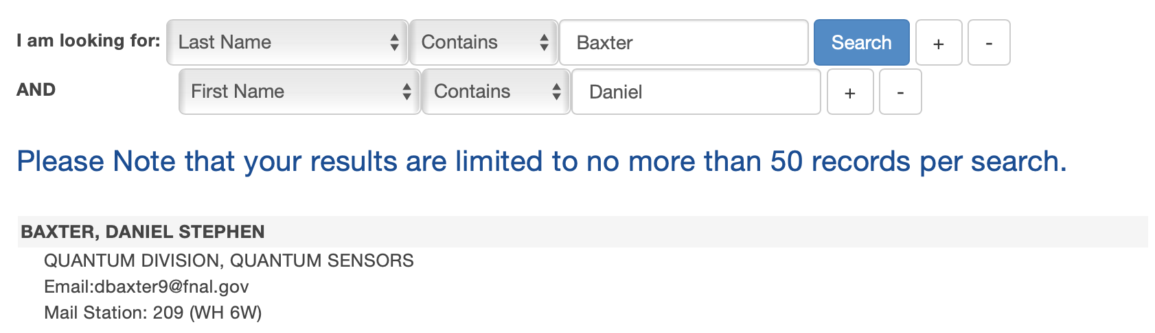
Summary of the issue
For the majority of people at FNAL (including myself), the telephone directory is now the only publicly accessible information about us to colleagues and the public
This hampers:
The professional standing of our researchers in the community (networking)
Recruitment (“Who would I collaborate with if I went to FNAL?”)
Our ability to perform outreach (“Where do I go to learn more about your work?”)
Our relationship with the public (“What are you doing that warrants all the secrecy?”)
Morale… (employees no longer feel like they are part of a community)

Slide 3
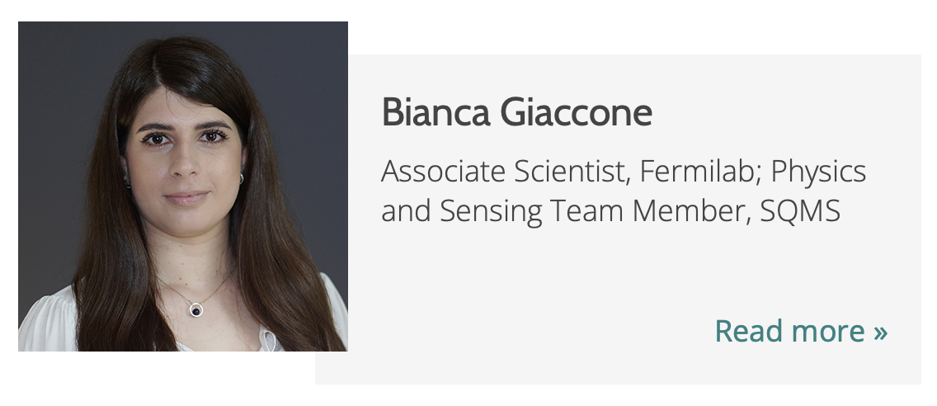
The problem: need a 0 FTE solution
SQMS pioneered this solution!
Answer: Workday and supervisor review
Name
Role/Department
Field of Work
Photo (reviewed by line management for conformity)
Short Bio (reviewed by line management for CUI)
ORC ID
Email? CUI concerns
Awards? Could be listed in bio
Selected Publications ORC ID links to professional profile

Slide 4
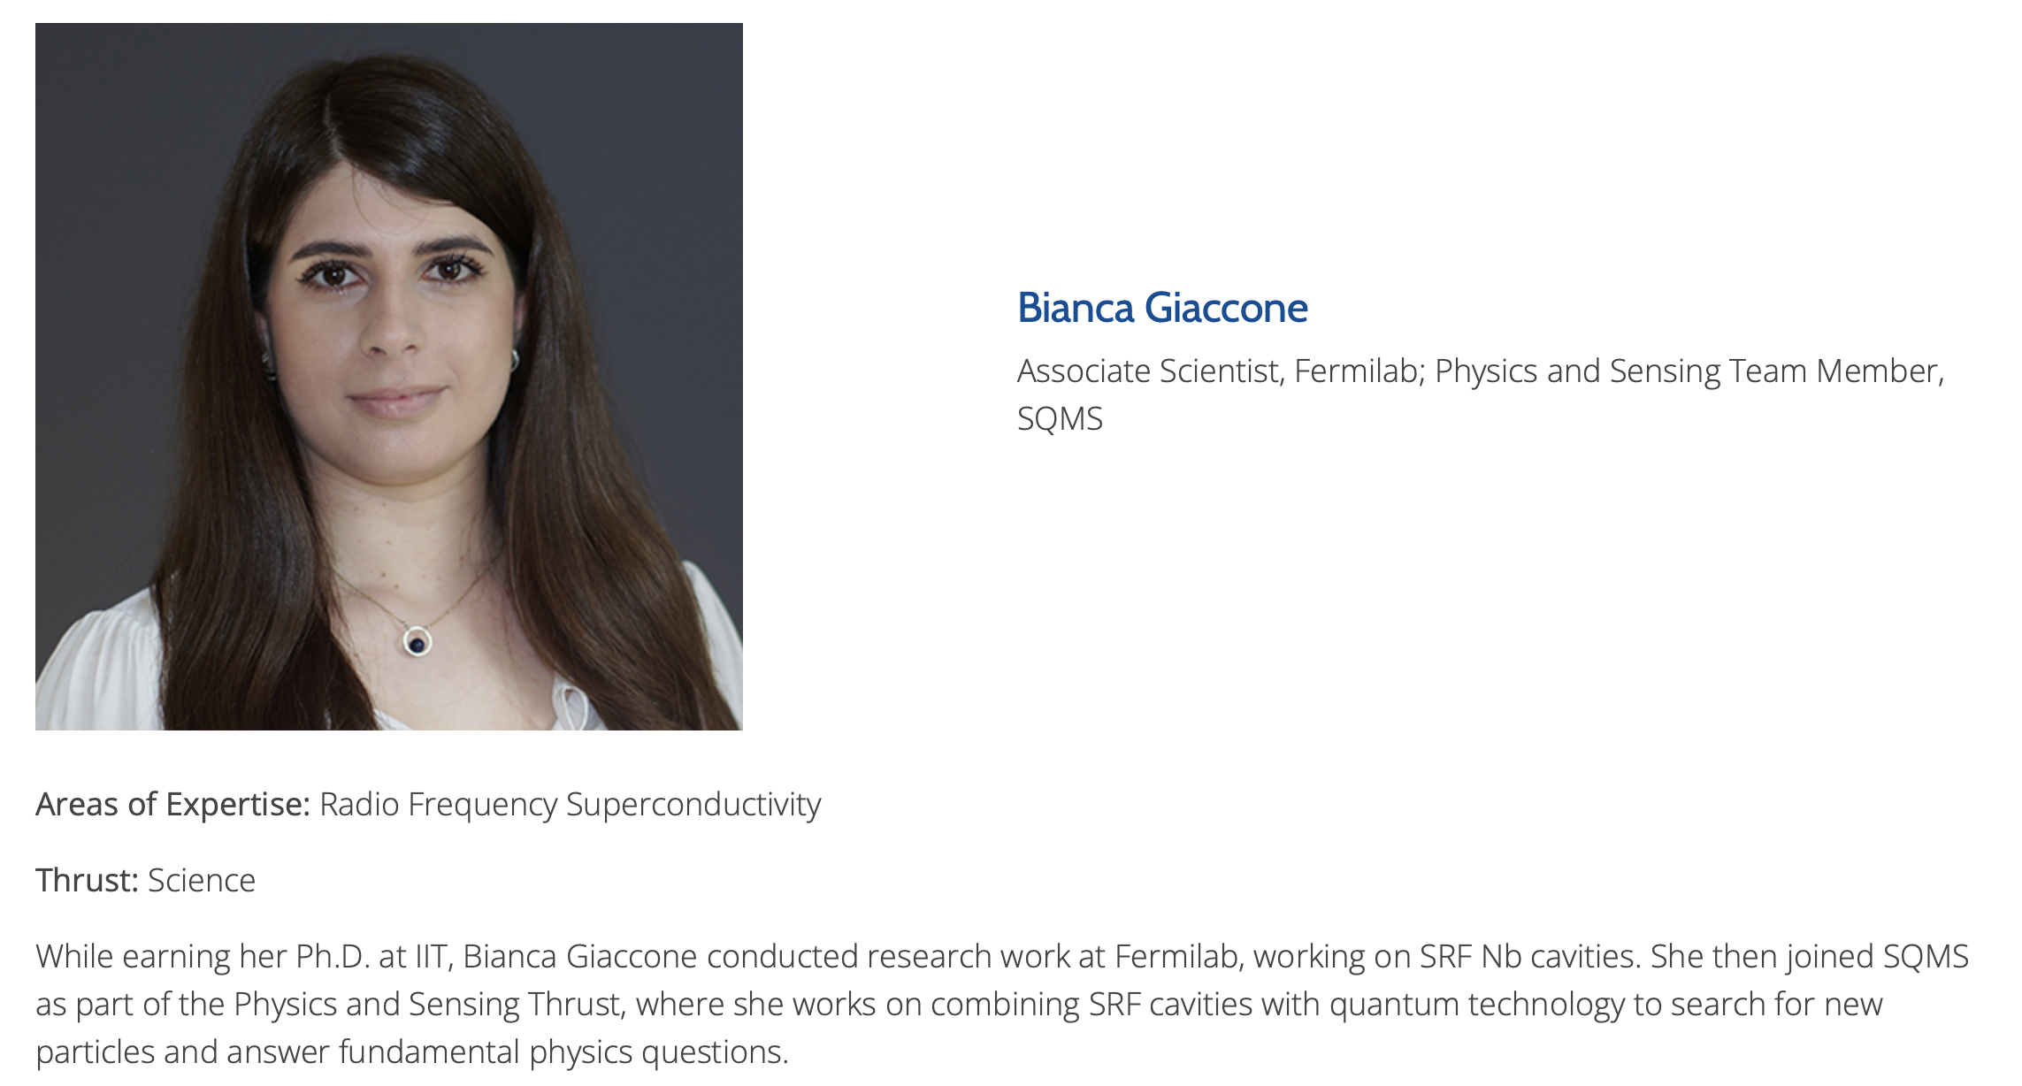
The problem: need a 0 FTE solution
SQMS pioneered this solution!
Answer: Workday and supervisor review
Name
Role/Department
Field of Work
Photo (reviewed by line management for conformity)
Short Bio (reviewed by line management for CUI)
ORC ID
Email? CUI concerns
Awards? Could be listed in bio
Selected Publications ORC ID links to professional profile
name
position
professional photo
short bio

Slide 5
Comparison
Place | Name | Role | Photo | Email | Bio | Awards | Pubs | Hosted | Ext Links
ORNL | X | X | X (!) | X | X | X | X | X | X
Argonne | X | X (!) | X | X* | X | NO | NO | X | X
SLAC | X | X | X | X | ish | NO | ish
FNAL (now) | X |  |  | X |  |  |  | X | NO
FNAL (proposed) | X | X | X | maybe | X | BIO | ORC | X | NO

Slide 6
Questions and Concerns
NAME: What name appears on the website?
Answer: preferred name
PHOTO: Upload with instructions on cropping via external passport photo site; supervisor review
Alternate: use badge photo
EMAIL: Can we list emails?
Answer: maybe… we can list emails in plain text, but we may be able to have an embedded email somehow
CV / EXTERNAL LINKS: Link to ORCID: people can put whatever they want on there
Answer: potential to create an internal directory that is identical but ALSO includes a CV. Exploring this option.
ADDITIONAL FIELDS: More fields like Awards/Publications would be nice, but this quickly spirals into requiring more FTE. (Kicking this down the road)

Slide 7
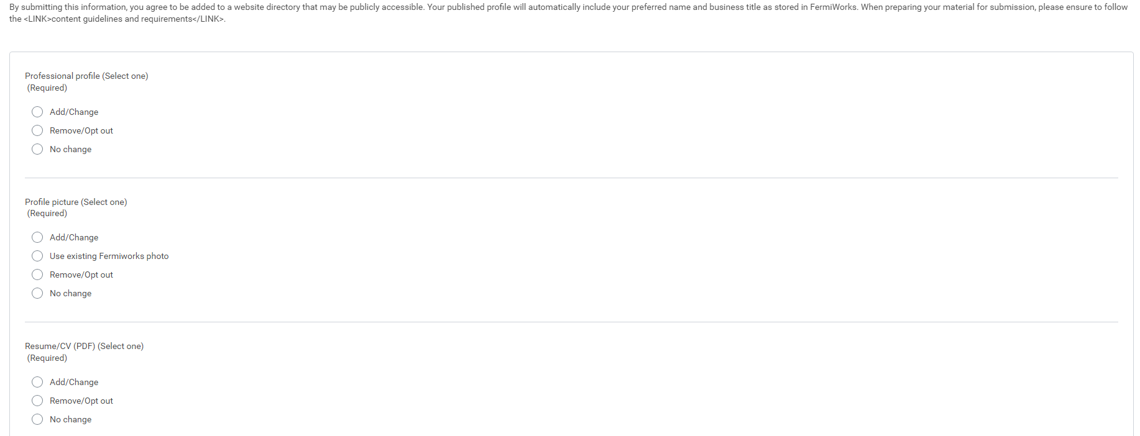
New Workday Public Profile Form

Slide 8
Rollout
Step 1 is done: Workday modification and API (Denodo?) updates to pull information from form submission into a website readable format.
Step 2: Prepare webpage layout
Includes customizing organization and search options, in addition to basic aesthetic concerns.
Step 3: Release for a limited subset of Lab Personnel (beginning with “Scientists”)
Step 4: Expand to anyone with a Workday account who wants their profile online

