Slide 1
Mu2e report
Tom Diehl (FNAL), Greg Rakness (FNAL)
Friday 9am AD meeting
19-Apr-2024
https://indico.fnal.gov/event/64393/

Slide 2
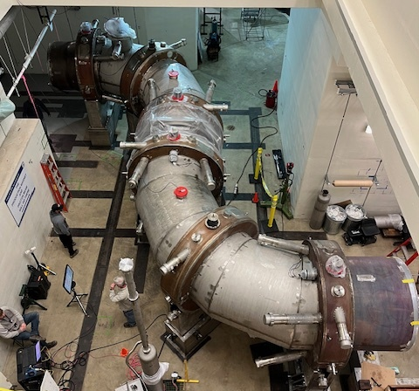
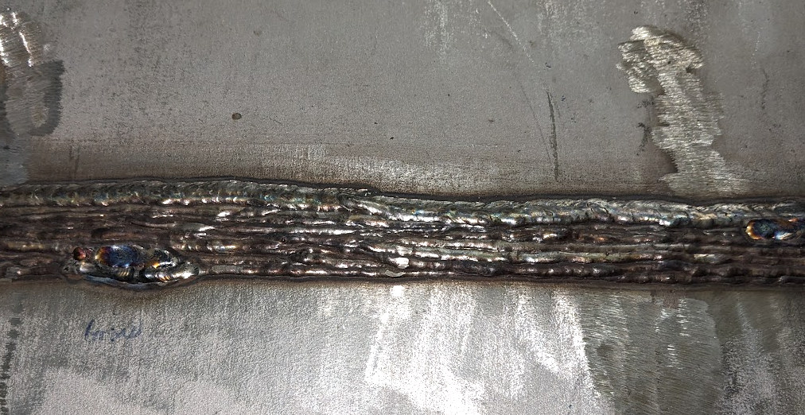
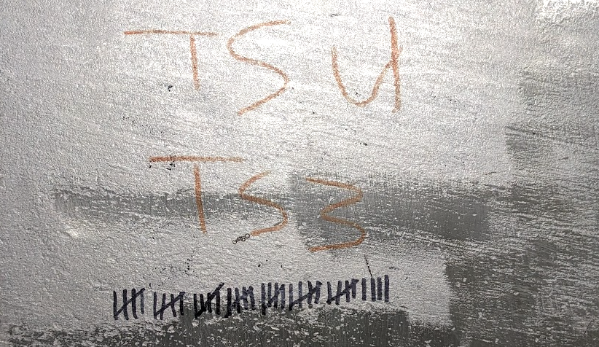
Ongoing work at the Mu2e building (1/3)
Preparations ongoing to make mechanical interconnect between TSu and TSd
Example of scope of interconnect job…
Count the number of passes the welder needed for TSu clamshell:

Slide 3
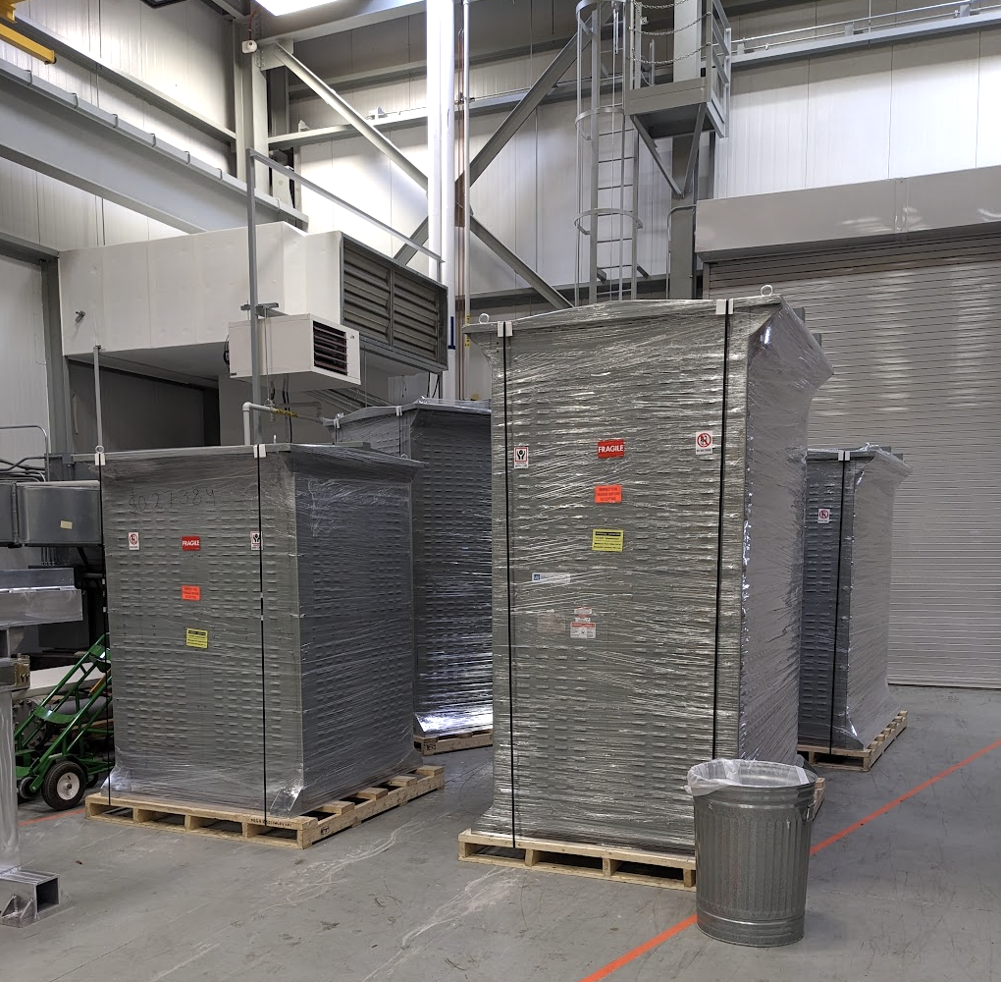
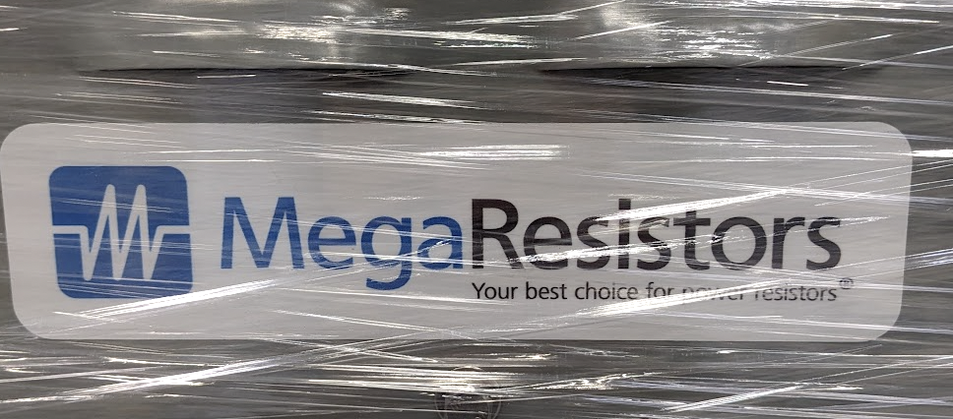
Ongoing work at the Mu2e building (2/3)
Working to understand planarity of the external stands
  FNAL observations inconsistent with vendor data
  More observations have been made, which are more consistent with the vendor data…
Dump resistors received at Mu2e
  Presently in high bay for checkout

Slide 4
Ongoing work at the Mu2e building (3/3)
ORC approval for DT generator in the hands of PPD
  Hoping to run the generator next week
Tracker cabling continues today
  Taking advantage of physical displacement of scientists from Wilson Hall to progress on work at the Mu2e building

Slide 5
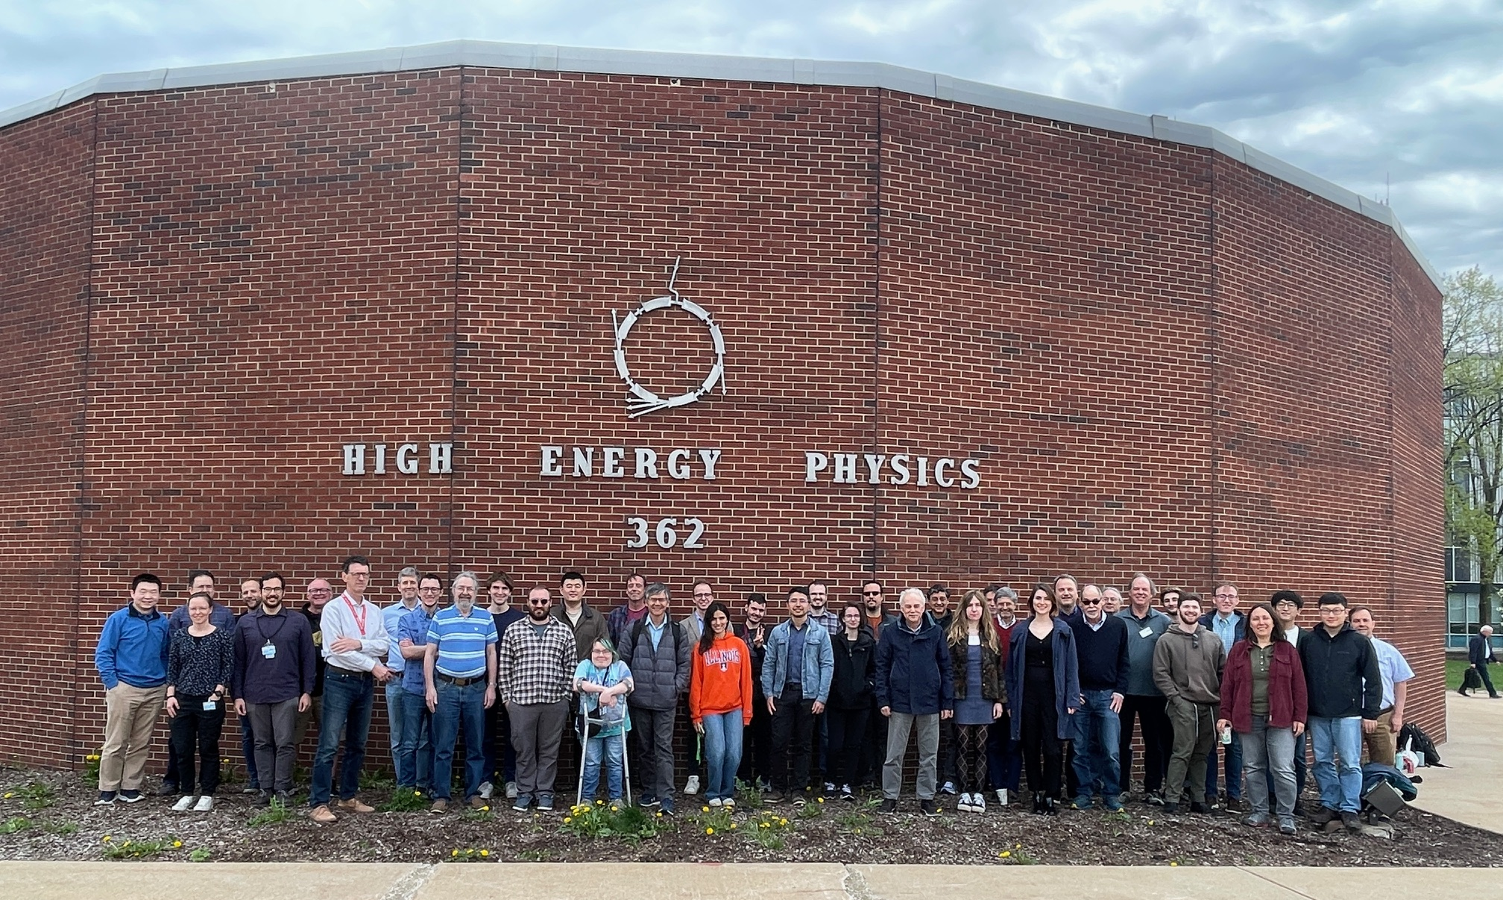
17-19 Apr: Muon g-2 collaboration mtg at Argonne

Slide 6
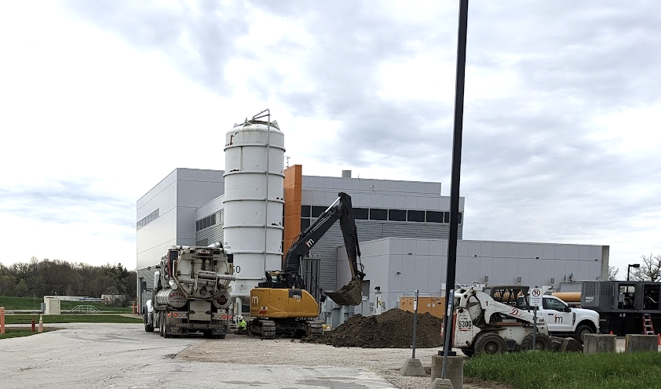
Recall: Mu2e uses same cryo plant as g-2
Concrete pad for 2nd LN₂ tank being poured at MC-1
  Expect to finish next week

