Slide 1
Muon Campus Operation Report
Jim Morgan
Friday 09:00 Operations Meeting
April 19, 2024

Slide 2
Muon Campus status
Working towards permission for beam operation
Vacuum work in D30 finished and equipment removed from the tunnel
Switched to operational two pump LCW operation at CUB
Power supply inspections completed, working on mitigating findings
Finished Credited Controls labeling in Pre-Vault and AP-0 Vault walls
Completed last known tunnel work, finishing with Prototype ESS HV termination
Readied PWC’s and ion chambers for operation, checking gas flow and high voltage
Worked on issue discovered with AP-30 vacuum controls
ES&H re-cored Delivery Ring, Extraction and M4 Enclosures to operational keys
These three enclosures secured on Thursday, all enclosures now secured
Half-way through beam sign-offs
ESS1 & ESS2 Electrostatic Septa
ESS1 high voltage conditioning continued at NWA, now around 71 kV
ESS2 assembly resumed in the A0 Clean Room
AP-0 A/C work continued
Completed installation of refrigerant lines and ducting
Technical Division personnel worked on reconfiguring water inlets on some LQ quadrupoles in the downstream M4 Line
Study – M1-M3 Optics
Study – Alternative M5 optics

Slide 3
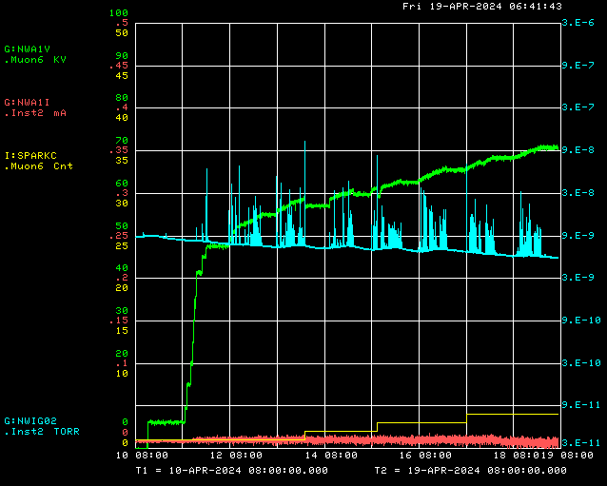
ESS1 high voltage conditioning at NWA
Operational Voltage with 12 cm foil to cathode distance
ESS1 P.S. Voltage
Ion Gauge
Spark Detector
ESS1 P.S. Current

Slide 4
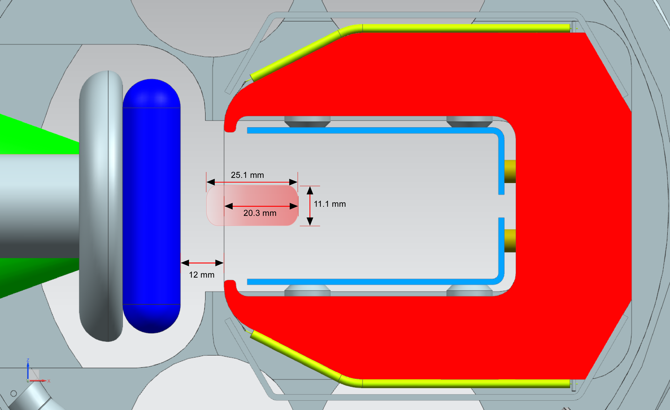
ESS1 beam dimensions and foil to cathode distance

Slide 5
Upcoming work
Hope to resume beam operation next week
Working on beam sign-offs (6/12, but several ready for signatures or close to it)
Delivery Ring, Extraction and M4 Enclosure interlocks testing today
May do some power supply testing before setting up to run beam
ESS1 and ESS2
ESS1 high voltage conditioning continues at NWA
ESS2 assembly continues in A0 Clean Room
AP-0 A/C work paused while awaiting controls sub-contractor
Will need access to AP-0 Water Cage and rad fence area and will require beam off to Muon Campus
Estimate six days of work needed for system to be operational

