Slide 1
REVIEW – Steel - Coils – Power Supply and Water Cooling
Wes Craddock July 17, 2024

Slide 2
Steel Plates
PROPOSAL: Select Nucor Steel for our steel plates and have the plates water jet cut by a separate company.
Nucor Steel is a good choice for steel. It is the largest steel company in the US by market capitalization and almost certainly the most modern.
Nucor’s Kentucky plant should be our choice. It is the most modern (it is still in the process of being fully commissioned).
They can do ½ ASTM steel spec and probably ¼ ASTM steel spec.

Slide 3
Steel Plates
Nucor estimates $1200/short ton or 60¢/lb (1000 T = $1.2 million)
This does not include that we would have to purchase any extra steel in a given heat that couldn’t make a full plate. Each heat ~ 90 Ton. It also does not include the extra inch or two of width and length for water jet cutting.
PROPOSAL: Use water jet cutting for steel plates
Ayers Water Jet in Wisconsin quotes $666,155 ($558,444 water jet cutting + shipping)

Slide 4
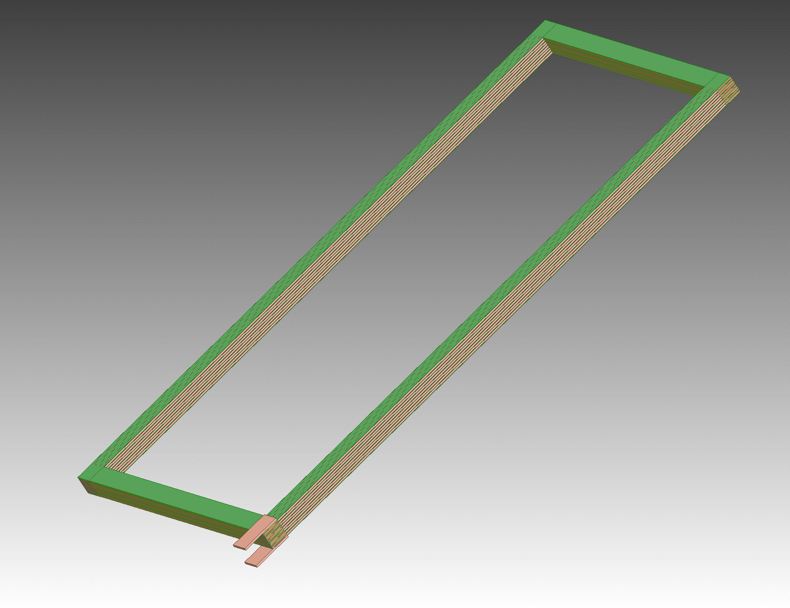
Coil Manufacture and Design
No Corner Transition Pieces Direct Plank to 6 Bar Plank Connections
Green is G-10
Input and Output Terminals

Slide 5
Coil Manufacture and Design
PROPOSED BASIC CONCEPT – Modification of Minos
Use solid ETP 110 copper instead of water cooled aluminum
Use Marco’s dimensions for overall size (six conductor wide X 8 layers tall with each conductor 1” X 1.5”)
Form the long length planks from 6 bars. These bars will have rounded corners and will be skip tack welded together. They may also be connected by several bolts going through all 6 bars.
1/8” Thick G-10 sheets between layers (This may go down to 3/32” thick G-10)
Joints will be pressed bolted contacts with silver plating.
The whole conductor pack will be joined with discrete connections (bands) as per Marco’s concept. The cooling plates will be integral with these connection pieces.

Slide 6
Coil Manufacture and Design
Vendor for Copper Planks and Bars for Planks:
Copper and Brass Sales -- Division of TKMNA, Thyssenkrup
Copper and Brass Sales functions like a Ryerson -- Sourcing materials from manufacturers and machining from outside vendors (Some in house machining?)
Waiting for quote – Expected soon
Bulk ETP copper price = $7.50 /lb
Can only supply in ETP copper bars without purchasing oversees. Length is the issue.
Contacts: Glenn Kreis (local and very eager to get this PO)

Slide 7
Coil Manufacture and Design
ETP vs OFHC
ETP copper is 90% of the electrical copper used in the US.
ETP is much easier to get
ETP has the same electrical conductivity as OFHC
OFHC is much easier to weld and braze
ETP is a bit easier to machine than OFHC
ETP has oxygen in it. This makes welding and brazing more difficult. A TIG welding/brazing method will be used. Silicon-bronze and other alloys are recommended.
Need to buy ETP samples with different filler rods and have Bob Conley try them out. Material cost ~ $400 and 1 day of Bobs time.

Slide 8
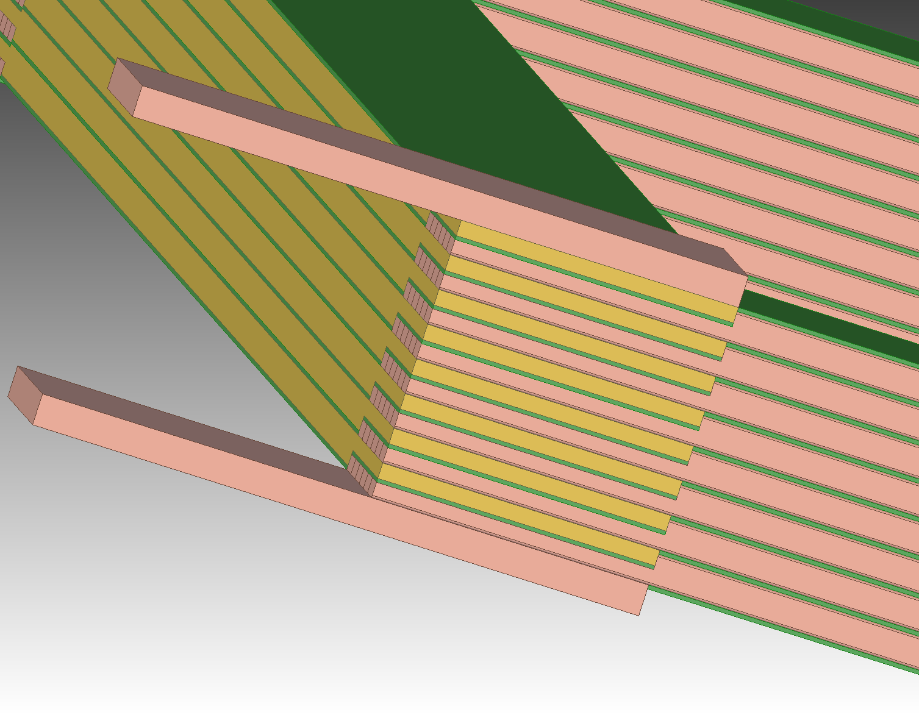
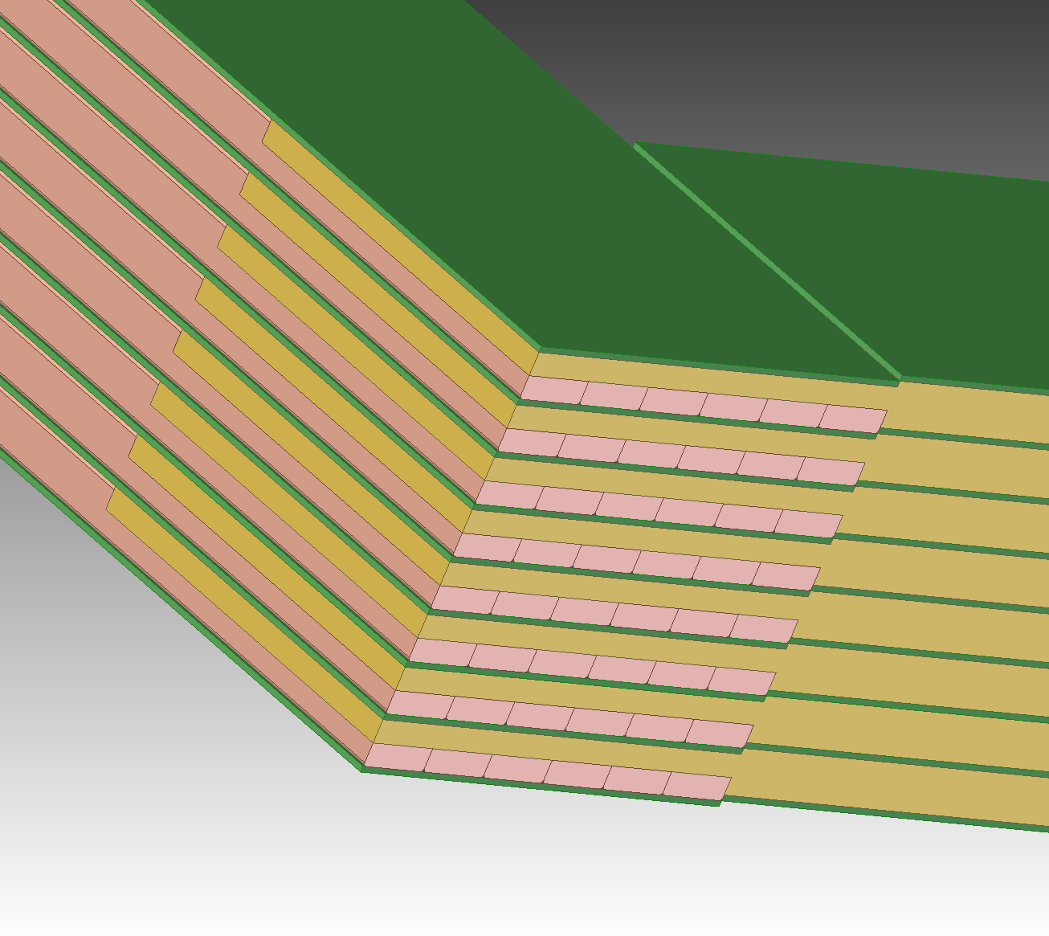
Coil Manufacture and Design
Current Corner Detail
(opposite from Current In/Out)
Current Input/Output Corner Detail
Notice double sided machining on plank end and G-10 step mismatch

Slide 9
Coil Manufacture and Design
Bar Machined End At Both Ends – Bolt holes not shown
Bars Formed Into Plank (Skip welds not shown)
Input and Output Terminals

Slide 10
Need 32 Plates 1” X 9.17” X 71” long
Need 16 Plates 1” X 9.17” X 144” long
Plate Machined End At Both Ends – Bolt holes not shown
Typical at both ends of bars

Slide 11
Coil Manufacture and Design
End Plates at Cross Over on End Opposite to Current Input/Output End
Need 32 Plates 1” X 9.17” X 71” long
Need 16 Plates 1” X 9.17” X 144” long
Plate Machined End At Both Ends – Bolt holes not shown

Slide 12
Coil Manufacture and Design
End Plates at Cross Over on Current Input/Output End
Need 32 Plates 1” X 9.17” X 71” long
Need 16 Plates 1” X 9.17” X 144” long
Need 32 Plates 1” X 9.17” X 71” long
Need 16 Plates 1” X 9.17” X 144” long
Plate Machined Ends
Bolt holes not shown
Typical at other end of bar
Typical at Current In/Out end of bar

Slide 13
Required Plates for 6 Coils
Two Center Coils:
Outside Length = 7.5 m, Inside Length = 7.1 m (from 1” x 1.5” bars)
Outside Width = 3.65 m, Inside Width = 3.29 m
Need 32 plates 1” X 295” and 32 plates 1” X 144”
4 Outer Coils
Outside Length = 7.5 m, Inside Length = 7.1 m
Outside Width = 1.8 m, Inside Width = 1.44 m
Need 64 plates 1” X 295” and 64 plates 1” X 71”
Total Plates Needed
96 plates 1” X 295” 576 bars
32 plates 1” X 144”
64 plates 1” X 71”
Total Mass of All Plates = 50,480 kg = 111,130 lbs

Slide 14
Coil Connection & Heat Load
All Six Coils are Connected in Series
Power and Voltage at 60 C (without contact resistance)
2 Center Coils + 4 Outer Coils: 46.1 kW and 12.3 Volt
Add in 20% for contact resistance: 55 kW and 14.8 Volt

Slide 15
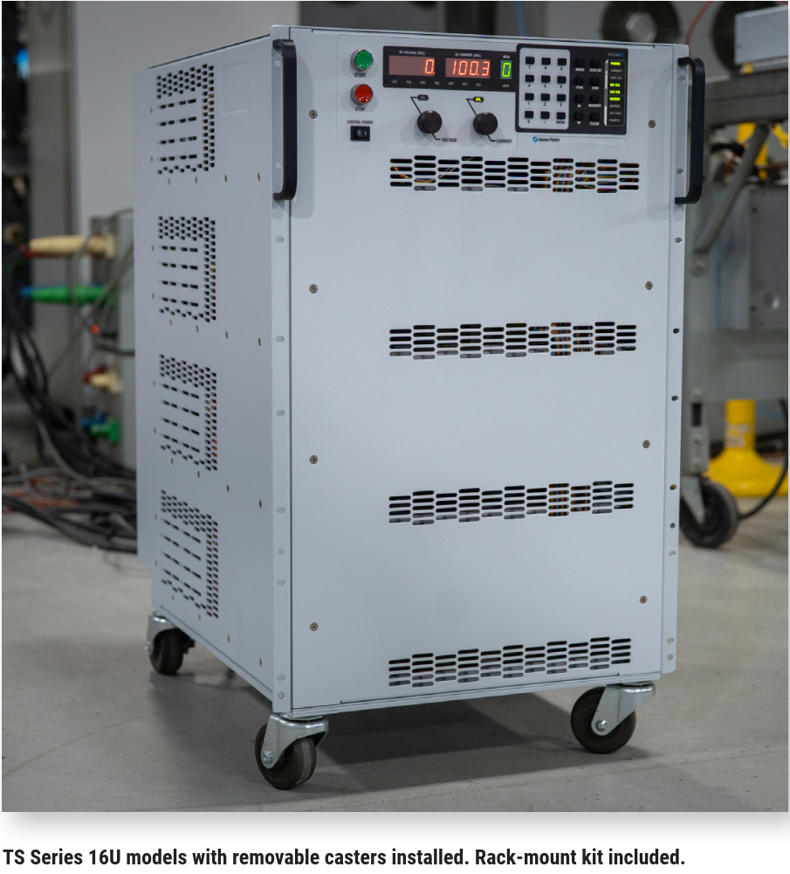
POWER SUPPLY
Magna-Power TSD-4000-25
4000 Amp at 25 Volt --- Able to run continuously at rated current and voltage
Integrated in a cabinet 28” high X 19” wide X 24” deep
Air Cooled at 85% efficiency at operating current/voltage = 7 kW reject heat
COST $53,185

Slide 16
COIL COOLING & WATER CHILLER
COIL COOLING:
Water cooled 1” thick aluminum plates are attached to the bottom of each 7.5 meter length of all 6 coils. Each plate has an up and back length of 5/8” OD copper tubing (15 m of continuous length).
Full length extrusion with grooves from Coast Aluminum. Estimated die cost $4000.
Wait for quote.
Each plate has its own water circuit. Flow balanced with valves.
10.5 GPM needed for 20 C temperature rise; 21 GPM for 10 C rise.
Pressure drop ~ 0.35 psi
Full ANSYS model very soon.

Slide 17
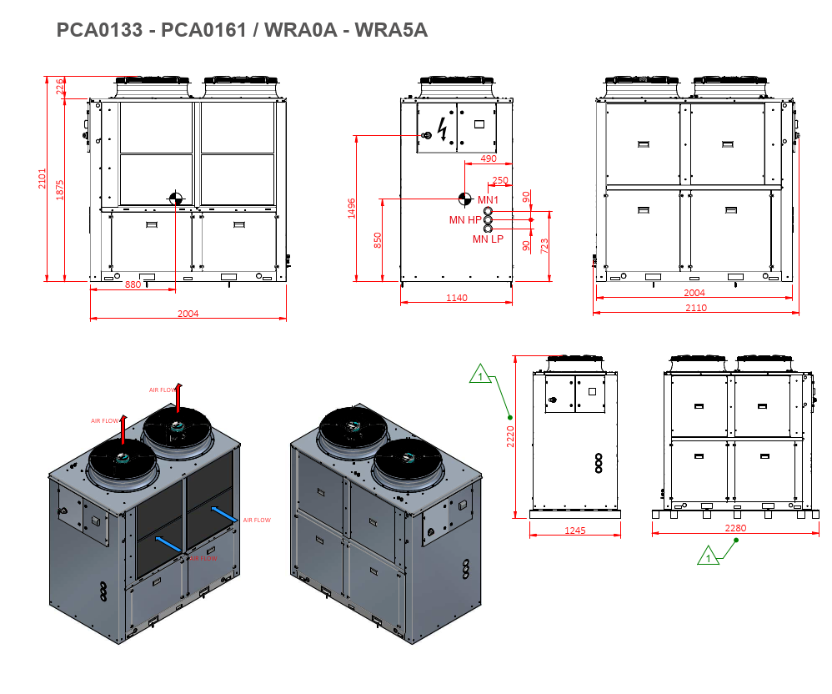
COIL COOLING & WATER CHILLER
NORDIC PCA 0161
81.7” high X 90” wide X 81.3” deep
COST $40,604
59 kW Cooling Capacity
68 psi max head pressure
Min/Max Flow 13/52 GPM
Power consumption 14.3 kW
Will look at other companies

Slide 18
OTHER UPDATES
Will receive a 4” X 4” x 1.5” thick water jet sample from Ayers Water Jet showing quality level 2, 3 and 4 cuts. Level 3 is the standard and is what we were quoted. Shawn Ayers stated the water jet cuts can cut even through gloves. Level 4 is the nicest cut but also the most expensive.

