Slide 1
9 O’Clock Meeting
Nathan Ruffatti
MCR Crew Chief
Wednesday, April 24th, 2024

Slide 2
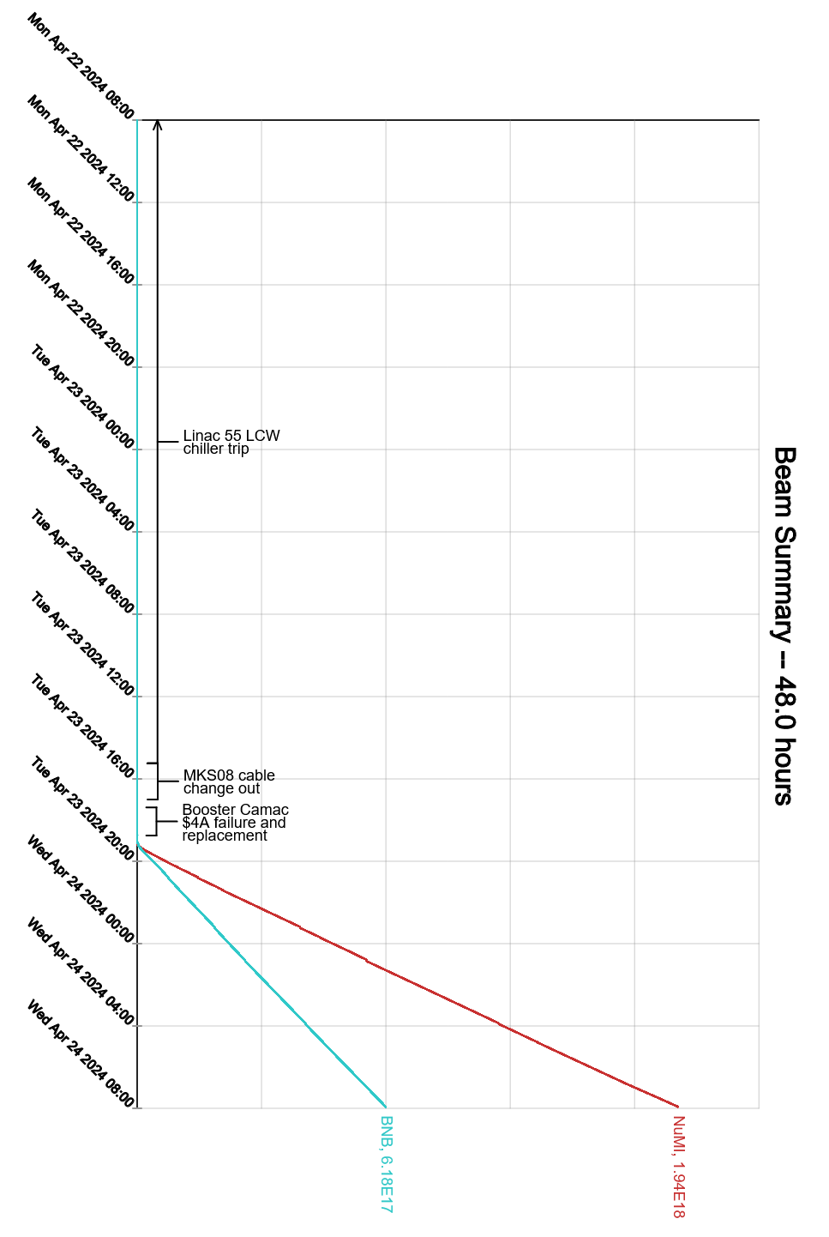
Since Monday…
Monday:
CUB chiller #3 still down
BRF work
BRF13 PA filament PS swapped
BRF09 IRM PS swapped
BRF21 leak fixed and dried out
MI switched on
Transfer Hall searched and secured
Tuesday:
Attempted to turn remnant LCW system on, too much air in the system
MKS08 kicker re-terminated in the tunnel
CUB Chiller #3 repaired. Control board cleaned and reinstalled.
HX remained on overnight
Booster switched on
Booster CAMAC crate 4A missing voltages, PS swapped
Beam resumes to BNB and NuMI
Wednesday:
Intensity briefly pushed to NuMI, tripping NuMI permit off on NUMIPWR at 980kW

