Slide 1
Discussion of the Demonstrator
Katsuya Yonehara
Inaugural US Muon Collider Community Meeting
8/08/2024

Slide 2
Layout of muon accelerator complex for colliders
Number of muons per bunch
The achievable collider luminosity depends on the
performance of the Front-End and Cooling sections
$$ℒ=\frac{N_{μ^{+}}{∙N}_{μ^{−}}∙f∙n_{b}}{4π{∙σ}_{x}∙σ_{y}}$$
Beam spot size at collision point
Scope of the demonstrator:
Can the realistic machine achieve the designed $N$ and $σ$?

Slide 3
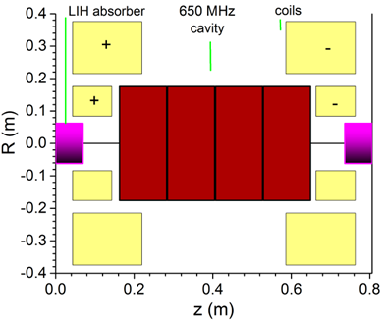
IMCC is the front runner of the Demonstrator design
While the physics of ionization cooling has been shown it is critical to benchmark a realistic MuC cooling lattice.
C. Rogers
Many cells
x5
Aim
Demonstrate 6D cooling in multiple cooling cells, an advanced technology derived from MICE (adding reacceleration and dispersion)
Engineering integration of high gradient RF cavity and absorber in strong solenoid magnets
US Muon Collider Community will join IMCC and support the demonstrator program

Slide 4
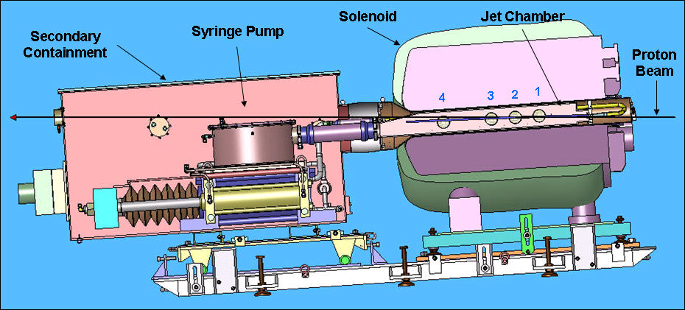
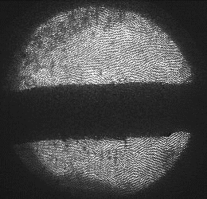
Highlight of MERcury Intense Target (MERIT)
Layout of MERcury Intense Target (MERIT)
1 cm
Proof-of-principle demonstration of a free Hg jet target for a 4-MW proton beam, contained in a 15-T pulsed solenoid
The yield measurement of the secondaries was performed (without PID)
Liquid metal target will survive with 10¹⁴⁻¹⁵ protons impact

Slide 5
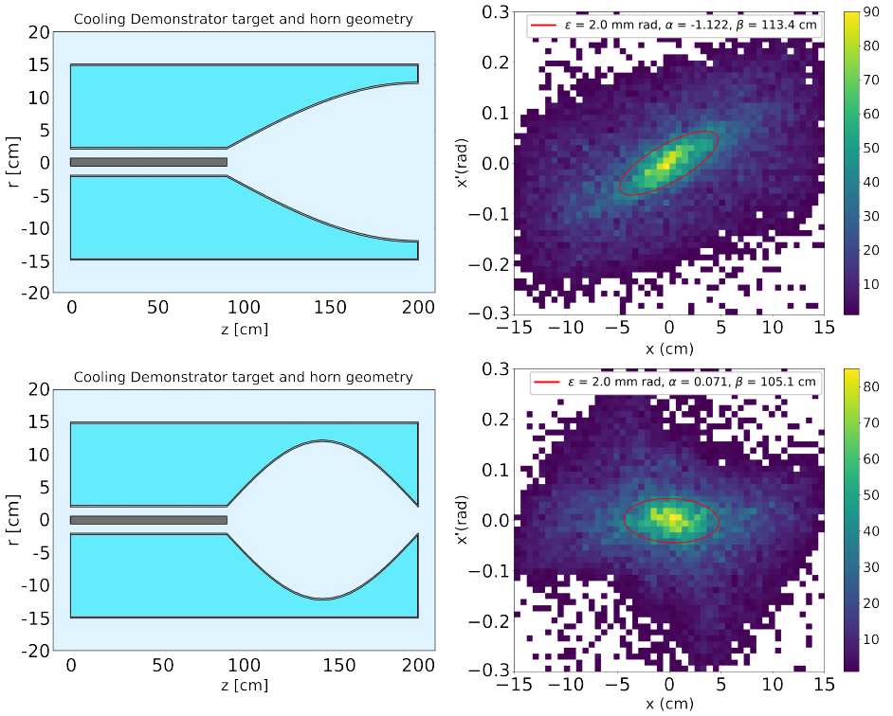
Possible Demonstrator Target and Capture
The liquid (powder) metal target has potential for use as a muon collider target
A few R&D steps are needed to be ready for use
20-Tesla capture solenoid + rad shielding is quite expensive
No real targetry R&D can occur until proton driver is available
IMCC has developed a simplified version of target and capture sections using well-established technologies
P.B. Jurj et al. IPAC’24, MOPR03
Use a magnetic horn and graphite target, as employed in neutrino experiments
A recent magnetic horn study shows that a horn forms a FODO channel, which will focus both charged pions

Slide 6
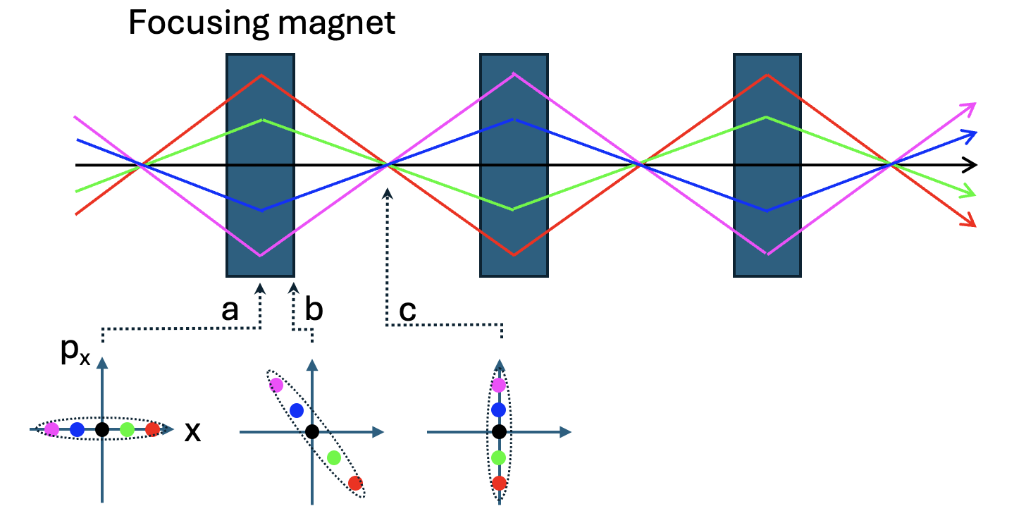
Concept of ionization cooling channel
Heat transfer from hot object to cold one
Beam temperature is maximum at a focusing point in a beam optics
Beam
Absorber
q (momentum)-transfer
via coulomb interaction
Heat flows when
$$\frac{∆p_{⊥}^{2}}{2m}=\frac{kT_{b}}{2}$$
$$\frac{kT_{abs}}{2}$$
$$T_{b}>T_{abs}$$
Equilibrium condition
$$T_{b} \sim { T}_{abs}$$
Optics is set
near “π” resonance
$$Δp_{⊥}$$
a: maximum beta function (RF cavity)
c: minimum beta function (absorber)

Slide 7
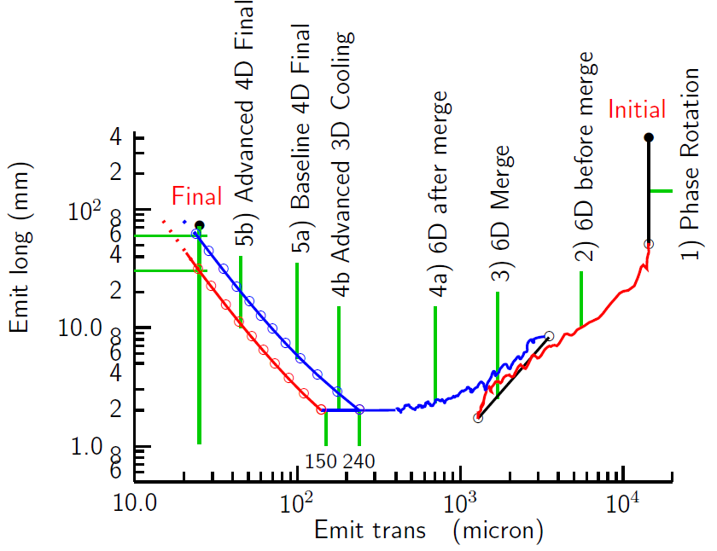
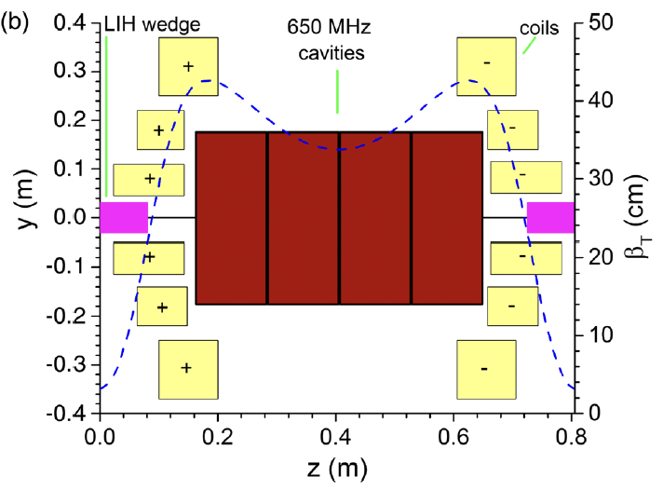
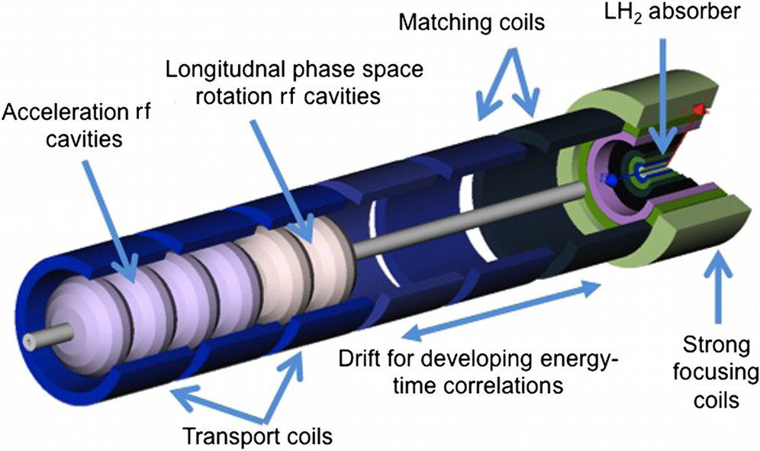
End-to-End MAP Frontend & Cooling simulations
4a) 6D cooling channel
(peak Bz 14 Tesla)
Yellow: Solenoid coil
Magenta: Absorber
Red: RF cavity
5a) 4D cooling channel (30 Tesla solenoid)

Slide 8
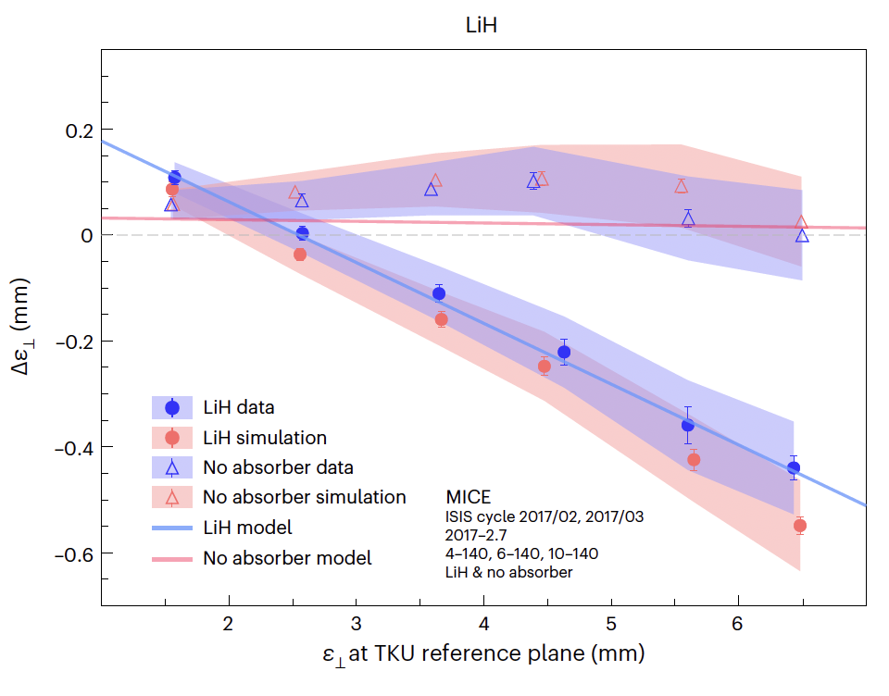
International Muon Ionization Cooling Experiment
Peak field 2 Tesla at absorber
P.B. Jurj doctoral thesis
MICE is designed for measuring ~10 % emittance reduction within 0.1 % accuracy
To this end, MICE use a single particle tracking
Red: Solenoid coil
Green: Absorber
Blue box: Tracker space
Nature Physics, July 2024
No absorber data:
No initial emittance dependence
$Δε_{⊥}$slightly high due to heating at beam windows
Crossing a blue line and zero $Δε_{⊥}$corresponds to the equilibrium emittance (2.5 mm):
MICE reports there is a mismatching in the optics which causes emittance growth
LiH data:
Larger initial emittance makes larger cooling effect
MICE demonstrates the achievable emittance
Initial transverse muon beam emittance

Slide 9
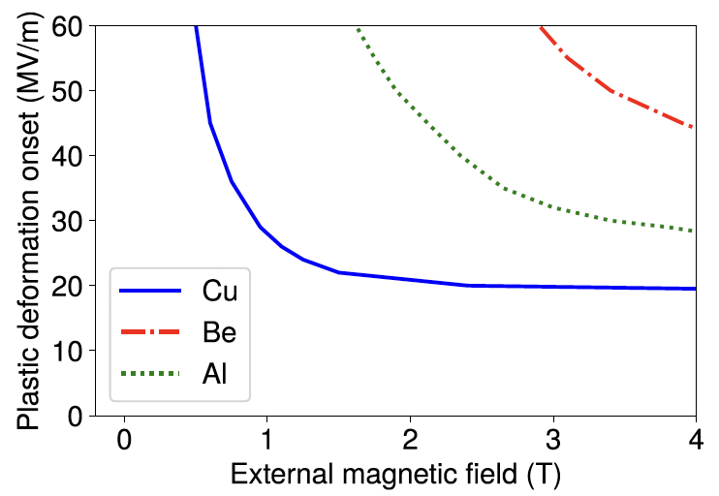
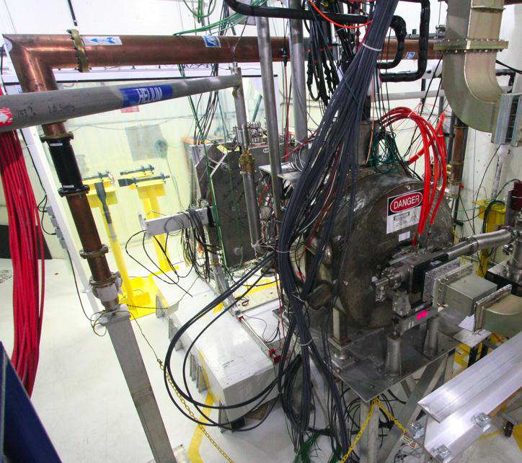
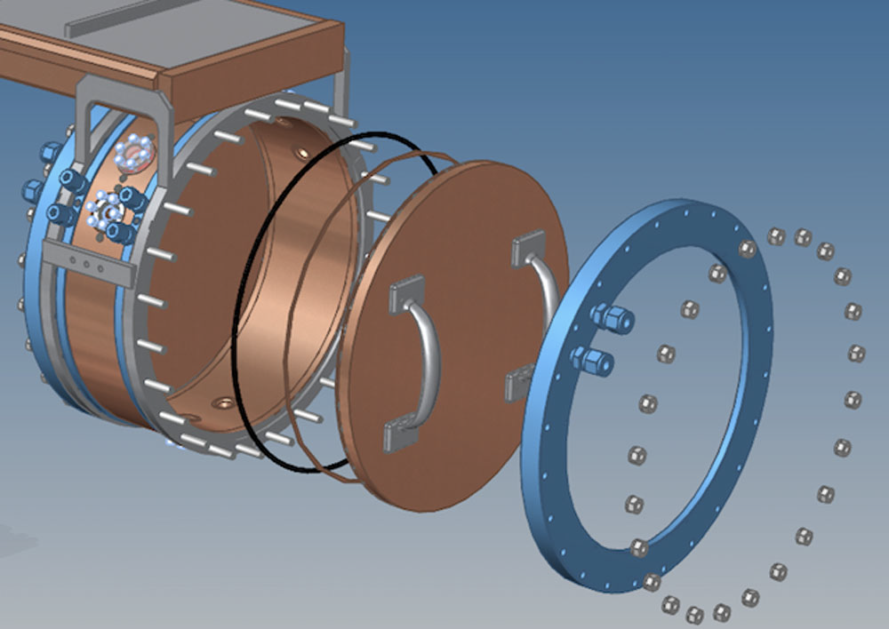
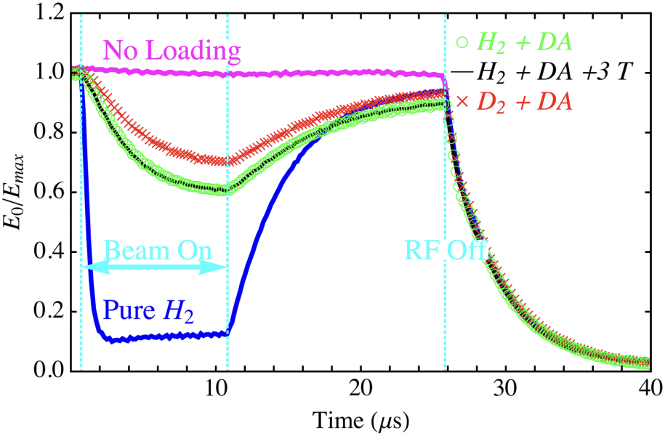
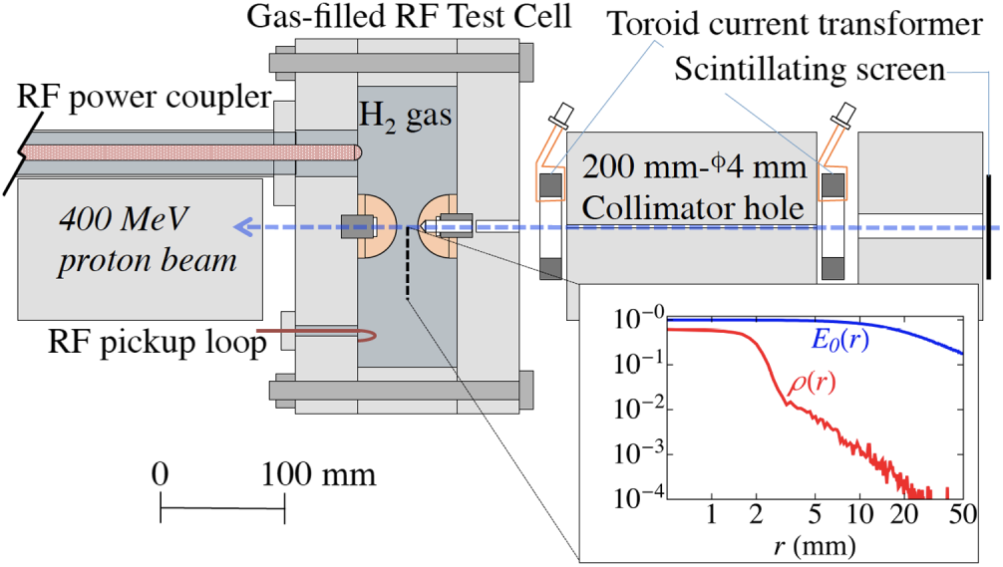
Highlight of Cooling RF cavity test at MTA
201 MHz MICE cavity
Peak gradient in vacuum RF
3-Tesla solenoid
Measurement
Prediction
Observed peak gradient in gas-filled RF
+ 3 Tesla
Beam loading

Slide 10
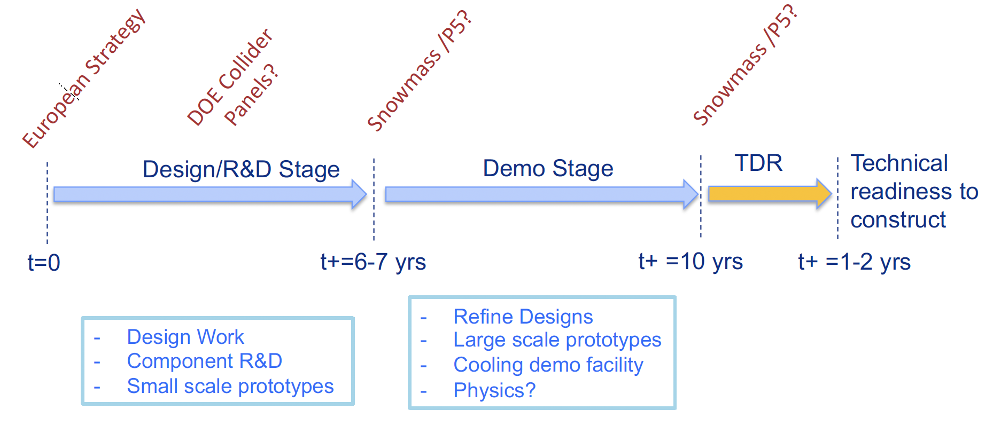
“Sketch” R&D Timeline
S. Jindariani
Orange font item
related to Demonstrator
Proton driver design R&D
Muon cooling design
Muon Collider Ring design
Machine Design R&D
Fermilab Task Force
set up three main subjects
Targets and Capture
Magnets
RF Technology
SRF Technology
Bunch Compression (for proton beam)
Machine Technology R&D
Demonstrator

Slide 11
Phase approach for the Demonstrator
D. Stratakis, IPAC’24 WECD3
Advanced RF technology to operate RF cavities in magnetic fields
Develop RF power source
Develop beam instrumentation and emittance monitor to study 6D emittance evolution along channel

Slide 12
Consider Final Cooling Channel
The exceptional cooling requires advanced accelerator science and technologies
High field magnets
Extend rectilinear channel using HTS magnet
> 30 Tesla solenoid channel
New cooling concept
Reverse emittance exchange
Parametric resonance Ionization Cooling
Plasma focusing cooling
These schemes will be investigated as part of the machine design R&D and the machine technology R&D
Prototype final cooling channel(s) and run the cooling demo test in the later stage of the demonstrator period

Slide 13
Summary
Focus on the Front End and Cooling sections as the Demonstrator
The performance of these channels is crucial in determining the achievable collider luminosity
Understand beam options, and control matching and correction components for stable operation
Several critical machine technology R&D projects have been completed in the past
We are ready to collaborate with IMCC to develop the demonstrator design and prototype the components
Identify a physics driver using a high brightness muon source

Slide 14
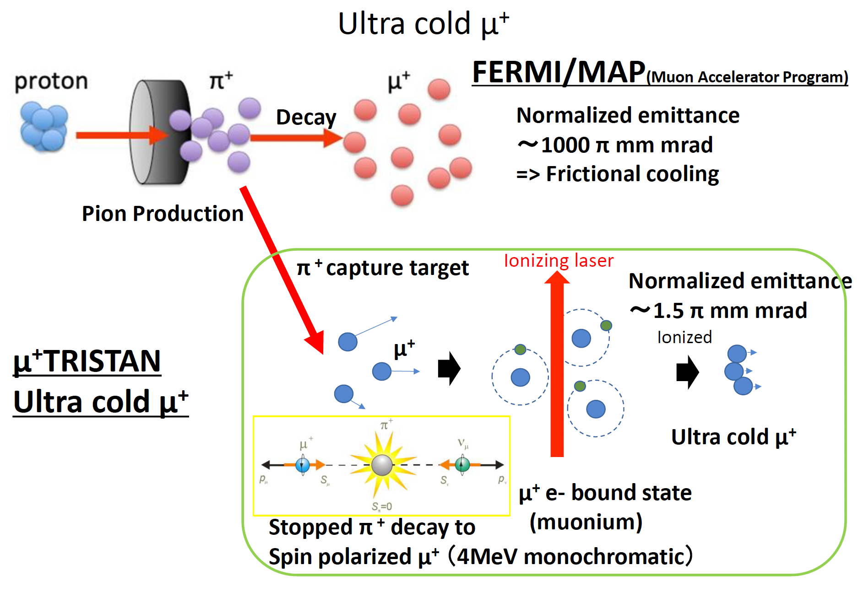
Alternative design: Cold muon beam from surface pion decay
Ideal muon source for the demonstrator
25
No ionization cooling channel is needed!
Cost of the μ+ source is ~$40M

