Slide 1
Muon Acceleration
J. Scott Berg, Brookhaven National Laboratory
Inaugural US Muon Collider Meeting
August 8, 2024

Slide 2
Outline
Principles of muon acceleration
Early linacs
  Initial acceleration after cooling
  Superconducting linac
Low energy acceleration
  RLA solution
  FFAs
High energy acceleration
  Pulsed synchrotrons
  FFAs
Future directions

Slide 3
Principles of Muon Acceleration

Slide 4
Principles of Muon Acceleration
Control cost, maintain beam
Limit decays: difficult and expensive to make muons
RF is expensive (hardware, power consumption)
  Make more passes through cavities
  Use higher RF frequencies where possible
Muons decay: everything must happen quickly
  Lower energies: no time to change magnet fields, RF frequencies, replace RF energy
  Higher energies, have time, but non-conventional rates of change
Avoid emittance growth
Both charge signs simultaneously in the same accelerator

Slide 5
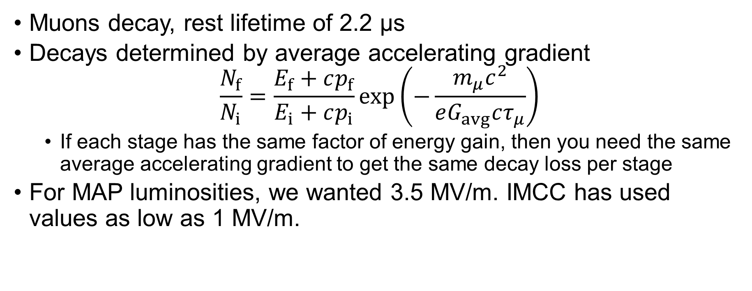
Decays and Acceleration Gradient
Muons decay, rest lifetime of 2.2 µs
Decays determined by average accelerating gradient
$\frac{N_{f}}{N_{i}}=\frac{E_{f}+cp_{f}}{E_{i}+cp_{i}}\exp\left(−\frac{m_{μ}c^{2}}{eG_{avg}cτ_{μ}}\right)$
  If each stage has the same factor of energy gain, then you need the same average accelerating gradient to get the same decay loss per stage
For MAP luminosities, we wanted 3.5 MV/m. IMCC has used values as low as 1 MV/m.

Slide 6
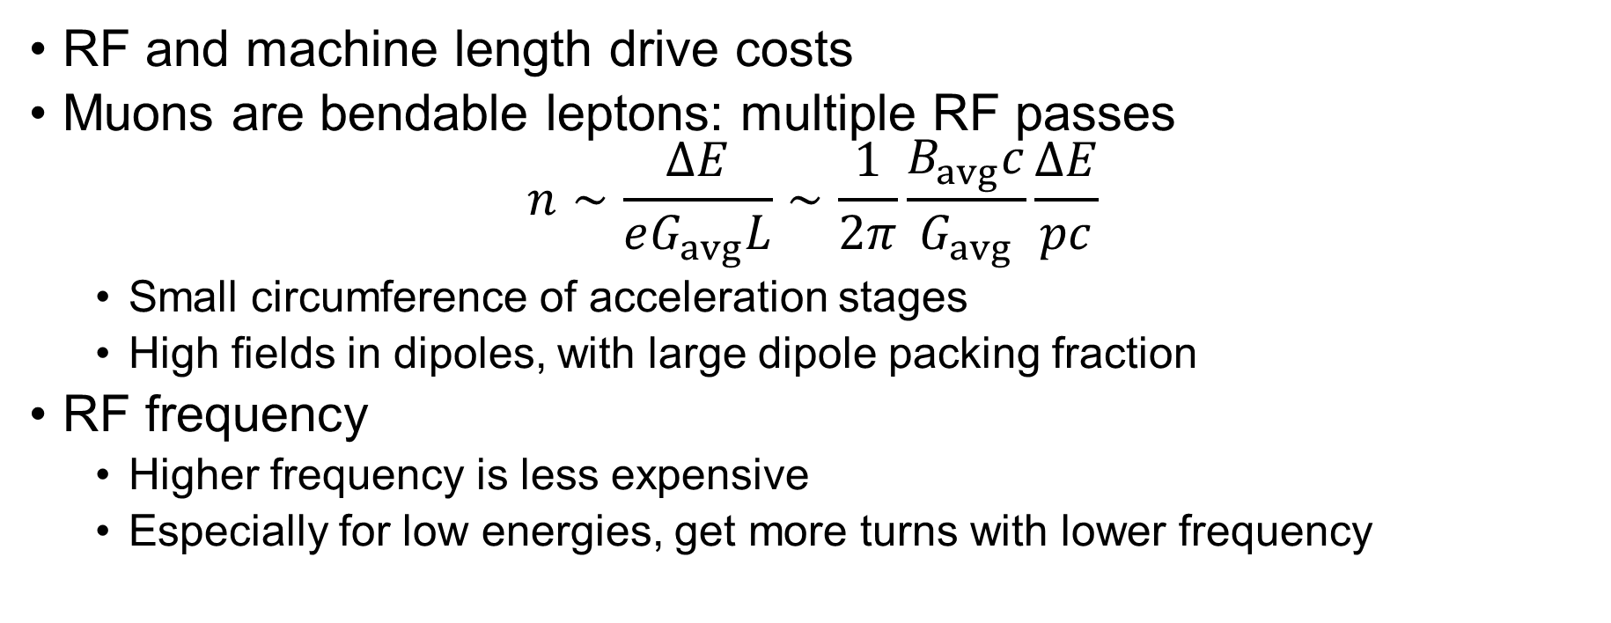
RF Efficiency
RF and machine length drive costs
Muons are bendable leptons: multiple RF passes
$n∼\frac{ΔE}{eG_{avg}L}∼\frac{1}{2π}\frac{B_{avg}c}{G_{avg}}\frac{ΔE}{pc}$
  Small circumference of acceleration stages
  High fields in dipoles, with large dipole packing fraction
RF frequency
  Higher frequency is less expensive
  Especially for low energies, get more turns with lower frequency

Slide 7
Emittance Growth and Instabilities
Designs need to look at
  Emittance growth, particularly in the longitudinal plane
  Collective instabilities
Reducing longitudinal emittance growth often requires
  Increased circumference: less efficient RF use or more decays
  Reduced RF frequency (cost)
  Addition of higher harmonic RF
Control of collective effects
  Add sextupoles for chromatic correction: again, greater circumference
  Lower frequency to reduce impedance

Slide 8
Phases of Muon Acceleration
Low Energy Linacs

Slide 9
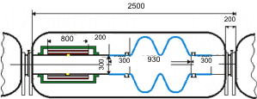
Superconducting Linac
During MAP and before, began with a low-frequency superconducting linac accelerating a neutrino factory beam
  Neutrino factory beam had a transverse emittance roughly 100 times larger and a longitudinal emittance 3 times smaller than a collider emittances
Have weak phase focusing initially (200 MeV/c momentum), until the beam becomes highly relativistic at around 1 GeV
  Requires low frequency given the longitudinal emittance
  Interleaved focusing means average accelerating
  gradient, longitudinal acceptance low. Off-crest for
  longitudinal acceptance: low acceleration rate.

Slide 10
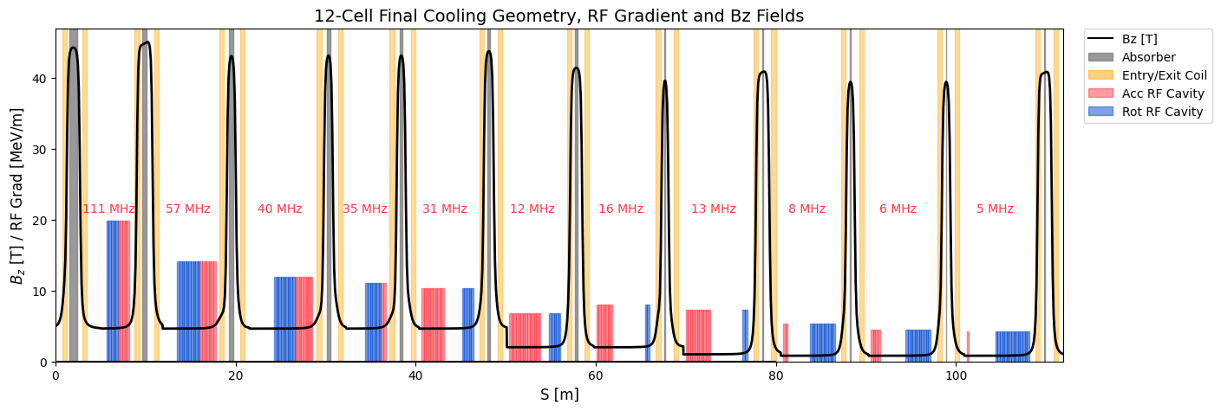
Acceleration from Cooling
Collider emittances, starting from 255 MeV: IMCC started with 88 MHz, could not switch to SCRF 352 MHz until about 1.1 GeV. Average acceleration rate about 1.6 MeV/m.
Final cooling has even lower energies (e.g., recent IMCC, 43 MeV/c momentum), low RF frequency (5 MHz)
Reverse final cooling, without high fields and absorbers
Then switch to rectilinear cooling
lattice, again without absorbers
High power consumption, so get
to SCRF as soon as possible

Slide 11
Phases of Muon Acceleration
Low Energy Acceleration

Slide 12
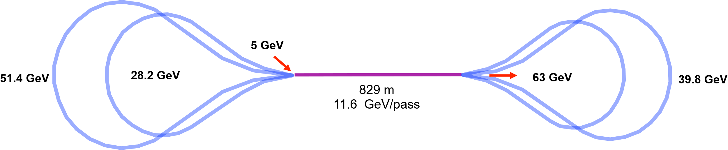
Low Energy Acceleration
Low energy: insufficient time to change magnet fields, replace energy or change phase of RF
Conventional solution: CEBAF-like recirculating linear accelerator (RLA). MAP scenario had 2 stages, 1.5–5 and 5–63 GeV
“Dogbone” geometry to improve efficiency and/or separation between arcs
Only have stored energy in cavities for acceleration: low frequency, few turns

Slide 13
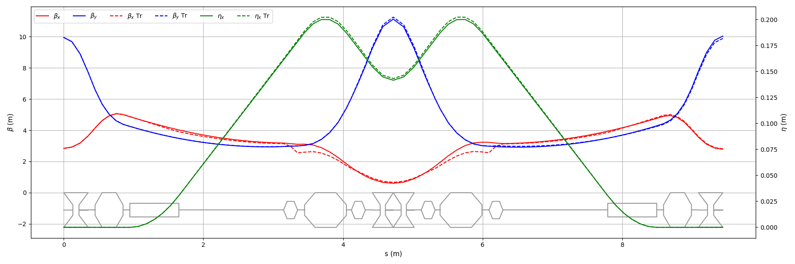
RLA Acceleration
MAP designs had 90 degree FODO arcs. Found potential longitudinal emittance issues from high arc R₅₆: lengthen arcs
IMCC studies:
  DBA FMC lattice with chromatic correction instead to lower R₅₆
  Higher harmonic in linac to linearize RF (stored energy issue?)

Slide 14
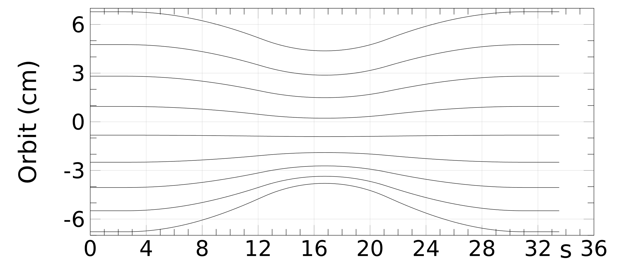
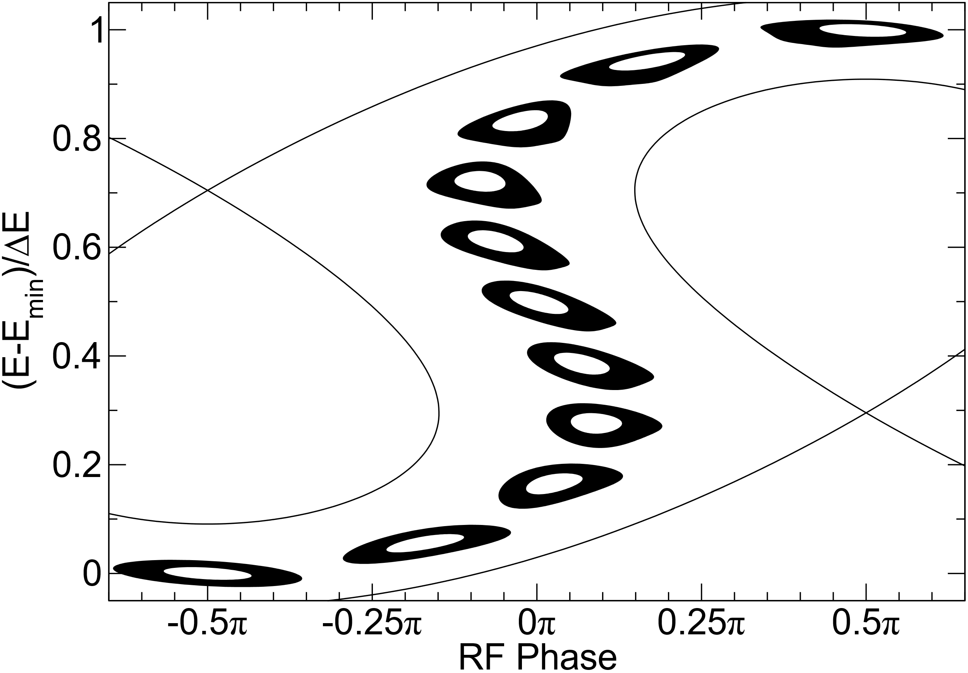
FFAs at Low Energy
RLA switchyard limits passes and thus
efficiency
Alternative: fixed field alternating
gradient accelerators (FFAs)
  Many energies in a single beamline
Serpentine acceleration for orbit period variation
Appeared more costly than RLAs
  But long, complex RLA arcs may change that

Slide 15
Phases of Muon Acceleration
High Energy Acceleration

Slide 16
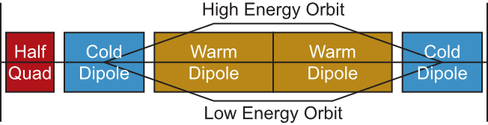
High Energy Acceleration
Have (barely) sufficient time to replace RF stored energy between passes, adjust RF phase, change magnet fields
  Above 63 GeV about the right range
Conventional solution: synchrotron with “hybrid” bends
  Interleave fixed field superconducting magnets with iron-dominated magnets ramped from negative to positive

Slide 17
Current Studies
Three approaches being considered
  IMCC: green-field approach
  IMCC: stages within the LHC and SPS tunnels
  SBU/BNL: fit acceleration on the Fermilab site
    I’ll focus on this for a bit
    More details in poster (Kyle Capobianco-Hogan)
IMCC has looked at other design issues as well
  Collective effects (need sextupoles!)
  Longitudinal simulations: RF frequency and needed number of RF stations

Slide 18
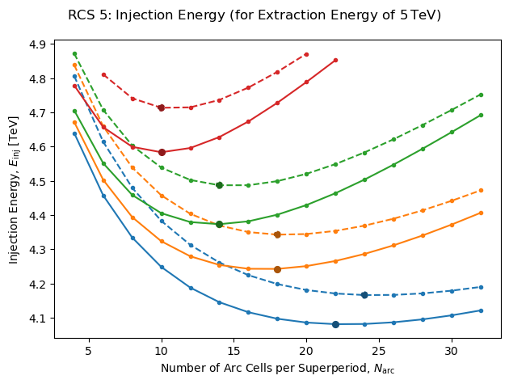
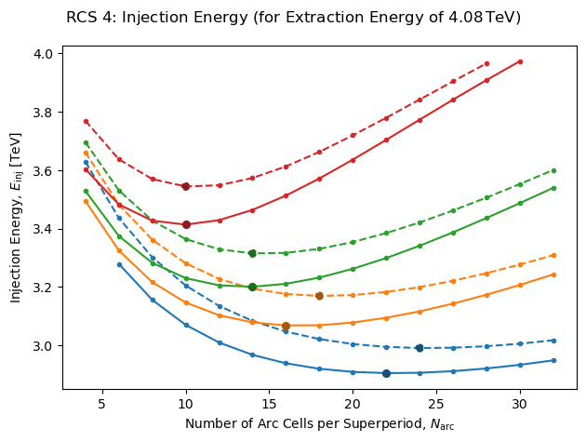
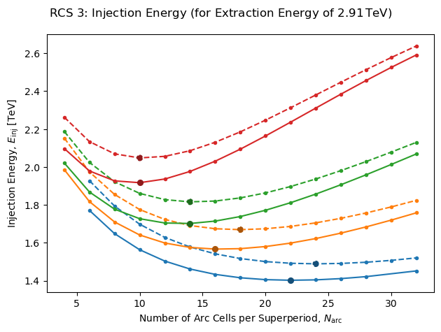
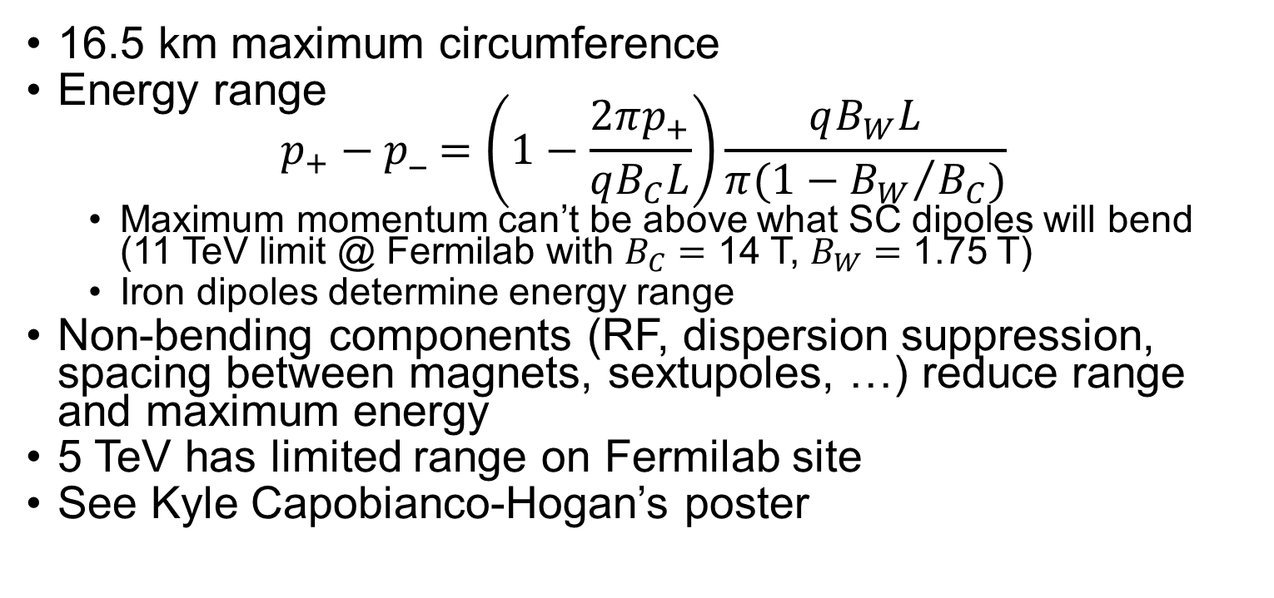
Pulsed Synchrotron on the Fermilab Site
16.5 km maximum circumference
Energy range
$p_{+}−p_=\left(1−\frac{2πp_{+}}{qB_{C}L}\right)\frac{qB_{W}L}{π(1−{B_{W}}/{B_{C}})}$
  Maximum momentum can’t be above what SC dipoles will bend (11 TeV limit @ Fermilab with $B_{C}=$ 14 T, $B_{W}=$ 1.75 T)
  Iron dipoles determine energy range
Non-bending components (RF, dispersion suppression, spacing between magnets, sextupoles, …) reduce range and maximum energy
5 TeV has limited range on Fermilab site
See Kyle Capobianco-Hogan’s poster

Slide 19
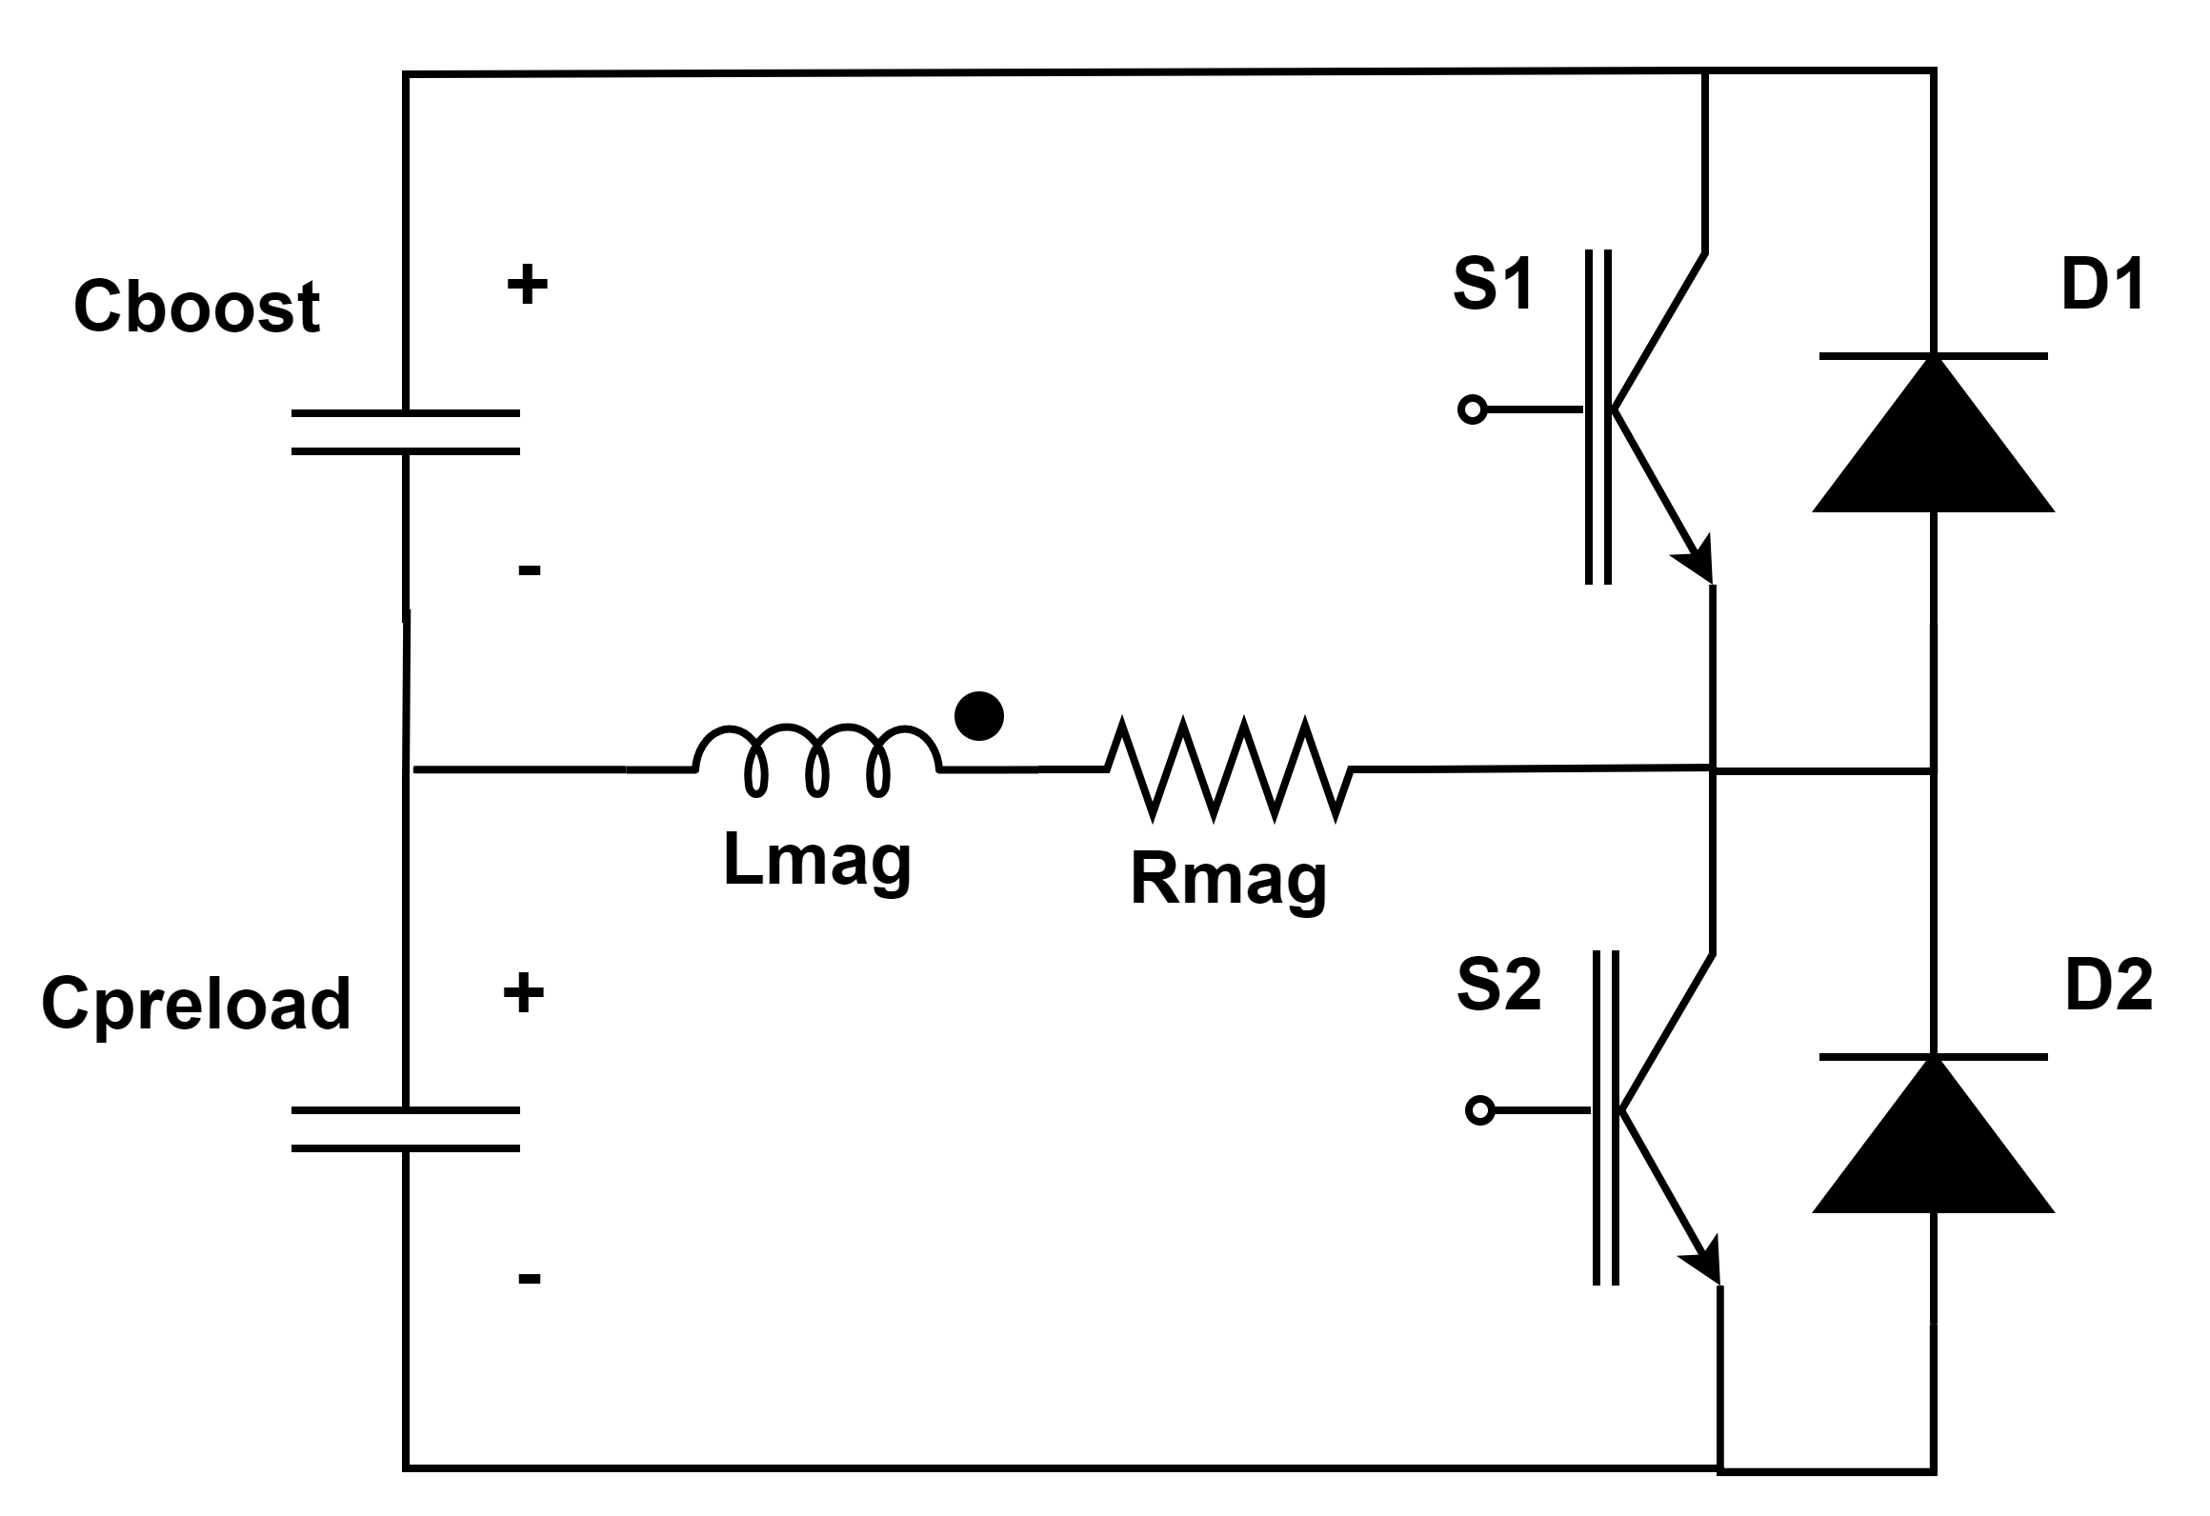
Pulsed Magnets
Swing from negative to positive in ms time
scales
High fields important for energy range
  More important than fixed field magnets
Iron limits to about 1.75 T
  Higher fields for pulsed magnets very beneficial
Efficient magnet design from MAP
  IMCC has revisited, focusing on Fe/Co pole
IMCC has looked at power supply
  Design with preload and boost capacitors looks
  promising

Slide 20
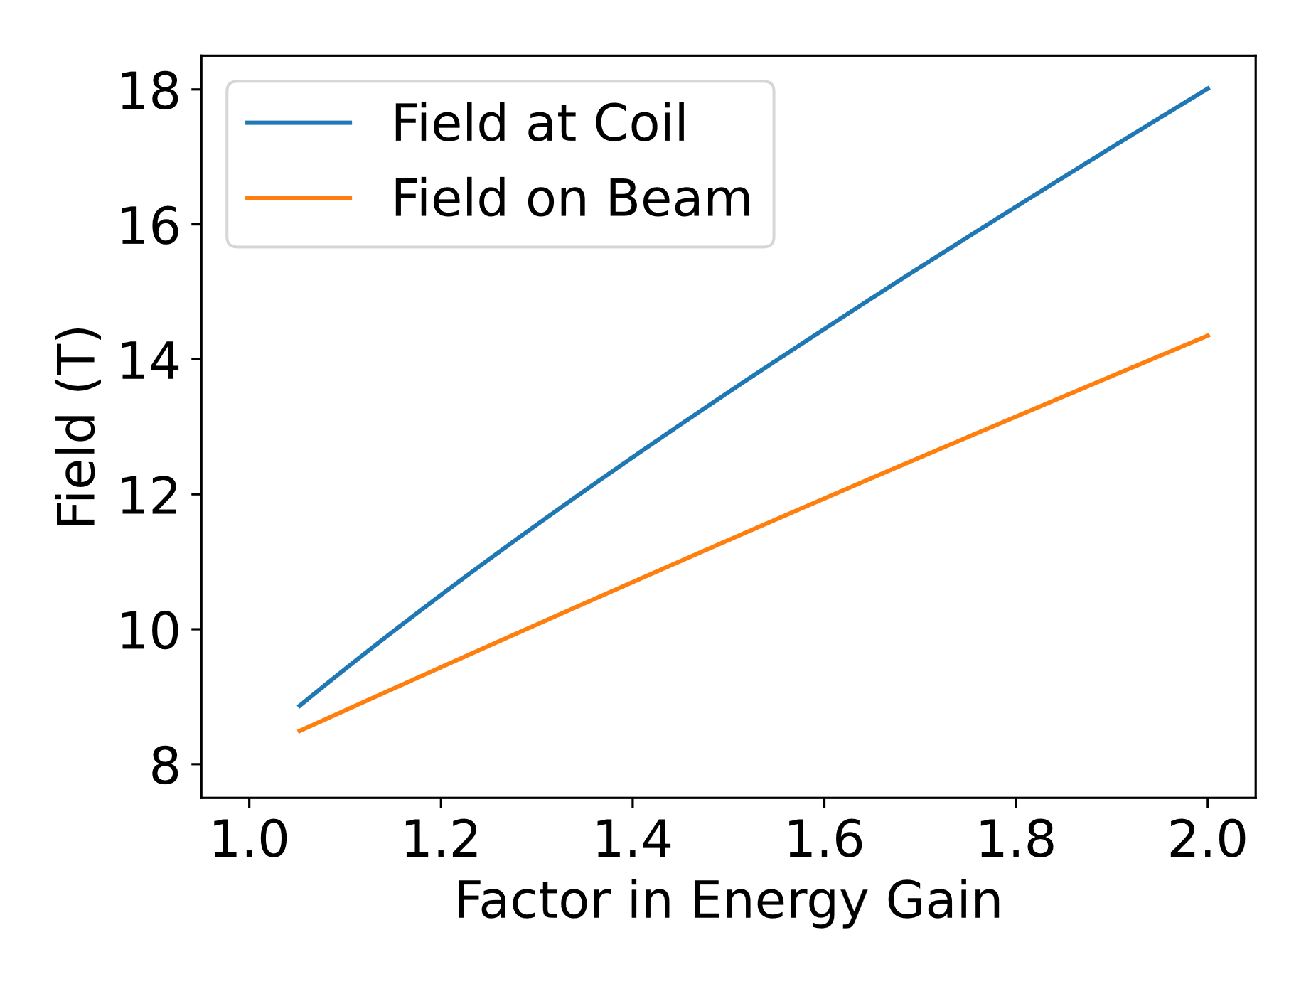
FFAs at High Energy
Pulsed design energy and range does not scale linearly with SC magnet field
FFA would scale linearly with SC field
Preliminary design work showed similar
energy ranges on the Fermilab site to
pulsed synchrotrons
Injection/extraction septum was biggest
challenge
  Insufficient available drift space

Slide 21
Future Directions

Slide 22
Design Work
Have significant progress on pulsed synchrotron lattice design
  Complete design with all required components
  Fully simulate, incorporating effects as in IMCC studies
  Preliminary work on engineering
When final cooling stabilizes, design acceleration for that beam
Study whether we can get better performance from FFAs
  Address septum concern in high energy FFAs
  Can FFA-like techniques improve a pulsed synchrotron?
RLA designs at lower energies
  Engineering studies at switchyard

Slide 23
Hardware Studies
Insure we understand response of iron pulsed magnets
  Material testing at our pulse ramp rates and fields
    Evaluate Fe/Co in our radiation environment
  Build a small test magnet, perform detailed measurements
Build a prototype power supply
  Ideally a linear field ramp
  Test using a larger-scale magnet
Pulsed magnets reaching higher fields?

