Slide 1
9 O’Clock Meeting
Nathan Ruffatti
MCR Crew Chief
Friday, April 26th, 2024

Slide 2
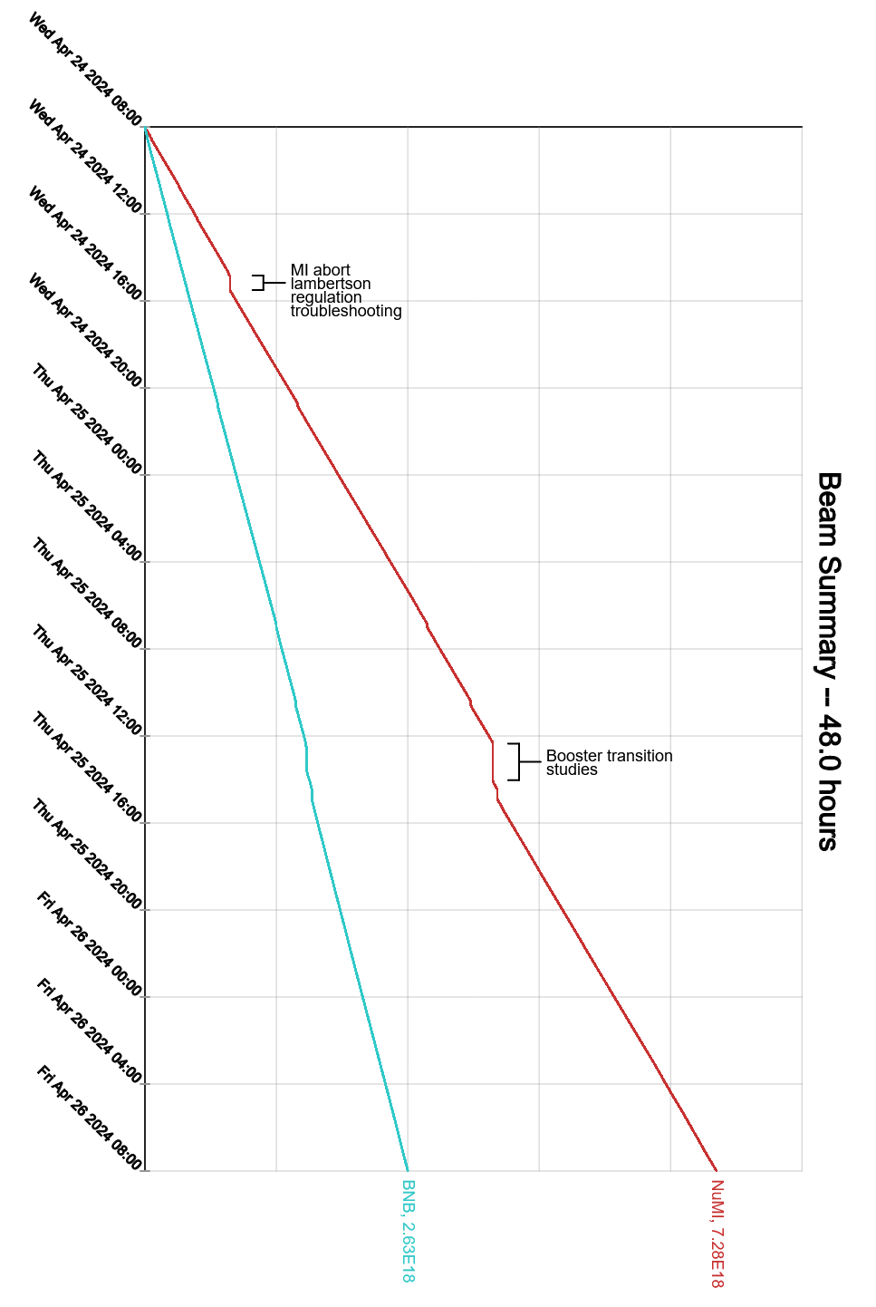
Since Wednesday…
Wednesday:
95 vacuum station repaired and running
MI abort lambertson regulation troubleshooting
Thursday:
Remnant LCW system turned on
Booster transition studies
Rep rate monitor safety system testing
Enclosure B & CDE search & secured
Config Control unlock:
F-Sector
Transfer Hall
Enclosures B & CDE
Friday:
NM4 search & secured

