Slide 1
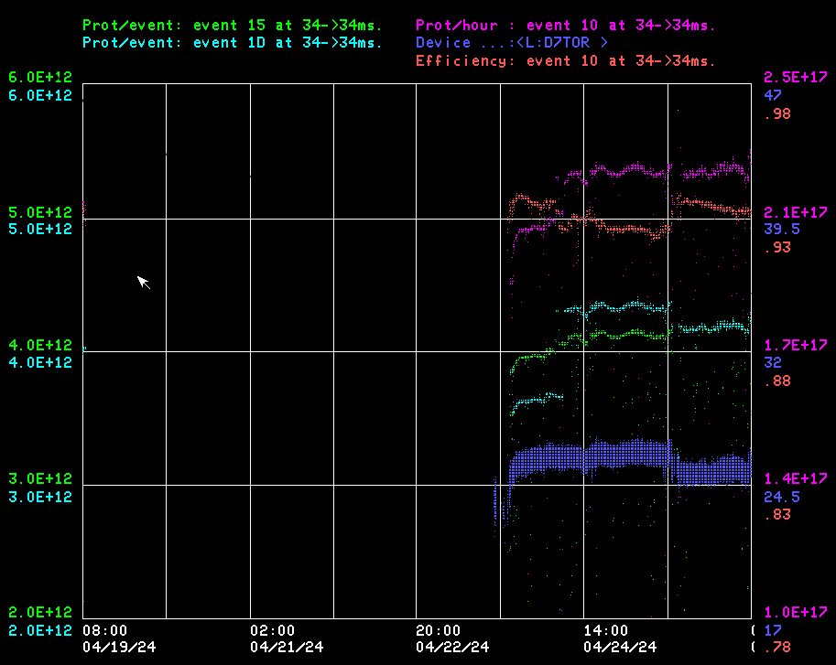
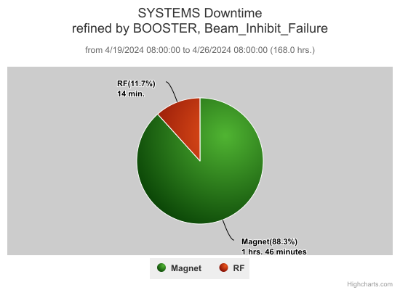
Booster Operations 4/19/24 – 4/26/24
F
Misc RF ~14min
MK08~ 1.75hrs
DT 2hrs
RF tested new Mode 2 Damper on BRF6, it was not left in.
PESD PS checkout at E4R planning continues.
Controls resolved M188 file save Postgres issue.
Controls working on proton torpedo hangups.
Instrumentation working on new Booster BPM system.
MSD setup of RGA on spare magnets for PD testing in progress.
This week:
Last Friday day shift started with 55 Chiller taking Linac down until Tuesday.
Late Monday day shift discovered MK08 had termination fault, repaired on Tuesday. MSD also leak checked around MK08. Work on kicker took several hours within the Chiller/Linac recovery time.
Tuesday Beam established eve shift, Crate$4A had bad PS(no +/-12V,-24) delaying beam while investigating why beam was not circulating. Correctors did not have proper ramps but were tracking the bad ramps. Supply failed Saturday evening.
Delivered beam on $15’s to MI/RR from 3-4E12 p/pulse. Rates over 800-900+kW in RR/MI.
Beam to BNB at 5Hz, 3-5E12 p/ pulse 4-6E16 p/hr. over week.
RF experts recovered all RF stations down this week, all are available going into weekend.
Implemented new transition Phase jump LL process, change left in and evaluation in progress.
General tuning by experts and Ops. Thanks to Ops for maintaining Booster operations.

