Slide 1
Muon Campus Operation Report
Jim Morgan
Friday 09:00 Operations Meeting
April 26, 2024

Slide 2
Muon Campus status
Working towards permission for beam operation
Power supply inspections completed; mitigated findings needed for start-up
Readied PWC’s and ion chambers for operation, checking gas flow and high voltage
Interlocks techs tested all safety enclosures last Friday, waiting on rad monitors
Discovered discrepancy in SAD/ASE Credited Control documentation regarding AP-30 penetrations and MC-1 rad detector
7/12 beam sign-offs (including Muon and Ops signatures, which come last)
Other work done preparing for beam start-up
Checked profile monitor motion-control and high voltage to PWC’s
Updating BBM for Mu2e operation and newer toroid electronics
Testing logic modifications to 30 sector vacuum controls
ESS1 & ESS2 Electrostatic Septa
ESS1 high voltage conditioning continued at NWA, nearing operational voltage
ESS2 foil plane installation completed on frame
AP-0 A/C work stalled again
Waiting for controls sub-contractor to show up
Technical Division personnel worked on reconfiguring water inlets and rad hardening the last three LQ quadrupoles in the M4 Line
Study – M1-M3 Optics
Study – Alternative M5 optics

Slide 3
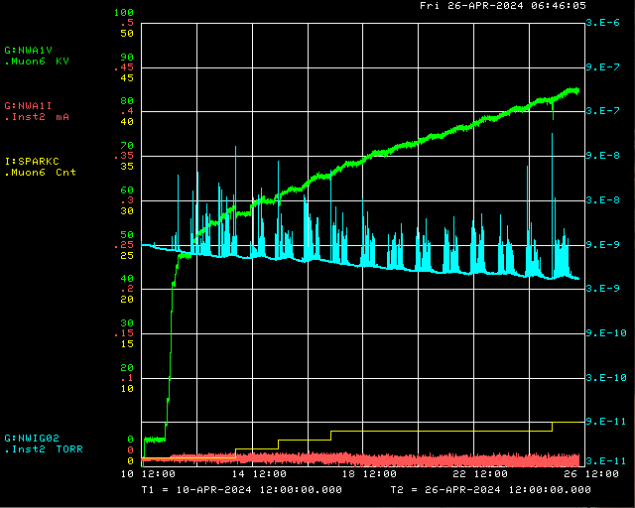
ESS1 high voltage conditioning at NWA
Conditioning target voltage
Operational Voltage with 12 cm foil to cathode distance
ESS1 P.S. Voltage
Ion Gauge
Spark Detector
ESS1 P.S. Current

Slide 4
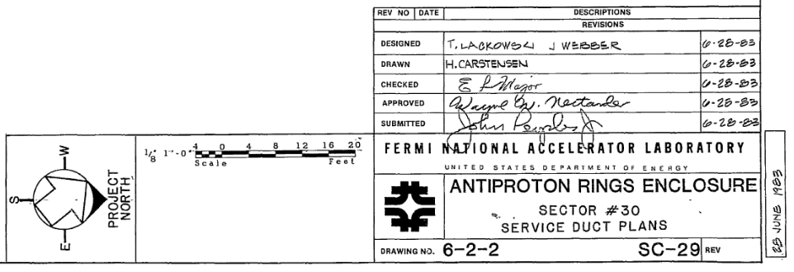
Penetrations in D30 tunnel
Delivery Ring

Slide 5
Upcoming work
Hope to have signing party next week
Waiting on Interlocks testing to be finished
Need to resolve SAD/ASE documentation discrepancies
Working on beam sign-offs (7/12, but several ready for signatures or close to it)
May do some power supply testing before setting up to run beam
ESS1 and ESS2
ESS1 high voltage conditioning continues at NWA, plan to go to 90 kV
ESS2 being checked for foil plane straightness, then will be installed in tank
AP-0 A/C work paused while awaiting controls sub-contractor
Will need access to AP-0 Water Cage and rad fence area, turning off beam to Muon Campus
Estimate six days of work needed for system to be operational
Make updates to Muon Campus BBM
Eliminate mode for beam to AP-0 Target
Switch to newer toroid electronics and use M:TR105B for input

