Slide 1
Mu2e report
Tom Diehl (FNAL), Greg Rakness (FNAL)
Friday 9am AD meeting
26-Apr-2024
https://indico.fnal.gov/event/64500/

Slide 2
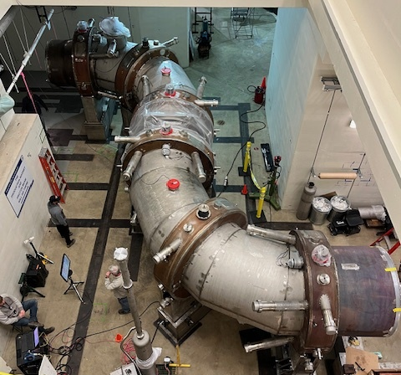
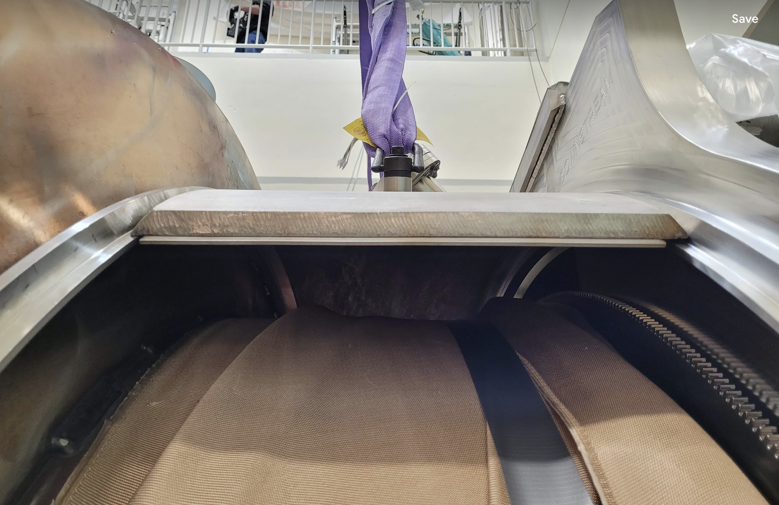
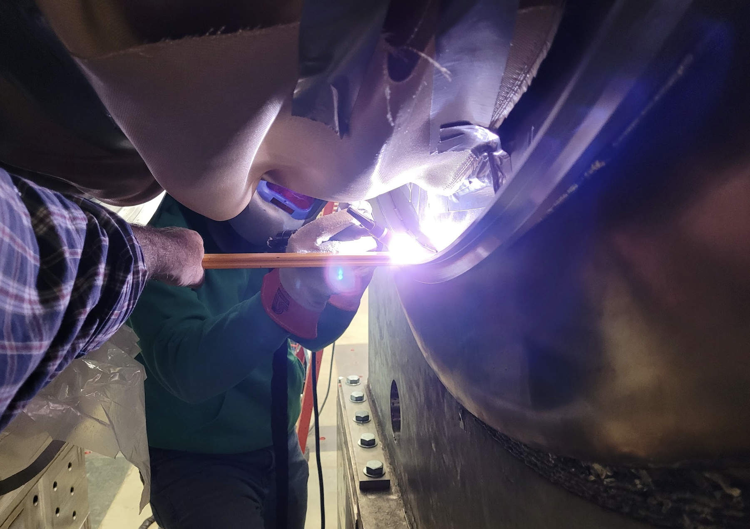
Some of the ongoing work at Mu2e (1/3)
Mechanical interconnect between TSu and TSd

Slide 3
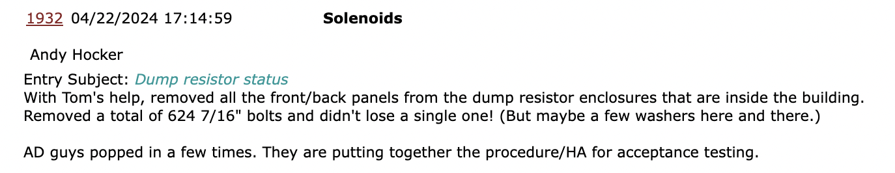
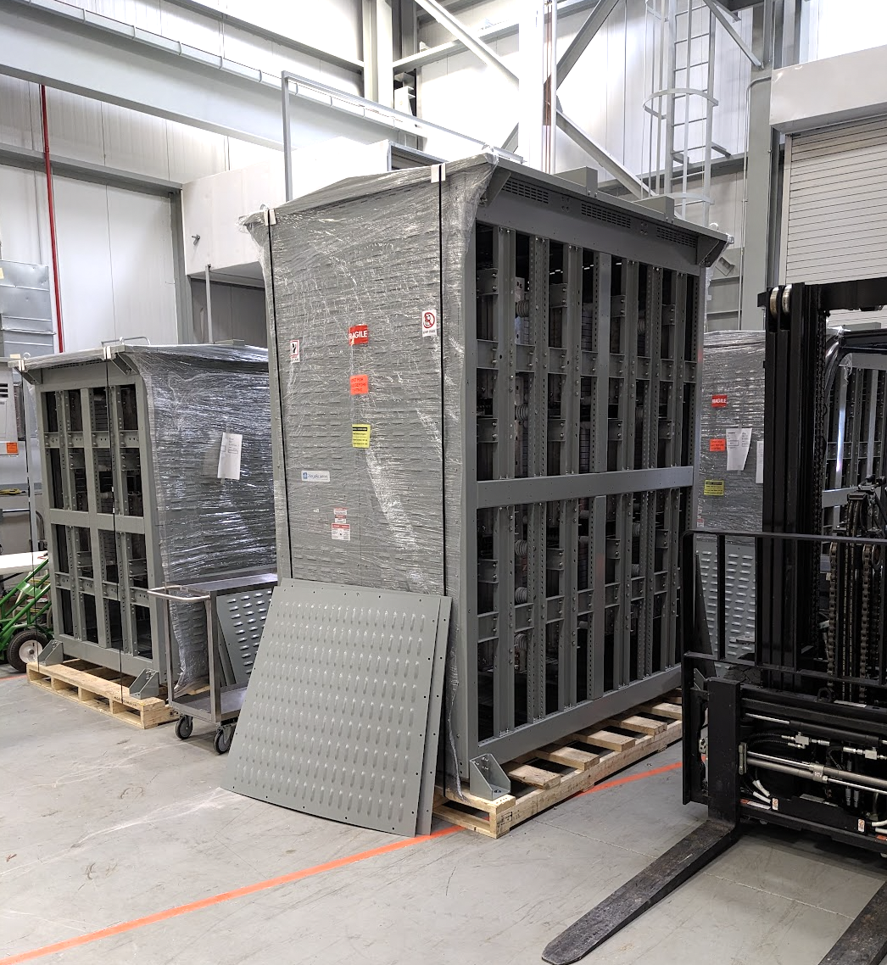
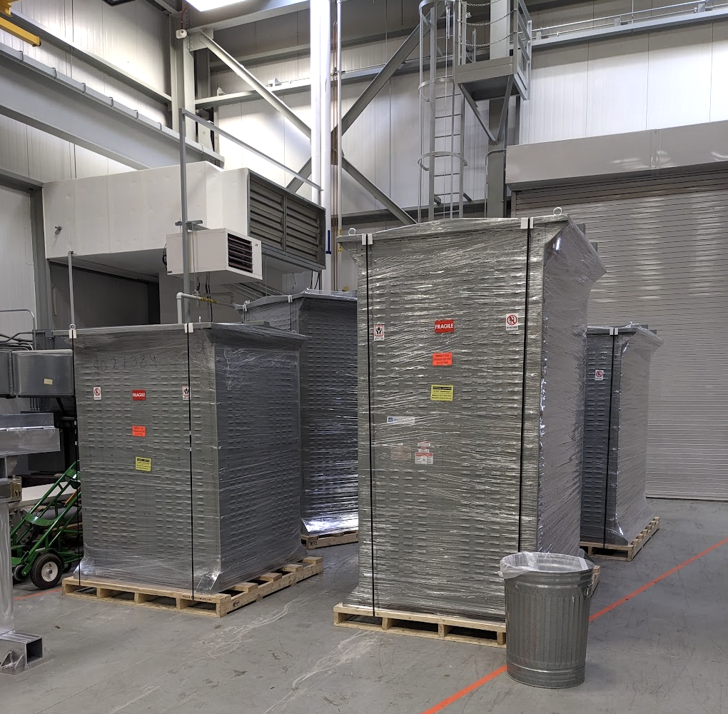
Some of the ongoing work at Mu2e (2/3)

Slide 4
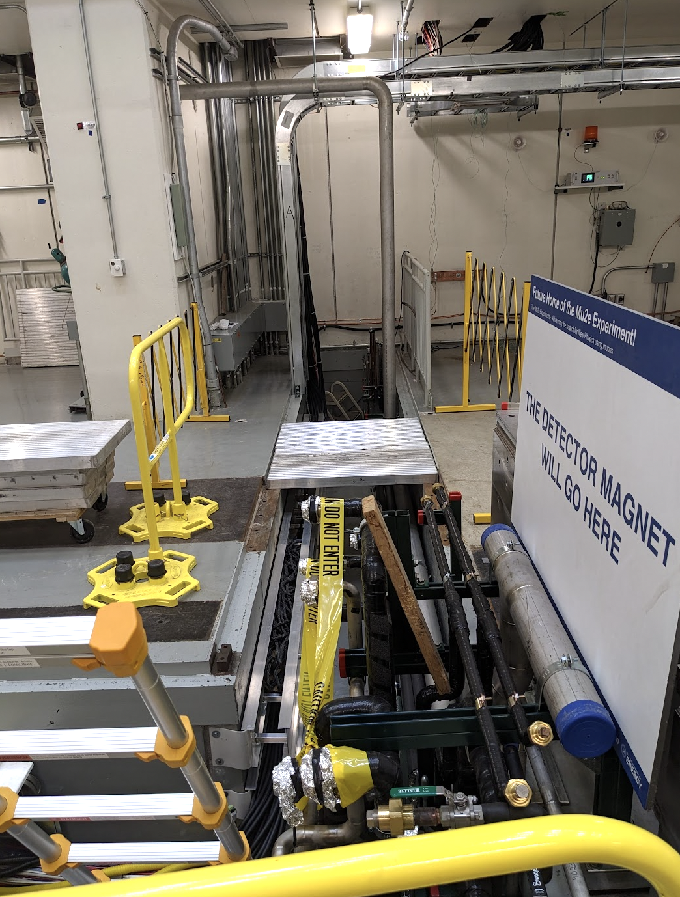
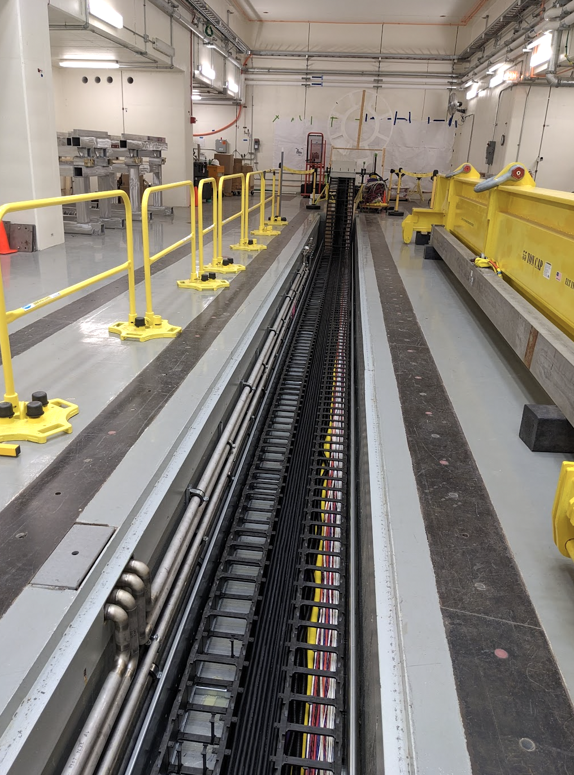
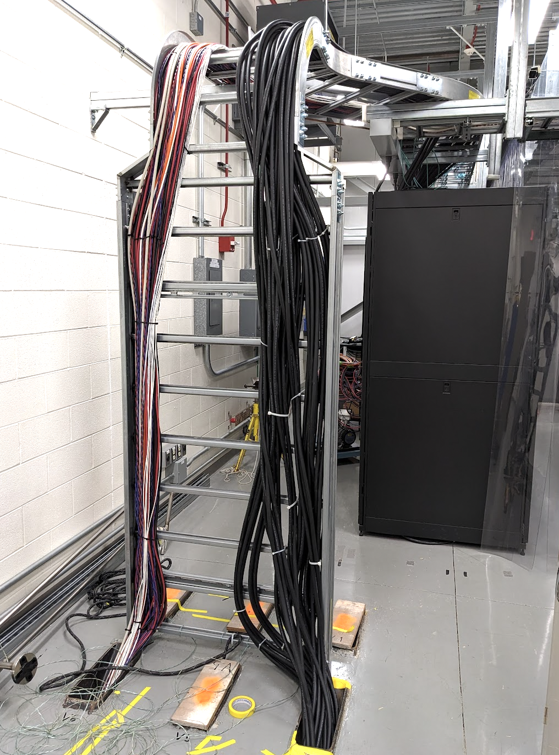
Some of the ongoing work at Mu2e (3/3)
DT generator ORC approved
  Thanks to ES&H for facilitating this
  Hoping to run the DT generator next week
Tracker cabling continues → = ideal placement of personnel

Slide 5
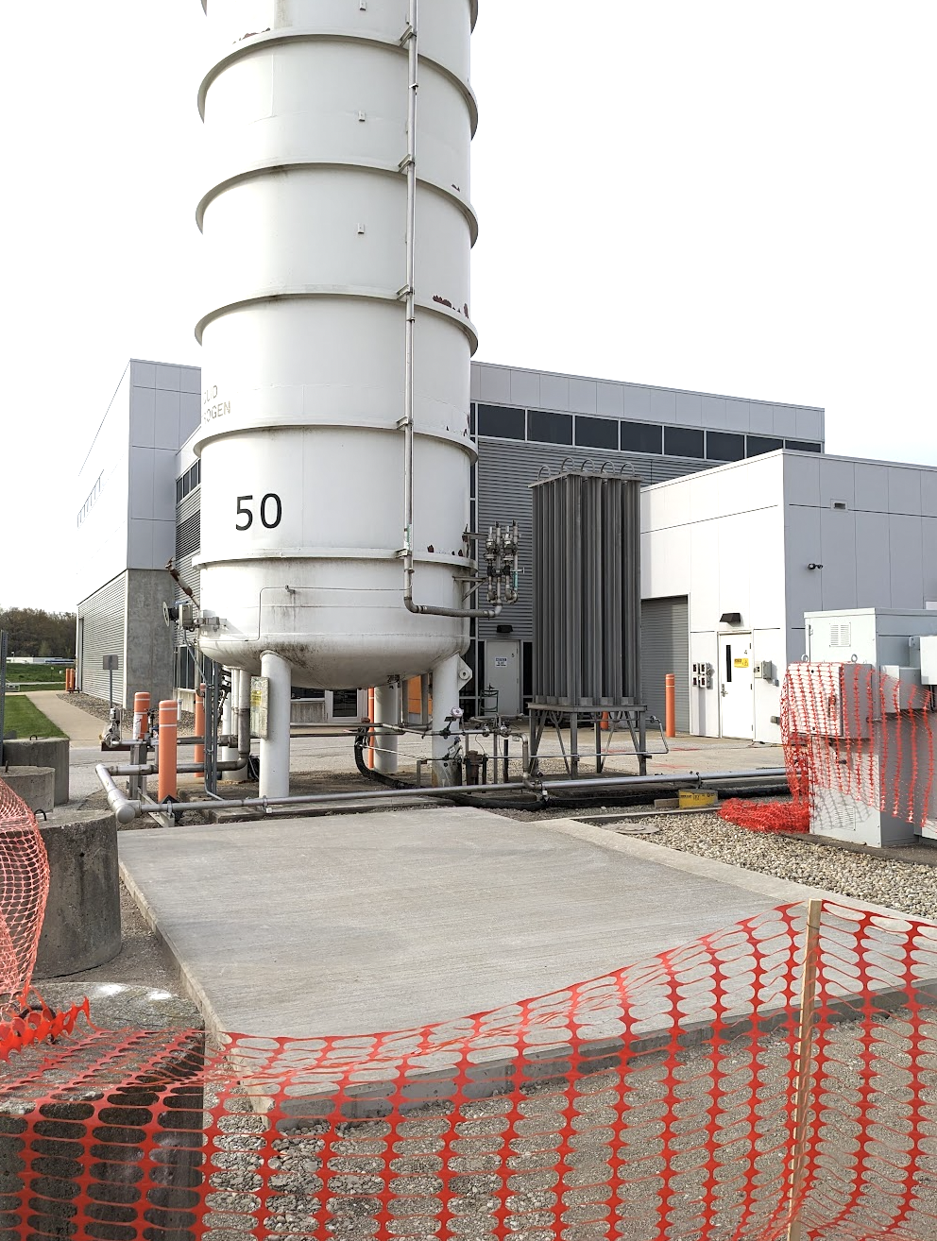
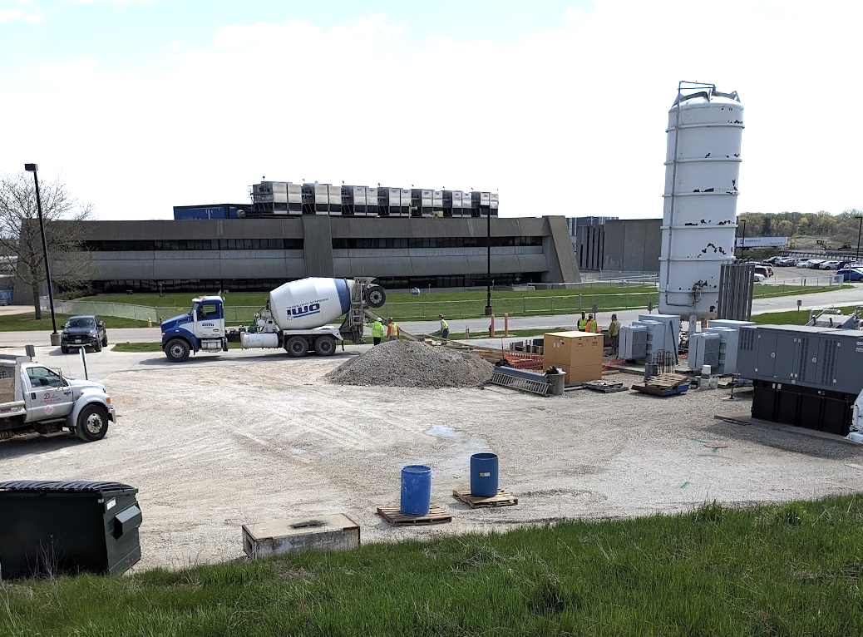
Concrete pad for 2nd LN₂ tank finished
Thanks to ISD for facilitating this

