Slide 1


302.2 - MQXFA Results and Status
G. Ambrosio – FNAL
MQXFA magnets L2 manager
HL-LHC AUP DOE IPR – July 23rd–25th 2024

Slide 2
MQXFA Status Summary
Charge #1
Control Account | Status* | Actual Yield | Yield in Baseline
Strand procurement & QC (FNAL, FSU) | 97.6% complete
Cable fabrication & insulation (LBNL) | 99.9% complete | 95.6% | 90% at start
Coil part procurement (FNAL) | 97.4% complete
Coil fabrication (FNAL) | 97.3% complete
Coil fabrication (BNL) | 99.1% complete
Total coil yield |  | 74.3% | 75.7%
Magnet assembly (LBNL) | 89.8% complete
Magnet yield after cold test |  | 79.0% | 84%
Focus on Inventory
2
3
Focus on Preventive Actions
Magnets tested in vertical cryostat (by 302.4.1): 14 8
Met requirements: 10 6
Did not meet requirements: 4 2
  Affected by Covid restrictions: 2 2
  Met requirements after replacing the limiting coil: 2 0
  To be tested after replacing the limiting coil: 2 2
@
rebaseline
review
Focus on Lessons Learned & Preventive Actions
1
*EDMS % Complete

Slide 3
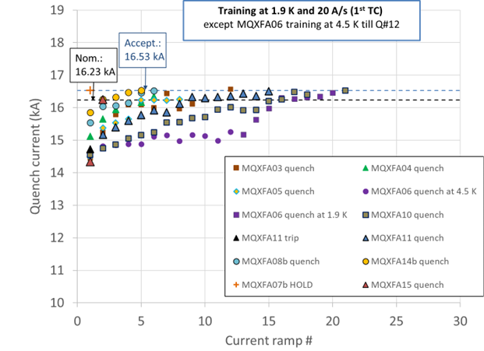
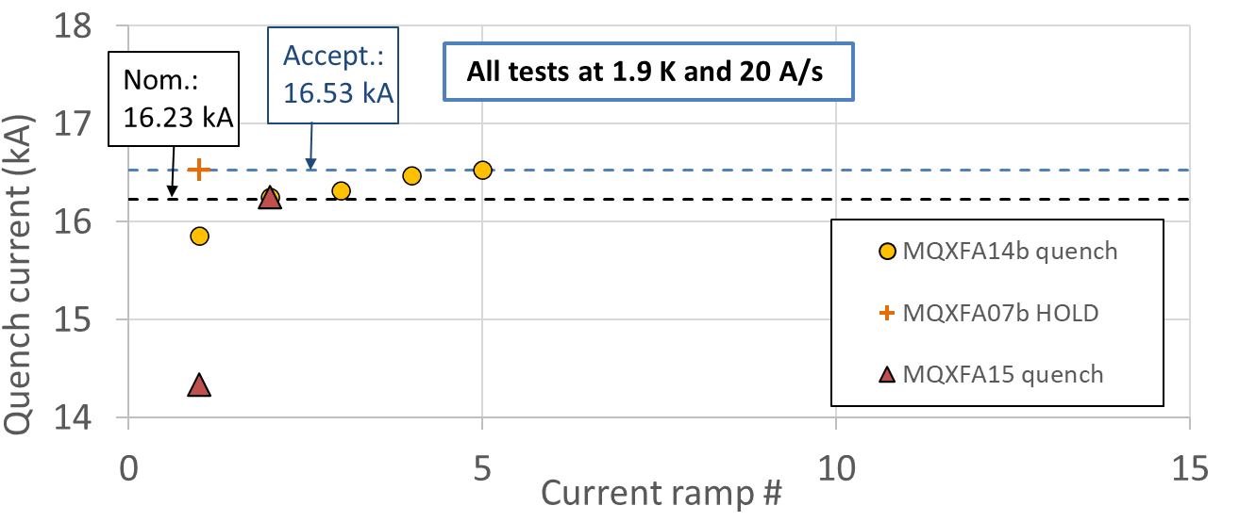
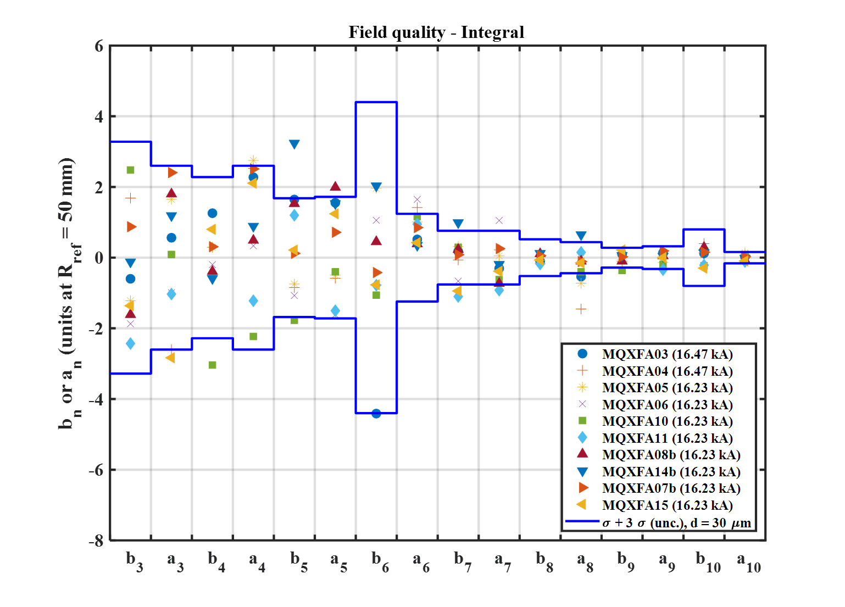
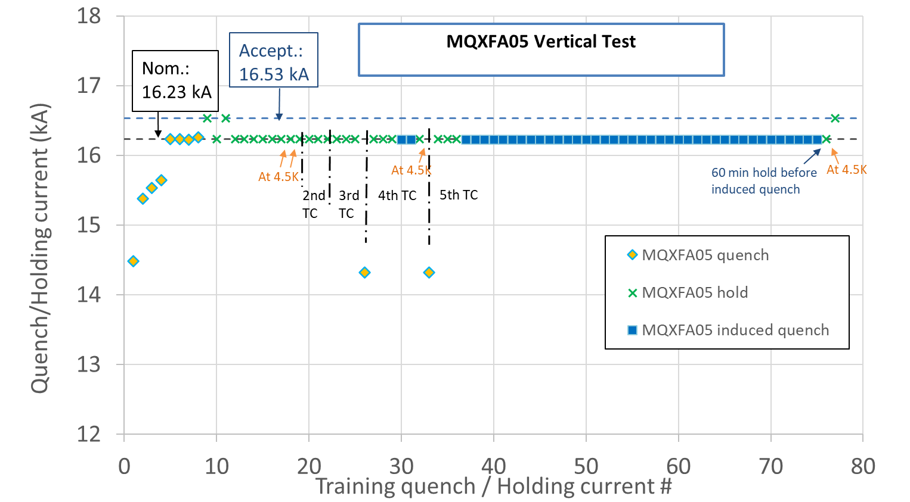
Test Results
Vertical test is done at BNL by 302.4.01, post-test analysis is done by 302.2.01
10 magnets met requirements with very good training memory
  Demonstrated endurance (MQXFA05)
  Demonstrated resilience (MQXFA11)
  Significant training reduction in last 3 magnets
Field quality, integrated gradient and other requirements are fine

Slide 4
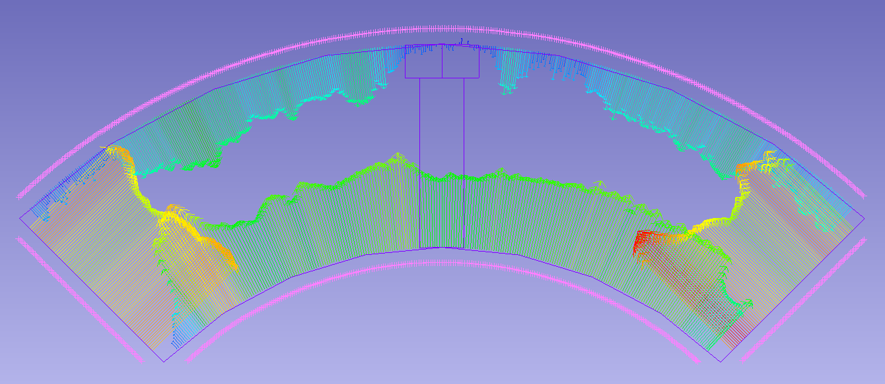
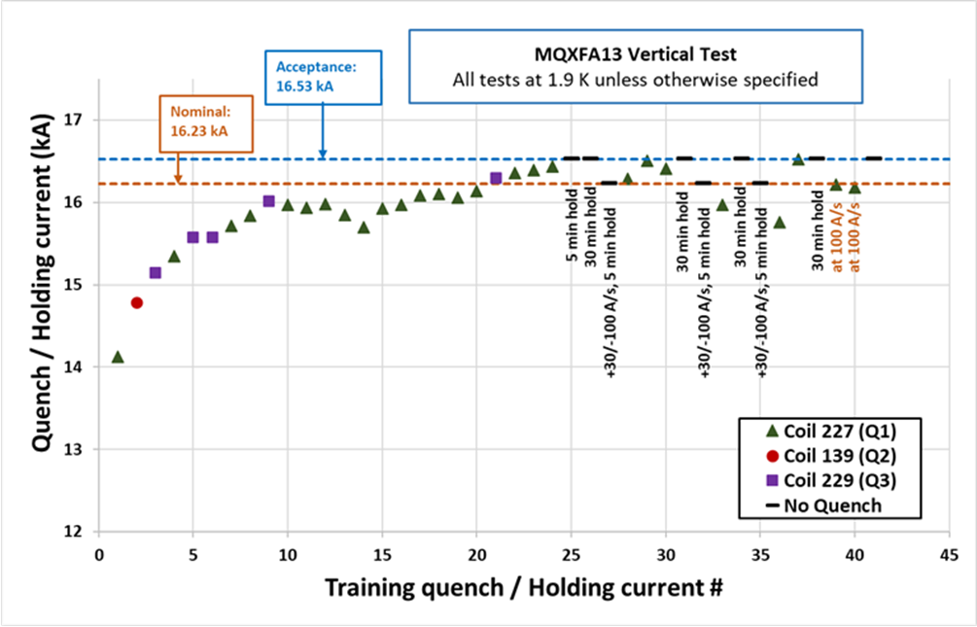
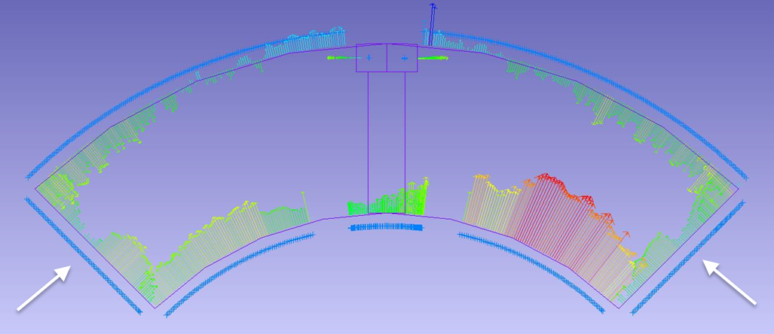
MQXFA13 Analysis
MQXFA13 was able to hold acceptance current.
Nonetheless, it showed concerning signals:
    Long training in a single coil (227)
    Many quenches at transition to lead end
    Quenching in the first current ramp-up following a ramp-down at -100 A/s (3 times)
    ➔ Test was stopped to prevent damage to other coils
All 4 coils have arc-length in the lead end smaller than in the straight section
Coil CMM examples

Slide 5
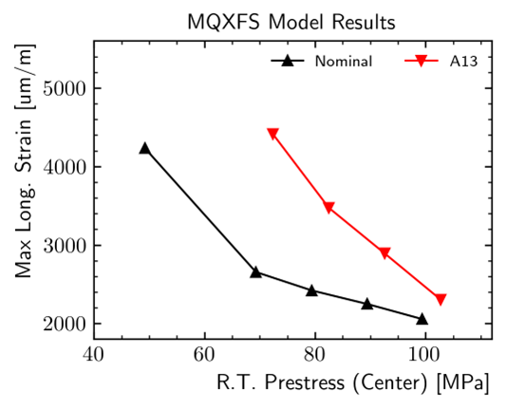
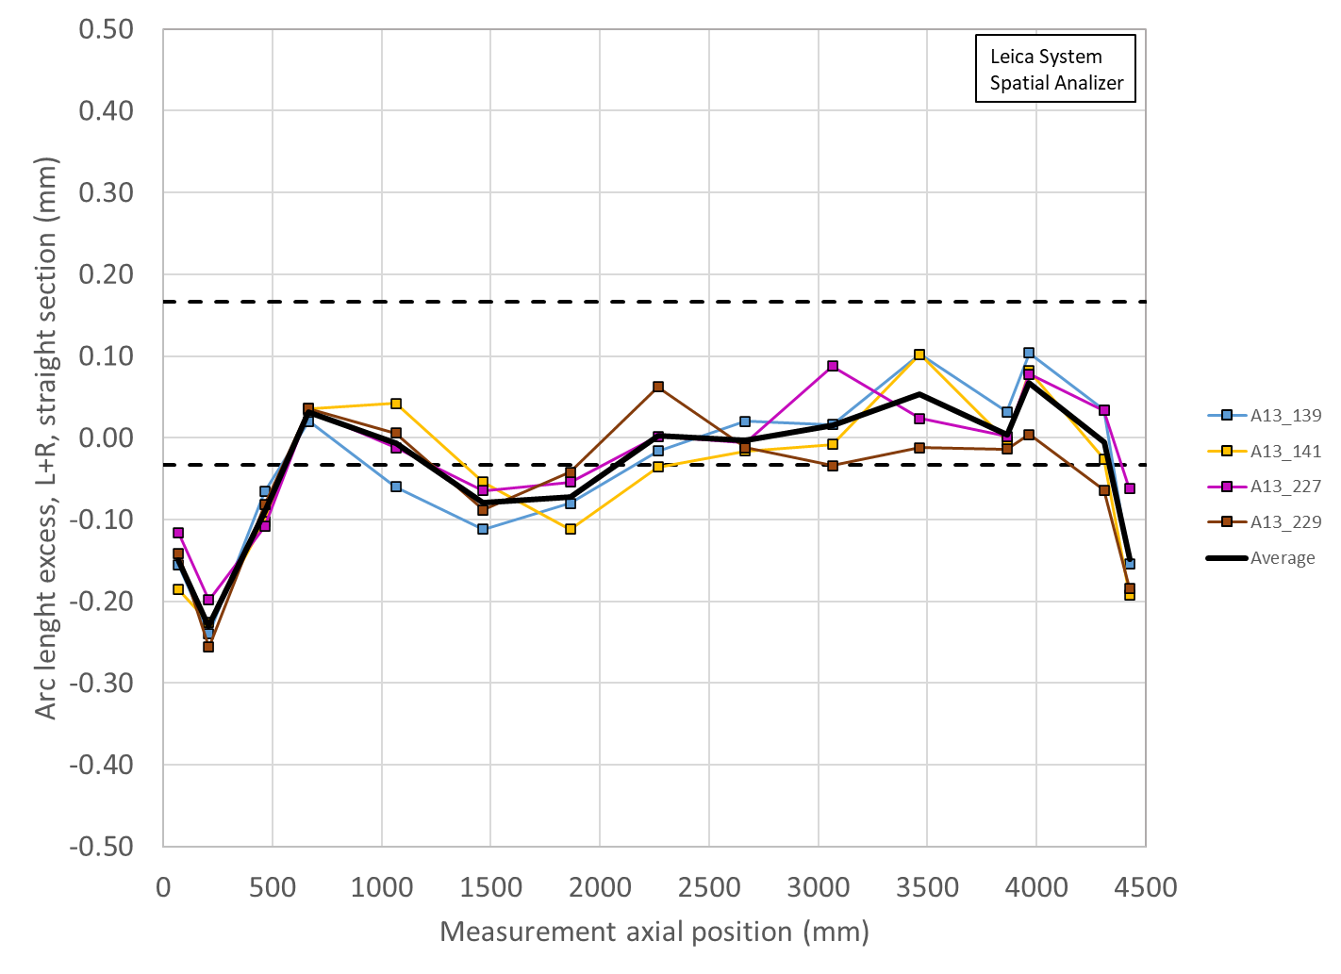
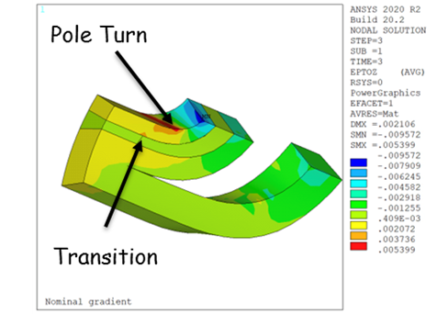
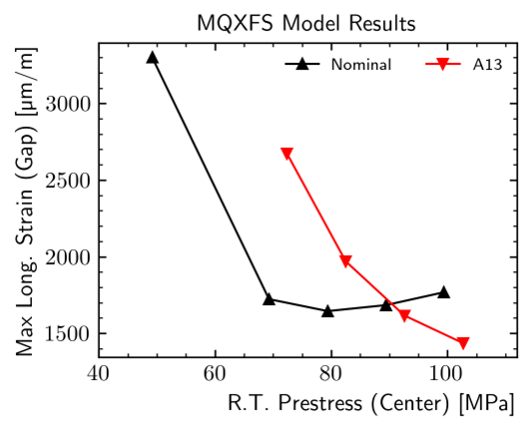
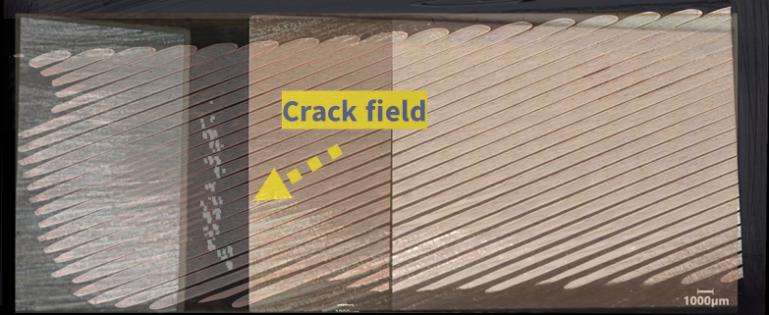
MQXFA13 Analysis II
FE simulations with MQXFA13 coil dimensions showed possible high conductor strain
  Higher strain in MQXFA13 than in nominal case (less friction)
  Higher strain with lower prestress
Broken filaments found where predicted by FE
  Metallographic investigation by CERN team
doc-4958 and on review website
MQXFA13 coil arc-length error
Relative differences are more relevant than absolute numbers because of mesh size and de-bonding assumptions
Courtesy of A. Bartkowska

Slide 6
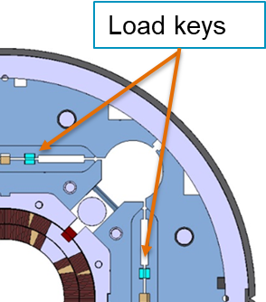
MQXFA13: Preventive Actions I
Lesson learned: if coil ends are “too small” ➔ risk of excessive strain with low pre-stress
Preventive Actions:
Added specs for coil dimensions in the critical region to MQXFA Coil Specs (doc-2986):
  Locations in Lead End & Return End for CMM measurements
  Spec for maximum acceptable Delta btw CMM in LE/RE end and average in straight section
Changes in MQXFA magnet Specs (doc-4009):
  Increased max acceptable stress during bladder op.: 110 ➔ 120 MPa
    MQXFS7 remained above 85% SSL up to 190 MPa (see back up slides)
  Defined process to compute minimum load-keys size based on coils CMM for each magnet,
    Targeting higher prestress controlled by strain gauges and load keys

Slide 7
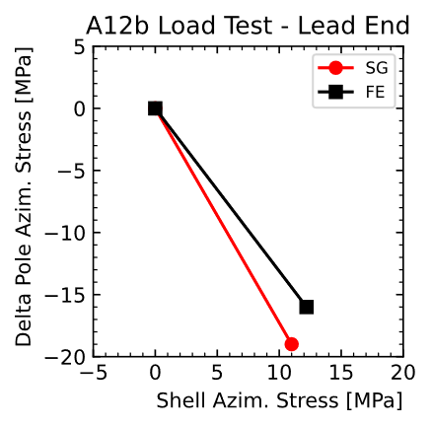
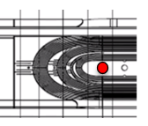
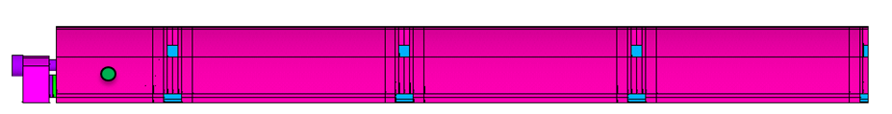
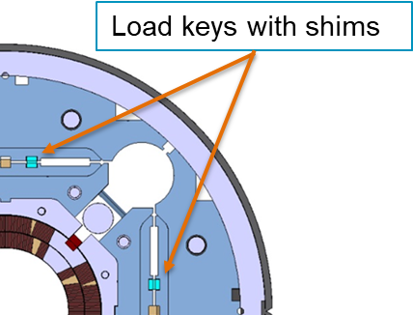
MQXFA13: Preventive Actions II
Developed tapered load shims to compensate coils with small ends. Tested during MQXFA12b loading
Delta stress on gauges @ pole tip:
measured (SG) vs computed (FE)
W/o tapered shims
W tapered shims
Procuring bladders for yoke holes (CERN-style)
  Allowing higher preload without overshoot during bladder operation

Slide 8
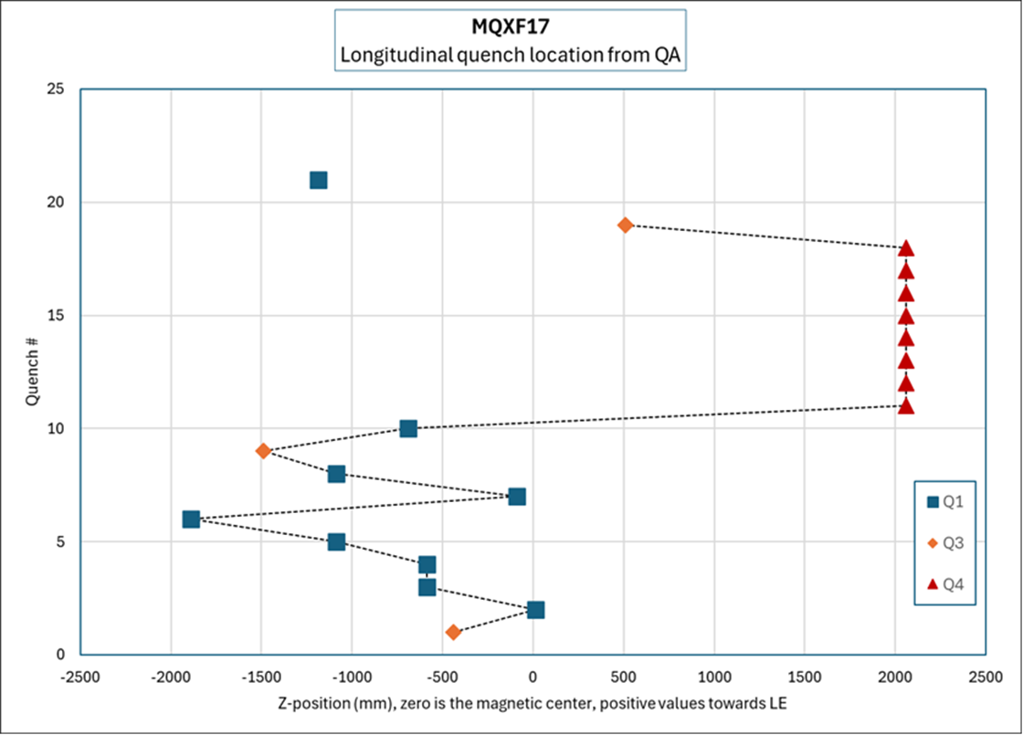
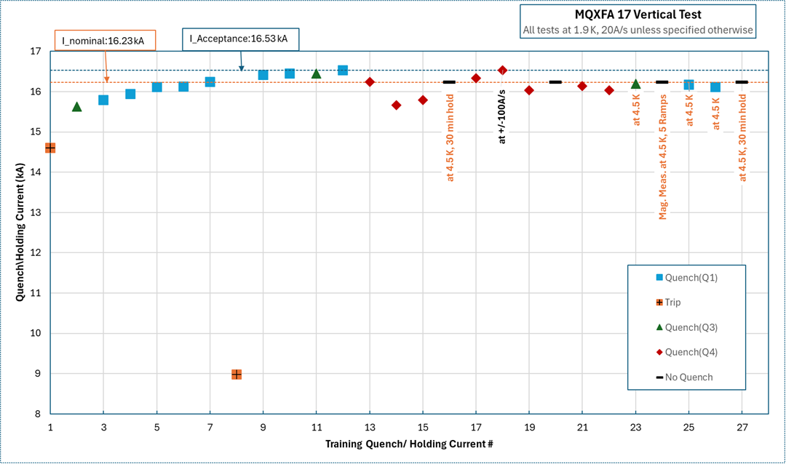
MQXFA17 Analysis I
MQXFA17 showed detraining and degradation in a single coil during vertical test
  Quench location (Lead End) similar to MQXFA13
  Inverse temperature and ramp-rate dependence
Analysis, in progress, has found 3 factors
  Main factor: low prestress in the lead end
  Possible contributing factors: “CLIQ forces”, and variations in coil properties
MQXFA17 Test sequence

Slide 9
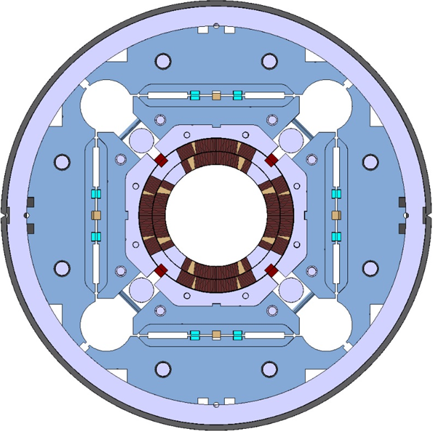
MQXFA17 Analysis II
Main factor: low prestress in lead end
  Actual load keys (39 mil) < Target load keys (43 mil)
    One coil gauge reached max allowable stress (120 MPa) during bladder operation.
    Shell and Coil averages were also close to the max of their spec ranges
    MQXFA magnet Specs (doc-4009): “If, with such load key shim targets, the coil stress measured in 2+ strain gauges during the loading or during bladder inflation indicate that the coil stress may reach values above the coil stress spec. during subsequent loading steps or at the end of the loading, priority should be given to keeping the coil stress within the specs.”
Load keys
Tapered load shims had not yet been demonstrated

Slide 10
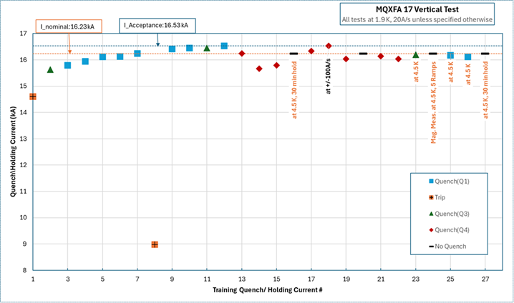
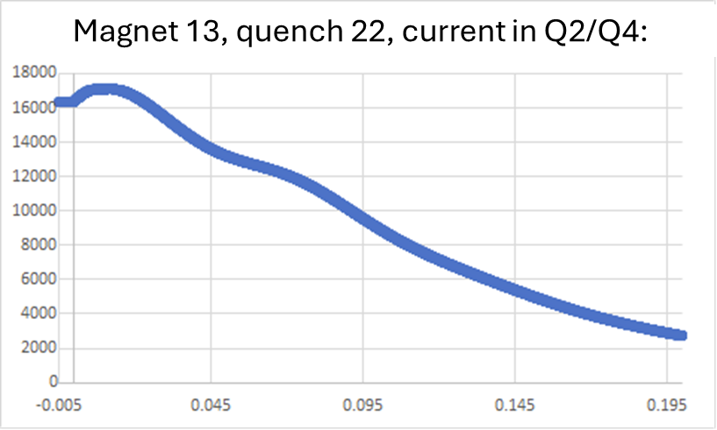
MQXFA17 Analysis III
Other possible factors:
  CLIQ increases currents in Q2 and Q4 coils
    Detraining started after quench at ~acceptance current, and was preceded by 4 quenches at higher current
  Analysis of differences among coils is in progress
Current boost by CLIQ
S. Stoynev et al., "Effect of CLIQ on Training of HL-LHC Quadrupole Magnets," in IEEE TAS., vol. 34, no. 5, Aug. 2024, Art no. 4900606,

Slide 11
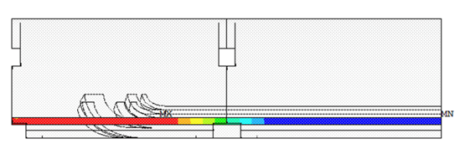
MQXFA17 Preventive Actions
We will use tapered load shims in the lead end of future magnets, as needed:
  FE analysis will be done using coil CMM data, planned coil shims and tapered load shims, prior to use.
  Strain gauges will be added to each Lead End coil tip and on shell 1
  The strain gauges on shell 1 will be connected for reading during vertical test (in place of SG on shell 2)
First magnets to use Tapered Load Shims: MQXFA12b (retrofit), MQXFA17b (re-assembly), MQXFA18 (new assembly)
Load keys with shims
+ 100 μm + 0 μm
Tapered load shims in Lead End

Slide 12
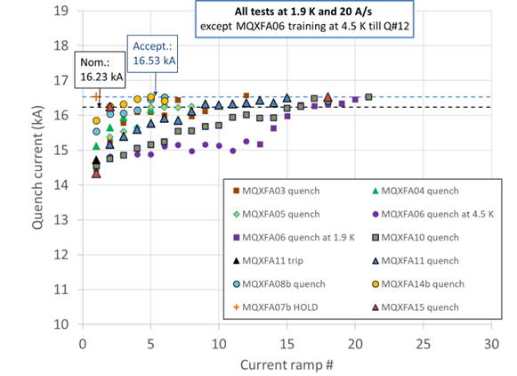
302.2.01: Magnet Integration & Coordination
Coil and Magnet shipments:
  90+ shipments: no coil/magnet damage
  Accelerometer data analysis for all shipments
Magnet Post-Test Analysis:
10 magnets (MQXFA03/4/5/6/7b/8b/10/11/14/15) met requirements during vertical test
  MQXFA05 passed an Endurance Test
  MQXFA11 demonstrated resilience after highway crash
4 magnets (MQXFA07/8/13/17) did not meet requirements:
  67% COVID attribution for MQXFA07/8 issues
  Design changes and specification changes implementing lessons learned
  MQXFA07b and 08b met requirements after changing the limiting coil
  MQXFA13 and 17 to be tested after changing the limiting coil
Talk “Magnets 302.2.01 - Integration, Coordination, and Shipments”
Test yield w/o Covid impact: 79.0%
Original yield in Baseline: 83.3%
Yield of future magnets (BL & EAC): 84.6%
Risk RT-302-2-01-003 about magnet yield was increased after MQXFA17 issue
Risks will be presented in Talk “Magnets 302.2.01 - Integration, Coordination, and Shipments”

Slide 13
302.2.02/03: Strand & Cables
Strand inventory:
  Strand for one cable is available
  60 km (for three cables) to be replaced by BOST:
    25 km by August
    35 km in December 2024
  40 km (for 2 cables): Waiting for bid
Cable Yield:
  95.6% vs. 90% assumed in Baseline at AUP start
Cable inventory:
  One insulated cable

Slide 14
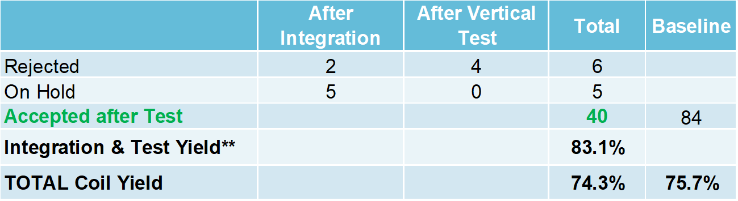
302.2.05/06: Coil Fabrication at FNAL/BNL
Simple Coil Fabrication Yield
  Coils on hold: The number of coils on hold expected to be used is the sum of the probabilities of using each coil on hold (0%, 25%, 50%, 75%).
  **Integration and test yield computed after removing Covid impact
MQXFA15 has 3 coils that were previously on hold

Slide 15
Coils needed to complete all magnets
Fabrication of one coil was added to the manual EAC after MQXFA17 issue
We have conductor and parts to add more coils, if needed

Slide 16
302.2.04: Coil Parts for additional coils if needed
Item | Inventory | In procurement | Status
Pole parts | 4 sets | -
End parts | 0 | 4 sets | Solid parts received, slits are being added, coting to be done
Wedges | 17 sets | -
QH traces | 1 | 4 by CERN | Have been shipped to FNAL
  All other components are available or can be procured quickly (consumable with short shelf life)
  Additional pole & end parts may be salvaged from rejected coils after burning the epoxy

Slide 17
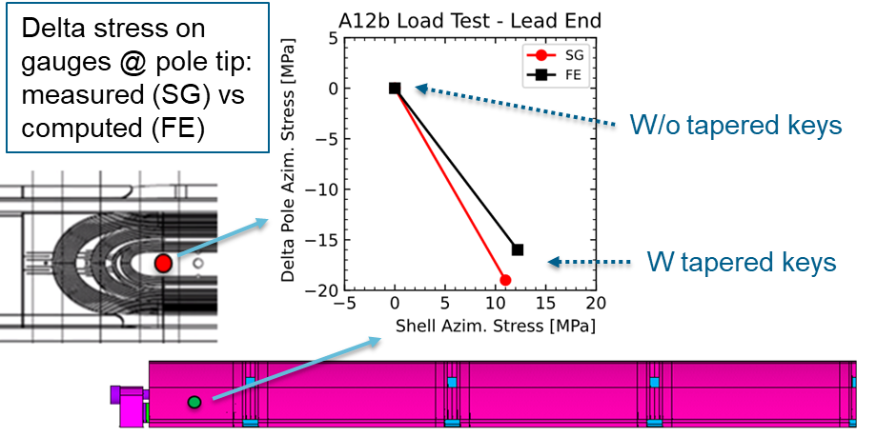
302.2.07: MQXFA Structures and Assembly
Structure procurement is complete (except a few spare parts).
Magnet assembly is at peak production with two assembly lines fully operational
19 MQXFA magnets assembled (MQXFA03-17, 7b, 8b, 13b, 12b):
  MQXFA12b: used to test insertion of tapered load shims
    Tapered load shims were inserted in the Lead End at ½ preload and removed to test the procedure.
    Data from additional gauges were analyzed ➔ very good agreement with FE
FMEA through all magnet assembly travelers to address integration issues (first round done, second in progress)
  MQXFA16 is at FNAL
  MQXFA13b and MQXFA12b are at BNL
Talk “Magnets 302.2.07 - Magnet Assembly at LBNL”

Slide 18
WBS 302.2: Summary
Magnet scope is 94% complete and some CAs have completed discrete activities
Magnet assembly is at peak production rate
Coil yield is slightly below Baseline assumptions
  We added 1 cable and 1 coil fabrication to the manual EAC
  We have parts for 4 coils, and we will have conductor for 7.
Magnet yield is below Baseline assumptions
  We added 1 magnet re-assembly to the manual EAC
  We are implementing lessons learned and doing design changes to prevent issues during magnet tests
We are confident to complete magnet scope within budget and schedule

Slide 19
Backup Slides

Slide 20
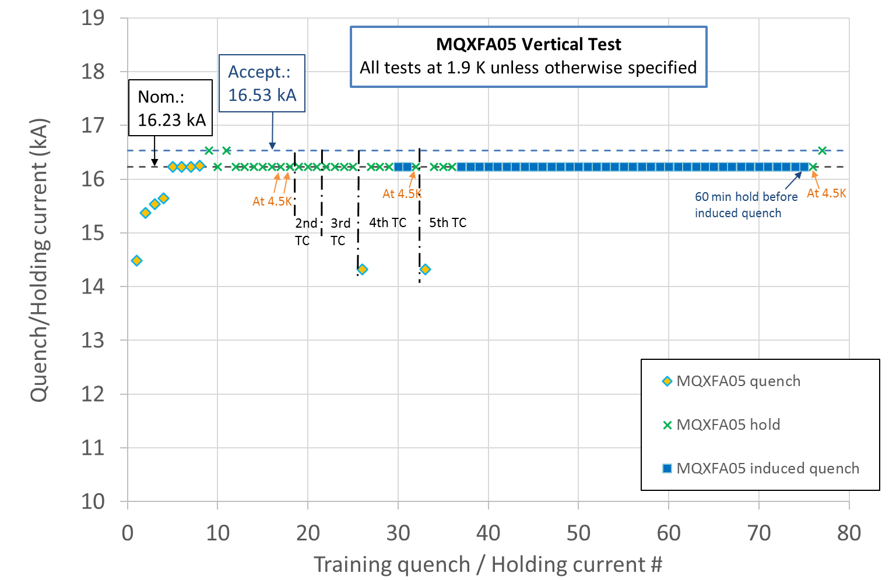
Endurance Tests
Previous endurance tests were successfully performed on short models
MQXFA05 met requirements after 5 thermal cycles, 52 quenches and 79 powering cycles
5 Thermal cycles
52 quenches (10 spontaneous + 42 induced)
79 power cycles (52 quenches + 27 cycles w/o quench) above 10 kA.

Slide 21
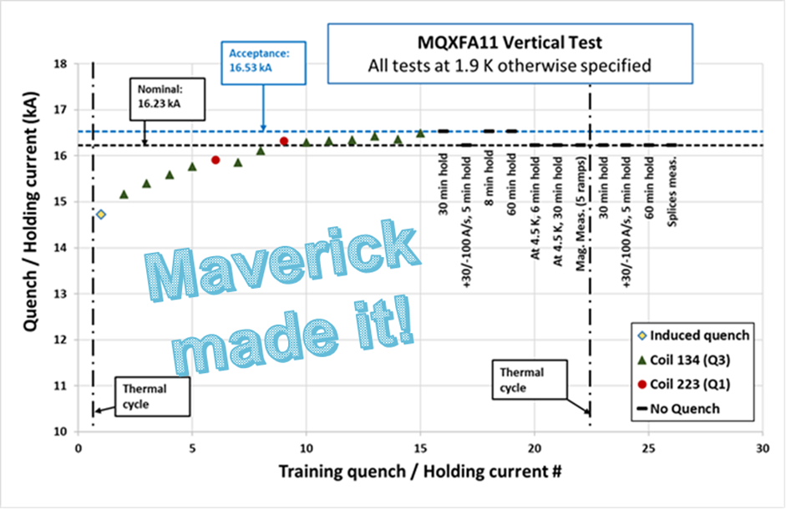
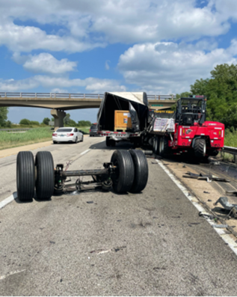
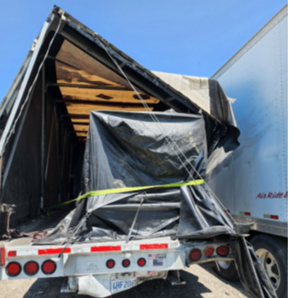

MQXFA11 truck incident
The truck transporting the MQXFA11 magnet from LBNL to BNL was rear ended by another truck on 7/20/22.
The main hit took place on the right back corner. During the incident the truck rear axle disengaged as displayed below.
The magnet was moved to FNAL on 7/28/22. Upon arrival a visual inspection was performed followed by electrical checkout, metrology survey, analysis of the fiber optic sensors and accelerometer data analysis
  Max shock: 6 or 10 g vertical (depending on the device in the same accelerometer unit)
  Duration: 5 ms
All tests and analyses were OK. Magnet was shipped to BNL
No Personal Injury to driver

Slide 22
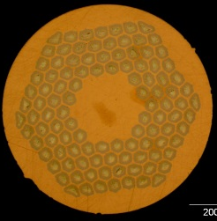
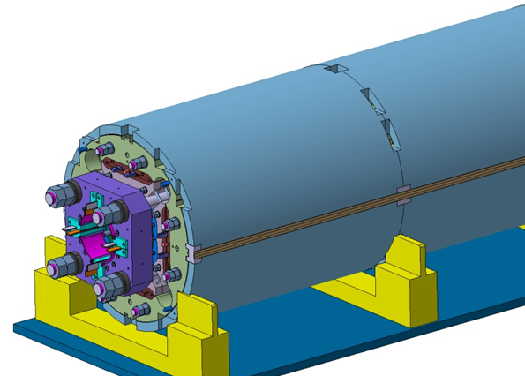
MQXFA Design
Parameter | Unit | MQXFA
Coil aperture | mm | 150
Magnetic length | m | 4.2
N. of layers |  | 2
N. of turns Inner-Outer layer |  | 22-28
Operation temperature | K | 1.9
Nominal gradient | T/m | 132.2
Nominal current | kA | 16.23
Peak field at nom. current | T | 11.3
Short Sample Limit |  | 76%
Stored energy at nom. curr. | MJ/m | 1.15
Diff. inductance | mH/m | 8.26
Strand diameter | mm | 0.85
Strand number |  | 40
Cable width | mm | 18.15
Cable mid thickness | mm | 1.525
Keystone angle |  | 0.4
Design stable since Jan 2016
with a few minor DCRs approved
Nb₃Sn Conductor
B-OST RRP
P. Ferracin et al., “Development of MQXF, the Nb₃Sn Low-β Quadrupole for the HiLumi LHC ” IEEE Trans App. Supercond. Vol. 26, no. 4, 4000207
G. Ambrosio et al., “First Test Results of the 150 mm Aperture IR Quadrupole Models for the High Luminosity LHC” NAPAC16, FERMILAB-CONF-16-440-TD

Slide 23
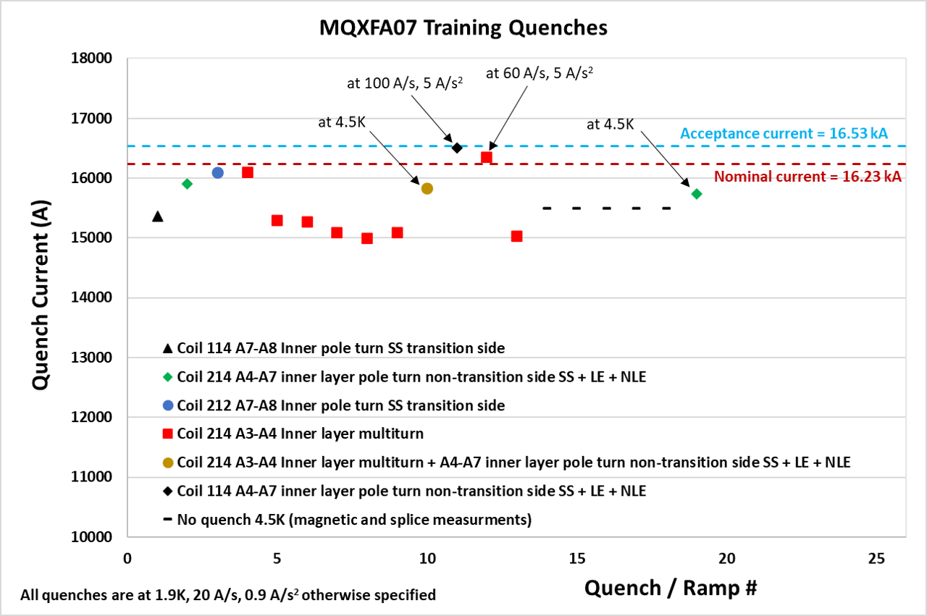
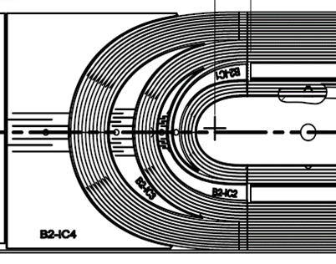
Location based on Quench Antenna and Voltage Taps
Courtesy of J. Muratore and A. Ben Yahia
Reverse temperature dependence
Reverse ramp-rate dependence
Same features and location in MQXFA08

Slide 24
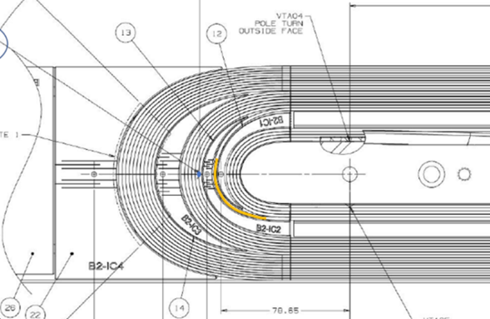
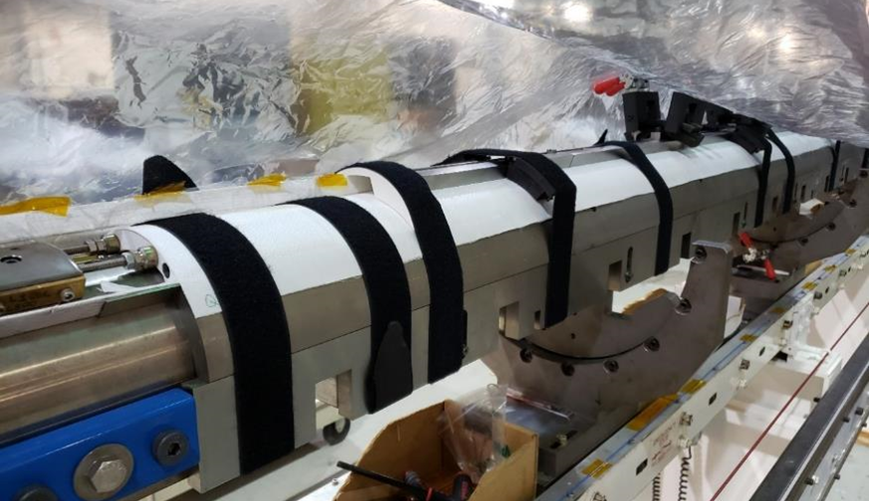
Discrepancies and Non-conformities
Possible causes of local issue:
  Some strands popped out during winding, were fixed, popped out overnight and were fixed a second time (BNL DR AM-164)
  Limiting coil was affected by COVID lockdown
    14 weeks stop after winding & curing of inner layer
  Axial preload had to be removed in order to fix position of end plate (LBNL MQXFA-NCR-0220)
Inner layer coil showing in yellow the position of coil-214 cable affected by DR AM-164
coil 214 as it was setup for the lab shutdown

Slide 25
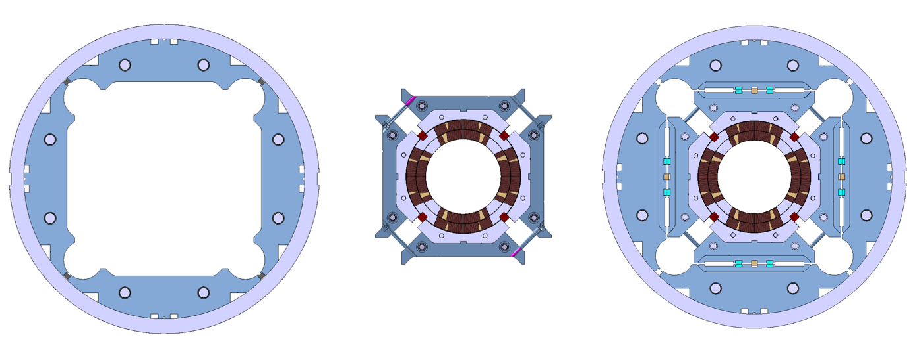
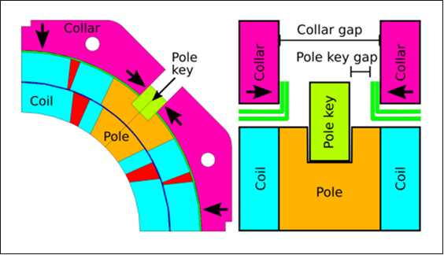
Structure Analysis & MQXFA07 Disassembly
Master
keys
Bladder
location
Yoke
Gap key
Pad
Pole key
Cooling
holes
Collar
Axial rod
location
Load
key
Al shell
A pole-key gap asymmetry was found during MQXFA07 and MQXFA08 disassembly:
- Gaps closed in quadrant 3
- Gaps open in other quadrants
Courtesy of P. Ferracin and D. Cheng

Slide 26
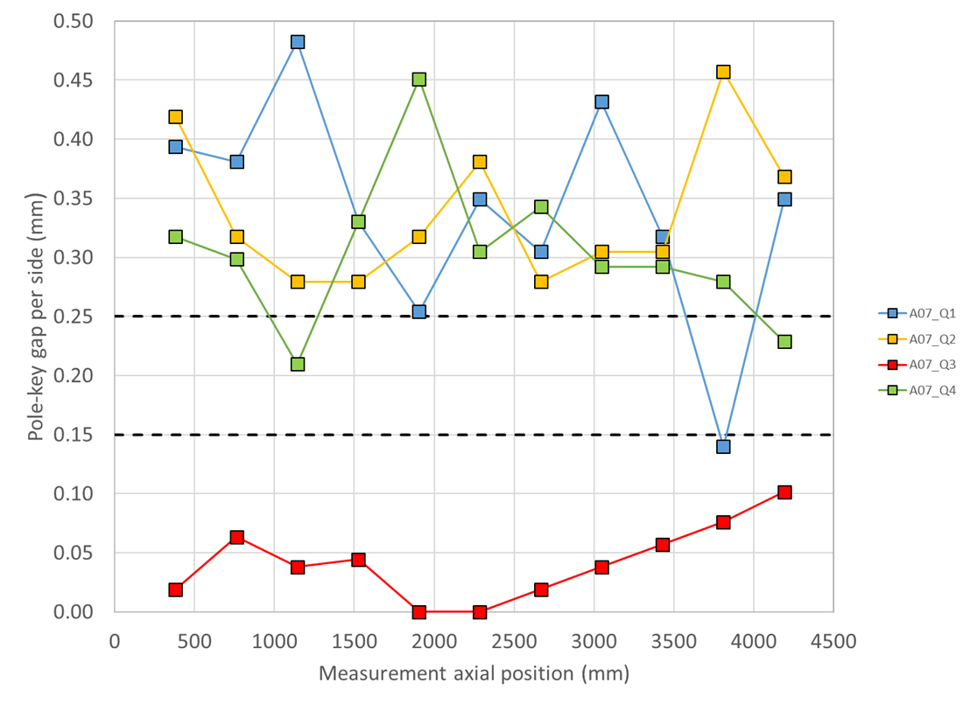
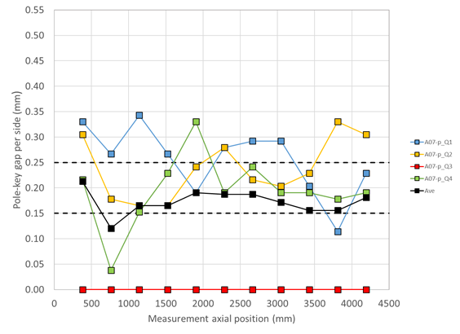
Pole-key gaps in MQXFA07
The measured pole-key gaps were not as uniform in MQXFA07 and MQXFA08 as in past magnets; this is particularly apparent on the limiting coils (Q3 for both magnets)
Only the total average (on the 4 keys) was targeted in the specification. The underlying assumption was that the gaps would be redistributed across coils during loading.
Investigation of the effect of this non-uniformity on the mechanical performances with 2D and 3D FE models
  2D effect: preload variation within acceptable range
LL1
Courtesy of P. Ferracin and D. Cheng

Slide 27
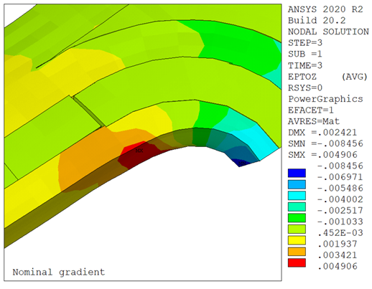
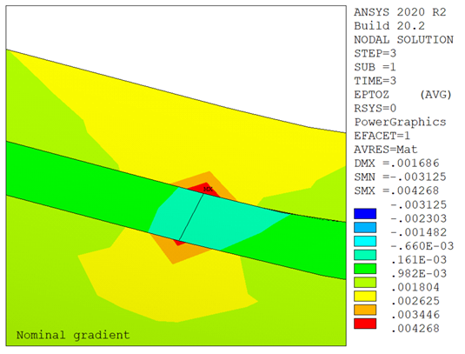
Possible Damage at Wedge-Spacer Interface
At cold the coil with less azimuthal preload ends up with less longitudinal preload
At nominal current tension develops between the inner wedge and the end spacer, and a (small) gap may open
This may result in high longitudinal strain (up to 0.4%) in that location
  This location is consistent with quench data
  Effect is larger on the pole block, but also visible on the mid plane block
LL2
Courtesy of G. Vallone and P. Ferracin

Slide 28
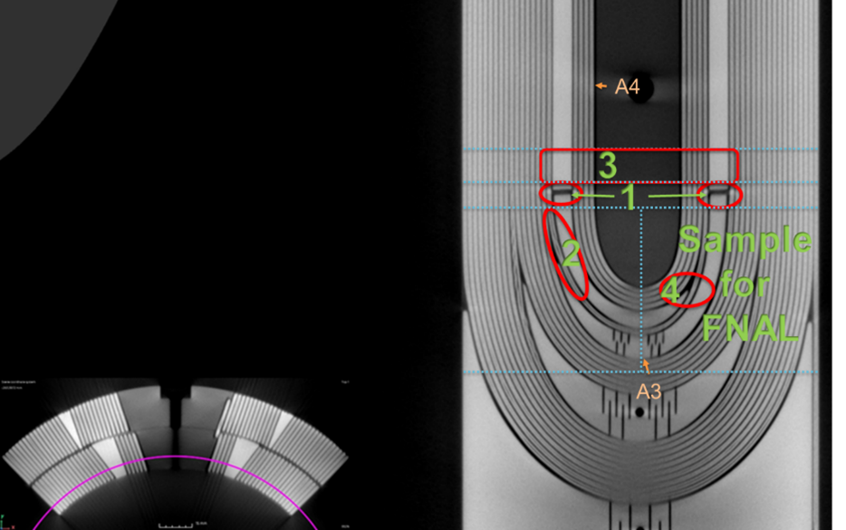
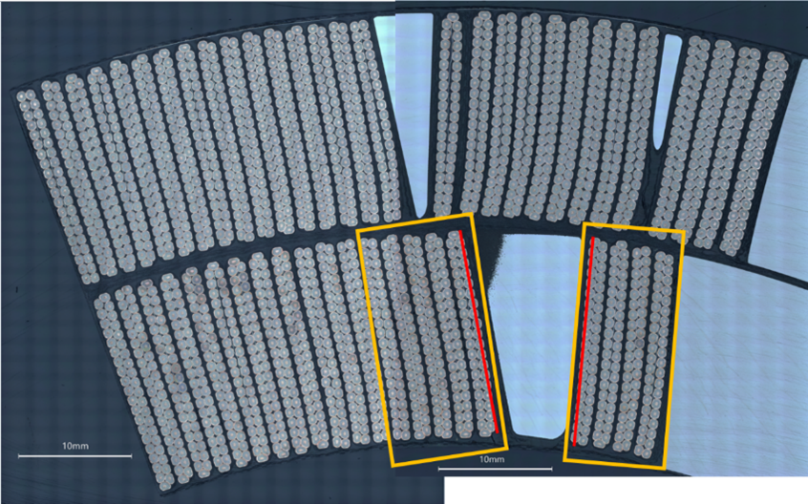
Micrographic Analysis of Coil 214 Lead End
CT-scan, dye-penetrant test and metallurgical analysis by CERN teams
OUTSTANDING!
S. Sgobba et al., “Advanced Examination of Nb₃Sn Coils and Conductors for the LHC luminosity upgrade: Computed Tomography and Materialographic Analyses”, ASC22 paper
Analysis started with sample #1: wedge-spacer interface
By B. Bulat, CERN
No anomalies found in cross-section #1.
Therefore, we did longitudinal sections
By M. Crouvizier, A. Moros, S. Sgobba, CERN

Slide 29
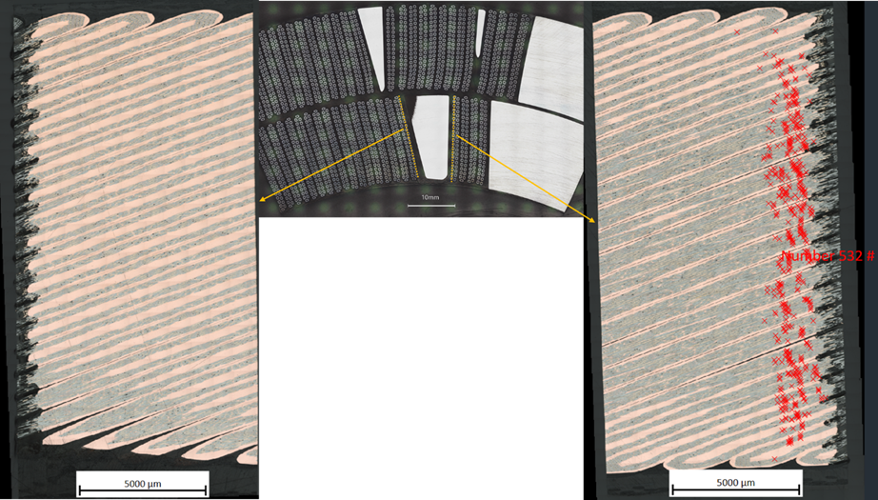
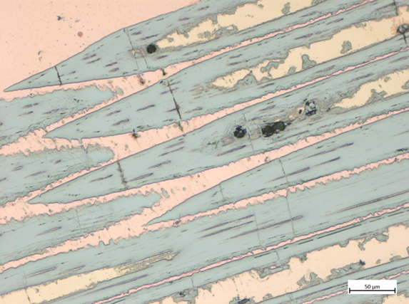
The Smoking Gun!
Each red marker is a broken Nb₃Sn filament

Slide 30
COVID Lockdown Impact on Coil 214
Table: MQXFA coils whose fabrication was interrupted by COVID lockdown. Test status is green if magnet met requirements during vertical test; it is red if it did not meet requirements.
Coil # | Idle time | Status during lockdown | Test status
122 | ~9 weeks | OL impregnation prep, no lead soldering. | Tested in MQXFA06
123 | 11 weeks | Reaction was stopped during first ramp at 76 C. Coil in reaction fixture inside oven. | Tested in MQXFA06
124 | 8 weeks | Coil winding prep mostly complete. 1st turn not wound. | Tested in MQXFA07, will be used in MQXFA07b
211 | ~14 weeks | Impregnated coil. Coil remained closed in the impregnation fixture, hanging in the impregnation tank. | Tested in MQXFA06
212 | ~14 weeks | Reacted coil with leads soldered. Coil stored in the lower half of the reaction fixture, clamped with several form blocks and covered in plastic. | Tested in MQXFA07, will be used in MQXFA07b
213 | ~14 weeks | Reacted coil. Coil remained closed in the reaction fixture, in the oven. | Limiting coil in MQXFA08
214 | ~14 weeks | Inner layer wound and cured. Coil stored on mandrel in winding machine, inner layer pushers bolted in place supporting midplane, numerous Velcro straps securing coil OD and coil ends, coil covered in plastic. | Limiting coil in MQXFA07
Unique condition,
may have weakened wedge-spacer bonding

Slide 31
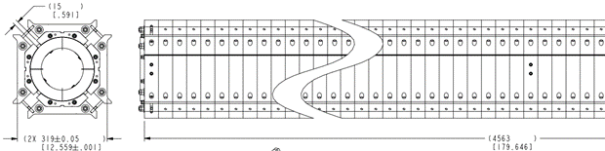
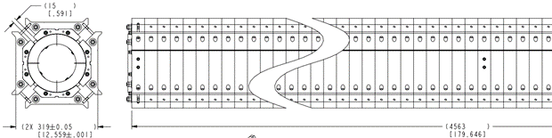


COVID impact on Magnet Assembly
Changes to magnet assembly procedures due to COVID requirements:
#1: change in bolting procedure for increasing tech distance
#2: the technician who had been leading the coil-pack assembly operations up to magnet MQXFA05 was removed from that task (starting from MQXFA06) because not vaccinated.
Before change #1
After change #1

Slide 32
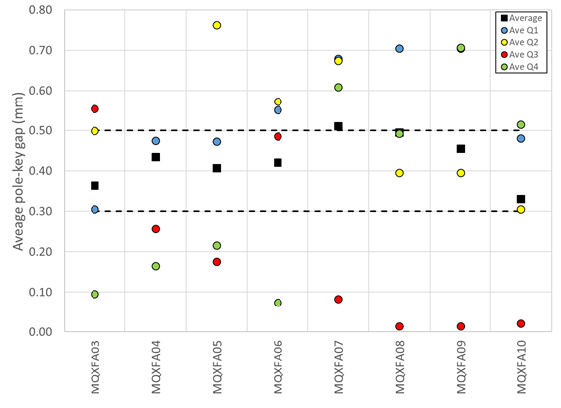
COVID Impact on pole-key gaps
Change #2
COVID lockdown
Change #1
With COVID change #2:
Smaller minimum
“Negative” trends
Fixed after MQXFA08 test
Coil 214 affected by COVID lockdown

Slide 33
Contributing factors
Specs for pole-key gaps
  ➔ Allowed non-uniform pole-key gaps
Changes to assembly procedures caused by COVID requirements
  ➔increased probability of non-uniform pole-key gaps, and possibly other magnet-magnet differences
COVID lockdown
  ➔ Stop in fabrication of coil 214 after Inner-Layer was cured may have weakened wedge-spacer bond
Less supervision caused by COVID
  ➔ increased probability of non-uniform pole-key gaps and other differences.
1/3
1/3
1/6
1/6
COVID share = 67%

Slide 34
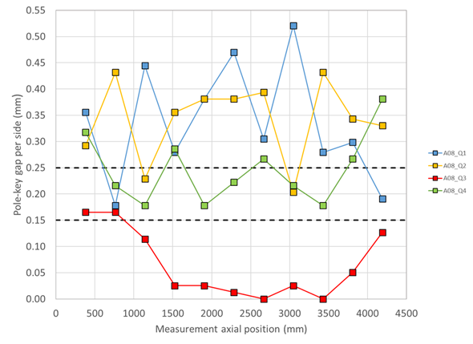

MQXFA07/A08: Preventive Actions
Design change for larger pole-key gaps (doc-4304):
  From 200 μm to 400 μm - average pole key gap per side
Added spec for minimum gap on each coil at each longitudinal location: 300 μm per side
  MQXFA Series Magnet Production Spec. (doc-4009)
Revised magnet assembly traveler to assure coil-pack squareness and uniform gaps
D. Cheng et al., “The challenges and solutions of meeting the assembly specifications for the 4.5 m long MQXFA magnets for the Hi-Luminosity LHC” IEEE TAS, 2023, vol. 33, issue 5, id. 3260766
MQXFA08 Pole-key gaps
Courtesy of P. Ferracin
MQXFA17 Pole-key gaps

Slide 35
HL-LHC MQXF results and lessons learnt
Paolo Ferracin, Giorgio Ambrosio, Susana Izquierdo Bermudez, Ezio Todesco
on behalf of the MQXF collaboration
FCC Week 2024
San Francisco, CA, USA
June 10-14, 2024

Slide 36


MQXFS: pre-stress limits
Impact of pre-stress at 1.9 K on maximum current studied with MQXFS7 (PIT and RRP)
  Some degradation appears in the PIT conductor in the 170-190 MPa range
  No degradation observe in RRP up to 190 MPa in the 85% of I_{ss} level
  Magnet above ultimate (and above 85% of I_{ss}) after 150 quenches, 600 power cycles, 14 thermal cycles, many re-loads up to 190 MPa
-116 MPa
-148 MPa
-116 MPa
-148 MPa
-116 MPa
-171 MPa
-190 MPa
-90 MPa
-129 MPa
-171 MPa
-190 MPa
-90 MPa

