Slide 1


Magnets 302.2.07 - Structure Fabrications and Magnet Assembly at LBNL
Soren Prestemon – LBNL (L3/CAM)
Dan Cheng - LBNL (Deputy L3)
HL-LHC AUP DOE IPR – July 23rd–25th 2024

Slide 2
Outline
Scope, Interfaces, Dependencies & Team
Achievements since Rebaseline Review
Procurement Status
Schedule
Cost and Schedule Performance & VAR Reports
BCRs since Rebaseline Review
Estimate at Completion and EAC Manual Adjustments
QA/QC
Risks
ES&H
Summary

Slide 3
WBS 302.2.07: Scope and Interfaces
Charge #2
Scope of Work
Re-assemble magnet prototype MQXFAP1b, fabricate 5 pre-series magnets (from MQXFA-03 to MQXFA-07), fabricate 16 MQXFA series production magnets, and re-assemble 5 MQXFA magnets . Scope includes:
Parts procurement for 21 magnet structures (shell, Yoke, masters, pads, collars, axial support components, keys, strain gauges and wires)
27 magnet assemblies (1 prototype re-assembly, 5 pre-series, 16 series production, and 5 re-assemblies). Assembly includes install strain gauges on shells, Fabricate Yoke/Shell subassemblies. Receive and check coils, perform CMM measurements and prepare coils for magnet assembly. Assemble collar packs and coil packs. Insert coil packs, setup bladders, and perform azimuthal and axial preload, and conduct electrical QC
Prepare for shipment and ship the magnet assembly to BNL for vertical testing or to FNAL for cold-mass assembly.
Scope Assumptions/Exclusions
Fabrication of magnet prototype MQXFAP1 is off-project (by LARP), only MQXFAP1b re-work is on project.
One set of magnet fabrication tooling is available from LARP, installed and fully functional in LBNL Building B77a.
4 of the 16 series magnets and one out of 5 pre-series magnets are assumed to be re-worked before passing acceptance test. Parts are assumed to be re-used for this re-work.

Slide 4
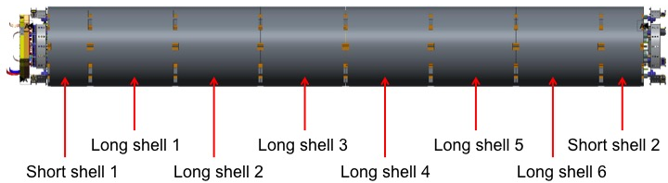
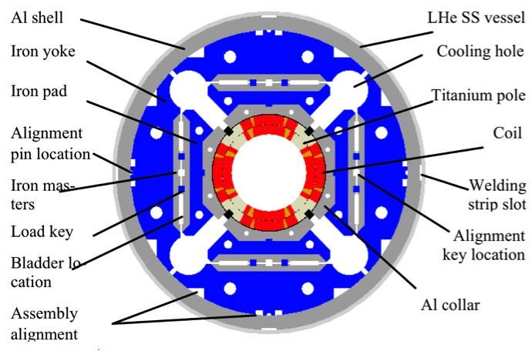
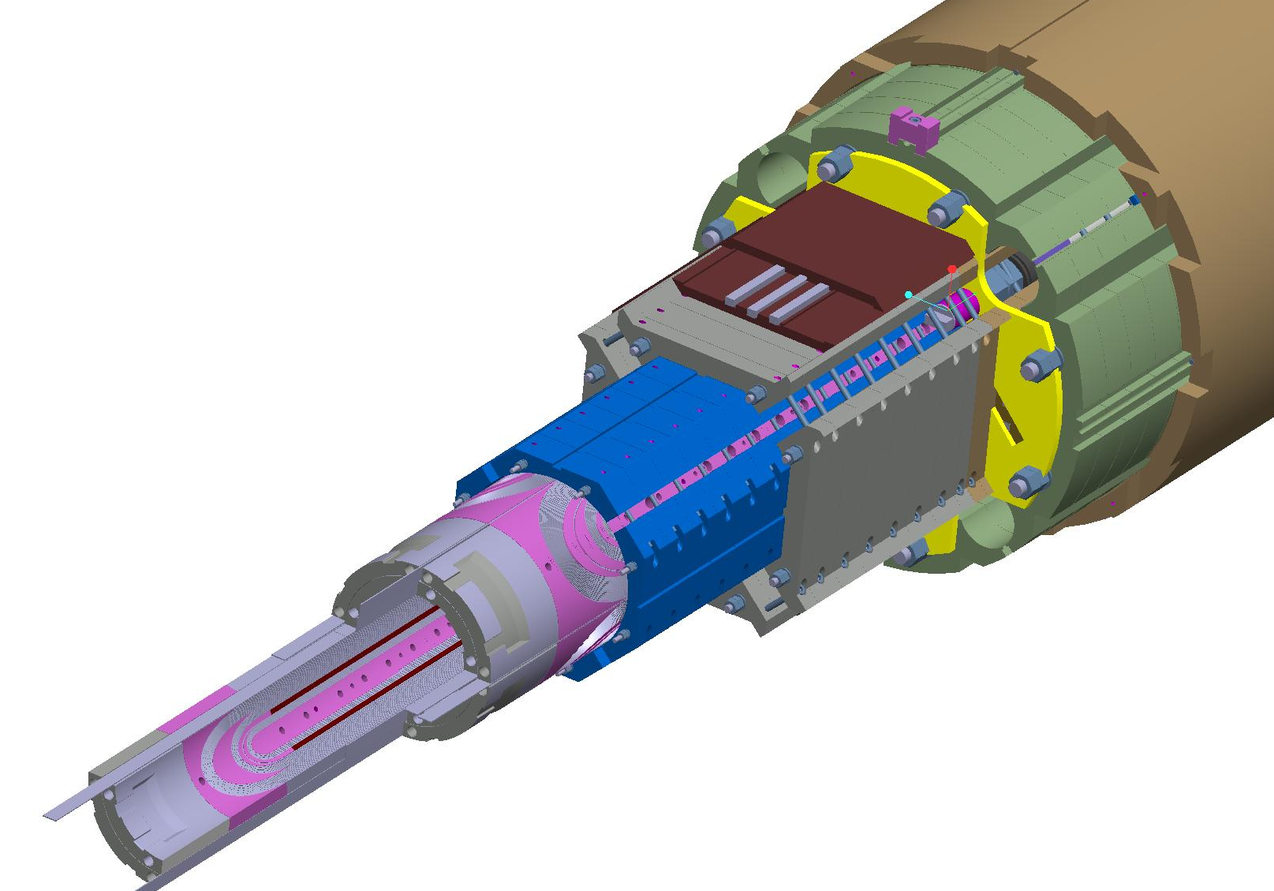
WBS 302.2.07: Overview of deliverables

Slide 5
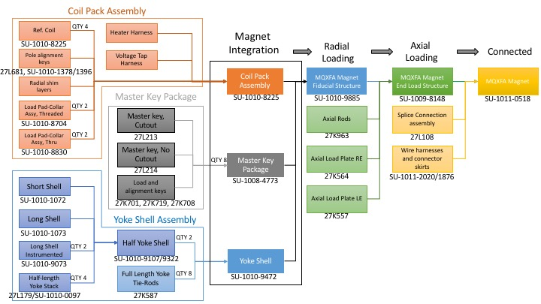
WBS 302.2.07: Work Flow and Interfaces
Charge #9
Coils from FNAL
302.2.05
Coils from BNL
302.2.06
Coil components
302.2.04
Magnet shipped to BNL
302.4.1
US-HiLumi-doc-252
US-HiLumi-doc-309
US-HiLumi-doc-273
US-HiLumi-doc-321
Fiducialization Data to FNAL
302.4.02
US-HiLumi-doc-216
5

Slide 6
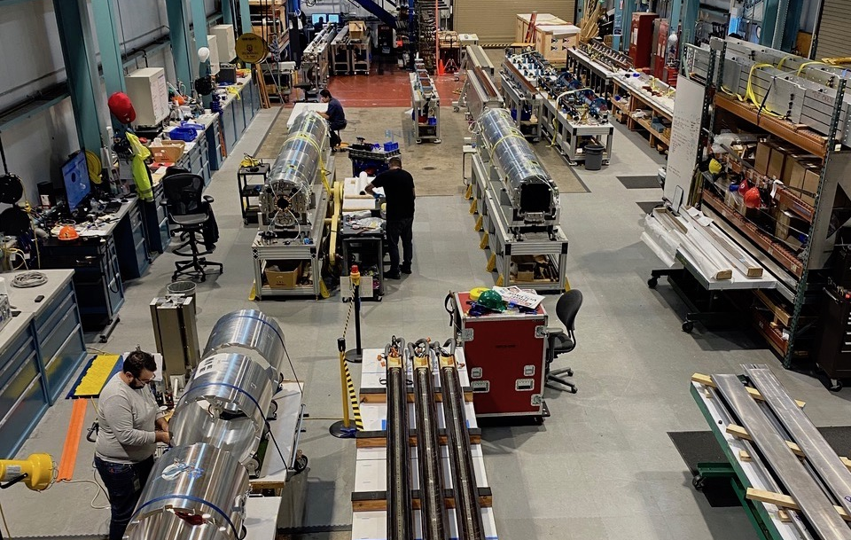
Work flow enabled by two assembly lines

Slide 7
WBS Deliverables & Yield Assumptions
WBS Deliverables
  Re-assembled prototype magnet MQXFAP1b, 21 accepted production MQXFA magnets with their corresponding QC reports.
Yield Assumptions:
  5 magnets (4 of the 16 series magnets and one out of 5 pre-series magnets) are assumed to be re-worked before passing acceptance test. Parts are assumed to be re-used for this re-work.

Slide 8
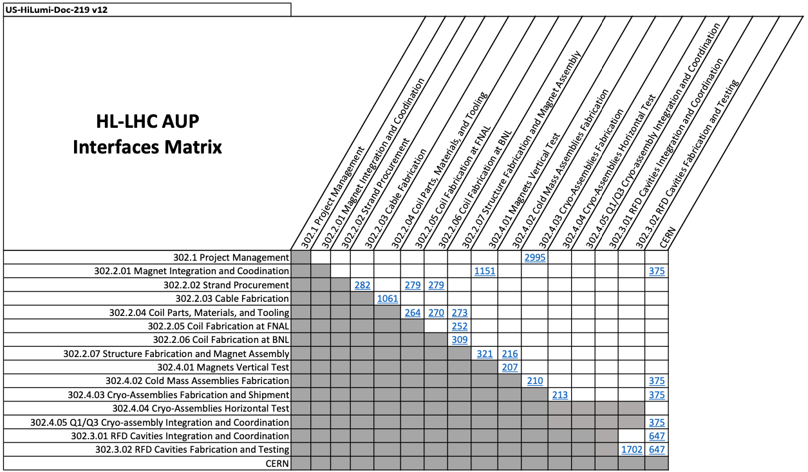
Interfaces with incoming coils and with magnet testing
Charge #9

Slide 9
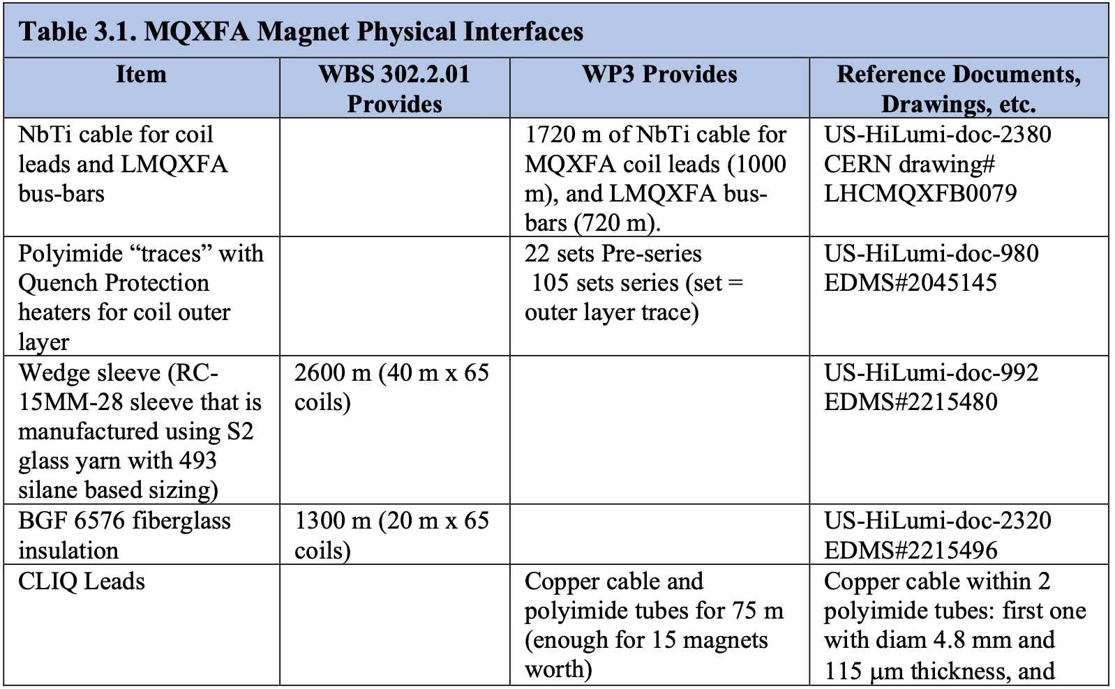
WBS 302.2.07: External Dependencies
Charge #6 & #9
Original CLIQ leads were provided by CERN (see interface control document US-HiLumi-doc-375); described in US-HiLumi-doc-998
In August 2022 a modified procedure was defined
  Described in US-HiLumi-doc-4328
    Based on CERN version of the assembly procedure (EDMS 2772060)
  ICD US-HiLumi-doc-375 has been updated
  CLIQ lead spec US-HiLumi-doc-998 has been updated
All CLIQ lead material provided and delivered from CERN; installation at LBNL per doc-4328

Slide 10
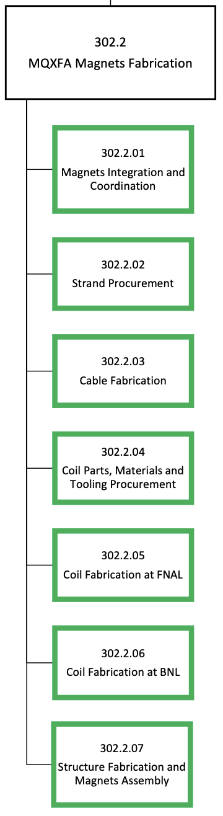
WBS 302.2.07: Team
Charge #4
Very established team
Soren Prestemon, L3 Manager
Dan Cheng, Deputy L3 Manager
Paolo Ferracin, Deputy L2 Manager
Laura Garcia Fajardo, L4 Instrumentation
Giorgio Vallone, L4 Structure Analysis
QA:
Jennifer Doyle
Katherine Ray
Mike Solis (also procurements)
Technicians:
Joshua Herrera, lead
Juan Rodriguez
Jonathan Hekmat
Matt Reynolds
Pardeep Chahal
Banzragch Purevdorj
Bob Memmo (Electrical)
Full staffing level:
Cross-training to avoid potential bottlenecks or single-point failures
Two recent tech hires developing well

Slide 11
WBS 302.2.07: Achievements since Rebaseline
Charge #1
Completed assembly of all pre-series scope (MQXFA03-A07); assembled series magnets MQXFA08-17
  Reassembled A07b, A08b, A13b due to test results
  Reassembled A14b due to QA/QC during assembly (glass-bead issue)
  Magnet A09 was disassembled; will be renamed A24
Assumptions:
1 of 5 pre-series assumed reworked
4 of 16 series magnets assumed reworked

Slide 12
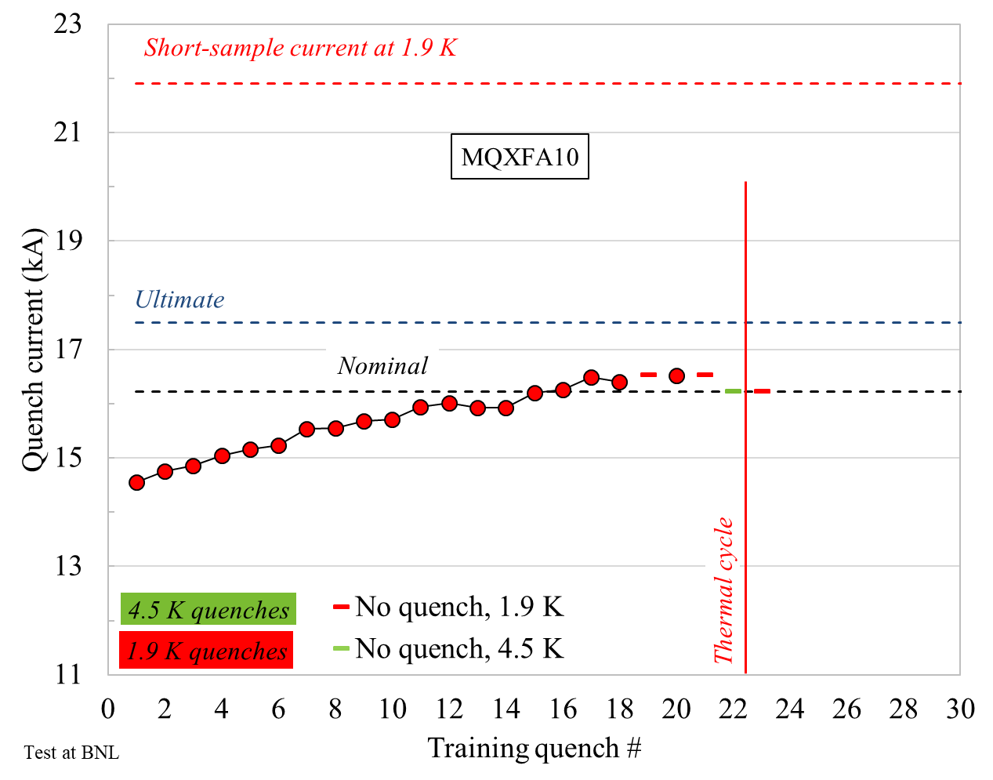
Lesson’s learned from A07 and A08: analysis indicated the need for uniformity of pole gaps
Demonstrated with MQXFA10
Lessons learned and preventive actions were implemented on all magnets going forward

Slide 13
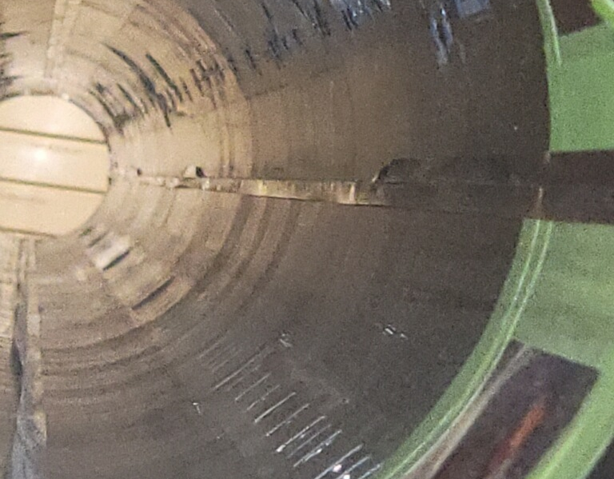
Issues and resolutions: GPI fold in MQXFA09
GPI fold issue in MQXFA09 – NCR-0313 (critical)
  Identified by technician prior to shipment
  Corrective actions:
    change in GPI installation process
    specific inspection in WI during coilpack assembly
  The two associated coils were rejected

Slide 14
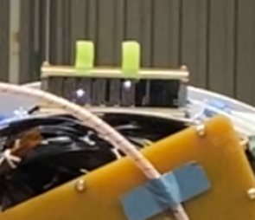
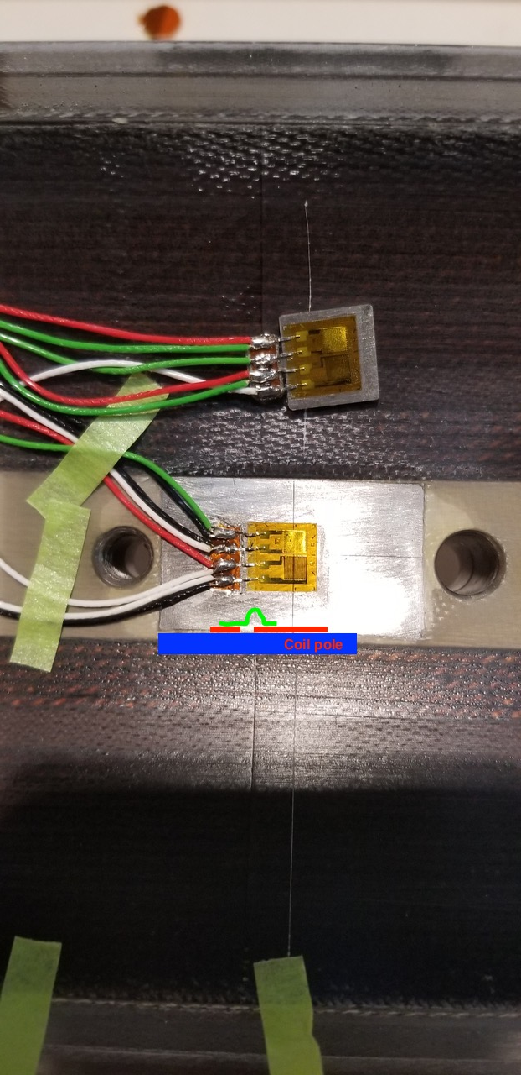
Issues and resolutions: Strain Gauges and Hipot in MQXFA12
Issue discovered during final EQC Hipot of MQXFA12
  revealed potential weakness of SG to coil pole
  Cause: SG pins of coils and shells were mixed on one connector
All tests after MQXFA08b have coil SGs disconnected during final hipot test and magnet test campaign
  Shells and Rods can still be present
  Improved QC and oversight

Slide 15
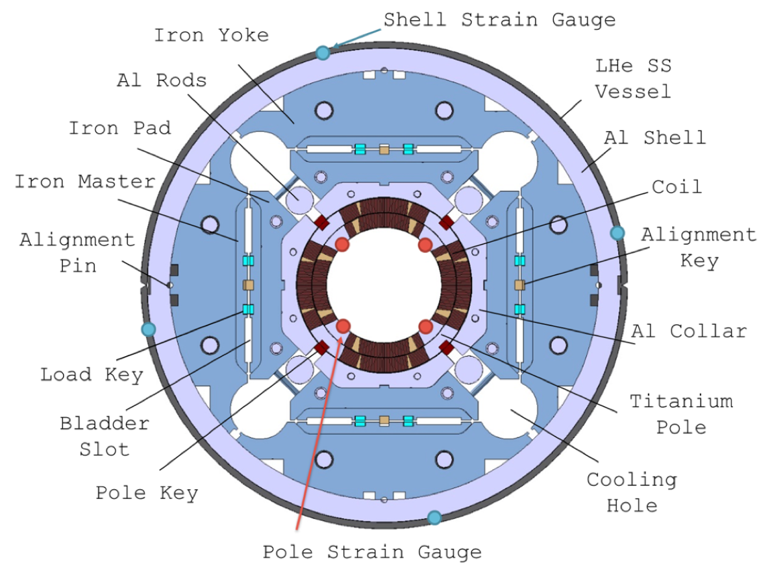
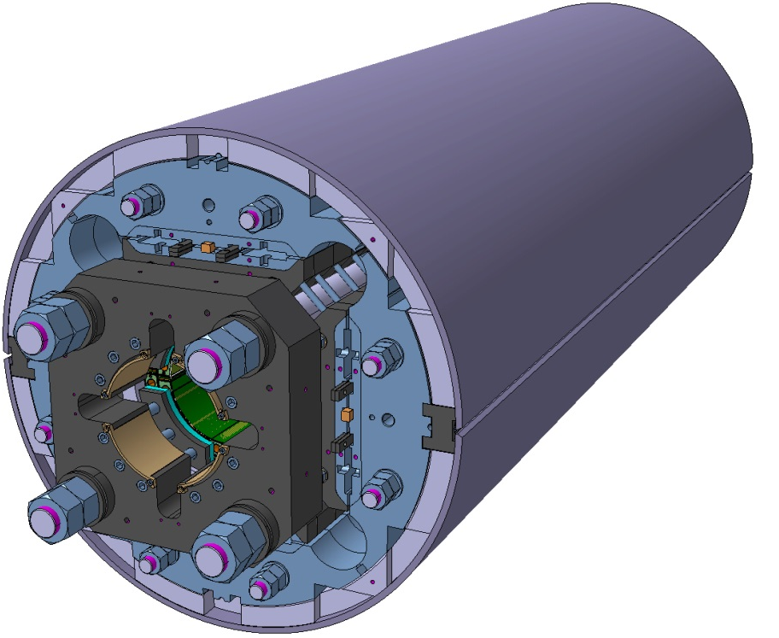
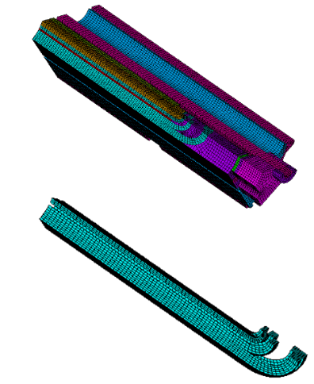
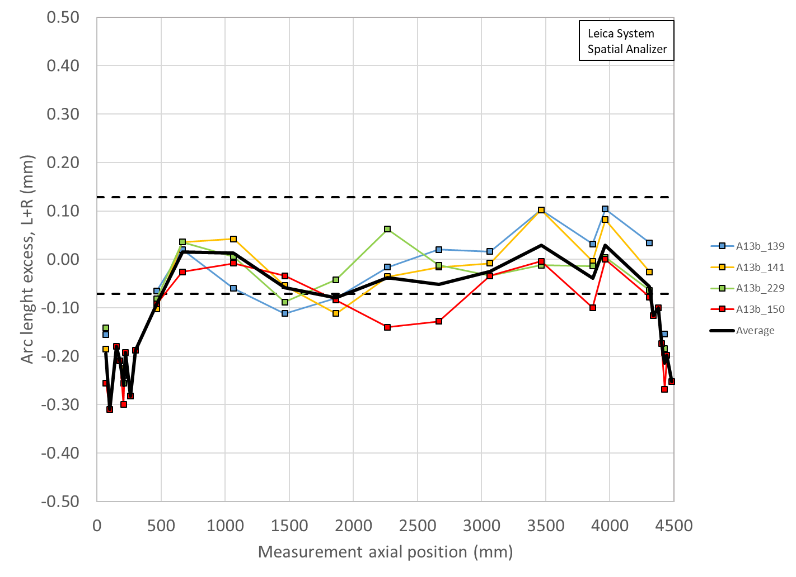
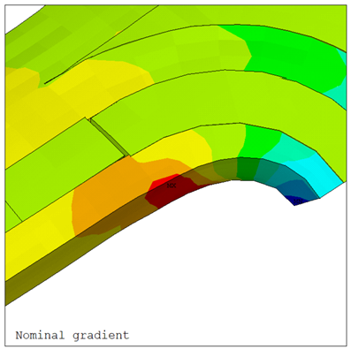
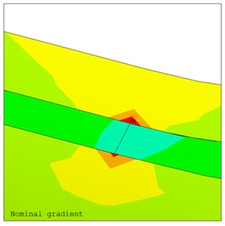
Issues and resolutions: smaller coil ends in MQXFA13
Effect of axial Lorentz forces in the coil end region
By design, axial forces counteracted by end support structure
  axial loading (end-plate) + azimuthal loading (friction with support structure )
Lack of end support caused by
  Pole key interception of azimuthal loading (A07, A08)
  Coil significantly smaller in the end (A13, A17)
High axial strain in turn close to the transition
So far, out of spec magnets fixed with coil replacement and increased pre-load
Solutions:
  Increase overall pre-load (done)
  tapered shims – currently being implemented
    Dedicated testing on MQXFA12b validated approach
    Has also been tested (but not applied) at CERN
    Planned for non-conforming coils
Specification modified (US-HiLumi-doc-4009):
Revised to allow excursion to 120 MPa maximum in coil
At the end of the pre-loading operation, the sum of the loading shim size and the coil-pack radial dimension deviations in straight section, LE and RE shall be within the range achieved in magnets MQXFA14b and MQXFA05

Slide 16
Issues and resolutions: MQXFA14 QH Hipot failure, MQXFA17 splice box issue
Coil 142 developed a hipot failure from QH3 to coil during the EQC after preload
  Glass bead puncture/burn was found upon disassembly
  Replaced with Coil 217 from MQXFA09
Coil fabrication processes no longer use laser-cut fiberglass sheets
During the magnet splice operations on MQXFA17, lack of coordination led to overheating of splice box and damaged G11 requiring repair – NCR 651
Recovery:
  A new CLIQ lead was soldered in
  Standard finishing operations then performed
    Abbreviated EQC: Hipot Coil-Structure, SeqR
Clear single-person assignment of responsible technician for the splice operation

Slide 17
WBS 302.2.07: Procurement Status
Charge #4
Scope: procurement of components for 21 magnet structures
  Completed and all major parts in-hand
  Leveraged “Master Agreement” contracts
    Significant vetting prior to selection of successful vendors
    Orders then placed as needed without re-competing contract
    Avoided major supply chain issues
    Limited project exposure to inflation
  Spare parts procurement approved in BCR348 are currently underway

Slide 18
WBS 302.2.07: Schedule
Charge #2
We have two fully functioning assembly lines to support meeting the schedule
The schedule chart shows parts procurement for 21 structures; the spare-parts procurement schedule from BCR348 is not shown.

Slide 19
WBS 302.2.07: Milestones
Charge #2
T1 & T2 Milestones not complete prior to Rebaselining in March 2023
Activity ID | Milestone Name | PEP Date
T1 Milestones - DOE Program (1 year float)
A205650 | T1:Shipment of 08 Dressed Cavities to TRIUMF Completed | 15-Aug-25
A205660 | T1:Shipment of 10 Dressed Cavities to TRIUMF Completed | 26-Nov-25
A205060 | T1:Shipment Q1/Q3 Cryo Ass'y 08 to CERN Completed | 12-Nov-26
A205070 | T1:Shipment Q1/Q3 Cryo Ass'y 10 to CERN Completed | 13-Aug-27
A204296 | T1:CD-4:Approve Project Completion | 4-Jan-28
T2 Milestones - DOE Federal Project Director (6 months float)
A205320 | T2:Bare Cavities Fab Complete | 26-Jun-24
A205280 | T2:Receipt of Bare Cavity Series | 26-Jun-24
A205350 | T2:Bare Cavities Processing & Test Complete | 18-Nov-24
A205500 | T2:Coil Production Complete | 10-Apr-24
A205410 | T2:Shipment of 08 Dressed Cavities to TRIUMF Completed | 17-Feb-25
A205420 | T2:Dressed Cavities Fab Complete | 17-Mar-25
A205440 | T2:Dressed Cavities Processing & Test Complete | 29-Apr-25
A205470 | T2:Shipment of 10 Dressed Cavities to TRIUMF Completed | 27-May-25
A205490 | T2:Key Performance Parameters for Crab Cavities Achieved | 30-Jul-25
A205530 | T2:Magnet Production Complete | 3-Mar-25
A205570 | T2:Cold Mass Production Complete | 7-Jul-25
A205540 | T2:Shipment Q1/Q3 Cryo Ass'y 08 to CERN Completed | 12-May-26
A205590 | T2:Cryo Ass'y Testing Complete | 17-Dec-26
A205600 | T2:Shipment Q1/Q3 Cryo Ass'y 10 to CERN Completed | 15-Feb-27
A205380 | T2:Shipment Q1/Q3 Cryo Ass'y to CERN Completed | 15-Feb-27
A205640 | T2:Key Performance Parameters for Q1/Q3 Cryo-Assemblies Achieved | 9-Apr-27
A205630 | T2:CD-4:Approve Project Completion | 6-Jul-27

Slide 20

WBS 302.2.07: Cost and Schedule Performance & VAR Reports
Charge #2
Major schedule variances earlier in project stemmed from large procurements and various vendor issues in delivering on schedule
Recent variances typically associated with labor connected with redirection of efforts – examples include:
  To accommodate issues encountered during assembly or magnet testing, e.g. MQXFA13b rework due to magnetic measurements identifying issue
  Overheating of a splice on MQXFA17, requiring additional work to verify issue did not damage splice
  Timely receiving and processing coils when space becomes available

Slide 21

WBS 302.2.07: BCRs Approved Since Baseline
Charge #2
There have been 12 BCR’s since rebaselining that impacted 302.2.07; the dominant ones include:
  BCR348: The project decided to procure specific spare parts for one magnet due to the need to ship magnet MQXFA23to CERN accounting for the non-conformities of MQXFA03 in CA-01.
    The spare parts are needed to ensure the successful completion of the MQXFA fabrication and assembly scope
  BCR344: Adjusted the magnet yield assumption after MQXFA13 to align with experience in magnets up through MQXFA13, consistent with observation.
BCR# | BCR TITLE | Cost Impact | Schedule Impact
BCR311 | AUP Project Rebaseline after March 2023 ESAAB Approval | $275,231 | 182
BCR313 | FY23 BNL and LBNL Rate Adjustments | -$74,524 | 0
BCR315 | Using Vertically Untested Magnets in Cold Mass 05 Rather than Cold Mass 09 | -$1,653 | 0
BCR314 | Shipping and Tariff Charges to Ship Remaining ARMCO Iron from Sicom to LBNL | $47,262 | 0
BCR324 | Disassembly of Magnet MQXFA13 before Assembly of Magnet MQXFA16 | $20,599 | 0
BCR333 | Split Year-long LOE Activities into Quarter-long Activities | $0 | 0
BCR331 | Fabrication of 2 additional Coils and 2 additional Cables | $7,809 | 0
BCR332 | Rework MQXFA15 to Adjust Preload | $98,929 | 0
BCR344 | Additional Magnet Rework | $270,065 | 0
BCR349 | BNL and LBNL FY24 Rate Adjustments | $3,522 | 23
BCR352 | Critical DR on MQXFA-17 and other Schedule Impacts to WBS 302.2 | $147,865 | 68
BCR348 | Magnet Spare Parts Order | $336,126 | 0
BCR359 | ETC - Spring 2024 - Control Account 302.2.07 | $116,924 | 7
TOTAL |  | $1,248,156

Slide 22
WBS 302.2.07: EAC Manual Adjustments
Charge #2
The very recent issue encountered during testing of MQXFA17 led to the following manual EAC adjustment
  A BCR will be processed to account for this additional cost.
WBS | EAC Manual Adjustment Description | Cost ($k)
302.2.07 | Rework of 1 additional magnet to maintain magnet yield assumptions in WBS dictionary | 352

Slide 23

WBS 302.2.07: Estimate at Completion
Charge #2
The variance at complete is currently at ~2.4%
  The variance at completion includes variances to-date as well as manual EAC adjustments
  A magnet rework has been added as manual EAC adjustment has been added for MQXFA17 rework, which we know will be required given the recent test results of the magnet.
    A BCR will be processed in the near future to adjust the BAC accordingly.
  Once the BCR is processed, the VAC will be at ~1.3%

Slide 24
WBS 302.2.07: QA/QC
Charge #3
Area | QC / Work Instructions | QA – MIP element
Coil Selection and Shimming Plan Review | Coil Acceptance WI SU-1011-5294; Coil CMM WI SU-1012-3958 | 1.1
Incoming Shells and Yokes & inspection |  | 2.2
Assemble Yoke Half-Stacks | Yoke Pre-Stack SU-1008-8072; Yoke Half Stack SU-1009-7829 | 2.2
Put strain gauges on shells | Shell Instrumentation SU-1009-3745 | 2.3
Complete Shell-Yoke Assembly | Shell-Yoke Assembly SU-1008-2169 | 2.4
Incoming coil pack assembly parts inspection | Load Pad Pre-Stack SU-1008-8075 | 3.1
Dressed Coil | Dressed Coil SU-1008-8073 | 3.2
Pad Collar Assembly | Pad-Collar Assembly SU-1010-1610 | 3.3
Coil Pack Assembly | Coil Pack Subassembly SU-1008-8074 | 3.4
Coil Pack Electrical Tests | MQXF Magnet Electrical QA at LBNL SU-1010-1903 | 3.5
Coil Pack Magnetic Measurements | Magnetic Meas. SU-1010-2018 | 3.6
Area | QC / Work Instructions | QA – MIP element
Incoming parts inspection (Master Keys, etc.) |  | 4.1
Strain Gauges on Axial Rods | Axial Rods Instrumented SU-1008-8069 | 4.4
Magnet Integration and Loading | MQXFA Loading and Integration WI SU-1011-5637 | 4.5
Post-preload Electrical QC | MQXF Magnet Electrical QA at LBNL SU-1010-1903 | 4.6
Finish Wiring | Connectors and Finishing WI SU-101205517 | 4.7
Assemble Splice Box and verify Bore ID Clearance | Splice Box WI SU-1008-8067 | 4.8
Magnetic Measurements, Fiducial Structure | Magnetic Measurements SU-1010-2018 | 4.10
Final Electrical QC | MQXF Magnet Electrical QA at LBNL SU-1010-1903 | 4.11
Strain Gauge Reading |  | 4.12
Prepare for Shipment |  | 4.13
MIP has been approved by all parties
QC data for each magnet is uploaded to Vector and to the CERN MTF – all magnet data is then available to subsequent WBS elements

Slide 25
WBS 302.2.07 QA/QC process
Charge #3
Detailed tracking sheet is maintained
Monthly reports submitted to L2 and Project QA Manager, as well as regular meetings
  Clear process for informing L2 of an issue and for resolution
  Excellent relations within AUP and with CERN – strong team, very transparent
Snapshot of the Change Record Tracker
In process | MQXFA | ECN | -0691 | Dress master keys to reduce risk of bladdes/magnetic shims getting stuck |  | 4/12/24
Closed, Approved | MQXFA | DEV | -0692 | Splice box first and second layers. Took temp measurements across joint (two points) for all joints |  | 4/5/24
Closed, Approved | MQXFA | NCR | -0693 | Some master keys bowed significantly | Non-critical | 4/9/24
Closed, Approved | MQXFA | NCR | -0693 |  | Non-critical | 4/9/24
Closed, Approved | MQXFA | NCR | -0694 | Radial layer torn on Left pad-collar during shim removal; replaced | Non-critical | 4/12/24
In process | MQXFA | ECN | -0694 | Modify WI steps for shims removal to reduce risk of tearing radial layers - loosen bolts slightly prior to pulling shims if too tight. |  | 4/12/24
Closed, Approved | MQXFA | NCR | -0695 | Axial center alignment off during coil pack build (leading to offsets of 3/8" and 7/8" on LE/RE respectively). Coil pack rebuilt. | Non-critical | 4/17/24
In process | MQXFA | ECN | -0695 | Mark coil center point with thin Sharpie only |  | 4/17/24
Closed, Approved | MQXFA | NCR | -0696 | Final SG pre-shipping readings taken; Q1 Coil (150) FBG has low signals (not broken), so several channels do not read | Non-critical | 4/24/24
Closed, Approved | MQXFA | NCR | -0697 | No rubber shims used when clamping crate brace fixtures, so braces loose and some clamps damaged and need replacement; dirt inside crate; plastic sheet missing | Non-critical | 4/26/24
In process | MQXFA | NCR | -0698 | Full assembly MM harmonic b3 out of spec (followup to coilpack MM NCR-0660) | Non-critical | 4/29/24
In process | MQXFA | DEV | -0699 | Use a stone and long SST brake line to dress burrs inside the load key slots in master keys, along with 0.008" shims. |  | 5/2/24
In process | MQXFA | NCR | -0700 | Reglue G11 layer on RH and LH because dust in glue under Kapton layers; then reglue the G11 pieces on RH and LH due to high spots. | Non-critical | 5/16/24
In process | MQXFA | NCR | -0701 | Protruding epoxy plugs | Non-critical | 5/20/24
In process | MQXFA | NCR | -0702 | 2 Shockwatch indicators tripped, RE PH wires unsecured, epoxy on leads not trimmed to 1/2" | Non-critical | 5/20/24
In process | MQXFA | NCR | -0703 | 3 protruding metal pins in coil keyway | Non-critical | 5/20/24
In process | MQXFA | NCR | -0704 | 35 mm gauge block left in after axial endplate installation, now wedged behind Q4 corner of LE axial end plate | Non-critical | 5/21/24

Slide 26
WBS 302.02.07: Risks
Magnet coil-pack disassembly/reassembly to meet requirements is a risk that has manifested
  Mitigations:
    Improve training of staff to avoid mistakes that require rework
    Properly chosen intermediate QC steps added in the assembly procedures
Bladder pressurizing system failure has occurred
  Mitigation:
    included procurement of a spare system; result was negligible down time
    Original bladder pressurizing system has been repaired, serves as spare
We have systematically performed a PFMEA of our assembly processes
  Reviewed all major Work Instructions with key engineers, technicians, and QA/QC staff from LBNL and FNAL
  Resulting discussions led to improvements in our WI documents and in our training of new staff on the project
RI-ID | Title | Risk Rank
RT-302-2-07-007 | Magnet coil-pack disassembly and reassembly needed to meet the requirements | 2 (Medium)
RT-302-2-07-002 | Bladder pressurizing system failure | 1 (Low)

Slide 27
WBS 302.2.07: ES&H
Charge #10
We have regular LBNL HL-LHC AUP EH&S meetings
Meeting agenda’s and notes are shared regularly with FNAL Project EH&S Manager Amy Pavnica
Excellent safety record to-date
Crane failed in assembly area:
  Failure mode did not jeopardize safety of equipment or personnel
  Resulted in halt of use until inspected and operation recovered
  Spare parts were procured, and maintenance performed
The PFMEA of our assembly processes identified improvements in safety, and in staff training

Slide 28
WBS 302.2.07: Summary
Our processes are mature & well documented
We have encountered issues, leading to lessons-learned and improvements in our procedures, QC, and oversight
We are deep into full production, with two production lines operating and a full compliment of technical staff
We are managing cost and schedule for this large WBS as planned by the project

Slide 29
Backup Slides

Slide 30
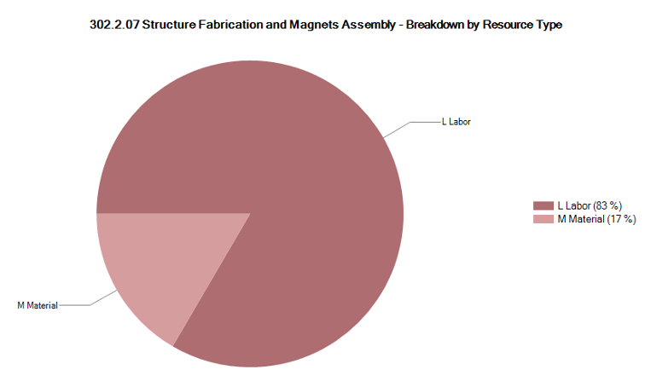
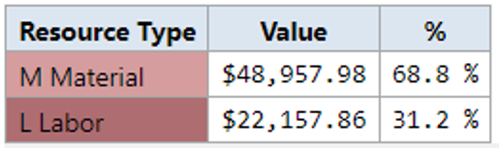
302.2.07 Resource Type Breakdown
Charge #2
Lab
Logo

Slide 31
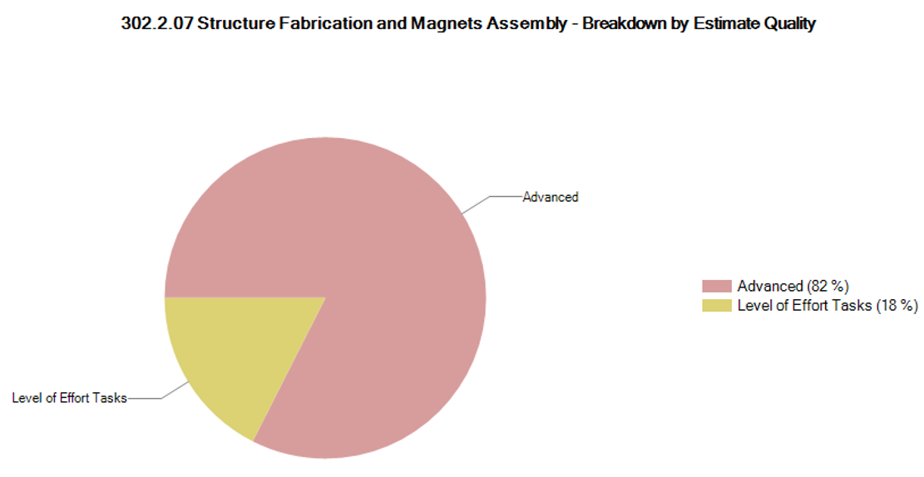
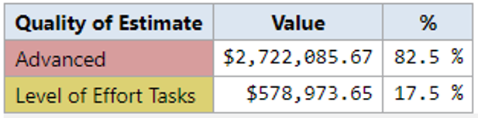
302.2.07 Estimate Quality
Charge #2
Lab
Logo

Slide 32
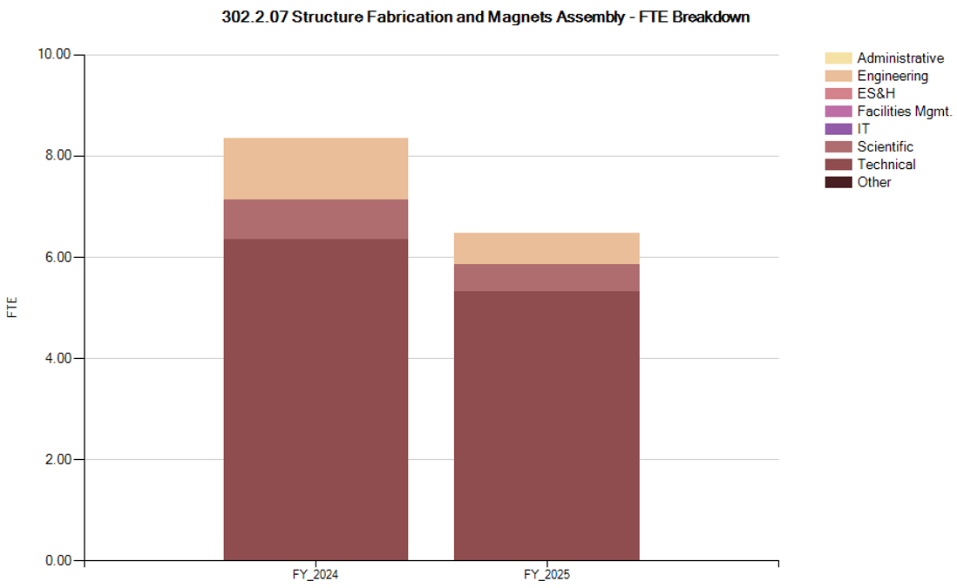
302.2.07 FTE Breakdown
Charge #2
Lab
Logo

