Slide 1
Magnets 302.2.04 - Coil Parts, Materials and Tooling
Miao Yu - FNAL
HL-LHC AUP DOE IPR – July 23rd–25th 2024

Slide 2
Outline
Scope, Interfaces, Dependencies & Team
Achievements since Rebaseline Review
Procurement Status
Schedule
Cost and Schedule Performance & VAR Reports
BCRs since Rebaseline Review
Estimate at Completion and EAC Manual Adjustments
QA/QC
Risks
ES&H
Summary

Slide 3
WBS 302.2.04: Scope
WBS Code | WBS Name | Control Account
302.2.04 | Coil Parts, Materials, and Tooling | Yes
WBS Description
Scope of Work Procure coil parts (excluding insulated cable) for the fabrication of 112 coils. Major parts include poles, wedges, end parts, traces, and consumable materials. A total number of 19 coil part sets are assumed to be available from LARP and the balance (92) are procured with project funds. Procure additional tooling required to increase coil production throughput at both FNAL and BNL locations. Additional tooling includes 4 reaction fixtures, 2 impregnation fixtures, 10 storage fixtures and a FNAL second winding mandrel. Ship corresponding parts and additional tooling to BNL for coils to be fabricated at the BNL location as part of 302.2.06 “Coil Fabrication at BNL”. FNAL equipment maintenance for coil fabrication, including cable length counter, SELVA winder, the rotating winding table and its tensioner, curing press, rollover fixtures, reaction oven, impregnation vacuum oven, and etc. Scope Assumptions/Exclusions 19 coil part sets are available from LARP One set of coil production tooling is available from LARP at both FNAL and BNL location BNL also requires a second winding mandrel, but it will be procured at BNL as part of 302.2.06 “Coil Fabrication at BNL” because this mandrel is specific to the BNL winding machine. WBS Deliverables59 sets for FNAL Parts for the fabrication of 112 coils (59 sets for FNAL, 53 sets for BNL) 1 winding machine mandrel for FNAL 4 reaction fixtures (2 for FNAL, 2 for BNL) 2 impregnation fixtures (1 for FNAL, 1 for BNL) 10 storage fixtures (5 for FNAL, 5 for BNL)

Slide 4
WBS 302.2.04: Interfaces
Charge #2, #3
Receive
US-HiLumi-Doc-1061: (from LBNL)
Insulated cable
US-HiLumi-Doc-375: (from CERN)
Quench heater trace
NbTi cable
Deliver
US-HiLumi-Doc-264: (to FNAL)
Drawings
Insulated cable
Coil parts and materials
Part kit list for each coil
US-HiLumi-Doc 270: (to BNL)
Drawings
Insulated cable
Coil parts and materials
Part kit list for each coil
US-HiLumi-Doc-273: (to LBNL)
Ti-alloy block for strain compensator
464441-HL-LHC AUP Coil Interface Traveler
US-HiLumi-doc-219

Slide 5
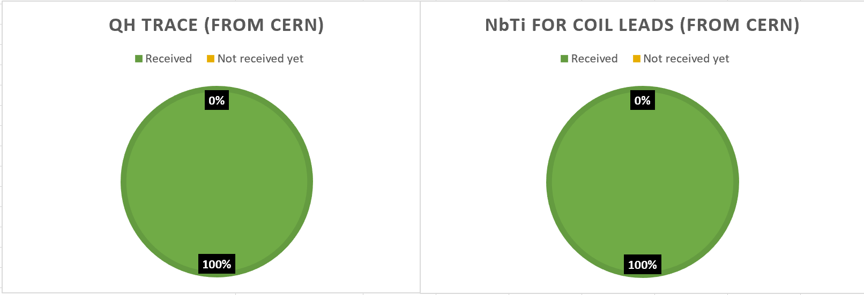
WBS 302.2.04: External Dependencies
Charge #3
US-HiLumi-Doc-375: (from CERN)
Quench heater trace: 100% Received
NbTi cable: 100% Received

Slide 6
WBS 302.2.04: Team
Charge #2
MQXFA Magnets
Fabrication
302.2
L2: G. Ambrosio
(M. Baldini)
Control Account
Magnet Design, Integration and Coordination
302.2.01
L3/CAM: G. Ambrosio
(M. Baldini)
Strand Procurement and Testing
302.2.02
L3: L. Cooley
(V. Lombardo)
CAM: V. Lombardo
Cable Fabrication
302.2.03
L3: I. Pong (M. Naus) CAM: I. Pong (E. Lee)
Coil Parts, Materials, and
Tooling Procurement
302.2.04
L3/CAM: M. Yu
(A. Nobrega)
Coil Fabrication at FNAL
302.2.05
L3/CAM:
A. Nobrega
(M. Yu)
Coil Fabrication at BNL
302.2.06
L3/CAM: J. Schmalzle
(M. Anerella)
Structure Fabrication and
Magnets Assembly
302.2.07
L3/CAM: S. Prestemon
(D. Cheng)
FNAL Quality & Materials Dept., with high priority on AUP

Slide 7
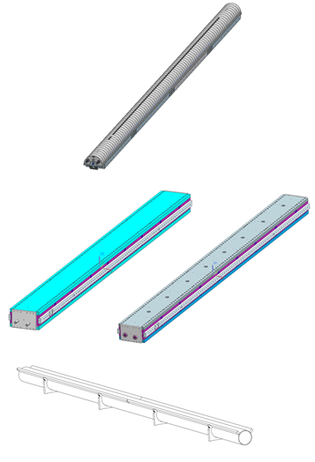
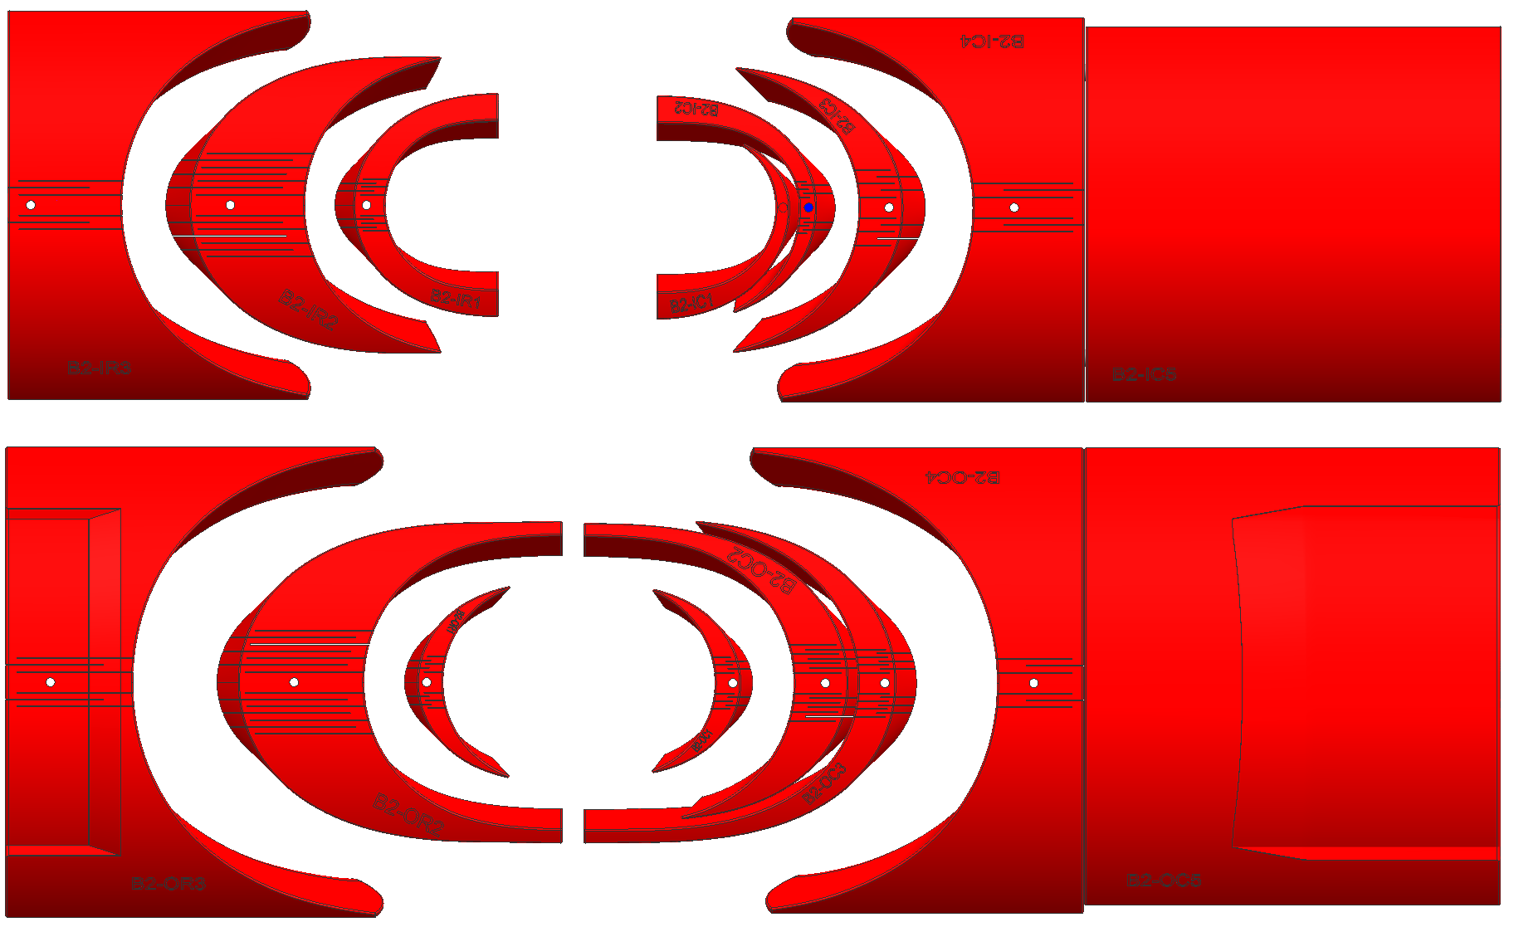
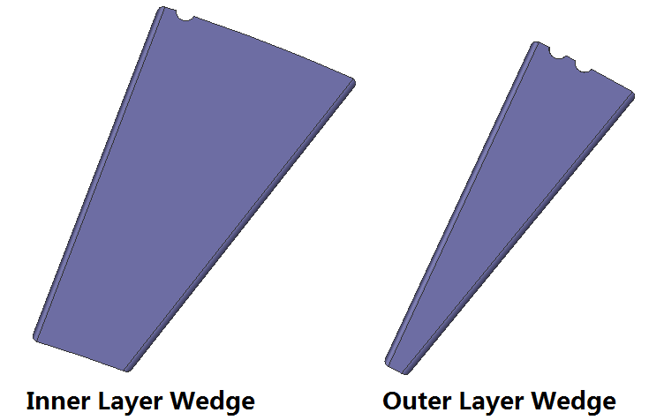
WBS 302.2.04: Achievements since Rebaseline
Charge #1
Coil Parts
Tooling
Tooling is in place to support the series coil production.
Coil parts were all delivered to FNAL and BNL fabrication teams.
Pole
1 x Winding Mandrel
2 x Impregnation Fixture
10 x Storage Fixture

Slide 8
WBS 302.2.04: Procurement Status
Charge #4
Pole Parts and End Parts: Received all 112 sets, procurement is completed.
Wedges: Received all 112 sets, procurement is completed.
In inventory as spare, there are 4 sets of coil parts.

Slide 9
WBS 302.2.04: Schedule (Need update in June)
Charge #2
302.2.04

Slide 10
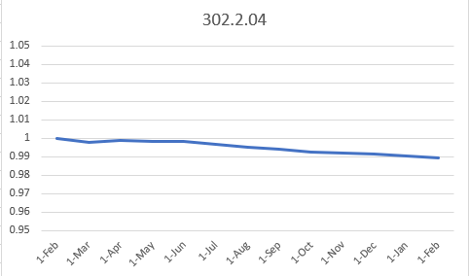
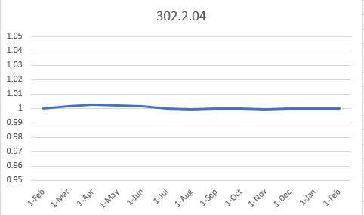
WBS 302.2.04: Cost and Schedule Performance & VAR Reports (Need update in June)
Charge #2
CPI
SPI
The cost and schedule performance has been well under control since rebaseline.

Slide 11
WBS 302.2.04: BCRs Approved Since Baseline
Charge #2
BCR # | Description | Cost ($k) | Sch. (days)
311 | AUP Project Rebaseline after March 2023 ESAAB Approval | 105 | 125
336 | CERN Acceptance to Ship Cryo-assembly LQXFA/B 01 | 364.8 | 151
340 | FY24 Rate Adjustment | 0.8 | 0
352 | Escalation due to delay to coating CERN coil parts | 1.6 | 4
BCR#336: 5 additional sets of coil parts and LOE to support the new discrete activities

Slide 12
WBS 302.2.04: Estimate at Completion (Need update in June)
Charge #2
The CA Variance at Completion (BAC- EAC) = $92k
Coil misc. material M&S: spent $43k more than the planned $736k.
Coil misc. material Labor: spent $39k more than the planned $392k.
L3 Management Labor: spent $18k more than the planned $937k.
Coil Parts Labor: spent $18k more than the planned $688k.

Slide 13
WBS 302.2.04: Risks (Need update in June)
Charge #6
RI-ID | Title | Risk Rank
Threats
RT-302-2-04-001 | Vendor delivery delay | 5%+25%(due to COVID)
RT-302-2-04-002 | Laser cutting machine failure | Retired
RT-302-2-04-003 | Shipping and Handling Damage | Retired

Slide 14
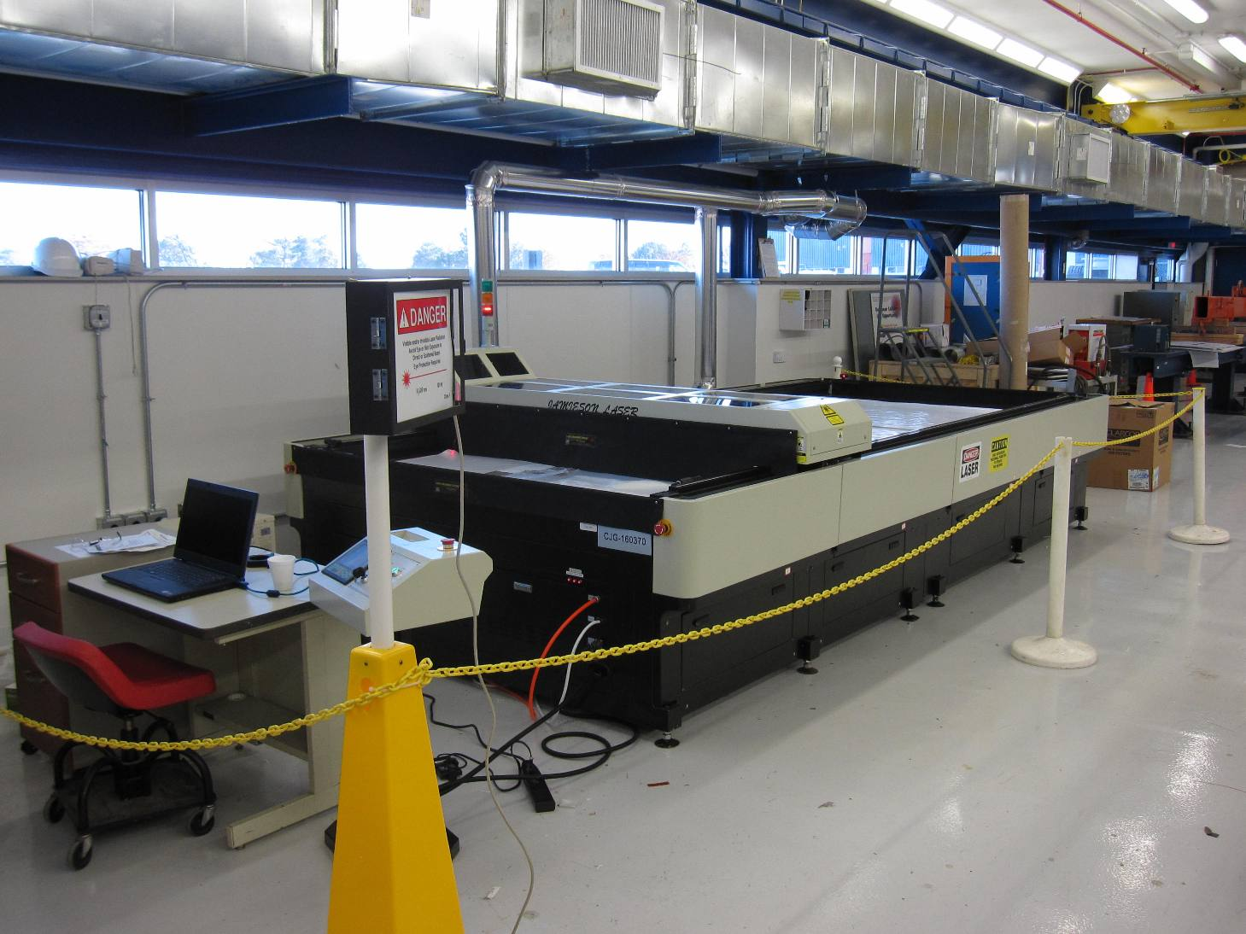
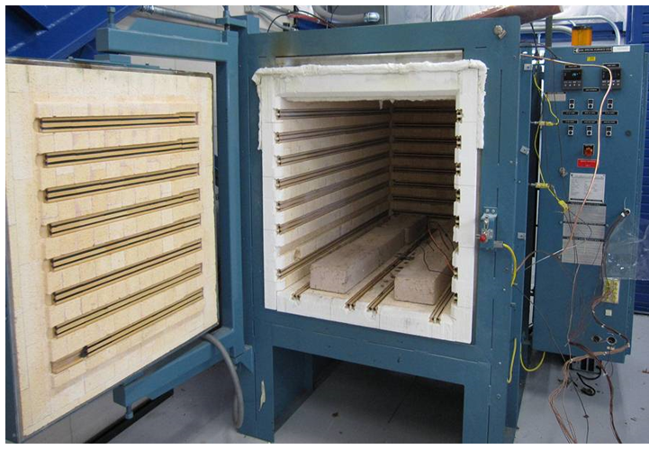
WBS 302.2.04: ES&H
Charge #5
Hazards and safety procedure for the work in 302.2.04:
Laser cutter (OP-464061)
Only Trained and Authorized personnel are allowed
Wear proper PPE (Face shield to protect eyes)
The machine is roped around when in operation with waring light on
2m furnace (OP-333916)
Wear proper PPE
Operated only by trained personnel and the area is roped out with signs in place during operation.
Open the furnace when the furnace temperature is below 100 °C
CTD product (following SDS)
Wear safety glasses and gloves to avoid contact with eyes and skin
S2 glass powder (following SDS)
Wear safety glasses and gloves to avoid contact with eyes and skin and wear N95 mask as respiratory protection
No safety incident and great safety record!

Slide 15
WBS 302.2.04: Summary
The work scope is clearly defined, which has been successfully completed.
Cost and schedule are very well controlled.
ES&H and Risks are properly specified and managed. No safety incident through the project!
The CA is now closed.

Slide 16
Backup Slides

Slide 17
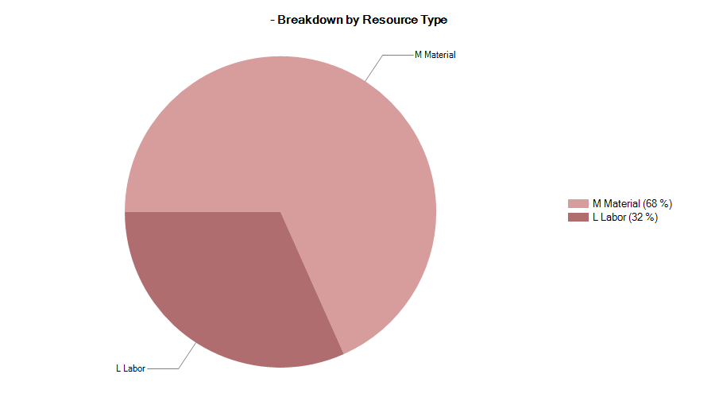
302.2.04 Resource Type Breakdown
32% Labor, 68% M&S

Slide 18
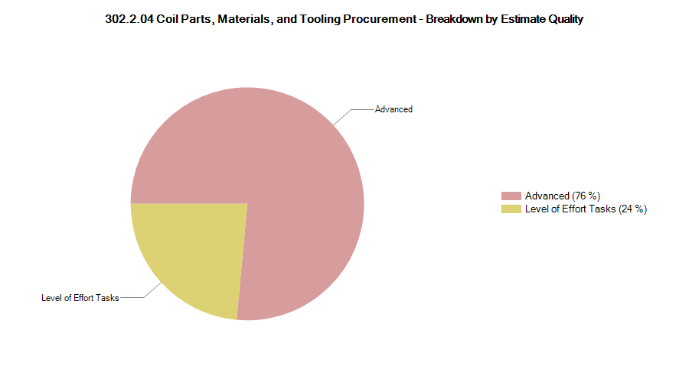
302.2.04 Estimate Quality
The quality of estimate has been updated for CD-2/3b

Slide 19
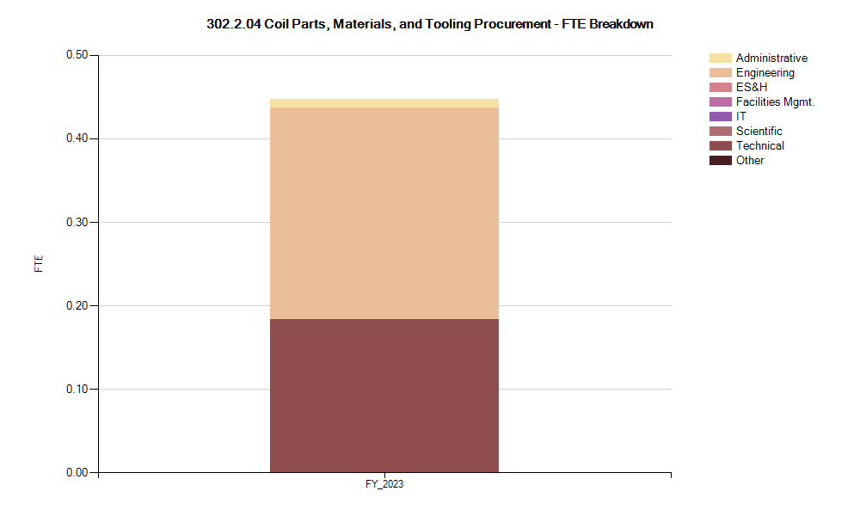
302.2.04 FTE Breakdown

Slide 20
302.2.04 Cost Performance Report
BAC = $8.760M
No thresholds crossed in Current Period Cost
No thresholds crossed in Cumulative to Date
Cumulative SPI = 0.97, CPI = 1.01

